Slide 1
The Report of GISC Beijing
Feng GAO
National Meteorological Information Center，CMA

Slide 2
OUTLINE
Timeline
GISC Beijing
Operations
About AMDCN
Next step
Suggestions

Slide 3
Timeline
Oct, 2009 Kick-off the developing of WIS system in CMA

Slide 4
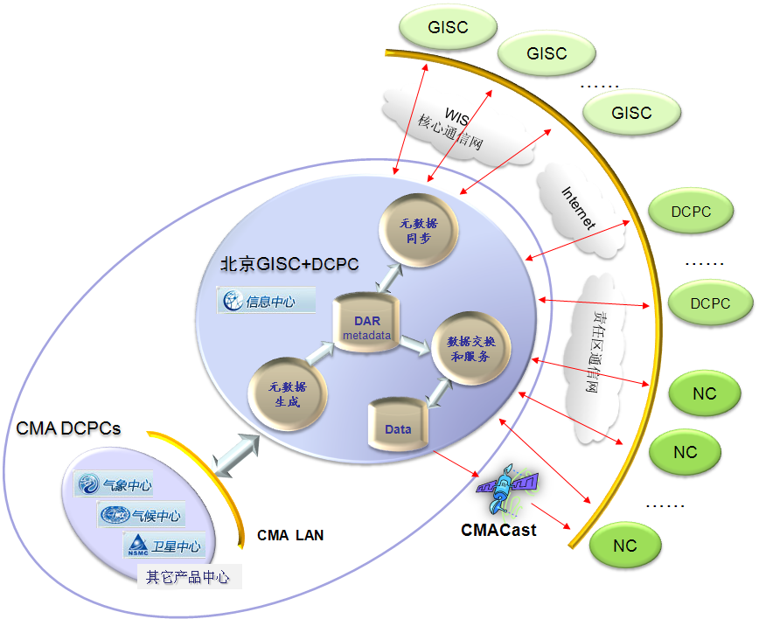
Timeline
Oct, 2009 Kick-off the developing of WIS system in CMA
  May, 2010 Finished the software system (GISC+DCPS)
to fully compliant with WIS technical specification
J2EE technical architecture
using software
  - O/I:SUSE Linux 10
  - Web Server：Apache 2
  - Web Server: Apache Tomcat 6.0
  - RDBMS：Oracle 10g
  - JAVA tools：SUN JDK 1.6

Slide 5
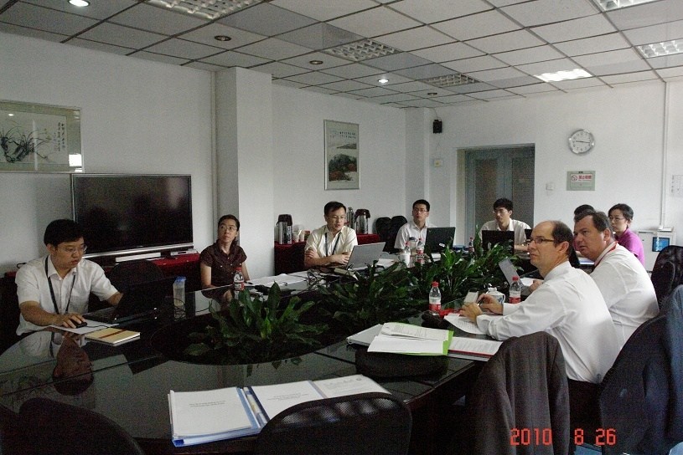
Timeline
Oct, 2009 Kick-off the developing of WIS system in CMA
  May, 2010 Finished the software system (GISC+DCPS)
  Aug, 2010 Endorsed by WMO ET-GDDP through on-site audit
(The function of system was fully meet the features of the design requirements)

Slide 6
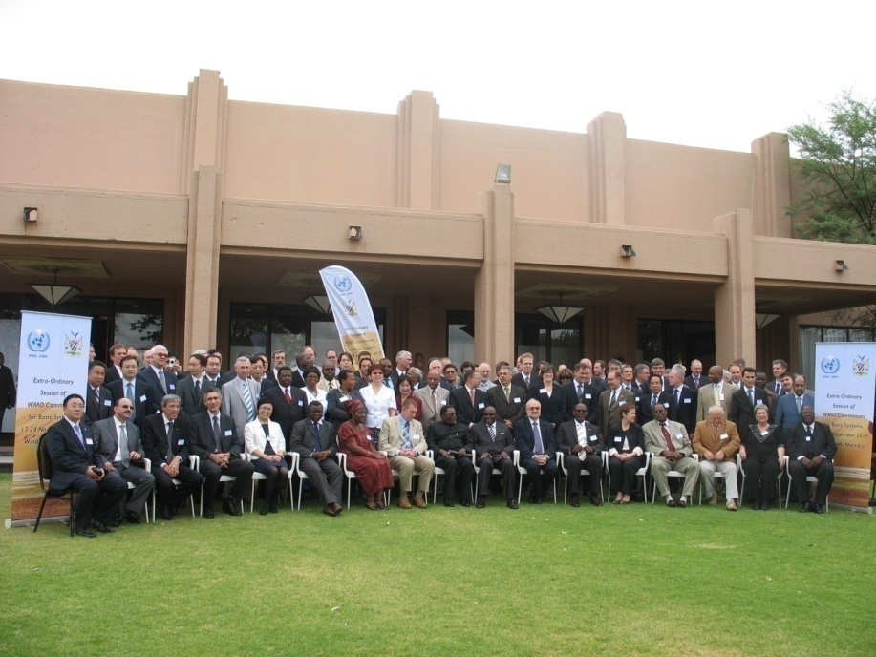
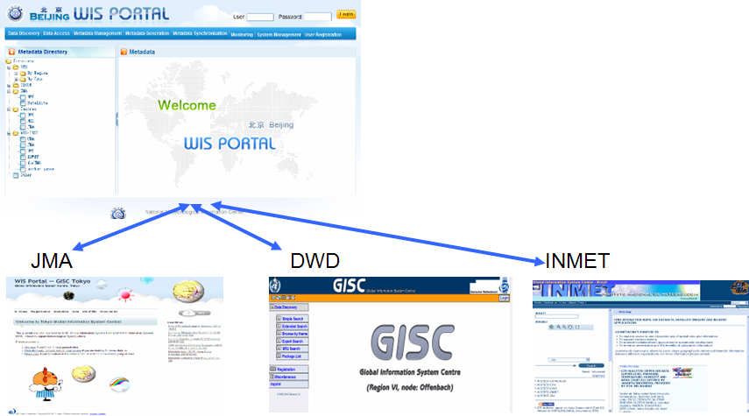
Timeline
Oct, 2009 Kick-off the developing of WIS system in CMA
  May, 2010 Finished the software system (GISC+DCPS)
  Aug, 2010 Endorsed by WMO ET-GDDP through on-site assessment
  Nov, 2010 Recognized as one of the nominations for WIS GISC at the meeting of CBS Extraordinary Session in Windhoek, Namibia
  Demonstrated CMA WIS/GISC services to the session
  Recommended to Congress as one of the three GISC candidatures by CBS

Slide 7
Timeline
Oct, 2009 Kick-off the developing of WIS system in CMA
  May, 2010 Finished the software system (GISC+DCPS)
  Aug, 2010 Endorsed by WMO ET-GDDP through on-site assessment
  Nov, 2010 Recognized as one of the three nominations for WIS GISC at the meeting of CBS Extraordinary Session in Windhoek, Namibia
  May, 2011 Designated as one of the GISC by the sixteenth WOM Congress(Cg-XVI)

Slide 8
Outline process
Subject: Operation of GISC Service in Beijing
Dear Sir/Madam,
As you are aware, the Sixteenth World Meteorological Congress (Cg-XVI) designated Beijing as one of the Global Information System Centre（GISC Beijing）. Following the trial operation over the past one year, I am pleased to inform you that the GISC Beijing will start its operation as from 15 August 2011.
Apart from continued provision of existing GTS data transmission and exchange services, GISC Beijing will provide the Data Discovery, Access and Retrieve (DAR) service, Data Subscription service as well as CMA’s NWP products and Fengyun satellite products. The users of the CMA satellite broadcasting system (CMACast) can also receive the meteorological data and products broadcasted by GISC Beijing.
As mentioned in Cg-XVI, the area of responsibility of each GISC in RA II should be decided and approved at the next session of RA II to be held in 2012. However, GISC Beijing will provide the DAR service and Data Subscription service to all Members in RAII as well as the Members from its adjacent areas through its website (http://wisportal.cma.gov.cn) so that you can benefit from the new WIS service before the next RAII session.
For specific functionalities and technical specifications of our WIS Service, please kindly refer to the attached flyer. If your organization wants to use the said services provided by the GISC Beijing, please contact Ms. LI Xiang, focal point for GISC Beijing, National Meteorological Information Centre, China Meteorological Administration, at Email: giscadmin@cma.gov.cn.
The establishment of GISC is only the beginning of WIS implementation. As one of the GISC service providers, CMA will spare no efforts to facilitate the WIS implementation and the WIS capacity building in collaboration with other GISCs and GISC candidates.
With my best regards,
Yours Sincerely,
(ZHENG Guoguang)
Administrator
China Meteorological Administration
Permanent Representative of China with WMO
Oct, 2009 Kick-off the developing of WIS service system in CMA
  May, 2010 Finished the software system (GISC+DCPS)
  Aug, 2010 Endorsed by WMO ET-GDDP through on-site assessment
  Nov, 2010 Recognized as one of the three nominations for WIS GISC at the meeting of CBS Extraordinary Session in Windhoek, Namibia
The letter to the members of RA II and WMO Secretariat
  May, 2011 Designated as one of the GISC by the sixteenth WOM Congress(Cg-XVI)
  Aug, 2011 Inform that GISC Beijing start official operation

Slide 9
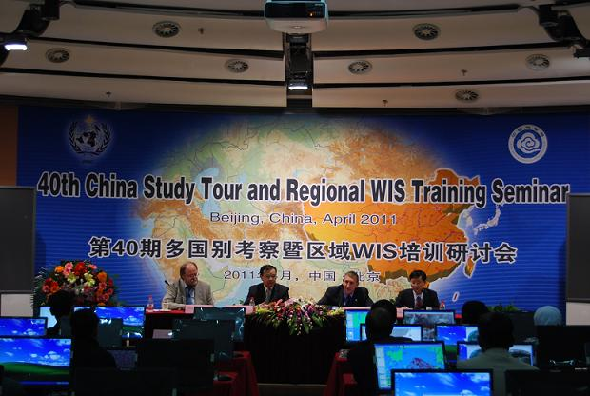
the Regional WIS Training Seminar Beijing, April, 2011.
(GISC、CMACAST and MICAPS)
In order to help the members of RAII to understand the relationships of the various systems, in April, 2011, we held the regional WIS Training seminar in Beijing, and introduced the GISC and CMACast technical knowledge to sixteen countries and regions.

Slide 10
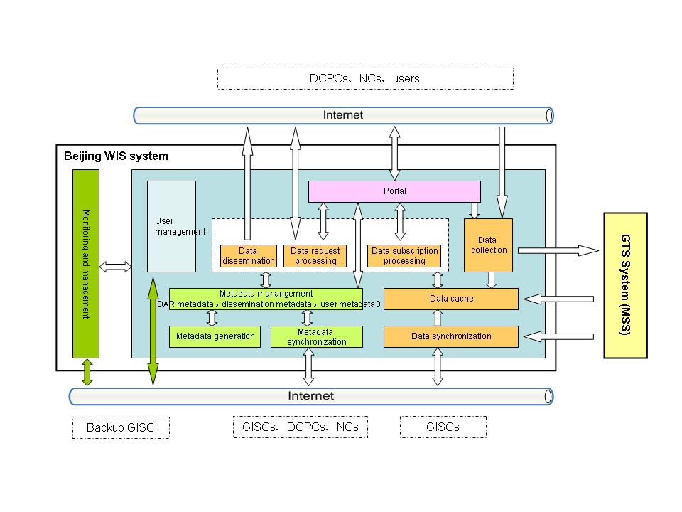
GISC Beijing-architecture
Register account,
edit audited account
Submit new requirements
It adopts J2EE framework and layered modular design, yields simple structure and easily scalable components, and owns user-friendly web interface for accessing metadata and data services. It consists of three sub-systems.

Slide 11
GISC Beijing-architecture
It is fully compliant with WIS technical specifications and standards.
DAR metadata: WMO Core Profile 1.2
Metadata synchronization: OAI-PMH, FTP
Data: TAC, BUFR, CREX, GRIB, NetCDF, ….
Data collection and dissemination: TCP sockets, FTP, HTTP, SMTP/POP3, multicast, …
It adopts J2EE framework and layered modular design, yields simple structure and easily scalable components, and owns user-friendly web interface for accessing metadata and data services

Slide 12
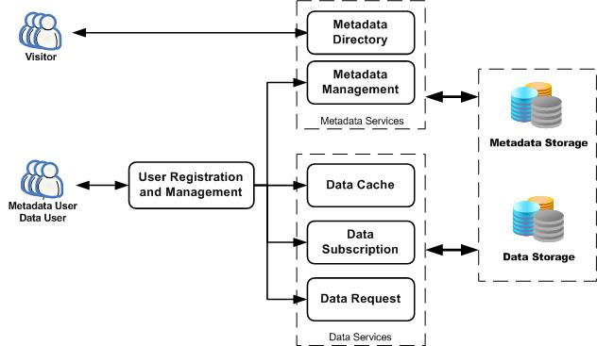
GISC Beijing-services

Slide 13
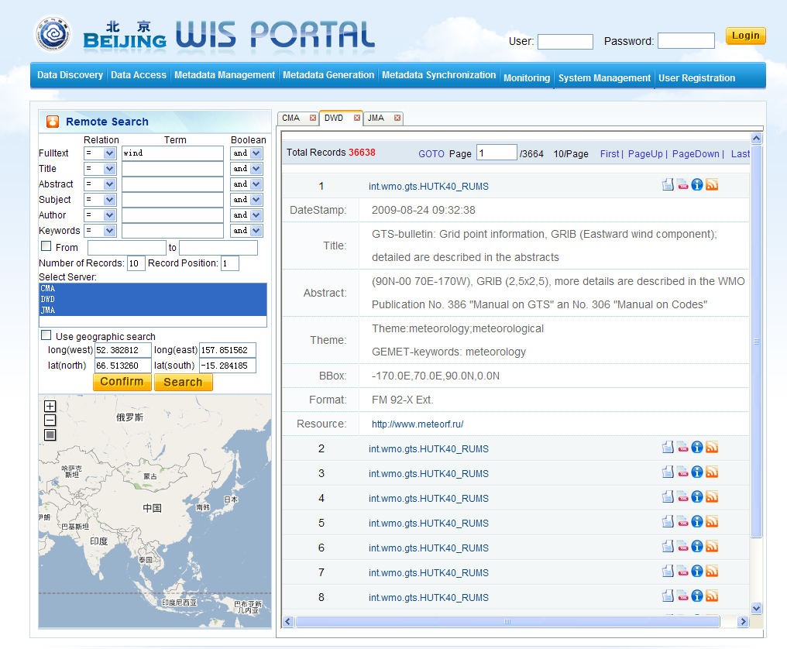
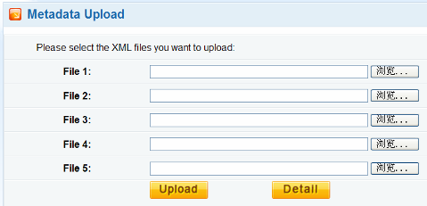
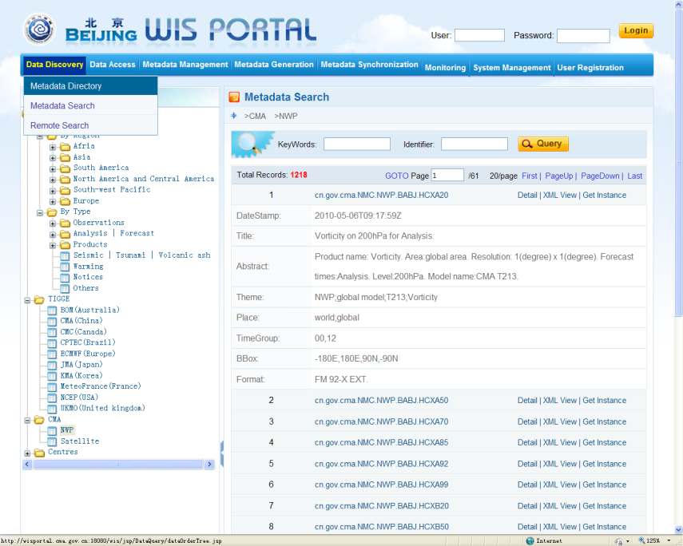
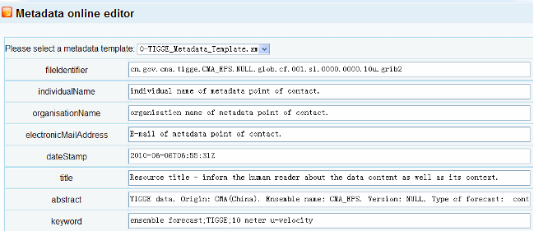
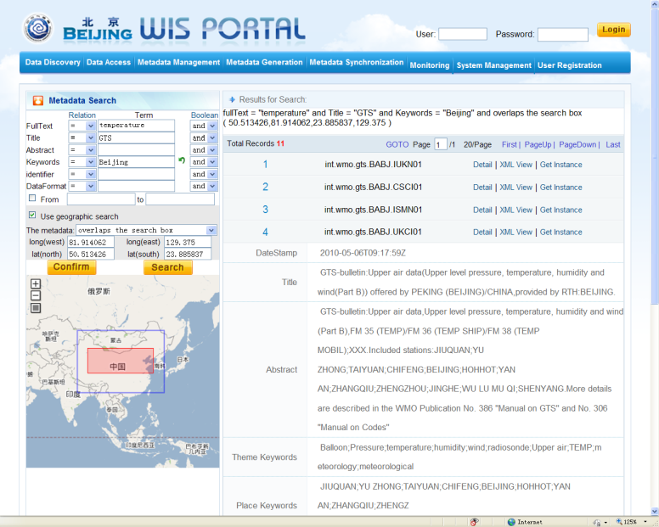
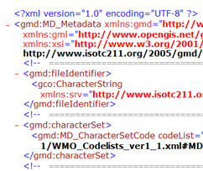
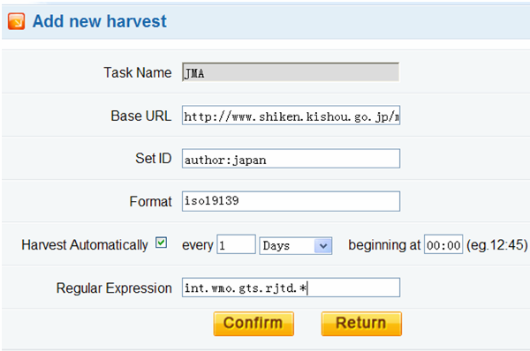
Metadata services
Remote Search based on SRU
Creating metadata for CMA data and products
Metadata generation
Search other centers from CMA
Tools for NCs uploading and editing metadata
Metadata Directory
Metadata upload
Metadata
catalogue
Metadata Search
Metadata online editor
Search Box
Metadata synchronization
Harvesting metadata from GISCs, DCPCs and NCs based on OAI-PMH and FTP
Metadata Bounding Box

Slide 14
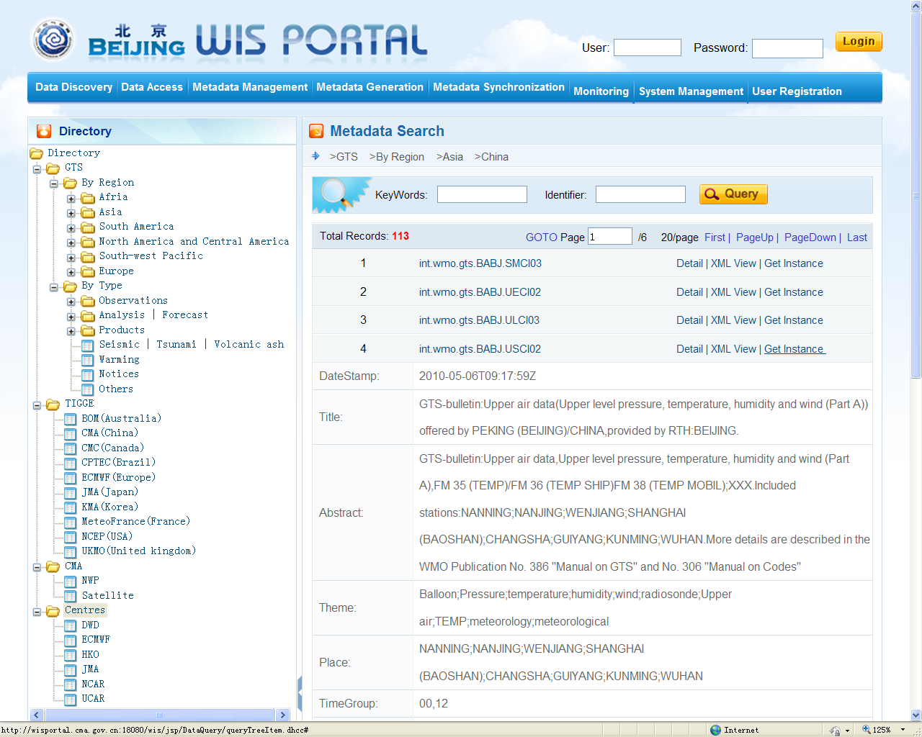
Data services
Click here to retrieve the data directly from 24 hour data cache
Data cache service allows users to access the recent 24-hour data for global exchange routinely provided via GTS.

Slide 15
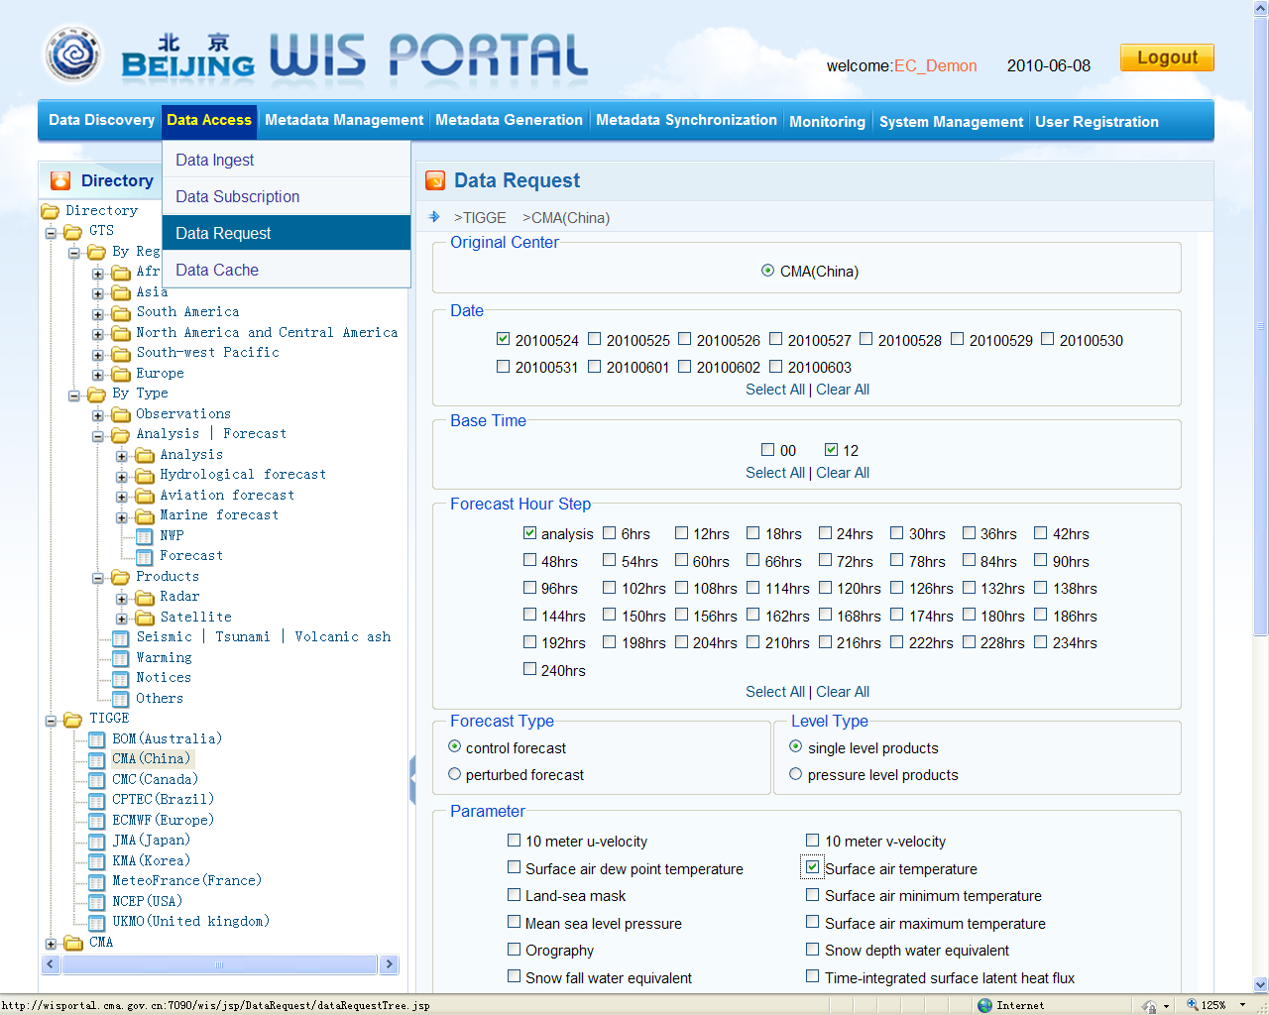
Data services
For accessing near real-time data stored in CMA and JMA
Data request service allows users to request historical data in the system. And users can query and monitor the processing information for each request.

Slide 16
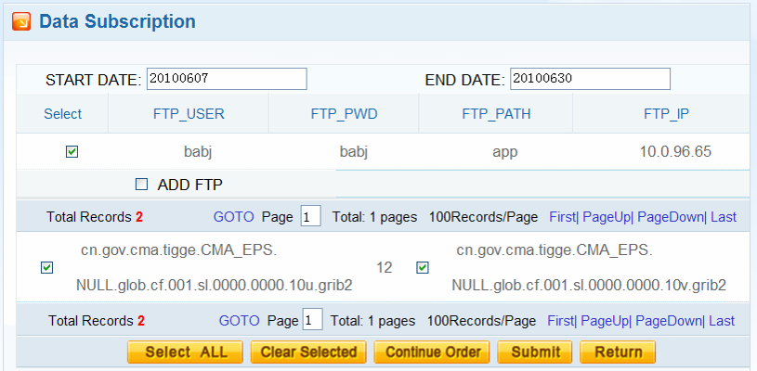
Data services
Data subscription service allows users to add, edit, delete metadata items in the shopping cart, and submit orders for interested data.
For accessing real-time data and receiving the data routinely
Data dissemination be provided via GTS, Internet and CMACast.

Slide 17
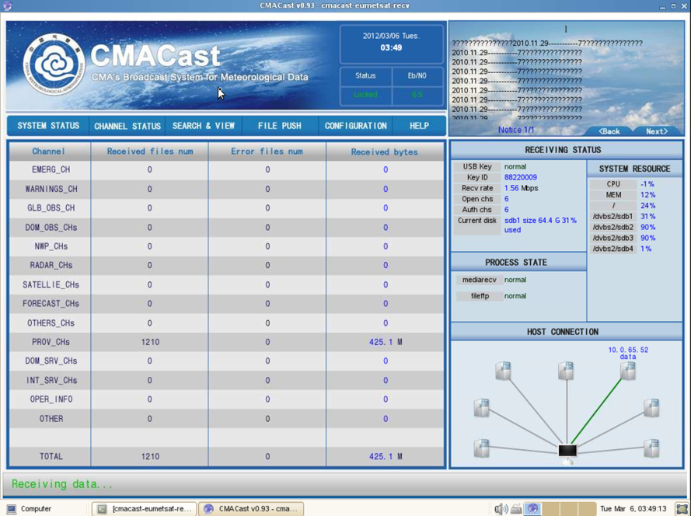
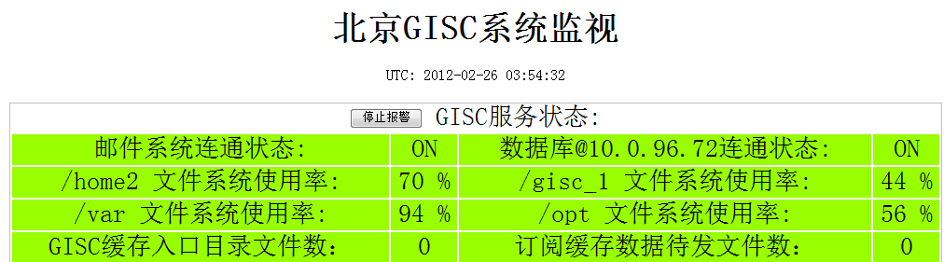
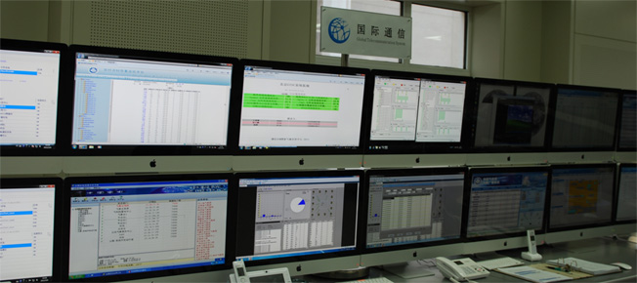
GISC Beijing-monitoring system (on developing)

Slide 18
Operations
Users & Data Services
At the end of Feb. 2012, GISC Beijing system has 38 registers(27 foreigners).
GISC Beijing provides 6GB data and products through Data dissemination every day.

Slide 19
Operations
Metadata Harvest
GISC Beijing system is in sync and harvesting with DWD and JMA , and harvest 5948 metadata records from DWD, 8298 records from JMA now. The full catalogue contains roughly 61,394 metadata records.

Slide 20






Operations
Exchange Data & Products
Exchanging metadata: with BOM, DWD, INMET, JMA, Meteo France, NWS, HKO;
Available data: global exchanged data, CMA NWP products, FengYun satellite data, TIGGE products (from 10 product centers);

Slide 21
AMDCN
GISC Beijing provide delivering services mainly relies on GTS, and also via CMACast and internet.
  GTS – to other WIS/GTS centers via ftp, tcp sockets
  Internet – to other centers, end-users via ftp, http, smtp
  CMACast – to other centers, end-users
GEONETCast = CMACast +EUMETSAT+GEONETCast Americas
CMACast has integrated DVB-S、PCVSAT、FENGYUNCast in data dissemination.
Compare with GTS, its efficiency, amount and reliability improved.

Slide 22
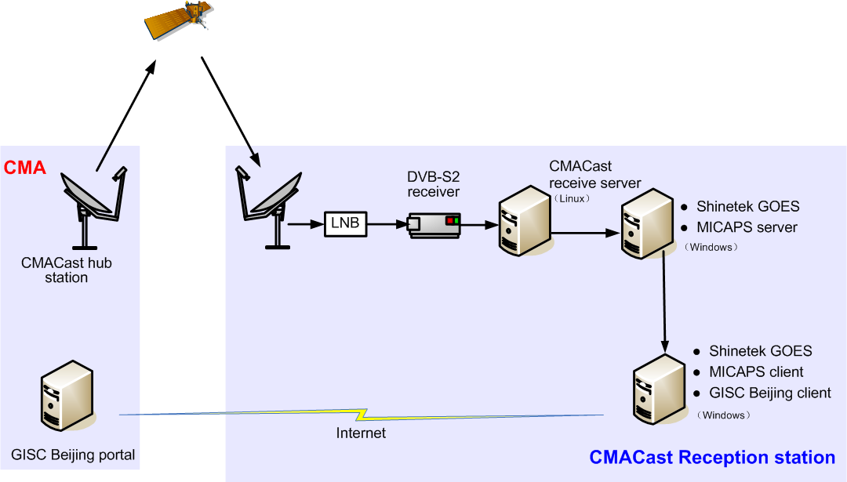
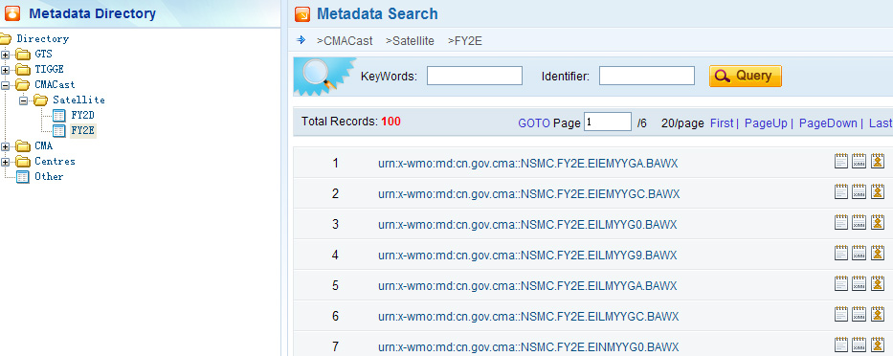
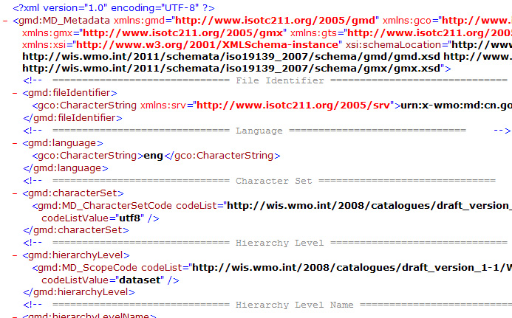
GISC Beijing integrated with the data services of CMACast.
subscribed data
subscribed data
discover data, make data subscription

Slide 23
AMDCN
Furthermore, we are going to improve and upgrade the AMDCN, according to the technical requirements for RTH and specifications of WIS in the future.

Slide 24
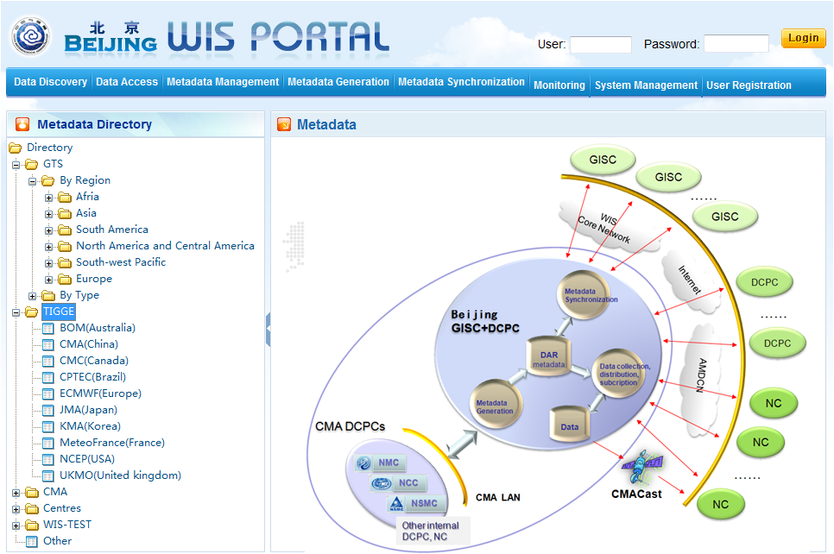
Next step
  Develop internal DCPCs, and provide their products via GISC Beijing portal.
  Ready to be audited by ET-GDDP around April, 2012.

Slide 25
Suggestions
  For only three operational GISCs, the generation of GTS global exchange of metadata mainly relying on Vol.C1, but they don’t match well. So we expect that TT-ApMD make plan to complete the transition from Vol C1 to metadata schema as soon as possible.

Slide 26
Suggestions
  The monitoring system to metadata sync and exchange for global GISC is very necessary. We recommend to establish a set of monitoring processes, but need to avoid causing add pressure on the OAI provider and affecting the OAI synchronization.

Slide 27
Suggestions
  Each GISC establish sound metadata audit mechanisms to ensure the quality of every metadata record.
  (At present, most GISCs do not check the quality and consistency of data and metadata, besides of format checks to schema. I am really worry about the quality of data and metadata, if we don’t set up effective audit mechanism.)

Slide 28
Thanks for your attention.

