Slide 1

Status Report of GISC Tokyo
Yoritsugi OHNO
Japan Meteorological Agency (JMA)
ET-WISC
13-16 March 2012, Melbourne

Slide 2
Content
Status of JMA
GISC Tokyo
Status of user registration
GISC Cache
Metadata Synchronization
Networks
Automatic Catalogue
KML
RSS
Subscription
Access Analysis

Slide 3
Status of JMA
As designated in Sixteenth WMO Congress in June 2011, JMA has started following services of WIS Centres on 1st August 2011:
    Global Information System Centre (GISC)
    8 Data Collection or Production Centres (DCPC)
Table : List of WIS centres at JMA
Type | Function
GISC | -
DCPC | RTH
DCPC | RSMC-Typhoon
DCPC | RSMC-Geographical
DCPC | RSMC-ATM
DCPC | Satellite Centre
DCPC | GPC-LRF ( Forecast)
DCPC | RCC (Tokyo Climate Centre)
DCPC | WDC-GG (Greenhouse Gases)

Slide 4
GISC Tokyo
http://www.wis-jma.go.jp/
Services
  Part-A
    Global Telecommunication System (GTS)
  Part-B
    Discovery, Access and Retrieval (DAR)
    Web interface to create/modify Metadata
    GISC Cache (data stored at least for 24 hours)
    Data subscription
    SATAID Service
      MTSAT Imagery and NWP products for SATAID software
    High-Resolution GSM data
  GISC Backup

Slide 5




Status of user registration
65 registered users from 32 Members of WMO so far
GISC Tokyo
GTS message
MTSAT Imagery
for NMHSs
High-resolution GSM for NMHSs

Slide 6

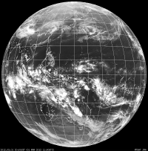
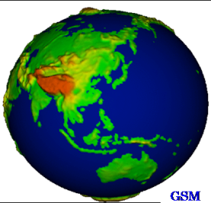
GISC Cache
http://www.wis-jma.go.jp/data/browse
GISC Tokyo stores GTS messages, DCPC's data and so on at least for 24 hours of arrival
GTS
GISC Tokyo
DCPCs
GSM
Users

Slide 7
Metadata Synchronization
As a role of GISC, GISC Tokyo has been exchanging metadata with other operational GISCs (such as Beijing and Offenbach) by OAI-PMH (Open Archives Initiative Protocol for Metadata Harvesting) at regular intervals.
Monitoring tool at: http://toyoda-eizi.net/2011/syncmon/mon.html
GISC Beijing
GISC Tokyo
GISC Offenbach
Other GISCs

Slide 8
Networks
64K
Khabarovsk
GISC Tokyo (RTH Tokyo)
128K
Seoul
100M
10M x 2
2M
RMDCN MPLS
Network
(OBS)
MPLS
Network
(NTT-COM)
Internet
DAR Users
Washington
New Delhi
Bangkok
NMHS users of MTSAT Imagery and High-resolution GSM
Melbourne
EUMETSAT
Hong Kong
Beijing
Exeter
Manila
Table : Current Status of RTH Tokyo
Circuit connected with | Type of circuit | Circuit speed (bps) |  | Protocol
 |  | Tokyo side | NMHS side
WMC Melbourne | RMDCN-MPLS (OBS) | 10M | 2M | TCP/IP (Socket, FTP)
WMC Washington |  |  | 1M
RTH Beijing |  |  | 4M | TCP/IP (FTP)
RTH Exeter |  |  | 2M | TCP/IP (Socket, FTP)
RTH New Delhi |  |  | 1M | TCP/IP (Socket)
RTH Khabarovsk | Dedicated (digital) | 64 k
RTH Bangkok | MPLS (NTT-COM) | 2M | 128k
NMC Hong Kong |  |  | 1M | TCP/IP (Socket, FTP)
NMC Manila |  |  | 64k | TCP/IP (Socket)
NMC Seoul | Dedicated (digital) | 128k |  | TCP/IP (Socket, FTP)

Slide 9
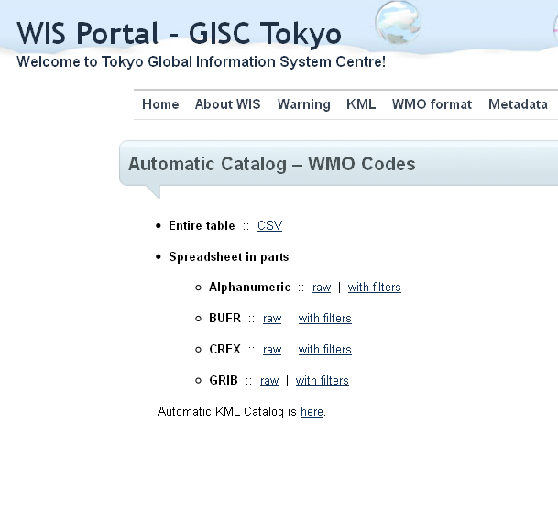
Automatic Catalog
GISC Tokyo has generated data catalog like Volume C1 at daily intervals. These data have information values as data monitoring.
Data Catalog at: http://www.wis-jma.go.jp/cms/automatic_catalog_wmo_format/
Category | Detail of message
"Published", | "2011-11-22",
"Updated", | "2012-01-10",
"Region", | "South-West Pacific",
"Location", | "Australia",
"Indicator", | “ABCS",
"Identifier", | "WSAU21",
"Access", | "Closed",
"Type", | "Alphanumeric",
"Category", | "Aviation",
"Subcategory", | "SIGMET“,
"Satellite", | "",
"Discipline", | "",
"Grid", | "",
"Resolution", | "",
"Area", | "",
"Level", | "",
"ReferenceTime" | "02 10 14 15 17 [h]"
"Published","Updated","Region","Location","Indicator","Identifier","Access","Type","Category","Subcategory","Satellite","Discipline","Grid","Resolution","Area","Level","ReferenceTime"
"2011-11-22","2012-01-10","South-West Pacific","Australia","ABCS","WSAU21","Closed","Alphanumeric","Aviation","SIGMET","","","","","","","02 10 14 15 17 [h]"
"2012-01-31","2012-02-01","South-West Pacific","Australia","ABRF","WWPS22","Open","Alphanumeric","Warning","Warnings and weather summary","","","","","","","01 08 14 20 [h]"
"2011-12-08","2012-02-02","South-West Pacific","Australia","ADRM","ISXK48","Open","BUFR","Analysis","Cyclone","","","","","","","00 01 06 07 11 12 13 18 19 [h]"
"2011-12-23","2011-12-25","South-West Pacific","Australia","ADRM","KSXK40","Open","CREX","Surface","","","","","","","","00 06 07 12 18 19 20 23 [h]"
"2011-08-01","2012-03-01","Asia","Japan","RJTD","HECB88","Open","GRIB","","","","Global Spectral Model","Latitude/Longitude","1.25 1.25","60.0 -20.0 60.0 200.0","Surface","00 06 12 18 [h]"

Slide 10
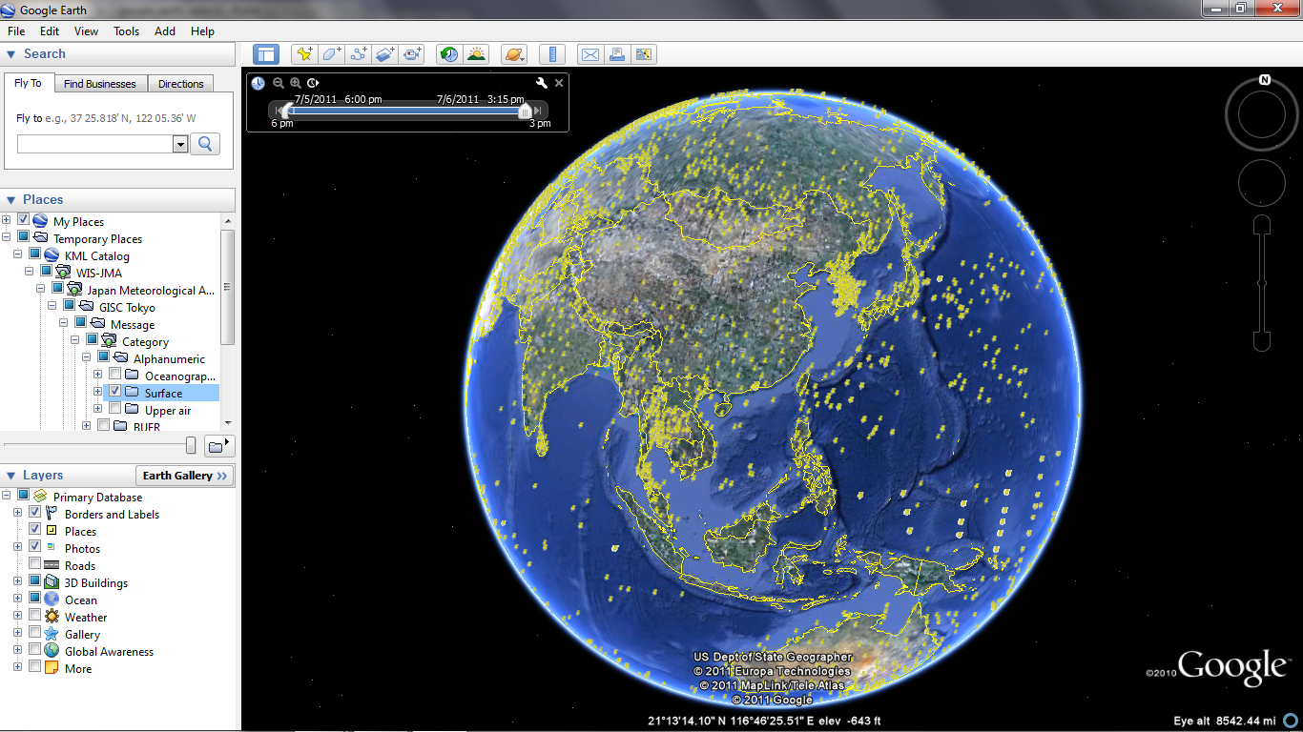
KML
Special at GISC Tokyo
KML is standard format for geographical data
Can be viewed with Google Earth
KML Catalogue at : http://www.wis-jma.go.jp/cms/kml/kml-catalog/
Ex. Recent surface reports mapped

Slide 11
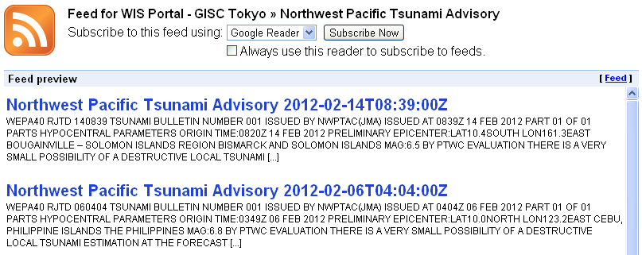
RSS
Warning bulletins are exceptions; their updates are provided in RSS. That is because the frequency is much lower, and all messages are plain text that is displayable by common RSS reader software. You can browse and subscribe to warnings listed at http://www.wis-jma.go.jp/cms/warning/warning-catalog/

Slide 12
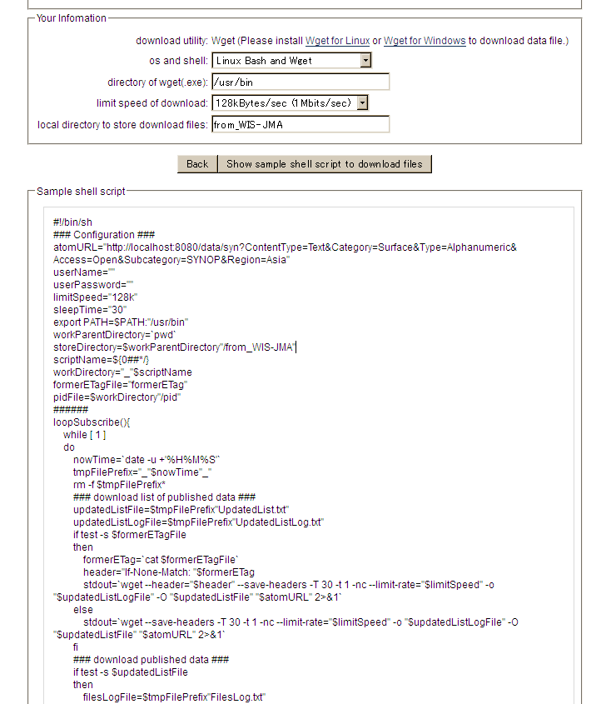
Subscription
http://www.wis-jma.go.jp/data/subscribe
JMA provide interactive web interface to generate sample shell script for linux (or powershell script for windows) to download data automatically.
GISC Tokyo
User

Slide 13
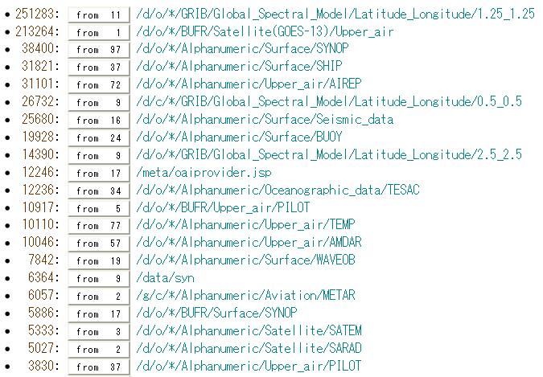
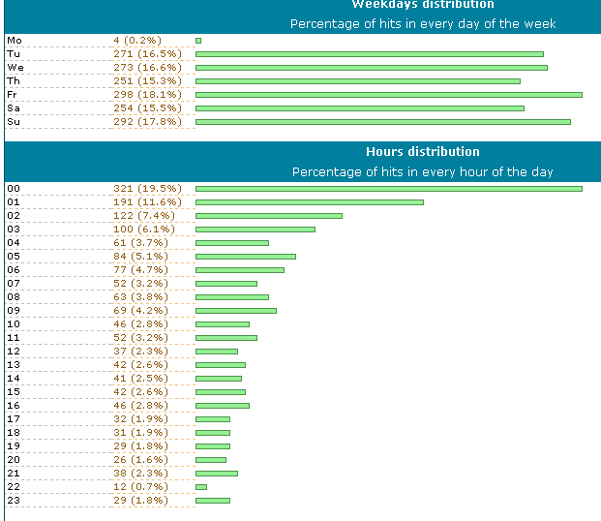
Access Analysis
GISC Tokyo has been analyzing condition of user access by using some applications.

Slide 14
Thank you!
http://www.jma.go.jp/jma/indexe.html

