Slide 1

World Meteorological Organization
Working together in weather, climate and water
WMO
PROGRESS AND FUTURE PLAN OF KMA WIS
Presented by Sunghoi HUH
Div. of Information & Communication Technology, KMA
shhuh@korea.kr
Notes:
I‘m Sunghoi HUH from KMA and would like to make presentation on KMA‘s WIS progress and future plan.

Slide 2
OpenWIS Progress in KMA
KMA’s WIS Centres (2008.12)
- GISC Seoul
- DCPC for WAMIS : World Agricultural Meteorological Information System
- DCPC for LC-LRFMME : Lead Centre for Long-Range Forecast Multi-Model Ensemble
- DCPC for NMSC : National Meteorological Satellite Centre
Setup the OpenWIS at KMA’s WIS DMZ Site, Successfully
Following the WIS Compliance with the Demonstration Test Cases
- “GISC Seoul - KMA’s legacy system”
- “GISC Seoul – Virtual GISC / Virtual DCPC”
Test Cases (KMA itself withtout connection to other centre(s))
1. Uploadiing of Metadata for Data and Products into DAR Catalogue ⇒ Done !
2. Synchronizing DAR Catalogue between GISC nodes ⇒ Done !
3. Uploading and downloading of data between WIS centres ⇒ Done !
4. Centralization of Globally Distributed Data ⇒ Done !
5. Maintenance of users, roles, authorization and authentication ⇒ Done !
6. DAR Catalogue Search and Retrieval ⇒ Done !
Notes:
KMA has applied GISC and 3 of DCPCs Dec. 2008 such as WAMIS, LC-LRFMME and NMSC.
Recently, OpenWIS has successfully installed at KMA’s WIS DMZ, and we’ve been following the WIS compliance with the demonstration test cases. Because GISC Seoul has no connection with other WIS centres yet, some virtual center has been built at KMA site. Based on this virtual environment, 6 of Demonstration Test Cases successfully has been passed by KMA itself.

Slide 3
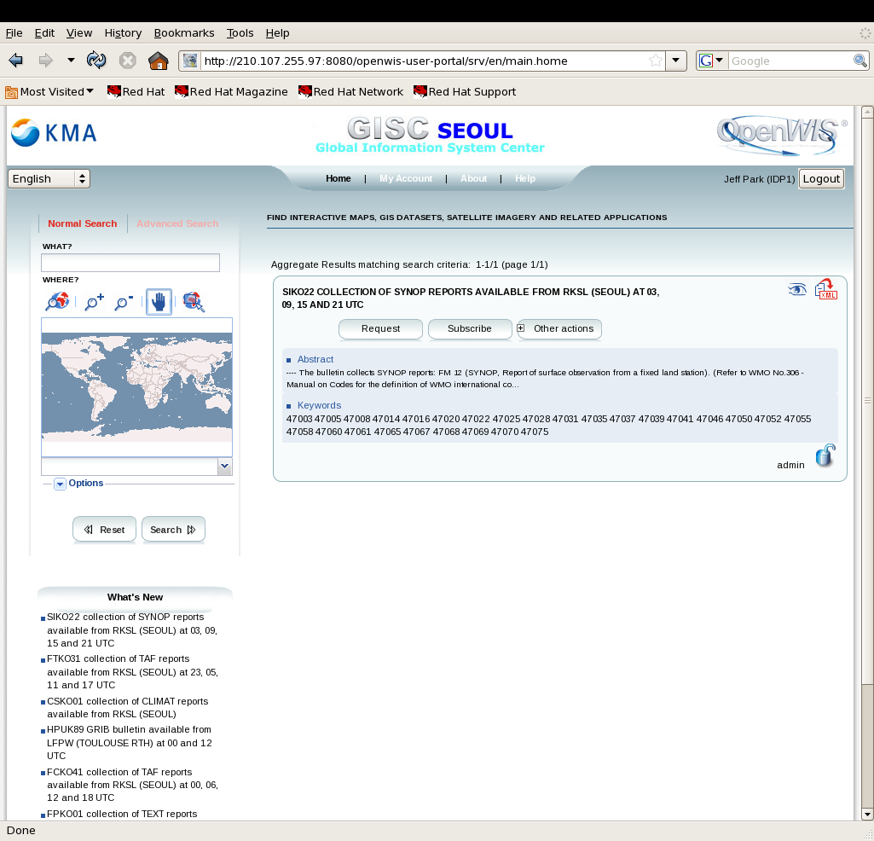
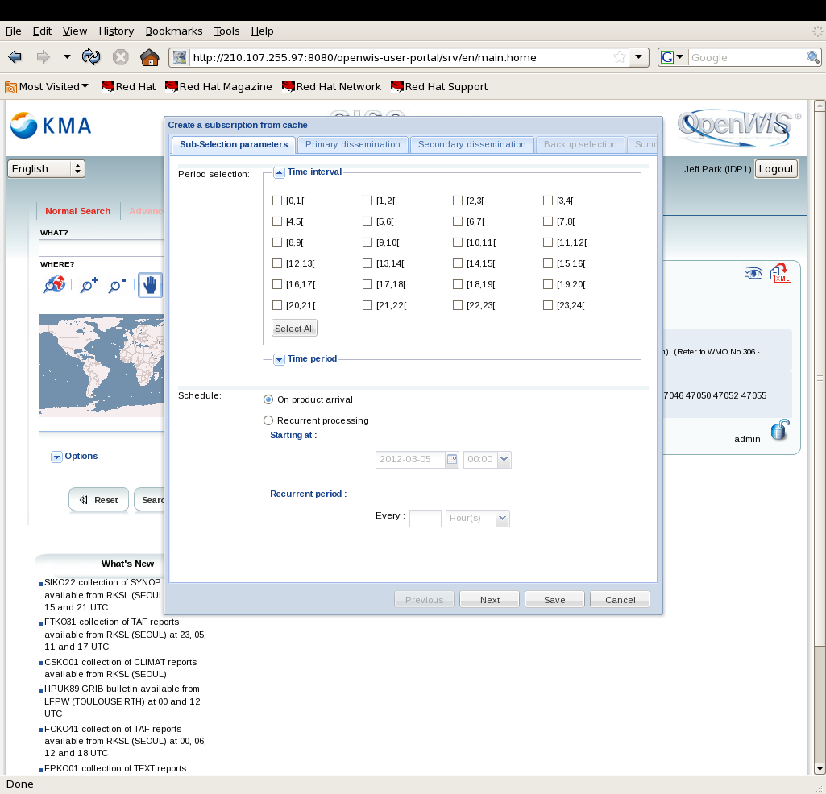
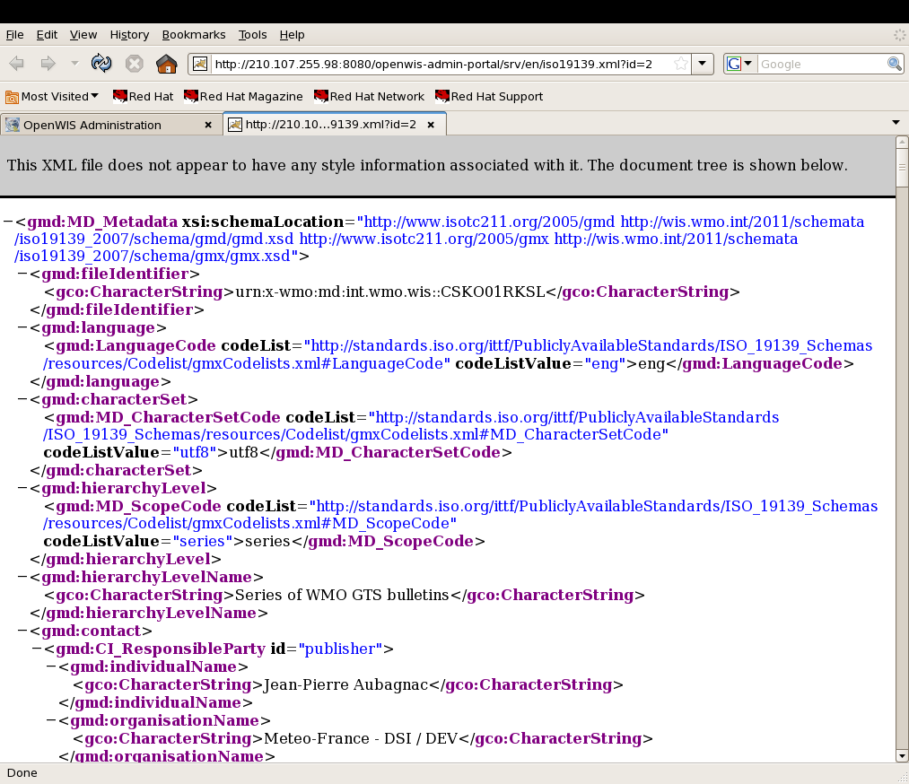
Notes:
Here’s some screen shots for GISC Seoul webportal.

Slide 4
Live Demo
Notes:
Here’s live demo for GISC Seoul webportal.

Slide 5
GISC Seoul Progress (March 2012)
GISC Seoul(Area of Responsibility)
- DCPC for WAMIS : World Agricultural Meteorological Information System
- DCPC for LC-LRFMME : Lead Centre for Long-Range Forecast Multi-Model Ensemble
- DCPC for NMSC : National Meteorological Satellite Centre
- DCPC and NC Tashkent : Uzbekistan
- NC Karachi : Pakistan
- DCPC for Cordex : Data Bank for Climate Change Scenario
GISC Seoul
Satellite data
DCPC
DCPC
Tashkent
AMDCN
Agri&Met data
DCPC
NC
Tashkent
Climate data
DCPC
NC
Karachi

Slide 6
GISC Seoul Progress (March 2012)
Be ready to ET-GDDP audit
- Asked the on-site audit : Early June, 2012
Time line of GISC Seoul Operation
- July 2012 : GISC Seoul Pre-operation(Normal Op. : Jan. 2013)
- Oct 2012 : DCPC COMS Pre-operation(Normal Op. : Jan. 2013)
- Oct 2013 : DCPC WAMIS, LRFGPC Pre-operation(Normal Op. : Jan. 2014)
- Oct 2013 : DCPC and NC Tashkent Pre-operation(Normal Op. : Jan. 2014)
Planning the first WIS Workshop in Seoul(2012)
Capacity Building and Sharing WIS Experience
WMO and WIS Experts, GISC Seoul’s Area of Responsibility
Notes:
Based on this preparation, KMA has asked the ET-GDDP on-site audit of early June 2012 to WMO Secretary.
GISC Seoul would be normal operation mode by Jan. 2013 with the pre-operation right after WMO EC, July 2012.
All of WIS Centres in the GISC Seoul’s Area of Responsibility would be operational mode by stages after Oct. 2013.
KMA has planned to open the first WIS workshop for capacity building and sharing WIS experience in Seoul this year, 2012.
We hope many of experts and related colleagues from all over the world participate into this first event.

Slide 7

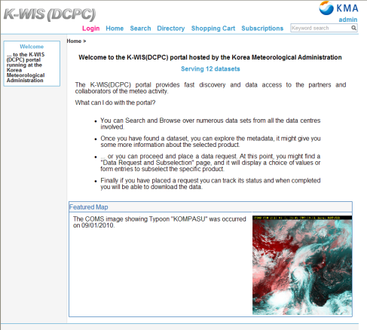
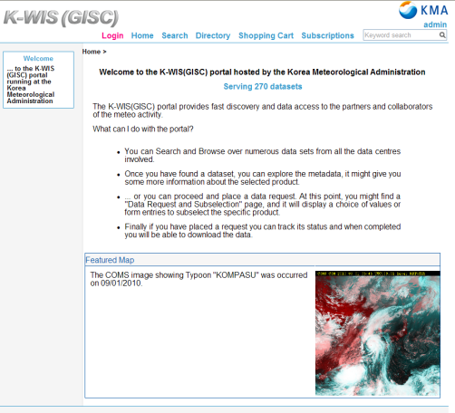




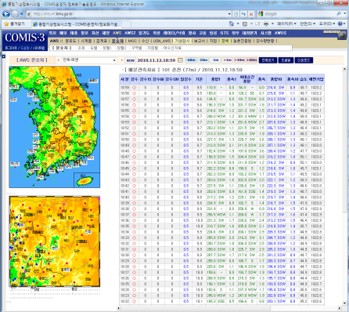
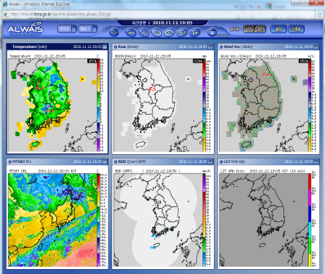



‘12.4 ~
OK
GISCs
RMDCN
WIS DMZ
’13.10 ~
User
Internet
DCPC KMA
GISC Seoul
DCPC Tashkent
GPCLRF
Synchronization
VPN
Intranet
WAMIS
Virtual centre
NMSC
’12.10 ~
OK
CORDEX
NC Karachi
KMA legacy system
(Internal)
KMA DMZ
Data Manager
KMA DATA
Center
COMIS
COMIS DB
Notes:
Here’s the GISC Seoul Test environment that we have built and plan to do.
The WIS compliance cases have been tested by KMA itself with the virtual centre and KMA’s legacy system.
Metadata has been created, modified and listed up for DAR service with synchronization.
GISC Seoul will be ready to make connection with other GISC(s) by April 2012, and DCPC NMSC(KMA) and DCPC Tashkent will be ready by Oct. 2012 and Oct. 2013, respectively.

Slide 8
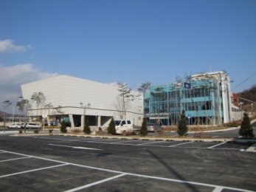
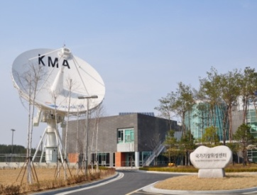
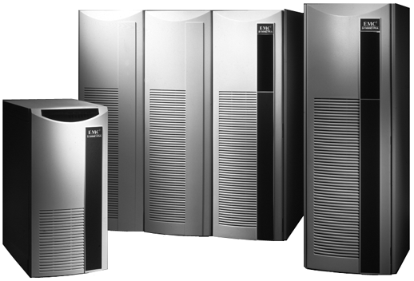

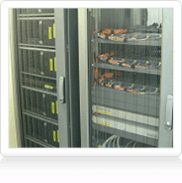
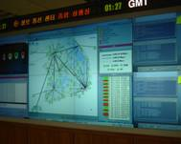
Network Environment in GISC Seoul
GISC Seoul Backup Site
DCPC NMSC
Internet
Supercomputer Center
Satellite Center
2 Gbps
1 Gbps
GTS
2 Gbps
GISC Seoul
64~128 Kbps
(KOREN/KREONET)
1~ 2 Gbps
RMDCN
2Mbps
Government
45 ~200 Mbps
ICT centre for 24/7
Certified IT Service quality
- ISO 2000(since 2008)
WIS Team in the Div. of ICT
Public Inst.
56K ~2 Mbps
Notes:
I would like to add an schematic diagram of network environment in GISC Seoul.
KMA has been proud of high quality network infra and high level software technology with 24/7 ICT centre and certified IT service quality, ISO 20000. We has been preparing GISC back up system in remote area, where the KMA’s supercomputer centre is operational.
We also have been discussing with NMHS to build up the bilateral GISC backup alliance.

