Slide 1
Report to ICAO MARIE-PT from WMO TT-AvXML
Jeremy Tandy
(Feb 2012)

Slide 2
Understanding of ICAO requirement
Urgency is required on the specification of XML/GML Schema for TAF, METAR/SPECI and SIGMET (VA SIGMET, TC SIGMET & WS SIGMET) to support Amendment 76 to ICAO Annex 3 (WMO No. 49): (for States in a position to do so) permitting bilateral exchange of OPMET data via XML.
Aviation community seek to harmonise data exchange technology around GML/XML to reduce overall cost-base of ATM / SWIM system.
Additional pressures beyond those of ATM /SWIM exist for adopting GML/XML. Commercial entities worldwide have long desired provision of weather data encoded in widely-used, vendor neutral formats.
Target delivery date for XML schema to support Amendment 76: July 2012.
ICAO shall own the MET information Logical Data Model from which the XML schema is derived.
¿WXXM2.0 shall be baseline input to ICAO MET information Logical Data Model?
  Use of WXXM2.0 implies a dependency on ISO 19156 Observations and Measurements

Slide 3
Distributed governance:
importing WMO Logical Data Model ‘generic weather’ packages
ICAO MET information Logical Data Model will build on many generic meteorological concepts.
Such generic ‘weather’ Classes and Concepts will be re-used across other domains.
Generic weather Classes shall be managed by WMO – importing definitions from ISO/TC 211 reference models and existing WMO Codes.
WMO shall publish a ‘Generic MET information’ Logical Data Model (WMO Logical Data Model) that contains generic meteorological definitions for use in other (non-aviation) domains / industries.
WMO is committed to maintaining the ‘Generic MET information’ Logical Data Model to support ICAO requirements. Broader exploitation of the Logical Data Model shall be debated at WMO Commission for Basic Systems [CBS] (Sept 2012).
ICAO MET information Logical Data Model should import Packages as necessary from WMO Logical Data Model – in the same manner as ICAO information models import Packages from ISO/TC 211 reference models.

Slide 4
Conversion to XML/GML schema
WMO shall own the Physical Data Model (e.g. the XML Schema). ¿WXXS?
ISO19136 (GML) provides rules for conversion of Application Schema to XML/GML Schema.
  ‘Application Schema’ is ISO/TC 211 parlance for Logical Data Model.
WXXS shall be automatically derived from ICAO MET information Logical Data Model.
WMO shall identify software tools that enable automated conversion from ICAO Met information Logical Data Model and underpinning WMO ‘generic weather’ Logical Data Model to XML Schema. The ‘Fullmoon’ application is currently being investigated.

Slide 5
Outline process
WMO _LOGICAL DATA MODEL_ shall be inferred from the TDCF and maintained in synchronisation
WMO shall derive XSD from WMO _LOGICAL DATA MODEL_ using an automated process such as Fullmoon
ICAO MET information _LOGICAL DATA MODEL_ should import packages from WMO _LOGICAL DATA MODEL_ as appropriate
ICAO MET information _LOGICAL DATA MODEL_ shall compose Classes and Datatypes imported from WMO _LOGICAL DATA MODEL_ into (new) locally defined Classes
On behalf of ICAO, WMO shall derive XSD from ICAO MET information _LOGICAL DATA MODEL_ - importing WMO XSD as necessary (WMO owns WXXS)

Slide 6
Defining the WMO
Logical Data Model

Slide 7
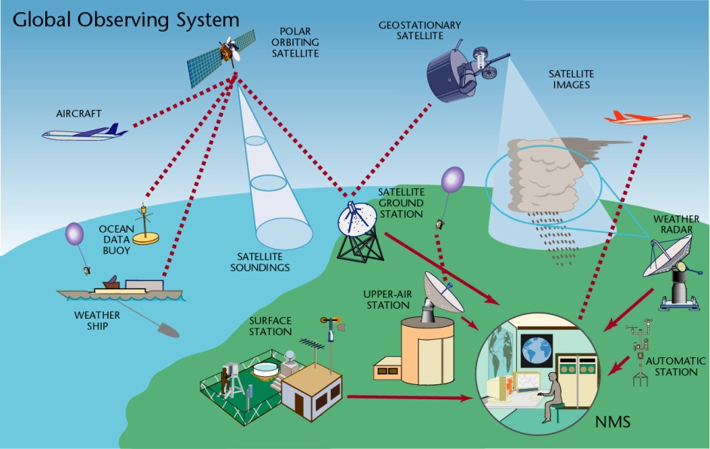

WMO’s World Weather Watch Programme combines observing systems, telecommunication facilities, and data-processing and forecasting centres to support weather prediction … time & safety critical
Notes:
Meteorology is about safety critical services; prediction of the weather depends on near instantaneous exchange of weather information across the entire globe.

Slide 8

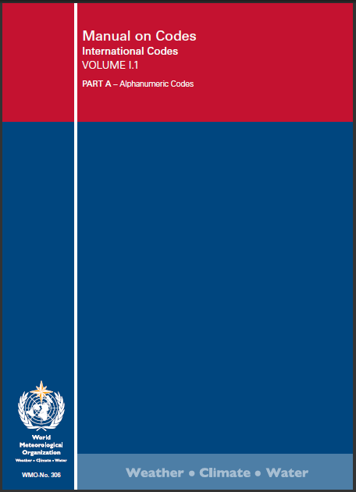
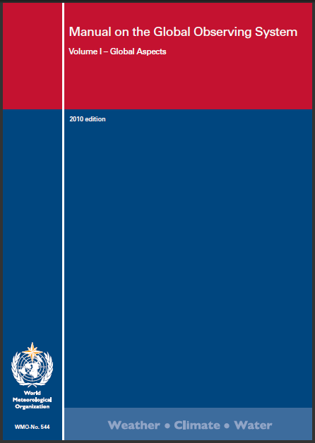
WMO Regulation
The successful facilitation of free and unrestricted exchange of data and information, products and services in real- or near-real time throughout the WMO community is due to strong governance
Procedures; i.e. Manual on GTS & Manual on Observing
Data formats; i.e. Manual on Codes
WMO has created a SUSTAINABLE infrastructure wherein regulation is MAINTAINED

Slide 9
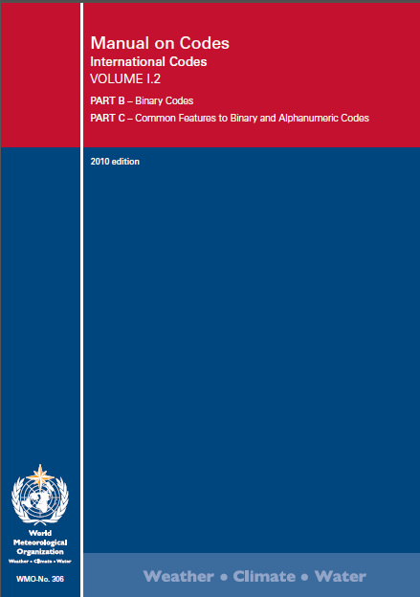
Manual on Codes
The Code-Tables underpinning WMO Table-Driven Code Forms (GRIB and BUFR) are WMO’s crown jewels …
Decades of expert effort have gone into establishing authoritative terminologies to describe meteorological phenomena

Slide 10
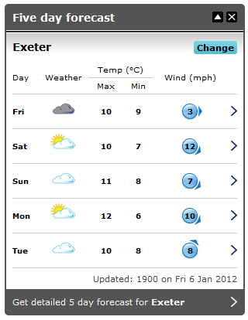
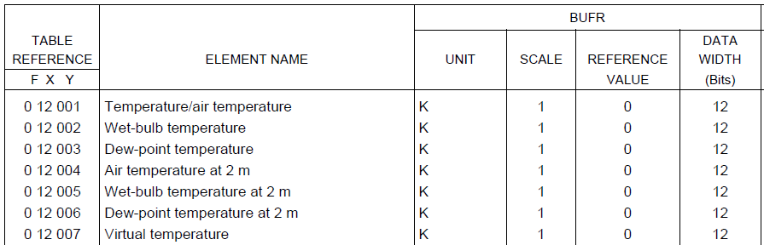
WMO TDCF:
authoritative definitions for meteorology
WMO Code-Tables combine authoritative definitions with encoding information – e.g. unit of measure and precision (derived from ‘scale’, ‘reference value’ and ‘data width (bits)’
(note: this approach is at variance with WXXM / GML where the unit of measure and precision is not prescribed in the Schema)
BUFR Code Table B – Class 12

Slide 11

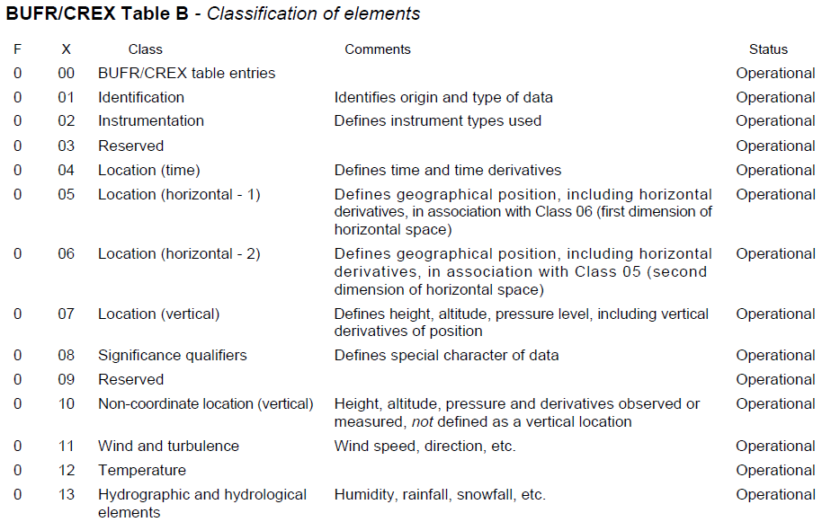
WMO TDCF: BUFR Table B
Generalized Coordinates
Significance Qualifiers
Measures

Slide 12
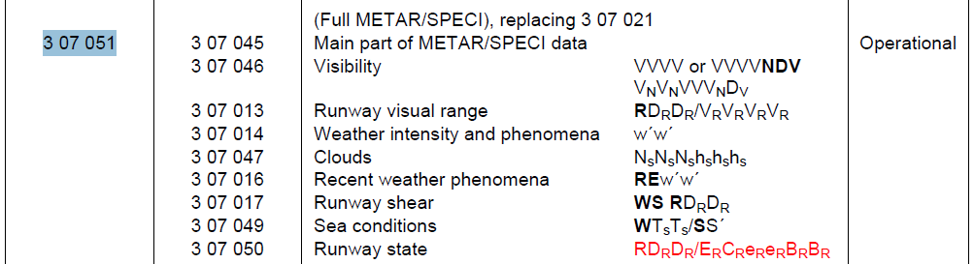
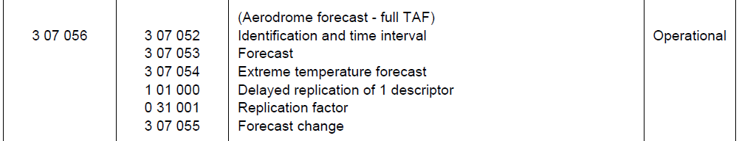
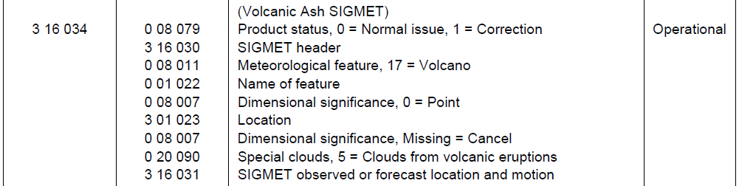
WMO TDCF:
BUFR Templates for OPMET data
BUFR Code Table D – Category 07 “Surface Report Sequences (Land)”
BUFR Code Table D – Category 16 “Synoptic Feature Sequences”

Slide 13
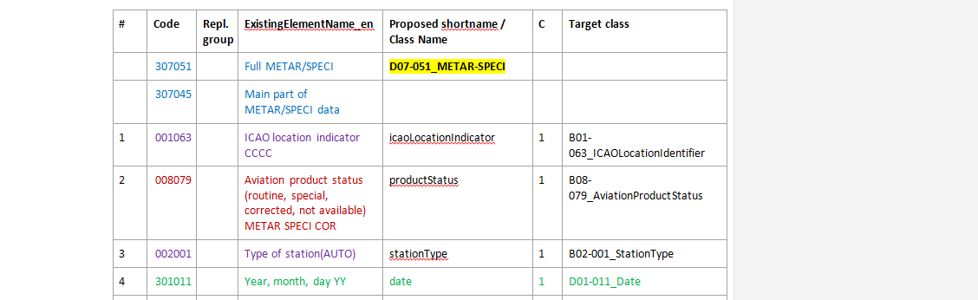
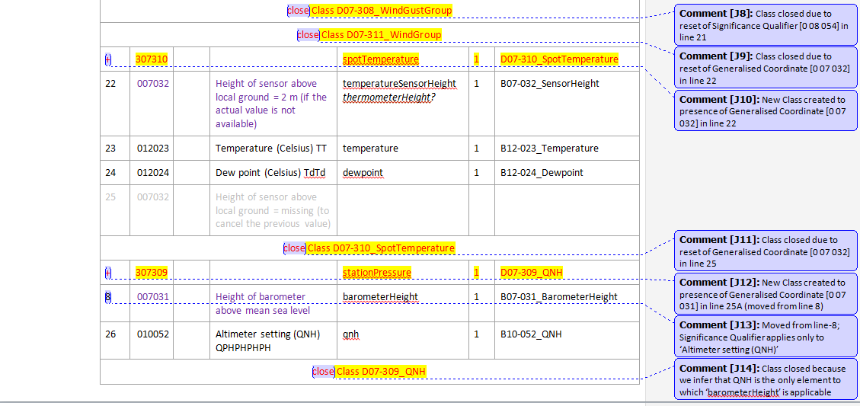
Analysis of BUFR Templates based on the incidence of Generalised Coordinates and Significance Qualifiers can be used to define modular components
13

Slide 14

METAR/SIGMET model derived from BUFR

Slide 15



















OGC Met-Ocean Domain Working Group:
Conceptual Modelling
OGC Met-Ocean domain working group provided the forum for development of a harmonized data model for meteorology
OGC
Met-Ocean DWG
INSPIRE Thematic Working Group:
Atmospheric Conditions & Meteorological Features

Slide 16
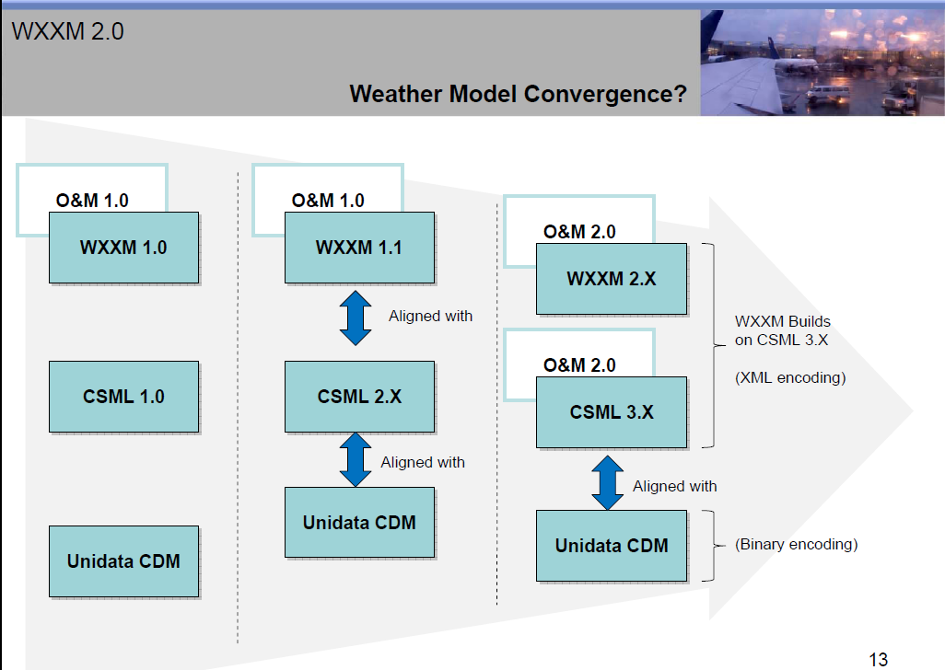


Weather model convergence …
Aviation
CF-conventions
netCDF
OGC Observations and Measurements (O&M2)
ISO 19156 Geographic Information
– Observations and measurements

Slide 17
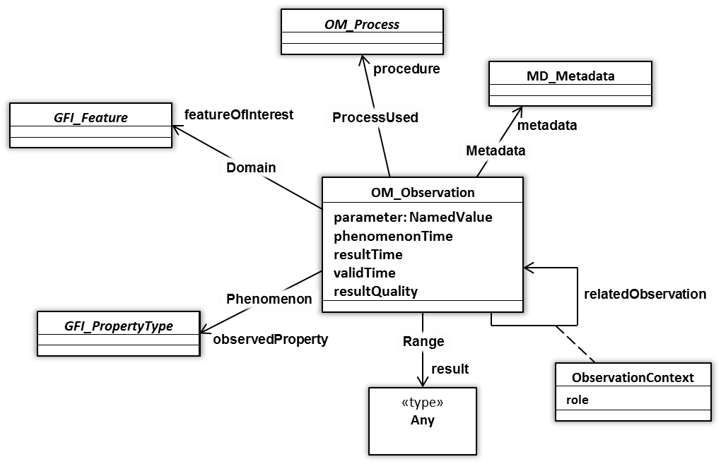
ISO19156 Observations and measurements
OM_Observation: an EVENT whose RESULT is an estimate of a value of some PROPERTY of some THING obtained using a specified PROCEDURE …

Slide 18
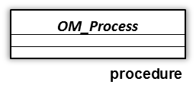
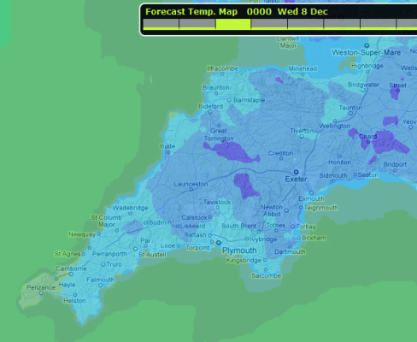
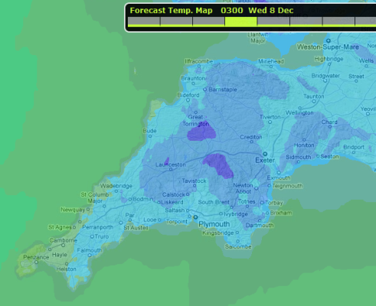
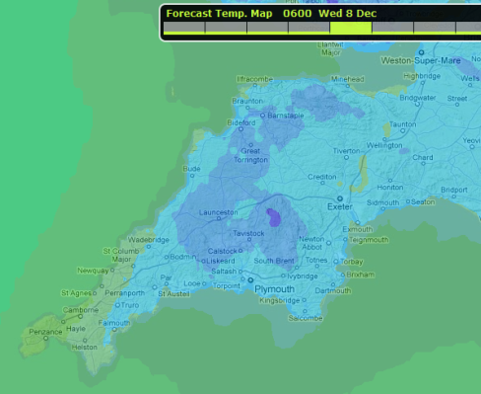
ISO19156 Observations and measurements:
also suitable for numerical simulations – including forecasts
forecast : OM_Observation
parameter.name = “analysisTime”
parameter.value = 2010-05-06T00:00Z
phenomenonTime.begin = 2010-05-06T00:00Z
phenomenonTime.end = 2010-05-09T12:00Z
resultTime = 2010-05-06T04:30Z
validTime [optional – not specified]
resultQuality [optional – not specified]
OM_Process can describe a numerical simulation to ESTIMATE a value in the future (e.g. a FORECAST)
5-May
6-May
7-May
8-May
9-May
12Z
00Z
12Z
00Z
12Z
00Z
12Z
00Z
12Z
00Z
result

Slide 19
Describing the Observation procedure
Each Observation event shall be executed according to a specified Procedure.
The Procedure can range from a repeatable list of instructions through to a specific instrument (or numerical simulation) in a particular calibrated state.
Essentially, the Process object provides context regarding how one should interpret the Result.
The WMO Logical Data Model provides a SimpleProcess definition providing the barest minimum of information: (optional) documentation and (optional) configuration parameters for the process.

Slide 20

Relationship to the real-world:
featureOfInterest & SamplingFeature
SamplingFeatures are used where the Observation is taken at a location that is purely an artefact of the sampling regime (e.g. the location of a sensor platform within the boundary of an aerodrome)
‘domain objects’ are related to the Observation via ‘featureOfInterest’ association

Slide 21

Describing the Observed phenomenon
An Observation is limited to a single Phenomenon
The ObservableProperty model (developed within OGC SWE-WG) provides a mechanism to group measures that estimated by a single Observation
The ObservableProperty model also allows basePhenomena to be qualified / constrained
(e.g. maximum windspeed during 10-minute period)

Slide 22
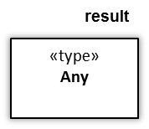
Describing the Observation Result
The WMO Logical Data Model is aligned with the patterns developed within the Climate Science Modelling Language (CSML3) – this is predicated on Observation sub-classes derived from SamplingCoverageObservation
SamplingCoverageObservation constrains the featureOfInterest to type ‘SF_SpatialSampingFeature’ and result to type ‘CV_DiscreteCoverage’

Slide 23
Harmonizing WMO BUFR models
with ISO/TC211 reference models
The METAR/SPECI product includes attributes that define the time & location of the Observation event plus procedure information (e.g. stationHeight*).
The METAR/SPECI is defined for a single geographic location at an instant in time – we can consider this to be a degenerate coverage with only a single domain object.
The process used to derive the UML model from BUFR Templates yields Classes that cluster physical properties (e.g. measures) and procedure information into well-defined modules.
Analysis of these modules indicates that the METAR/SPECI is comprised of multiple individual Observation instances.
* stationHeight is considered to be procedure information as this value is required in order to correctly interpret the Observation result (e.g. temperature measures)

Slide 24
METAR/SPECI expressed as Observations
SimpleProcess
PointObservation
documentation
(title + link to online resource)
phenomenonTime
METAR / SPECI Product
processParameter
(e.g. sensorHeightParameter)
AerodromeObservationGroup
resultTime
windElements
procedure
CompositeObservableProperty
temperatureElements
component
(e.g. temperature)
observedProperty
qnhElements
featureOfInterest
component
(e.g. dew-point temperature)
observedPhenomenaElements
result
SF_SamplingPoint
runwayWindShearElements
sampledFeature
(e.g. Karlovy Vary Airport)
seaConditionElements
shape
OM_Observation: an EVENT whose RESULT is an estimate of a value of some PROPERTY of some THING obtained using a specified PROCEDURE …
GM_Point
(e.g. lon 12.92, lat 50.20)
runwayConditionElements
RunwayObservationGroup
CV_DiscretePointCoverage
AerodromeTrendForecast
Notes:
(e.g. GM_Point: {12.92, 50.20})

Slide 25
METAR/SPECI temperatureElements result:
degenerate discrete point coverage
EX_Extent
The Coverage model seems over-engineered for a single point-observation.
However, its use does ensure that the WMO Logical Data Model is extensible and can easily adapt to future requirements where values are measured at multiple locations or at specified intervals over a time-period.
Adoption of the Coverage model also means that the data will be simple to publish via OGC WCS.
temporalElement
CV_DiscretePointCoverage
domainExtent
geographicElement
rangeType
DataRecord
element
field
(e.g. temperature)
field
(e.g. dew-point temperature)
CV_PointValuePair
geometry
GM_Point
(e.g. lon 12.92, lat 50.20)
value
Record
temperature = 27 ºC
dew-point temperature = 10 ºC
CV_DiscretePointCoverage
Notes:
(e.g. GM_Point: {12.92, 50.20})

Slide 26


Logical Data Model for OPMET:
conclusions
ISO/TC 211 provides standard reference models to underpin MET information Logical Data Model: ISO19103, ISO19107, ISO19108, ISO19123, ISO19156.
WMO Logical Data Model provides standard patterns for expressing observation and forecast data based on sub-Classes of SamplingCoverageObservation.
WMO Logical Data Model provides a palette of Measures, CodeLists and other entities (derived from BUFR Table B and BUFR Code&Flag Tables) that are used to define data value types and, where appropriate, ranges of permissible values.
ICAO MET information model can define sub-Classes of ‘Record’ that group Measures as necessary – importing Classes from WMO Logical Data Model.
ICAO MET information model can define Classes to represent aviation ‘data products’ (e.g. METAR/SIGMET) that group multiple Observations into a single report.
The resulting ‘data products’ are highly modular (e.g. Report | Observation | Coverage) – with each sub-component sufficiently self-contained that it does not require the context from enclosing component to be correctly interpreted.

Slide 27
Thank you
Questions and answers

