Slide 1
“Cache in and through the Cloud”
JMA
3rd August 2017

Slide 2
Requirements of Cache in Cloud
Reference document
  Tech-Spec-3: centralization of Global Distributed Data
    Performance metrics:
      Centralize Global data is to be transmitted end-to-end within two minutes (when priority data is included).
    Data Flow:
      Inputs: Global information
      Outputs: Cached Global information
    Note:
      Global data is required to be all GISCs within 15 minutes
Notes:
Reference document…
According to Tech-Spec-3 of “Centralization of Global Distributed Data”.
As the performance metrics global information is some of the operation-critical data intended for global distribution is to be transmitted end-to-end within two minutes.
Data flow, Inputs is Global information, and outputs is Cached Global information.
In the notes, Global data is required to be all GISCs within 15 minutes.

Slide 3
Purpose/Features
to reduce the member of connections (full mesh) between GISCs
Notes:
Purpose

Slide 4
Fundamental items
Operation of the cloud service should be step-by-step transition.
  Initial stage:
    Start Cache-in-Cloud based on the successful procedure of the Cloud Pilot in 2016. Advanced GISCs must be invited.
  Evolution stages:
    All GISCs participate.
    Some of NC/DCPCs participate.
    Add Metadata to the cloud.
    Add restricted data and manage user access right control
    Growth of data amount in the Cloud.
    Introduce Contingency plan (robustness enhancement)
    … etc.
  Final stage:
    Meet WIS 2.0 requirements
    Stop Full mesh topology between GISCs
Initial stage
Evolution
stage
Final stage
203X ??
202X ?
2018-2019
Notes:
Operation of the cloud service should be step-by-step transition.
Initial stage, Evolution stage, Final stage.

Slide 5

Functional and Technical requirement (1)
<<< for initial stage >>>
Define target architecture
  Conditions:
    SLA (availability) : Best effort
    Data volume, user license, optional service etc.
      Storage : 100GBytes
      number of users : 15 users (GISCs)
      CDN service : may be needed to meet 10Mb/s or more
      Management : Volunteer? or use Provider’s management service?
        e.g. ECMWF providing huge human resource to manage RMDCN
      Throughput : 10 Mb/s (not contractual) between a GISC and the Cloud
        To get 2GB (e.g. NWP) within 30 minutes, minimum actual speed must be 10Mb/s or more (see below)
If actual speed of each connection is 10Mb/s, the deliver time (end-to-end) will be 120 minutes
10Mb/s
2GB/30 min
10Mb/s
2GB/30 min
10Mb/s
2GB/30 min
10Mb/s
2GB/30 min
DCPC-A
NWP
GISC-A
GISC-B
DCPC-B
NC-B
Cache
End-to-end : 120 minutes
Notes:
To define target architecture, need system requirement first to estimate operational cost. If we have an abundance of money, of course it’s NO-PROBLEM.
At the initial stage, we may still have RMDCN to sync data between GISCs. So 99.999% availability is “OVER SPEC” and it’s too early to introduce Contingency plan at that time.
Generally data volume is growing twice year by year, so we need to prepare an appropriate system to avoid unnecessary cost, so the system must be upgradable.

Slide 6
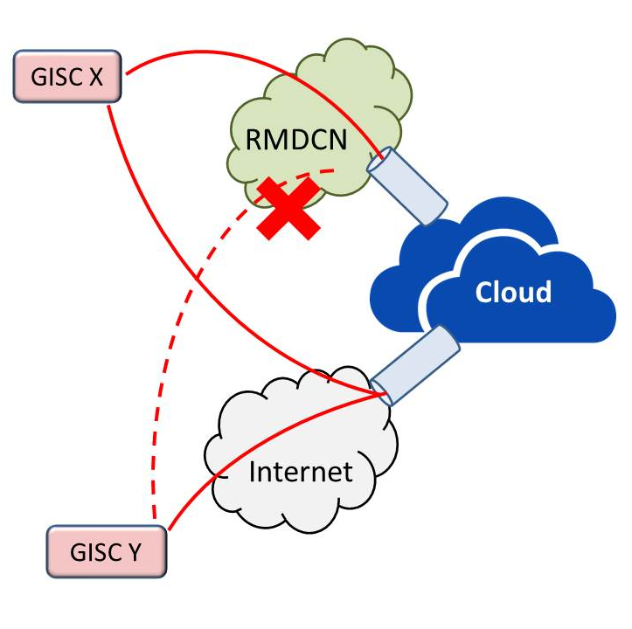
Functional and Technical requirement (2)
<<< for initial stage >>>
Interface for accessing to the cloud
  RMDCN : 12 GISCs
  Internet : 3 GISCs
Define access right strategy
  Must be controlled by WMO_Data_License_Code
    It should be only WMOEssential and WMONoRestriction
Data aspects
  WMO_DistributionScopeCode: GlobalExchange
  WMO_ProductCategoryCode： GTSPriority2,3,4 (except 1)
  Mechanism for many to many (as opposed to any to any)

Slide 7
Functional and Technical requirement (3)
<<< for initial stage >>>
File format
  WMO batched FTP format
    CCCCNNNNNNN.ext and GFNC (Att.II-15, Manual on the GTS)
    Do not unpack in the Cloud (for transmission performance)
Data flow (Evolution stage)
  Priority Level
    Attachment II-5 of Manual on the GTS.
  Data flow from GISC to Cloud
    GISCs should upload data/products from all DCPCs/NCs in its AoR (GlobalExchange, WMOEssential, GTS Priolity2,3,4)
  Data flow from Cloud to GISC
    Option-1: Cloud puts all data to all GISCs (without originating GISC).
    Option-2: a GISC gets other GISCs data from Cache Cloud
Notes:
At initial stage, File format use WMO batched FTP format and this data does not unpacked in the Cloud.
Its uploaded data is Global-Exchange data and can be shared it with All GISCs.

Slide 8
Functional and Technical requirement (4)
<<< for evolution stage >>>
Future items
  Robustness
    Backup (backup cloud(s), GISC backup etc.)
    Sync between RMDCN cloud and Internet cloud
      According to ECMWF, the cloud can access from both side.
  Expanding Data category (in WMO metadata)
    WMO_DataLicenseCode: WMOAdditional
    WMO_DataLicenseCode: WMOOther
    WMO_ProductCategoryCode： GTSPriority1 (critical)
    WMO_DistributionScopeCode: RegionalExchange
    WMO_DistributionScopeCode: OriginatingCentre
Notes:
Future items.
Needs robustness, expanding data category.

Slide 9
Security of the environment and cybersecurity
<<< for initial stage >>>
Needs IDS/IPS?
IP filtering
  The Cloud needs to register each GISC’s IP address to prevent unauthorized access.
Limited protocol to upload/download data
  Initial stage: FTP (RMDCN), SFTP (Internte)
  Evolution Stage: FTPS, AMQP
Notes:
Security
At the initial stage, the cloud needs to register each GISC’s IP address to prevent unauthorized access.
Limit protocol to use uploading and downloading data.

Slide 10
Data aspects
Initial stage:
  GISC uploads data by following convention
    Attachment-II-15 of manual on the GTS
      WMO FTP batch file (CCCCNNNNNNN.ext)
      Global File Naming Convention (GFNC)
Evolution/Final stage:
  GISC uploads mixed files
    pflag=‘X’, Attachment-II-15 of manual on the GTS
  DCPC/NC will upload own data to cloud directly.
  Data format for DCPC/NC
    E.g. Cloud software unpack data uploaded by GISCs.
Notes:
To exchange data, GISC uploads data by WMO FTP batch file or GFNC file.

Slide 11
Volume of data
Data volume per 1 file is up to 200 Mbytes.
  Each GISC should be to upload data within 7.5 minutes, because according to WIS Manual, Global data is required to be across all GISCs to within 15 minutes.
  In case of 4 Mbps access line, a potential capacity of its circuit has max 225 MBytes per 7.5 minutes.
  For example
    WMO Batched FTP: Bulletin: up to 50 MB per 1 file (500KB x 100 messages as binary)
    WMO GFNC: up to 200 MB per 1 file
  To be able to change specification according to the Manual on the WIS/GTS
GISC-A
7.5 min
7.5 min
GISC-B
Cloud
Within 15 min
Notes:
This is one of assumption data volume in case of 4M which is minimum bandwidth of GISC on RMDCN.

Slide 12
Store data
Initial stage:
  Cache is 24 hours at least
  Storage: 200GB
    If assumption of data volume for 1 day is 10 GB each GISC…
      2 GB products x 4 times + other data = about 10 GB x 15 GISCs x 1 day = 150 GB
      Actually, the cloud needs 200 GB as operation.
  24h cache would be enough as done in pilot so far.
  The cloud should store the original file which was uploaded by GISC. Its file is exchanged during GISCs as Global-Exchange. (not unpack)
Evolution stage:
  Cache time will be able to be changed to 48h/1w/more… whenever in the future as per emerging requirements.
  This is related to cloud’s storage capacity, which is also related to cost.
  The cloud makes directory for DCPC/NC to be able to download data as GFNC. (unpacked Global-Exchange)
Notes:
Cache is 24 hours on initial stage. In the next stage, cache time will be able to change to 2 days, 1 week or more. It depends on the cost.

Slide 13
Who will provide the data to the cache?
Initial stage: GISC
Evolution stage: DCPC/NC participate
Future stage: Other WMO members?
Notes:
This is data provider.

Slide 14
Metadata aspects
- Copy of the catalog in the cloud? -
In evolution stage, whole metadata set should be centralized in the cloud.
  Current issues (full mesh sync):
    Complicated. Inefficient due to duplicated efforts.
    Complete synchronization among all GISCs has never been done so far.
    Not easy to identify which set is authoritative. Confusing.
  Possible pros (metadata in the cloud):
    Remove duplication of effort.
    Much easier to sync.
    It’ll be obviously the authoritative set.
  Possible issues (metadata in the cloud):
    Policy and way to modify/insert/delete metadata.
Good thing is transition impact will be smaller compared to “data”.
  Metadata is not so time- and operational- critical, luckily.

Slide 15
Concerns(1)
  WMO_ProductCategoryCode：GTSPriority1 (critical)
  How to control data priority
  end-to-end within two minutes in the Cloud
  or don’t need to be in the Cache
Cached data is:
  Same as GobalExchangeData?
  Same as Core Cache?

Slide 16
Concerns(2)
  The number of hops will be increased
      Full mesh : Data provider --> GISC --> GISC --> consumer
      Cache cloud : Data provider --> GISC --> Cloud --> GISC --> consumer
      Cache cloud (Final stage): Data provider --> Cloud --> consumer?
  Need to estimate processing time (additional delay?) in the Cloud in the pilot stage
  Throughput
      There is “TCP/IP Round Trip Time issue”, if the distance to the cloud is long.
      Cost of Content Delivery Network (CDN)? It is expensive?

