Slide 1
“Cache in and through
the Cloud”
Procurement and
Financial
Mark Francis – 3rd August 2017

Slide 2
Contents
      Requirements
    Procurement
    Financial
    Recommended Text
    Questions

Slide 3
Requirement
      To deliver a report/presentation on procuring Cloud based services and identify cost challenges associated with a multi-region subscription base.
Notes:
The UKMO has agreed to take on the role of procurement and financial requirement. Cloud is a business term, both on-premiss and public cloud solution will be looked at. The end goal is about subscribers of the cached data. The focus should not be on just the technical aspect.

Slide 4
Assumptions
      More work is required to understand this topic once the technical solution has been better understood.
      Any costs discussed are correct at the time this presentation was prepared.
Notes:
Outline any assumptions that might be relevant and need clarifying

Slide 5
Procurement (Public – AWS, Azure)
      Understand the technical requirement and purchase the corresponding service(s).
      Procuring public cloud services are like building blocks.
      All suppliers require a single account setup.
      Leading cloud providers don’t provide bespoke solutions for PAAS.
Notes:
Procurement in the cloud is straightforward, determine what services you require and purchase those services. Without understanding the true technical solution the focus is around what we understand. For instance. The essential cache data is ~7GB, using main cloud hubs like USA, Europe, Asia etc.. Makes the cost cheaper. GISC’s will push data into the cache (although in the future NC’s could also do this). Based on each regions requirement, some cloud providers might be excluded. Consider the use of more than one cloud provider.

Slide 6
Procurement (Public - Interoute)
      Currently hosting the trial infrastructure
      Only provider hosting on the RMDCN
      Limited product and services
Notes:
Interoute were a good fit for the trial but realistically there are more mature providers of cloud services. NOTE – an on premises solution wasn’t looked at as this would be the same as we have now.

Slide 7
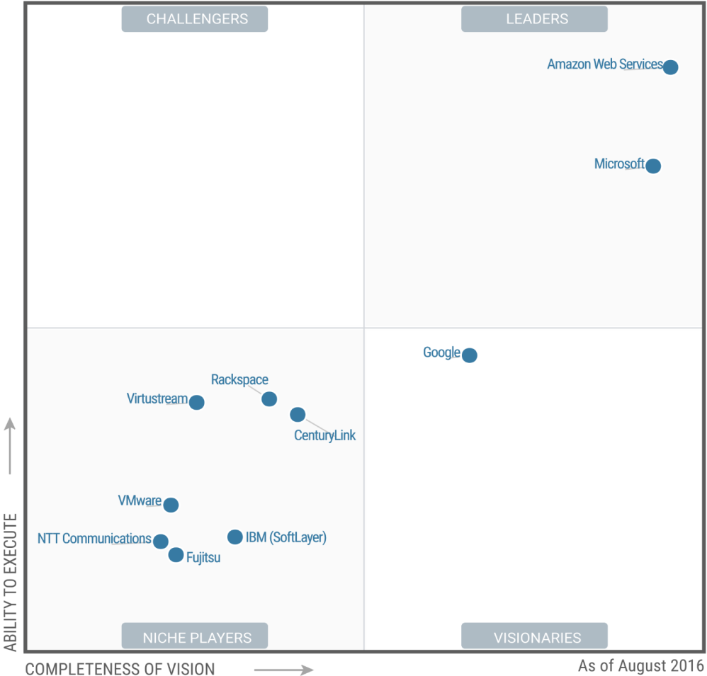
Procurement
Source: Gartner (August 2016)
Notes:
Gartner Quadrant shows AWS are the leader in the cloud market, with Microsoft not far behind. This is backed up by a recent exercise the Met Office did, looking at cloud technologies to satisfy a future requirement.

Slide 8
Procurement (Summary)
      The market leader is AWS with Azure a close second. Google have the investment power and will move into the Leader quadrant in the next few years.
      Interoute are very niche (source EMCWF), but are the only supplier able to host cloud services on the RMDCN.
      Consideration, moving data across regions has cost implications.
      Consideration, the use of more than a single cloud provider for different regions.
Notes:
In the pubic space there are two main supplies with AWS being the current market leader. Google is starting to make a lot of traction in the cloud space and in a few years they will move into the leader quadrant.

Slide 9
Financial - Considerations
      Account Ownership
          Single master account, WHO owns the account!
          Rotate account ownership between GISC’s.
          Each GISC takes responsibility for a set period of time.
          Understand the regional limitations
      Cost Ownership
          Single organisational model wouldn't work
          Putting ~7GB essential data into a cloud environment is free
          A chargeback model would need to be in place.
            Core cost model
            GISC chargeback
            Subscription based chargeback
Notes:
Single account ownership. Cost ownership, Having a single account maybe an issue? Sub accounts can be created for each GISC to administer. This in itself could be problematic
In a single organisation sharing the costs is fairly straight-forward. A budget is allocated and owner of the budget draws down against on the actual monthly cloud cost. See https://aws.amazon.com/s3/pricing/ for a full cost breakdown in AWS. For Azure see https://azure.microsoft.com/en-gb/pricing/calculator/
Core cost model is monthly storage cost. All other chargeback models would need agreements in place.

Slide 10
Financial - AWS
      Cost of transferring ~7GB into S3 storage, free
      Moving data across regions $0.020/GB
      Acceleration transfer tool, additional $0.04/GB
      Storing data in the cloud $0.024/GB per month, 7*0.024=0.068/day. 0.068*30 days =$5.04.
      Put, Copy, Post or List Requests, $0.0053/1,000 requests
      Get and all other requests, $0.0042/10,000 requests
      Additional costs would be incurred based on any solution accessing data
Notes:
Pricing based on location is set to London. Because the data changes on a daily basis then a daily rate is applied. Acceleration transfer tool can speed up transferring data between regions, although some local testing didn't show a real improvement.
Final point – the layer above the data would incur cost but until this is better defined it’s hard to understand what the cost wouldbe

Slide 11
Financial – Azure
      Cost of transferring ~7GB into Azure storage, free
      Moving data across regions, “unclear”
      Storing data in the cloud $0.056/GB per month, 7*0.056=0.392/day. 0.392*30 days =$11.76.
      Put, Copy, Post or List Requests, $0.0150/10,000 requests
      Get and all other requests, $0.0015/10,000 requests
      Additional costs would be incurred based on any solution accessing data
Notes:
Pricing based on location is set to London. Because the data changes on a daily basis then a daily rate is applied. Acceleration transfer tool can speed up transferring data between regions, although some local testing didn't show a real improvement.

Slide 12
Financial – Interoute
      A discussion was held with Interoute but they were vague in terms of pricing.
      An indicative cost for a virtual server is 4k€ per year). This is a fairly typical cost for hosting virtual servers and comparable to an on-premises VM.
      Interoute is only based in Europe.

Slide 13
Financial - Summary
      Both AWS and Azure are comparable with AWS being more open with their pricing.
      AWS is the market leader and it’s clear they can move data across regions.
      Interoute seem to be a typical small scale cloud provider in comparison to AWS and Azure. Products and services are limited.
      Cloud providers generally bill monthly, fundamental to any cloud initiative is determine who picks up the cost. There are two cost tires. The first is the day-to-day running cost, storing the data. The second and generally less well budgeted is the usage cost. This can increase significantly based on the number of subscribers.

Slide 14
Financial – Summary (continued..)
      Not included in this presentation is virtual machine (instance) costs. The technical solution presented should indicate what the layer above the storage will potentially look like.
      Other costs to consider are monitoring and security.
      Each cloud provider has tooling which can improve the service level. The cost of this hasn’t been included as it’s specific to each provider.
Notes:
FinOps is one of the terms that's used to describe optimising your usage of cloud resources to reduce your spend

Slide 15
Concerns
      Working in a cloud environment it’s easy to focus on the technical aspect. Successful cloud deployments focus on process and governance. Ensuring financial and security are at the forefront of any cloud based design
      Account ownership across GISC’s

Slide 16
Recommended Text
      There is a need to understand local regional constraints
      Storing non-essential data into cloud storage will increase costs
      A chargeback model would need to be put in place. Which includes day-to-day running costs and usage costs. Usage costs can be capped but this restrains the service.
      A better understanding of the subscriber base. Without this will mean uncontrollable usage costs.
Notes:
Local policies may hinder having a single cache on cloud based infrastructure. Only store the 7GB~ if non essential data is stored this introduces unknown costs.

Slide 17
Thank you slide
      Jason Malpas, Kay Church, Jeremy Tandy, Richard Carne, Cloud Ops team (UKMO)
      Oliver Gorwits (ECMWF)
      Previous presentations and reports (various WMO)
      Faye Holt, Matt Johnson (AWS)
      Andrew Munslow (UKMO (Azure))

Slide 18
      Questions?
Notes:
GISCS’s may have infrastructure that could be re-used for a cloud based solution,

