Slide 1
Connecting netCDF and ISO
Ted Habermann, NOAA/NESDIS/NGDC
Links:
THREDDS Crawler/Extension: https://www.nosc.noaa.gov/dmc/swg/wiki/index.php?title=ncISO
GEO-IDE Wiki: https://www.nosc.noaa.gov/dmc/swg/wiki/index.php
ISO WAF: http://www.ngdc.noaa.gov/metadata/published/19115/isoMetadataHome.html
Spirals: https://www.nosc.noaa.gov/dmc/swg/wiki/index.php?title=Creating_Good_Documentation
Questions / Comments / Suggestions: ted.habermann@noaa.gov

Slide 2
Documentation in Multiple Dialects
ISO
DIF, FGDC,
Data.Gov
Documentation
Repository
ISO 19115, 19115-2, 19119 and extensions
netCDF
SensorML
THREDDS
WCS, WMS, WFS, SOS
KML

Slide 3
Multiple Dialects: THREDDS Data Server
OPeNDAP
WMS
WCS
Extract Data
THREDDS
Catalog
THREDDS
Catalog
THREDDS
Catalog
file1.nc
file2.nc
file3.nc
file4.nc
file1.nc
file2.nc
file.nc
file.nc
file.nc
file.nc

Slide 4
netCDF Metadata
THREDDS Metadata
THREDDS Data Server
NcML
netCDF Data
Climate-Forecast Variable Attributes
netCDF Library
netCDF Metadata
netCDF Library
NcML

Slide 5
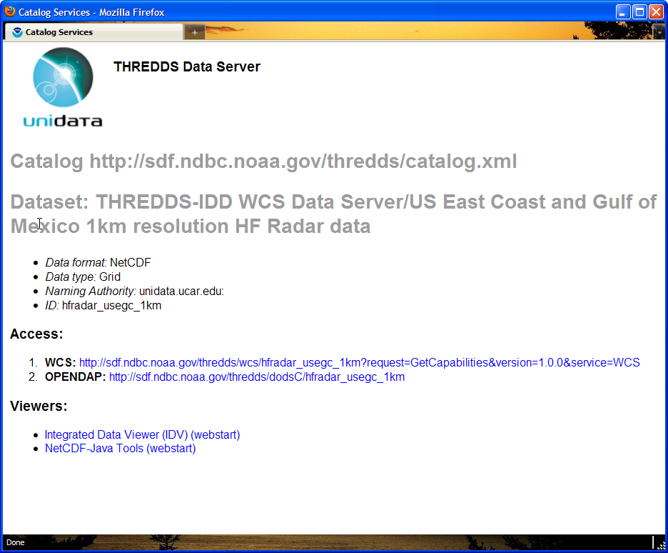
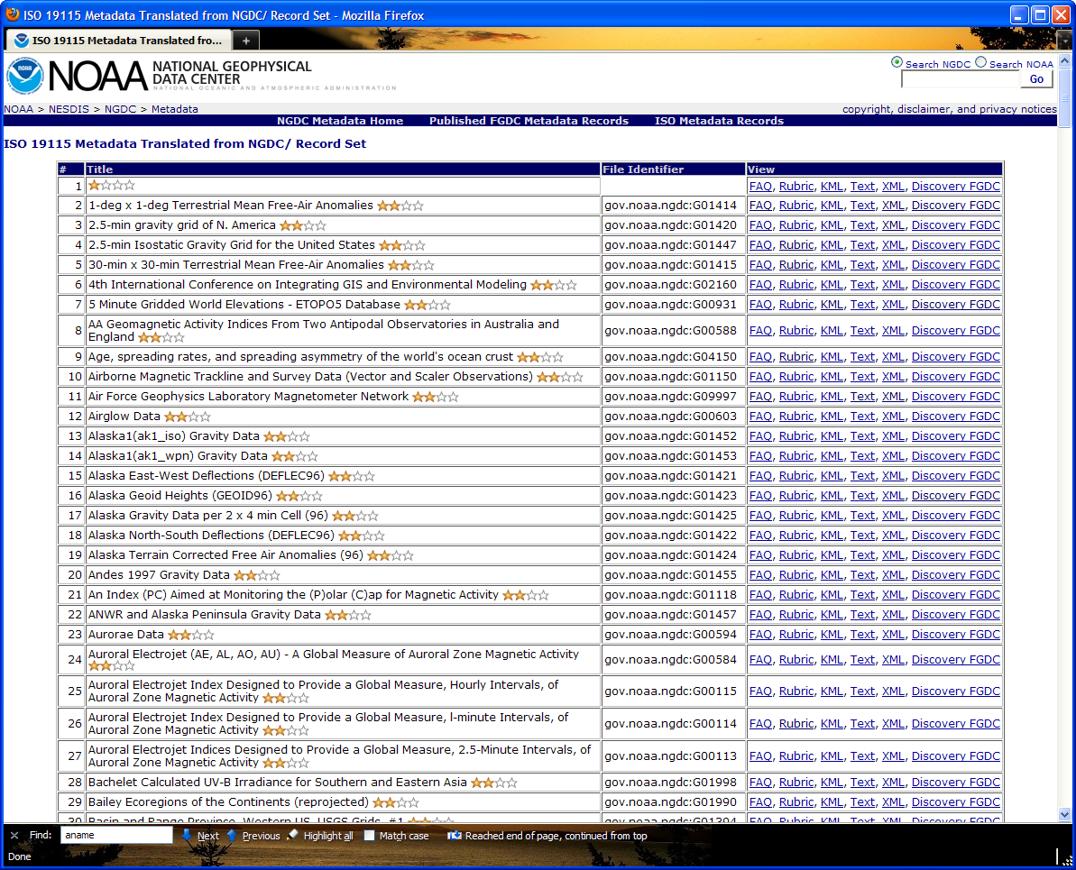
Multiple Dialects: Web Accessible Folders

Slide 6
ncISO - Adding Metadata Access to THREDDS
NcISO
1. Crawl remote THREDDS Catalogs:
  extract NcML
  translate it to ISO and Rubric using XSL
  create JSON hierarchy for web access
2. THREDDS Extension - Jar file that extends THREDDS Data Server to provide these three views as part of the dataset display page.
3. Data Provider Views - add your own metadata views to TDS using XSL
THREDDS
Catalogs
file.nc
file.nc
file.nc
file.nc
Notes:
OceanSITES documentation exists in netCDF files that are accessible through THREDDS Catalogs. What can we do with that documentation?
We have a THREDDS Catalog Crawler that identifies files (or datasets) in catalogs and extracts the NcML from those files. That NcML is then translated using standard XML tools (XSLT) into:
1) A rubric that examines the NcML for fields that are recommended by the Unidata Data Discovery

Slide 7
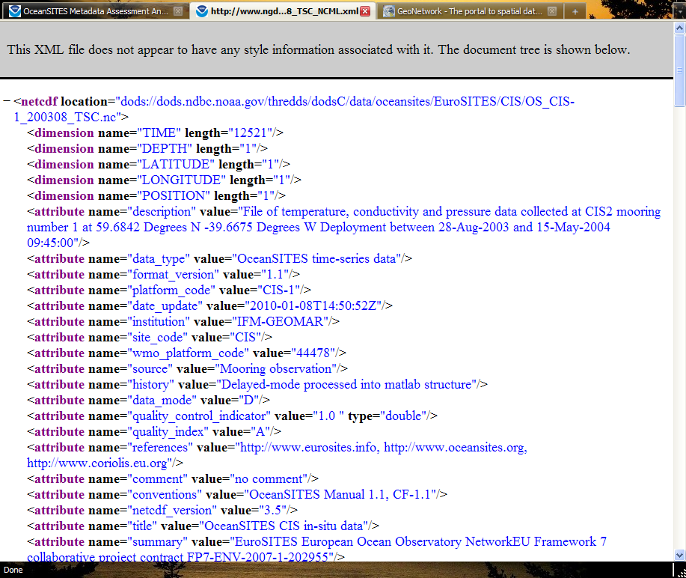
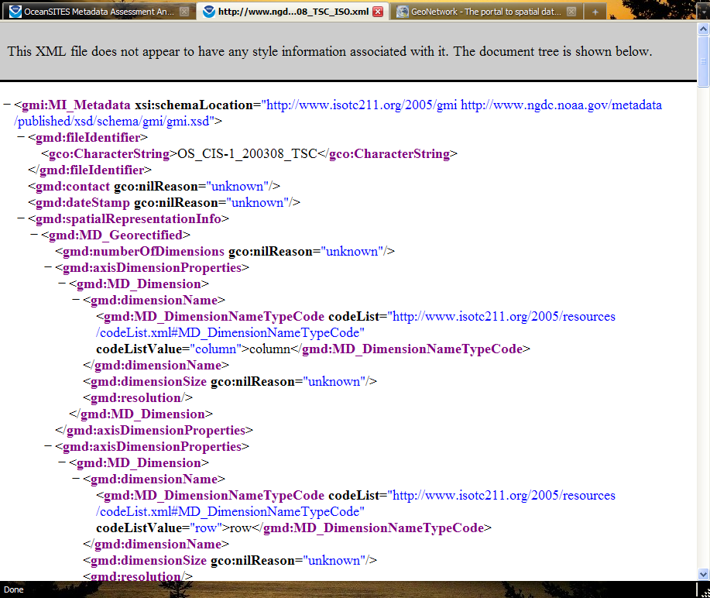
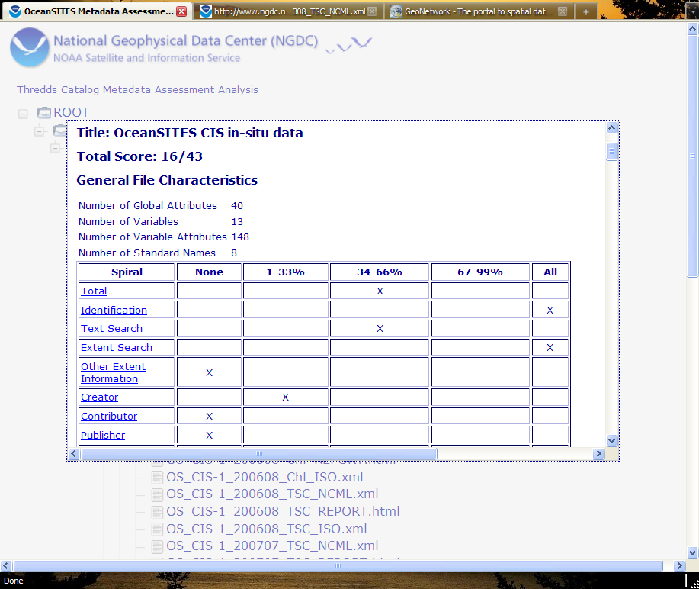
Documentation in Three Dialects
NcML
Documentation
Repository
Spiral Tracker

Slide 8
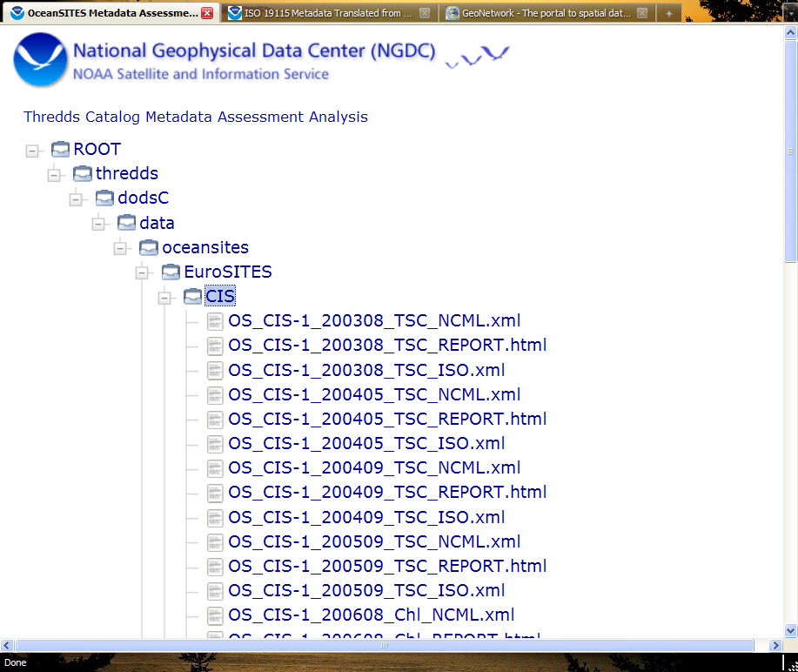
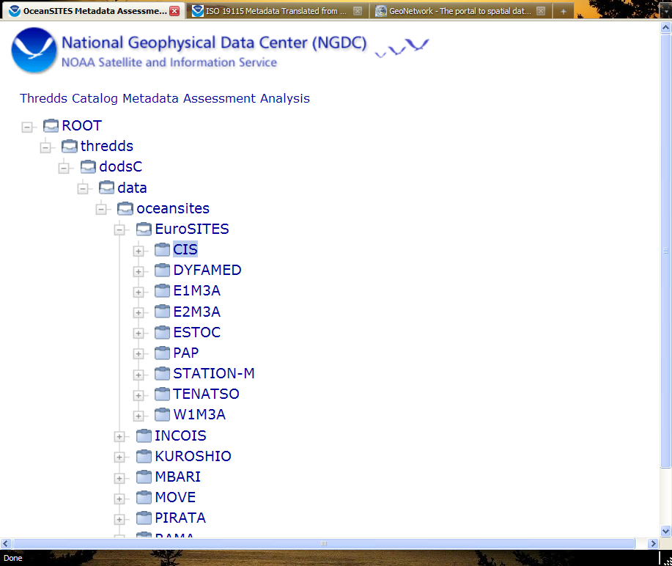
Multiple Dialects: Documentation Extraction
NcML
HTML
Spiral Tracker
Documentation
Repository
ISO XML
THREDDS
Catalogs
file.nc
file.nc
file.nc
file.nc
Notes:
OceanSITES documentation exists in netCDF files that are accessible through THREDDS Catalogs. What can we do with that documentation?
We have a THREDDS Catalog Crawler that identifies files (or datasets) in catalogs and extracts the NcML from those files. That NcML is then translated using standard XML tools (XSLT) into:
1) A rubric that examines the NcML for fields that are recommended by the Unidata Data Discovery

Slide 9

https://www.nosc.noaa.gov/dmc/swg/wiki/index.php?title=ncISO ted.habermann@noaa.gov

