Slide 1
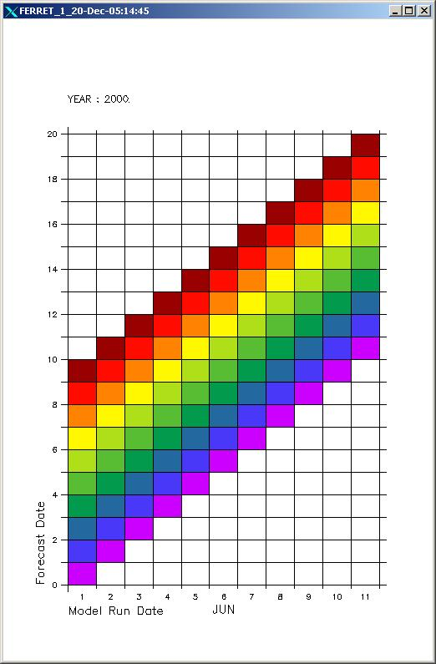
Forecast Model Run Collections and ISO
Ted Habermann
There has been considerable discussion of describing multiple times in forecast datasets
This is not the only challenge:
Dimensions
Shapes
Variables

Slide 2
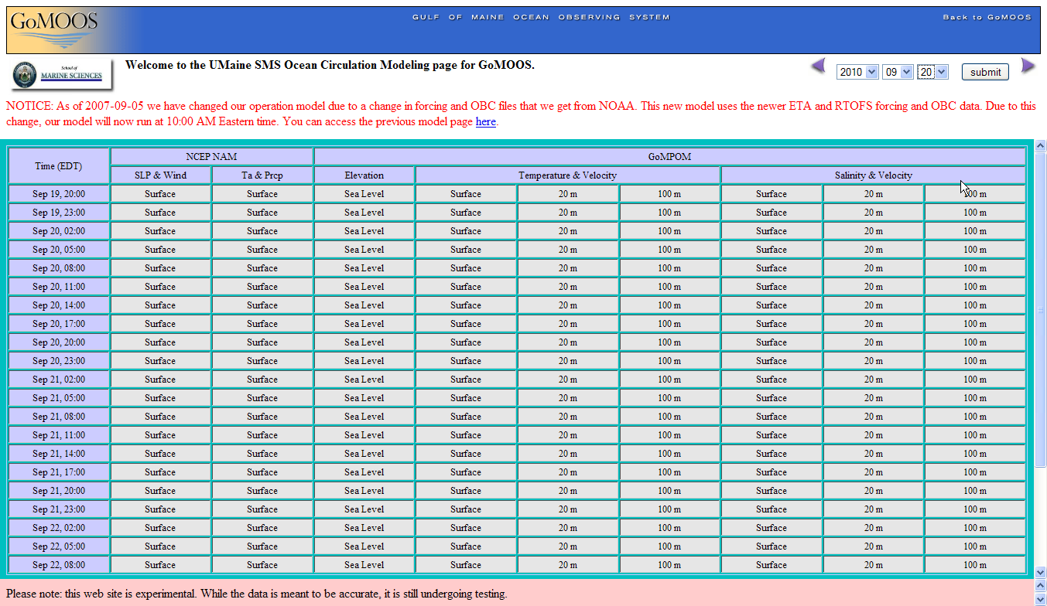
University of Maine Circulation Model
RunTime
Variables
ForecastTime

Slide 3
Dimensions
<dimension name="runtime" length="1753" />
<dimension name="time" length="21" />
<dimension name="ypos" length="120" />
<dimension name="xpos" length="180" />
<dimension name="zpos" length="22" />
5 dimensions in a single dataset can be combined in any way to describe the shapes of variables

Slide 4
Variables and Shapes
6 different shapes in a single dataset
<variable name="xpos" type="float" shape="xpos">
<variable name="ypos" type="float" shape="ypos">
<variable name="zpos" type="float" shape="zpos">
<variable name="runtime" type="String" shape="runtime">
<variable name="time" type="double" shape="runtime time">
<variable name="x" type="float" shape="ypos xpos">
<variable name="y" type="float" shape="ypos xpos">
<variable name="h1" type="float" shape="ypos xpos">
<variable name="h2" type="float" shape="ypos xpos">
<variable name="ang" type="float" shape="ypos xpos">
<variable name="depth" type="float" shape="ypos xpos">
<variable name="depth_at_sigma" type="float" shape="zpos ypos xpos">
<variable name="elev" type="float" shape="runtime time ypos xpos">
<variable name="ua" type="float" shape="runtime time ypos xpos">
<variable name="va" type="float" shape="runtime time ypos xpos">
<variable name="heat_flux" type="float" shape="runtime time ypos xpos">
<variable name="salt" type="float" shape="runtime time zpos ypos xpos">
<variable name="temp" type="float" shape="runtime time zpos ypos xpos">
<variable name="vv" type="float" shape="runtime time zpos ypos xpos">
<variable name="am" type="float" shape="runtime time zpos ypos xpos">
<variable name="u" type="float" shape="runtime time zpos ypos xpos">
<variable name="v" type="float" shape="runtime time zpos ypos xpos">
<variable name="w" type="float" shape="runtime time zpos ypos xpos">
Shapes | Dimensions | Variables
xpos, ypos, zpos, runtime | 1 | xpos, ypos, zpos, runtime
runtime time | 2 | time
ypos xpos | 2 | x,y,h1,h2,ang,depth
zpos ypos xpos | 3 | depth_at_sigma
runtime time ypos xpos | 4 | elev, ua, va, heat_flux
runtime time zpos ypos xpos | 5 | salt, temp, vv, am, u, v, w

Slide 5
NcML -> ISO 19115
Dimensions and Shapes = gmd:spatialRepresentationInfo
Variables = gmd:contentInfo
MD_ReferenceSystem
MD_MetadataExtensionInformation
MD_SpatialRepresentation
MI_Metadata
MD_MaintenanceInformation
MD_DataQuality
One MI_Metadata for each shape
Scope = dimensionGroup
+ fileIdentifier [0..1] : CharacterString
+ language [0..1] : CharacterString
+ characterSet [0..1] : MD_CharacterSetCode = "utf8"
+ parentIdentifier [0..1] : CharacterString
+ hierarchyLevel [0..*] : MD_ScopeCode = "dataset"
+ hierarchyLevelName [0..*] : CharacterString
+ contact [1..*] : CI_ResponsibleParty
+ dateStamp : Date
+ metadataStandardName [0..1] : CharacterString
+ metadataStandardVersion [0..1] : CharacterString
+ dataSetURI [0..1] : CharacterString
+ locale [0..*] : PT_Locale
MD_Distribution
MD_Identification
MD_ContentInformation
MD_Constraints
MD_PortrayalCatalogueReference
MD_ApplicationSchemaInformation

Slide 6
ISO Aggregations
MI_Metadata
+ seriesMetadata
1..*
+has
1..*
+ series 0..*
+ describes
0..*
+ superset 0..*
<<Abstract>>
DS_Aggregate
+ part of 0..*
DS_DataSet
MultipleAggregation
+ composedOf
1..*
+ subset 0..*
DS_OtherAggregate
DS_Series
DS_Initiative
DS_StereoMate
DS_Platform
DS_Sensor
DS_ProductionSeries

Slide 7
ISO Aggregations
MI_Metadata
(from Metadata entity set information)
+has
1..*
+ seriesMetadata
1..*
<<Abstract>>
DS_Aggregate
DS_DataSet
+ composedOf
1..*
DS_OtherAggregate

Slide 8
ISO Metadata Structure
<gmd:DS_OtherAggregate>
<gmd:composedOf>
<gmd:DS_Dataset>
<has>
<gmi:MI_Metadata> <!-- Metadata for shape 1 -->
</has>
<has>
<gmi:MI_Metadata><!-- Metadata for shape 2 -->
</has>
</gmd:DS_Dataset>
</gmd:composedOf>
<gmd:seriesMetadata><!-- Metadata for the entire FMRC -->
</gmd:DS_OtherAggregate>

Slide 9
dimensionGroup (shape) MI_Metadata
<gmi:MI_Metadata> <!-- Metadata for shape 1 -->
<gmd:fileIdentifier = shape name (shape 1)>
<gmd:hierarchyLevel = dimensionGroup>
<gmd:hierarchyLevelName = shape name (shape 1)>
<gmd:spatialRepresentation>
<!-- References to dimensions that make up shape 1 -->
</gmd:spatialRepresentation>
<gmd:identificationInfo xlink:href="#seriesIdentification"/>
<gmd:contentInfo>
<!-- Descriptions of variables with shape 1 -->
</gmd:contentInfo>
</gmi:MI_Metadata>

Slide 10
seriesMetadata
<gmd:seriesMetadata> <!-- Metadata for the entire FMRC -->
<gmd:MD_ScopeCode = dataset>
<gmd:spatialRepresentation>
<!-- Descriptions of dimensions that make up all shapes -->
</gmd:spatialRepresentation>
<gmd:identificationInfo id="#seriesIdentification">
<gmd:Citation>
<gmd:descriptiveKeywords>
<gmd:extent>
</gmd:identification>
<gmd:contentInfo>
<!-- Descriptions of variables with no shape -->
</gmd:contentInfo>
</gmd:seriesMetadata>

Slide 11

Questions?
Notes:
Questions?
Contact ted.habermann@noaa.gov.

