Slide 1
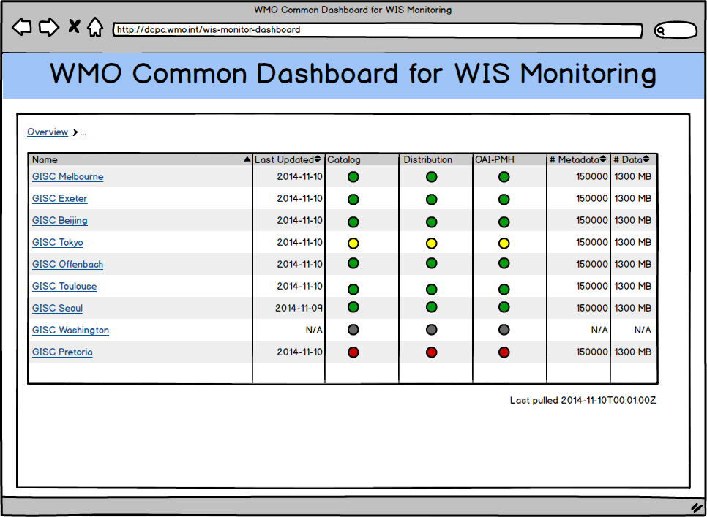



Overview of the WIS Monitoring Project
Introduction
The WIS Monitoring Project is a collective effort of all WIS Centres to provide comprehensive and up-to-date information that enable reports on system status including availability, stability, integrity and so on.
Monitoring messages are pulled from GISC centres all around the world as JSON messages. The messages are aggregated and displayed in a centralized web portal.
DCPC
GISC
NC
DCPC
GISC
NC
DCPC
GISC
JSON
JSON
NC
JSON
JSON
GISC
DCPC
JSON over
HTTP (pull)
NC
GISC Area of Responsibility
WMO Common
Dashboard
JSON
DCPC
DCPC
GISC
Aggregate
Display
DCPC
DCPC
JSON
GISC
Monitor
NC
NC
HTTP
NC
NC
GISC
DCPC
Monitor
NC
Users
The Architecture of the WIS Monitoring Project
The complete WIS monitoring network includes all three types of Centres (GISC, DCPC and NC).
The WMO Common Dashboard (WCD) is responsible for gathering monitoring information from GISCs and publishing the results through a web site.
Each GISC in turn needs to gather and aggregate monitoring information from its area of responsibility (DCPCs and NCs).
The receiver of the monitoring information is responsible for initializing pull requests for the information, while the provider must ensure the presence of the information before the agreed time.
Information is exchanged at least once per day.
All information is exchanged as JSON messages.
Simplified Architecture for WIS Monitoring Pilot
The pilot focuses on a limited set of system stats and involves mainly the GISCs.
The WMO Common Dashboard (WCD) is a product of the pilot project aiming to demonstrate and justify the design, architecture and technologies.
GISC
GISC
GISC
WMO Common
Dashboard
Users
monitor.json
{
"centre": "GISC ABCD",
"metrics": {
"services": {
"catalogue": {
"status": true
},
"distribution_system": {
"status": true
},
"oai_pmh": {
"status": true
}
},
"cache_24h": {
// ... ...
},
"metadata_catalogue": {
// ... ...
}
},
"gisc_properties": {
"events_url": "http://gisc_abcd.org/events.json",
"centres_inAoR_url": "http://gisc_abcd.org/centres.json",
},
"timestamp": "2015-05-11T00:00:01Z",
// ...
}
The Exchanged Monitoring Information
JSON over HTTP (pull request)
Three JSON files, one mandatory and two optional (mandatory JSON elements and file are emphasized with bold font in the follow list)
  monitor.json
    Services status (catalogue, distribution, OAI-PMH)
    Snapshot of content holdings at 00 UTC (number of total metadata, data, placeholder metadata, etc.)
    Accumulated daily network traffics from (number of insertion/update, deletion)
    Metadata about the GISC (name, contact, etc.) and the JSON file (version, timestamp, etc.)
    Addresses of other two monitoring JSON files
  centres.json
    Accumulated daily data/product traffics from each centres in GISC's area of responsibility
  events.json
    Events announcement (duration of maintenance, down time, etc.)
centres.json
{
"centres": [
{
"count": 100,
"volumesize": 80000,
"centre": "Centre X"
}
// ... ...
]
// ... ...
}
events.json
{
"events": [
{
"id": 1,
"title": "...",
"text": "... ...",
"start": "2015-05-30T00:00:00Z",
"end": "2015-05-31T00:00:00Z"
}
// ... ...
]
// ... ...
}

