Slide 1
I.R of Iran Meteorological Organization (IRIMO)
Existing System And Solution to Connecting RMDCN Network

Slide 2
IRIMO Existing Telecommunication Systems

Slide 3
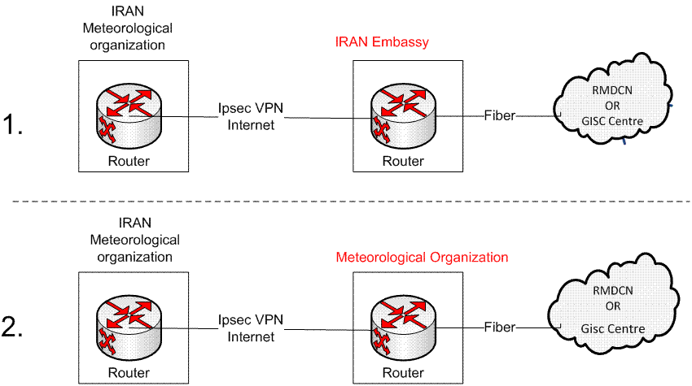
IRIMO Solution Based on IPSEC Internet

Slide 4
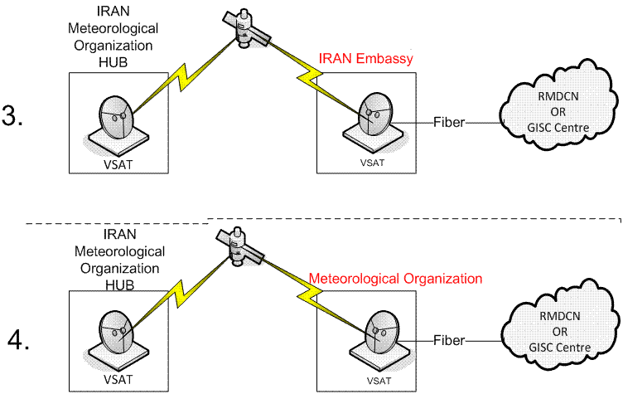
IRIMO Solution Based on Satellite

