Slide 1
WIGOS
The WMO Foundation for Meeting the Observing Needs of Weather, Climate, Water and Environmental Services
RA I Sub-Regional Workshop on WIGOS and WIS
Brazzaville, April 29- May 2 2014
Dr L.P. Riishojgaard,
WIGOS Project Manager, WMO Secretariat

Slide 2
Outline
  What is WIGOS and why do we need it?
  WIGOS Framework & Implementation:
    WIP
    WIGOS Key Areas
    Regional level
    National level
  What is needed
  Conclusions
WMO

Slide 3
What is WIGOS?
A framework for integrating all WMO observing systems and WMO contributions to co-sponsored observing systems.
A WMO Strategic Priority Area
Together with the WMO Information System (WIS), WIGOS is a WMO contribution to GEOSS.
WIGOS is not:
  Replacing or taking over existing observing systems, which will continue to be 'owned' and operated by a diverse array of organizations and programmes, national as well as international.

Slide 4
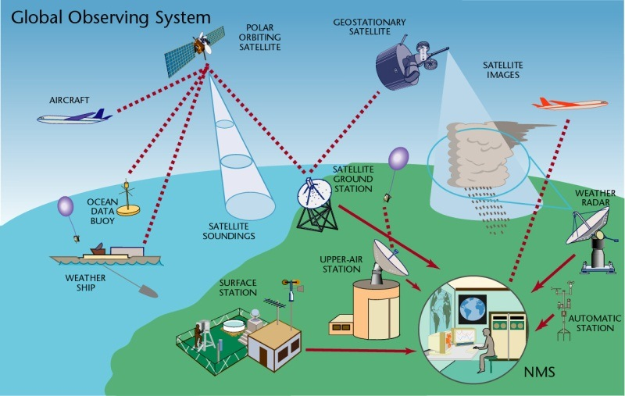
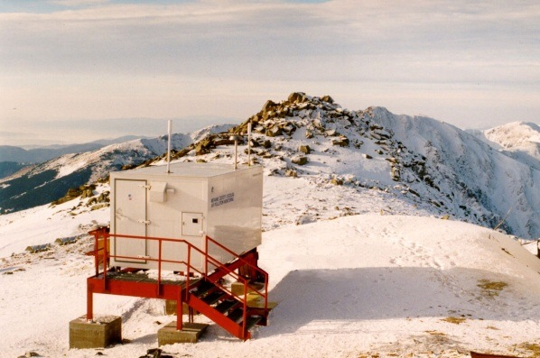
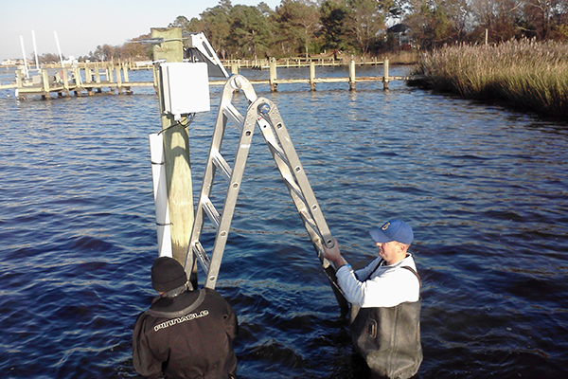
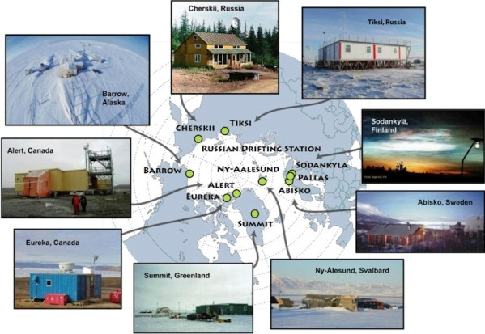
WIGOS Component Systems
Global Observing System
(WWW/GOS)
Observing component of Global Atmospheric Watch (GAW)
WMO Hydrological Observations
(including WHYCOS)
Observing component of Global Cryosphere Watch (GCW)

Slide 5
Why WIGOS?
The mandate of modern NMHS’s (Met Services) is much broader now than it was when WWW and the GOS were created, e.g.
  Climate monitoring, climate change, mitigation
  Air quality, atmospheric composition from urban to planetary scales
  Oceans
  Cryosphere
  Water resources
Advances (scientific and technical):
  Observing technology
  Telecommunications
  Numerical modeling and data assimilation
  Increased user demand to access and use observations in decision making

Slide 6
Why WIGOS (continued)?
Shortcomings of the current situation:
  Observing networks/systems not sustainable and stable,
  Design and planning not well coordinated,
  Observing standards not respected (and in some cases not well defined)
  Databases not integrated or interoperable, including metadata,
  Deficiencies in Quality Management (maintenance, monitoring, reporting, ...)
  Lack of qualified and trained staff;
Through coordinated data sharing and networks/systems development, Members will be better equipped to address existing deficiencies and to meet future challenges

Slide 7
WIGOS Implementation
The WIGOS framework is implemented to enable the integration, interoperability, optimized evolution and best practice operation for all WMO observing systems and WMO contribution to co-sponsored systems.
WIGOS relies on the WMO Information System (WIS) for continuous and reliable access to observational data and products, and associated metadata.
Notes:
Framework that describes processes, principles, procedures and practices to be included in the WMO Technical Regulations (WMO-No. 49) & Guides on WIGOS and other relevant documentation;

Slide 8
WIGOS Framework Implementation Plan (WIP)
CONTENTS
KEY ACTIVITY AREAS
  Management of WIGOS implementation
  Collaboration with WMO co-sponsored observing systems & international partners
  Design, planning and optimized evolution
  Observing System operation and maintenance
  Quality Management
  Standardization, system interoperability and data compatibility
  The WIGOS Operational Information Resource
  Data and metadata management, delivery and archival
  Capacity development
  Communications and outreach
Introduction and Background
Key Activity Areas for WIGOS Implementation
Project Management
Implementation
Resources
Risk Assessment / Management
Outlook
Annexes

Slide 9
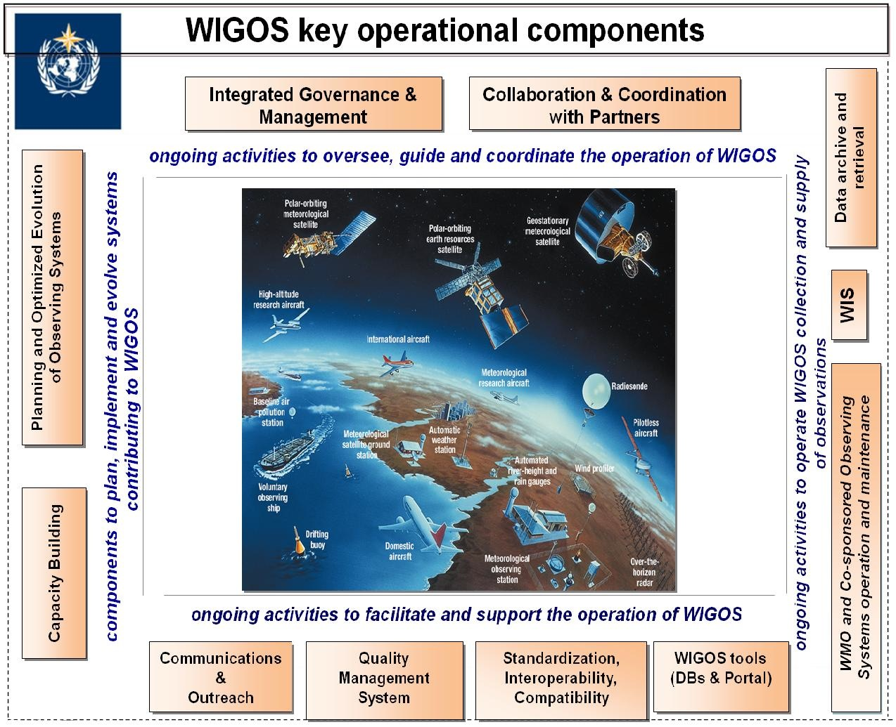

WIGOS Key areas
Management of WIGOS Implementation / operation
Collaboration with co-sponsors and partners
To oversee, guide and coordinate WIGOS
Data discovery, delivery & archival
Design, planning and optimised evolution
To ensure supply of and access to WIGOS observations
To plan, implement and evolve WIGOS component systems
Observing system operation & maintenance
Quality Management
To facilitate and support the operation of WIGOS
Communications and outreach
Capacity Development
Operational Information Resource
Standardization, interoperability & compatibility

Slide 10
Implementation Steps - Regional Level
Identify major issues of the Region (& its Sub-regions): observational challenges, critical gaps and solutions against the identified services priorities of the Region/Sub-regions;
Indicate the best/appropriate working approach for the Region / Sub-region taking advantage of on-going/planned initiatives, activities, groupings, projects (synergy of them) to address requirements, needs, priorities & associated challenges, respecting specifics of each Subregion;
Propose potential solutions against the identified services priorities of the Region/Sub-regions;

Slide 11
Implementation Steps - Regional Level
Develop R-WIP:
  Identify implementation activities for WIGOS Key Activity Areas;
  Align R-WIP with major regional / subregional & national activities and harmonized aid-funded on-going national/bilateral/subregional projects;
  Align R-WIP-I with all WMO Priorities (GFCS-IP, CB/CD, DRR), and GCOS-IP, EGOS-IP;
  Propose bilateral or multilateral Sub-regional projects, or inter-regional projects (e.g. between RA I & VI / RA I & II);
  Align with existing funding and look for funding opportunities;
Identify appropriate mechanism for implementation of agreed tasks and projects.
Identify Resources and potential Donors

Slide 12
Regional WIGOS Implementation Plan
for Region I (R-WIP-I)
Draft exist
The plan is to have R-WIP-I adopted by the RA-I Session in November 2014
The key element of the R-WIP is section 2, listing the ten main activity areas of the WIGOS implementation, with a regional focus
One of the main goals of the present Workshop is to identify and list any WIGOS implementation steps of particular relevance to the sub-region

Slide 13
WIGOS Framework Implementation Plan (WIP)
CONTENTS
KEY ACTIVITY AREAS
  Management of WIGOS implementation
  Collaboration with WMO co-sponsored observing systems & international partners
  Design, planning and optimized evolution
  Observing System operation and maintenance
  Quality Management
  Standardization, system interoperability and data compatibility
  The WIGOS Operational Information Resource
  Data and metadata management, delivery and archival
  Capacity development
  Communications and outreach
Introduction and Background
Key Activity Areas for WIGOS Implementation
Project Management
Implementation
Resources
Risk Assessment / Management
Outlook
Annexes

Slide 14
What are the main challenges in WIGOS for the Central Africa sub-region?
This is for the Workshop to map out!
One example: Availability of upper-air observations over the sub-region
  According to the Fifth WMO Impact Workshop (Sedona, 2012), the radiosonde and AMDAR network are both among the five most important observing systems overall
  One of the few direct measurements of winds
  Especially in the tropics, wind measurements are indispensable; flow cannot readily be inferred from temperature measurements
  These data are important for all WMO members, not just for the sub-region itself

Slide 15
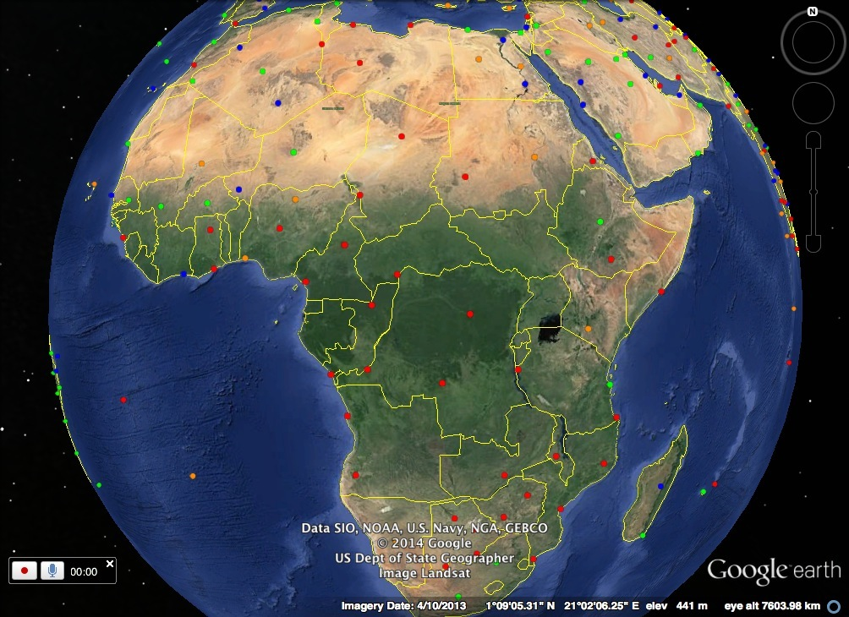

Slide 16
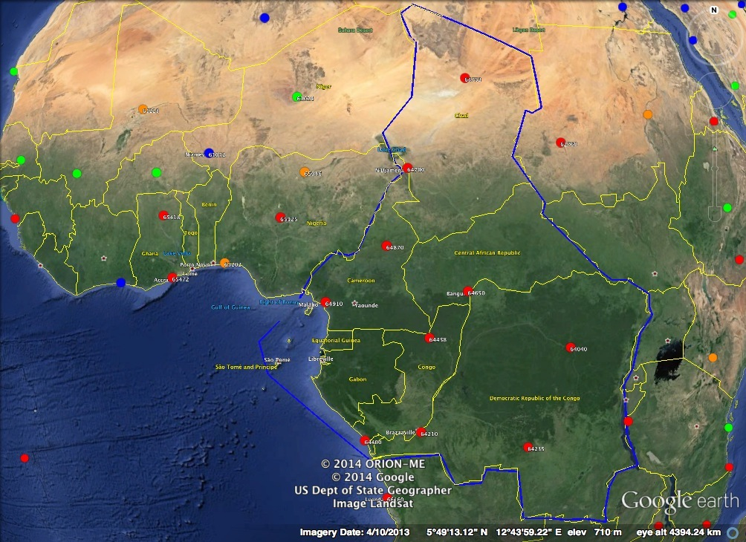

Slide 17
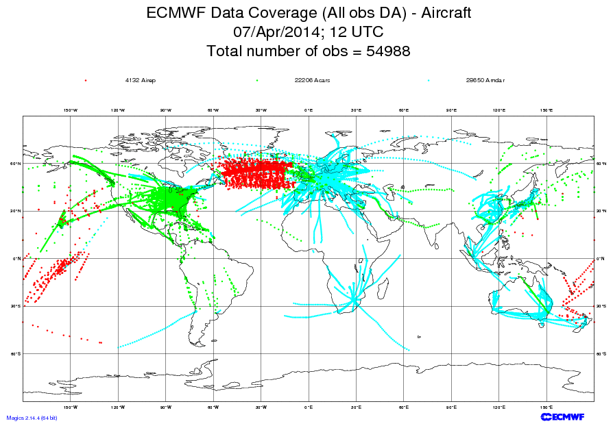

Slide 18
Challenge to the Workshop:
Can we identify concrete steps to mitigate this situation?
  Telecommunications issues
  Reduction of the number of stations and focusing resources on the ones that remain
  Expansion of the AMDAR network, including ascent/descent profile observations
  Can improved and increased use of satellite data help out?
  Other ideas? …

Slide 19
What does WIGOS mean at a National level?
N-WIGOS must be aligned with national needs/priorities (strategic and operational):
  NMS Strategy & Plan drive N-WIP
  N-WIP has to take such a Strategy & Plan into account and built on it
N-WIP must be consistent with:
  WIP and R-WIP (Key Activity Areas),
  GCOS-IP, EGOS-IP, GFCS-IP;

Slide 20
National leadership through WIGOS
WIGOS and WIS provide means & opportunities:
  To enhance national observing networks for benefit of all users
  To enhance sharing and accessibility of observations
  To reinforce central role of NMHS through partnerships & a network of networks
  To strengthen national mandate and authority
Strong national coordination & cooperation will assist in building strong regional coordination & cooperation

Slide 21
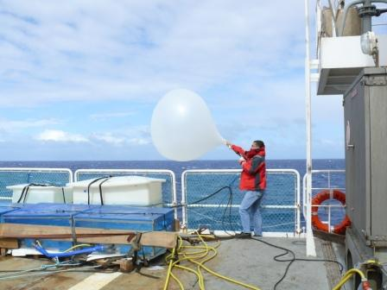
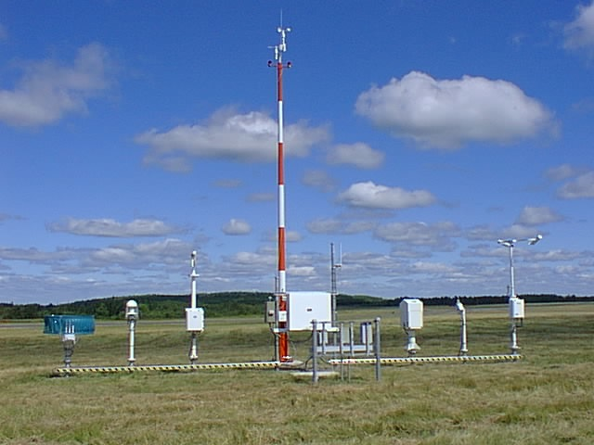
Observing Practices & Procedures
Standards and recommendations for instruments and methods of observation;
All aspects of observations and observing systems:
  establishment and installation;
  management and operation;
  maintenance, inspection and supervision;
  delivery & sharing of observations;
  data and metadata management (pre-processing & processing, QC, monitoring, remedial actions, …)
Data Quality: 'fit-for-purpose' ideal
Documenting known quality is key.

Slide 22
In conclusion…
WIGOS will not fix all problems of current national/regional observing systems/networks, but
WIGOS will lay down a framework that allows Members to start addressing the current problems in a systematic, coordinated, sustainable, efficient and effective way.

