Slide 1
 |  | Status and Plans of RMTN in RA V (For report to ICT-ISS Sep 2010) |  |  |  |  | Report any changes since Dec 2009 or post-RMDCN migration (Updates to be shaded in Yellow)
No | Circuit ID Site A (upper) Site B (lower) | Type of GTS | Constitution | Access Port Speed [bps] | Expected Trans Speed [bps] | Types of Trans Data | Procedures | Number of Trans Connections | Allocation Scheme of Link Addresses | Routing Protocol
1 | Melbourne (AMMC) | A | IP-VPN | 2M | 2M | AN, BI(500k), FX, FL(sat) | IP(soc, ftp) | 3(soc) 1(ftp) | Official-IP (self) | Dynamic (bgp)
 | Tokyo (RJTD) |  |  | 3M | 3M | AN, BI(500k), FX, FL(sat) | IP(soc, ftp) | 3(soc) 1(ftp)
2 | Melbourne (AMMC) | A | IP-VPN | 2M | 2M | AN, BI(500k), FX, FL(sat) | IP(soc, ftp) | 3(soc) 2(ftp) | Official-IP (self) | Dynamic (bgp)
 | Exeter (EGRR) |  |  | 2M | 2M | AN, BI(500k), FX, FL(sat) | IP(soc, ftp) | 3(soc) 2(ftp)

Slide 2
Circuits to be changed in RMTN diagram (Sep 2010) (Column A to be shaded in Orange)
Backup Solutions | Supplier(s) | Type of Contract & Payment with supplier(s) | Remarks | Plans | Additional information for the Site Outing / Incoming Circuits Internal Circuit ID and Data Type
DualAccs | Orange Business Service (OBS) | Contract: One-stop (Master-contract between ECMWF and OBS, Accession agreement between each center and OBS) Payment: Multi-end payment to UK OBS in UK pound | # 3 socket connections at each site correspond to 3 types of data (Text, Binary, Chart) # 1 ftp connection for RARS-ATOVS to RJTD # 1 ftp connection for RARS-ATOVS to AMMC # IMTN cloud II (OBS MPLS-IP/VPN) # Re-routing via Washington # Re-routing of Tokyo GTS messages via Exeter on internet terminated on 24 Aug 2010 # Canberra Data Centre (CDC) acts as a DRS site for Melbourne | # Migrated to IP-VPN (MPLS) 19 November 2009 | Socket connections on RMDCN ATK01, BTK01, CTK01 ftp connection on RMDCN DTK01 (RARS)
DualAccs Re-Rout(ptcl) |  |  |  |  | Socket connections on RMDCN TKA01, TKB01, TKC01 TKD01 (RARS) ftp on internet JMA01 (GSM 1.25)
DualAccs Re-Rout(ptcl) | Orange Business Service (OBS) | Contract: One-stop (Master-contract between ECMWF and OBS, Accession agreement between each center and OBS) Payment: Multi-end payment to UK OBS in UK pound | # 3 socket connections at each site correspond to 3 types of data (Text, Binary, Chart) # 1 ftp connection for satellite files to AMMC # 1 ftp connection for TOVS, SSMI IASI (Level 1d) files to AMMC via internet # 1 ftp connection for GPS occultation data (GTS format) to AMMC via internet # 1 ftp connection for ppn GRIB to AMMC via internet # 1 ftp connection for satellite files to EGRR # 1 ftp connection for satellite files and RARS-ATOVS to EGRR via internet # IMTN cloud II (OBS MPLS-IP/VPN) # Exeter backup on internet terminated on 24 Aug 2010 # Canberra Data Centre (CDC) acts as a DRS site for Melbourne | # Migrated to IP-VPN (MPLS) 17 November 2009 | Socket connections on RMDCN AUK01, BUK01, CUK01 ftp on RMDCN DUK01 (sat) ftp connection for RARS on internet EUK01 (RARS)
DualAccs Re-Rout(ptcl) |  |  |  |  | Socket connections on RMDCN UKA01, UKB01, UKC01 ftp connection for sat files on RMDCN UKD01 (sat) ftp on internet UKE01 (sat, TOVS, SSMI IAS) UKE02 (GPS occultation) RGB01(ppn GRIB)

Slide 3
№ | Circuit | Status | Type of circuit | Circuit speed (bps) |  | Protocol | Data type
 |  |  |  | Moscow side | NHMS side
1 | Exeter | MTN | MPLS | 2 M | 6 M | FTP WMO, Simple FTP | Messages: A/N, BIN, FAX, Files: NOAA satellite data
2 | Prague | MTN | MPLS | 2 M | 5,1 M | FTP WMO | Messages: A/N, BIN, FAX
3 | Sofia | MTN | MPLS | 2 M | 1,5 M | FTP WMO | Messages: A/N, BIN, FAX
4 | New-Delhi | MTN | MPLS | 2 M | 2 M | FTP WMO | Messages: A/N, BIN
5 | Cairo | MTN | Dedicated (digital) | 64 K | 64 K | FTP WMO | Messages: A/N, BIN
6 | Norrkoping | RMTN | MPLS | 2 M | 8,2 M | FTP WMO | Messages: A/N, BIN, FAX
7 | Minsk | RMTN | Dedicated (digital) | 128 K | 128 K | TCP/IP-Socket (Special) | Messages: A/N, BIN, FAX, BIN-RADAR
8 | Kiev | RMTN | Dedicated (digital) | 256 K | 256 K | FTP WMO | Messages: A/N, BIN, FAX, BIN-RADAR

Slide 5
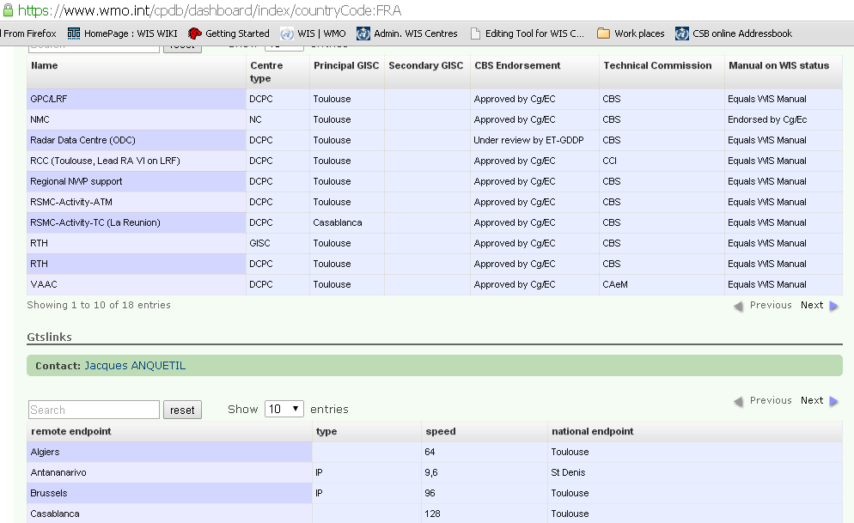
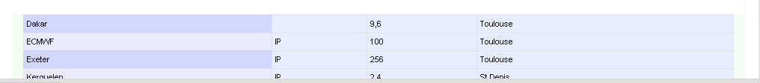

Slide 6
Database Content
Link
Start and end places
Type (Technology) MPLS, VPN over internet, point to point, etc, DVB, v27
Bandwidth (Don't need link speed) - (Frame relay would enter CIR)
Circuit (each access would have an Cntr ID for centre, ID for link , and each circuit would have a sub id or number
  eg Offenbach is OF, and link is 01 Ie rmdcn), circuit would “b” so link would be “OF 01 b” in three columns
Message types (tick boxes in columns) - See slide
  a/n, bin, fax, files, …

