Slide 1
WIGOS Framework Implementation Plan (WIP)
WMO Region III Workshop on WIGOS
Asuncion, May 14 2014
Dr L.P. Riishojgaard,
WIGOS Project Manager, WMO Secretariat

Slide 2
Outline
WMO
  WIGOS Implementation Plan
    Ten key activity areas of the WIP
    Activities at the global level
    (Regional Implementation Plan, R-WIP-III, will be covered by Jose Arimatea)
  Specific focus on items 1, 3 and 7 (Management, Observing System Network Design, and the WIGOS Information Resource)

Slide 3
WIGOS Framework Implementation Plan (WIP)
CONTENTS
KEY ACTIVITY AREAS
  Management of WIGOS implementation
  Collaboration with WMO co-sponsored observing systems & international partners
  Design, planning and optimized evolution
  Observing System operation and maintenance
  Quality Management
  Standardization, system interoperability and data compatibility
  The WIGOS Operational Information Resource
  Data and metadata management, delivery and archival
  Capacity development
  Communications and outreach
Introduction and Background
Key Activity Areas for WIGOS Implementation
Project Management
Implementation
Resources
Risk Assessment / Management
Outlook
Annexes

Slide 4
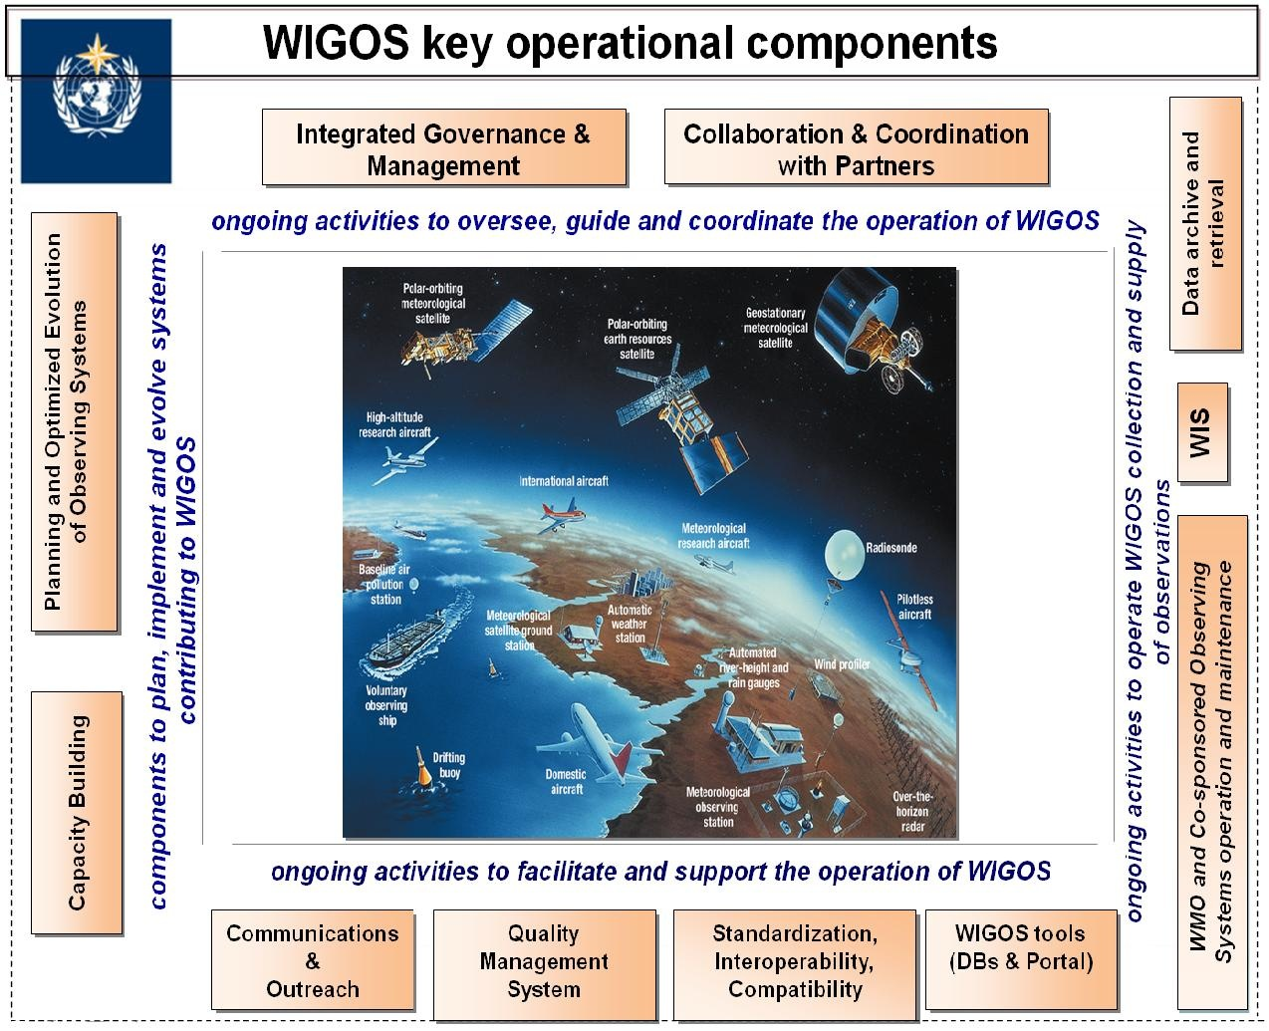

WIGOS Key areas
Management of WIGOS Implementation / operation
Collaboration with co-sponsors and partners
To oversee, guide and coordinate WIGOS
Data discovery, delivery & archival
Design, planning and optimised evolution
To ensure supply of and access to WIGOS observations
To plan, implement and evolve WIGOS component systems
Observing system operation & maintenance
Quality Management
To facilitate and support the operation of WIGOS
Communications and outreach
Capacity Development
Operational Information Resource
Standardization, interoperability & compatibility

Slide 5
  1. Management of WIGOS implementation
WMO
  WIGOS Implementation Plan, Table 2 (selected items):
    Develop/Revise/Update WMO Regulatory Material to include WIGOS Regulations
    Incorporate technical aspects of WIGOS implementation and continuing evolution into existing/new TCs and RAs working structures and procedures
    Develop Regional WIGOS Implementation Plans (R-WIPs)

Slide 6
Current WIGOS Management Structure and Activities
ICG-WIGOS oversees implementation, representation from
  All Technical Commissions
  All Regional Associations
Three Task Teams under ICG-WIGOS:
  Regulatory Material
    Technical Regulations, Manual on WIGOS currently out for review ; sent to all PTCs per decision made at PTC-2015
  Metadata
    Feeding into Regulatory Material, but at a slower pace; TT-WMD will wrap up the initial version of the WIGOS metadata standards this week
  Quality Management
    Team first met in Geneva April 23-24; initial focus on monitoring of observational data quality

Slide 7
  2. Collaboration with WMO co-sponsored observing systems and international partners
WMO
  WIP, Table 2 (selected items):
    Develop guidance, mechanisms and procedures for engagement, coordination and collaboration with partner organizations (to be used on all, global, regional and national levels)
    Develop Collaboration framework for the Architecture for Climate Monitoring from Space (ACMS)

Slide 8
  3. Design, planning and optimized evolution
  WIP, Table 2:
    Complete RRR practices, procedures, responsibilities and mechanisms for all systems and agreed application areas
    Many activities ongoing already, mostly at the global level, under the auspices of CBS, OPAG-IOS, and IPET-OSDE
WMO

Slide 9
Rolling Review of Requirements
The RRR is the WMO process for vetting and recording user requirements for observational data and matching them against existing and planned capabilities, resulting in a gap analysis that can be used for network design activities
The RRR is supported by three key databases of OSCAR, the Observation Systems Capabilities and Review tool :
  OSCAR/Requirements, in which requirements are stated by application area, “technology free”, formulated in geophysical variables, not in terms of measurands
  OSCAR/Space, listing satellite capabilities
  OSCAR/Surface, list surface-based capabilities (not yet developed)
  Close collaboration between WMO and Meteo-Suisse on developing, hosting and maintaining the OSCAR databases; WMO will remain the owner of the information content

Slide 10
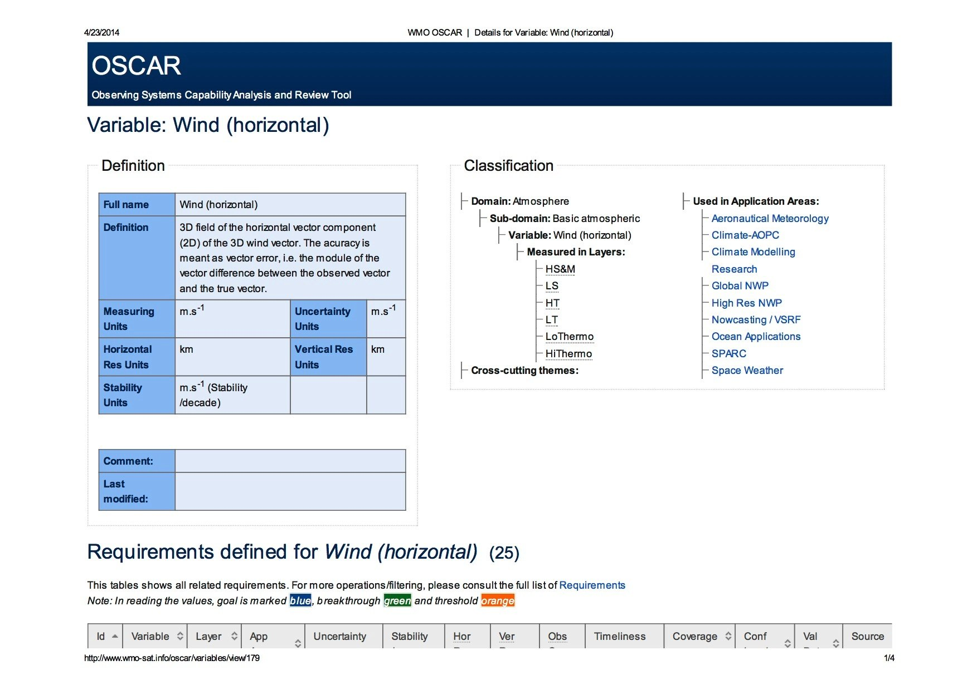

Slide 11
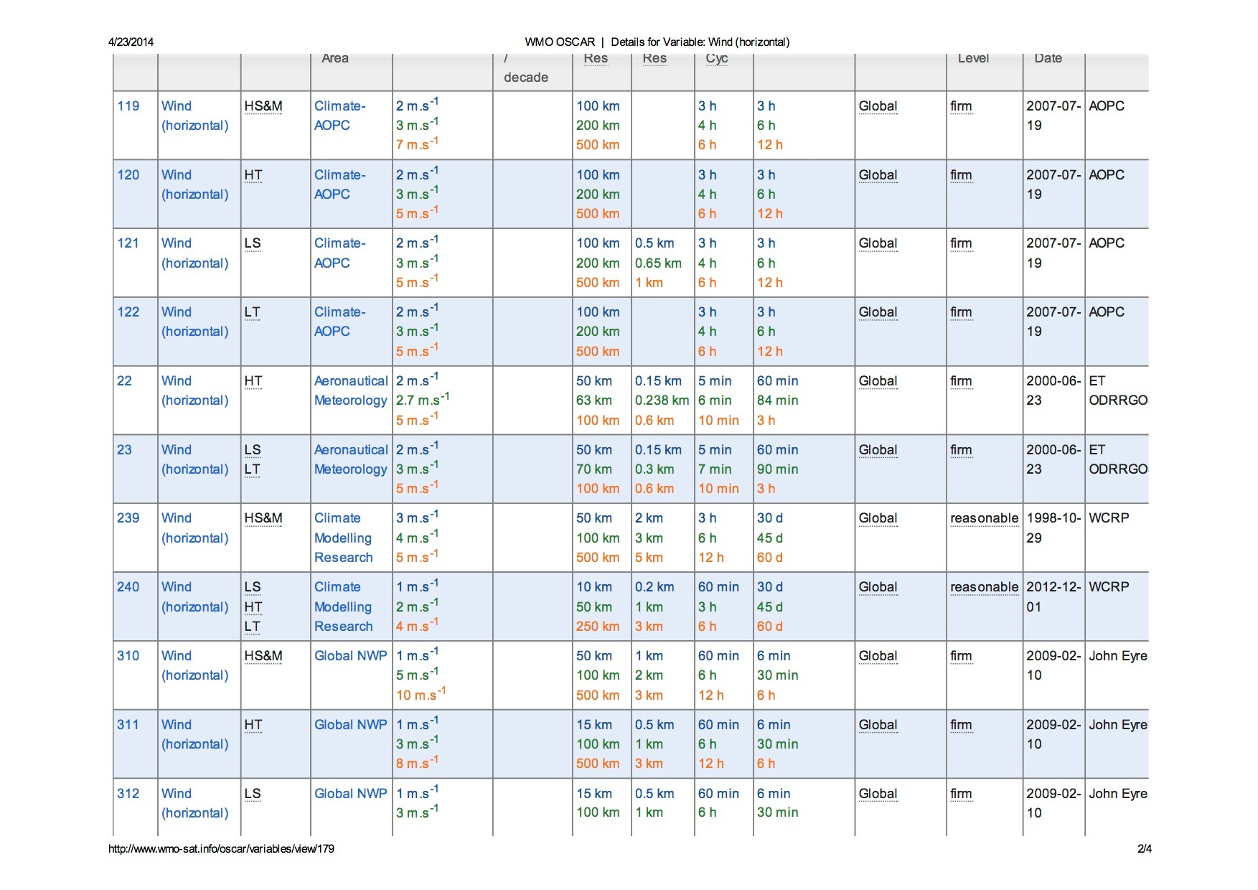

Slide 12
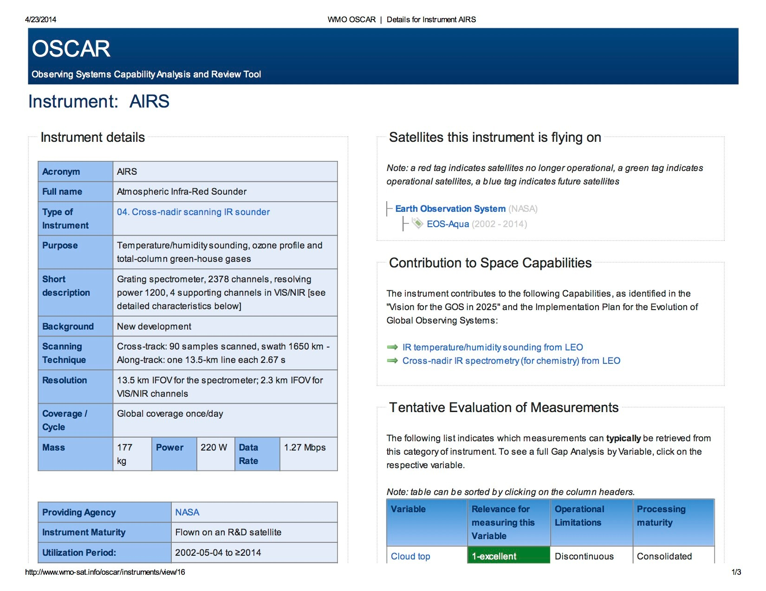

Slide 13
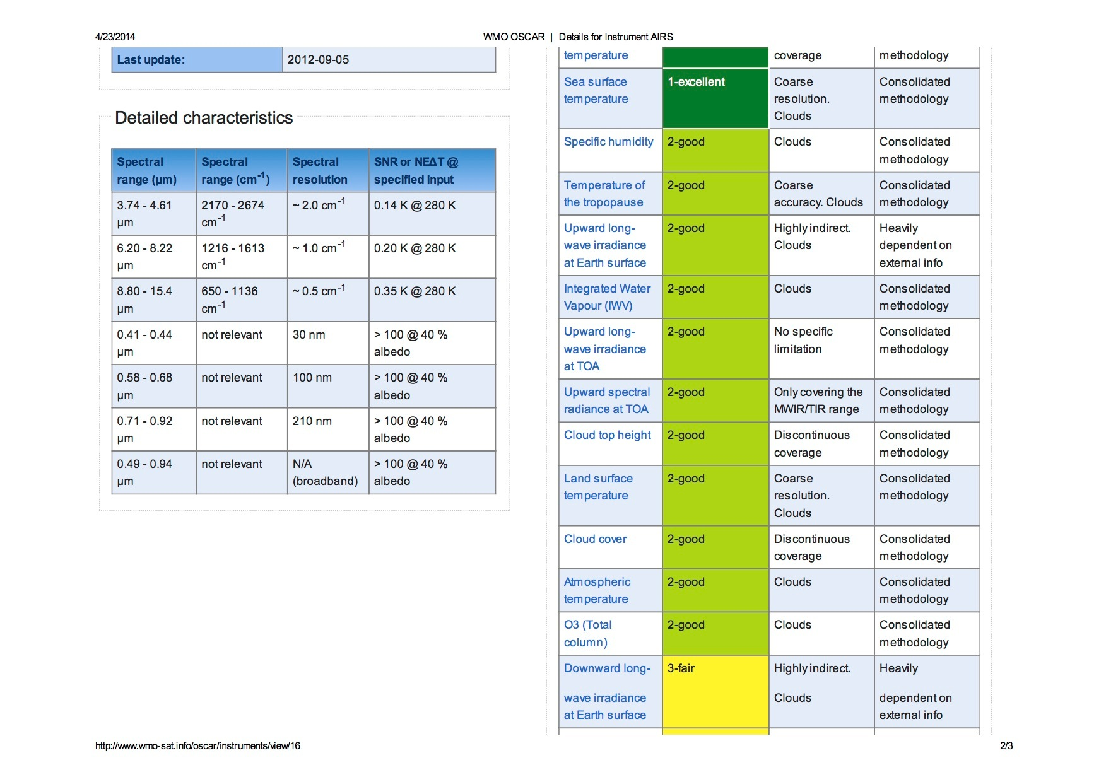

Slide 14
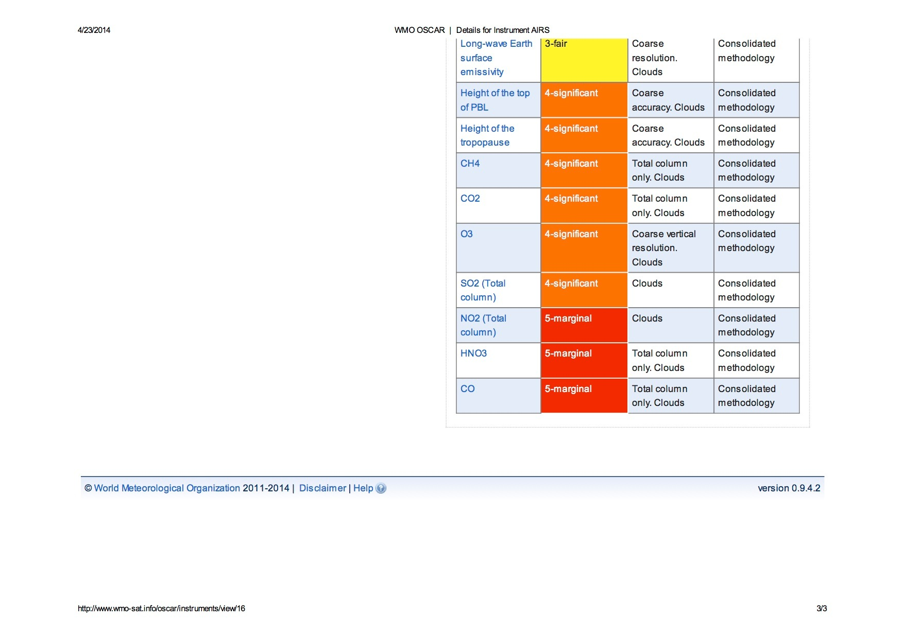

Slide 15
  4.) Observing System operation and maintenance
WMO
  WIP, Table 2:
    Develop guidance, mechanisms and procedures for improved integration of observational data and products
    One specific action proposed under WIP elements 3, 4, and 5 at ICG-WIGOS-3 is a serios of “WIGOS Workshops on Automated Weather Stations”, covering the life cycle of the network (design, procurement, installation, calibration, maintenance, operation, etc.), arranged region by region,

Slide 16
  5.) Quality Management
WMO
  WIP, Table 2:
    Develop WIGOS Quality Management guidance, mechanism, practices and procedures
    ICG-WIGOS-3: Initial focus on revising and modernising the operational monitoring of observational data quality

Slide 17
  6. Standardization, system interoperability and data compatibility
WMO
  WIP, Table 2:
    Develop guidance for WIGOS standards
    Document the implemented standard and recommended practices and procedures on instruments, methods of observation, data products, etc.

Slide 18
  7.The WIGOS Operational Information Resource
WMO
  WIP, Table 2:
    Design and develop the WIGOS Information Resource (WIR)

Slide 19
WIGOS Information Resource (WIR)
One-stop shop for WIGOS information
  Regulatory Material (searchable)
  Standards and best practices
  Other guidance material
  Outreach and communication
  Meeting documents and meeting reports
  Databases to support the WMO Rolling Review of Requirements (RRR)
  Most of the information available in English only at this point
  http://www.wmo.int/pages/prog/www/wigos/wir/index_en.html

Slide 20
  8. Data and metadata management, delivery and archival
WMO
  WIP, Table 2:
    Develop WIGOS metadata standards, practices and procedures

Slide 21
  9. Capacity development
WMO
  WIP, Table 2:
    Develop a WIGOS Capacity Development (WCD) strategy including education and training
    Assistance provided to Members regarding WIGOS implementation
    Develop WIGOS related guidelines and training materials and other relevant documentation
    Mobilize resources for WIGOS implementation

Slide 22
  10. Communications and outreach
WMO
  R-WIP-I:
    Develop an effective WIGOS communications and outreach strategy
    Develop communications and outreach materials

Slide 23
  Summary and Conclusions
WMO
  WIGOS Implementation Plan (WIP)
    Ten key activity areas, each with a set of activities listed, ranging from generic to very specific
    This structure (“list of ten”) is repeated in the Regional WIP for Region III (R-WIP-III)
    Workshop to review and endorse R-WIP-III, and make the initial steps from generic to specific elements of plan

