Slide 1


Slide 2
GISC Status
WIS Portal based on a commercial solution
  Configured as a cluster.
  Data exchange from RTH Message Switching System
  Not connected to the RMDCN yet
  Bilateral agreement with MeteoFrance and DWD to exchange data over the Internet
  Started conversation with RTH Exeter to establish an Internet connection too.

Slide 3
GISC Status
WIS Portal based on a commercial solution
  Configured as a cluster.
  Audited in April 2013
  Semi Operational
  GISC backup: Washington (planned)

Slide 4
Main obstacles for full operation
Lack of human resources (difficulties finding qualified staff or hire new people)
Regional and local advertisement
RMDCN connection

Slide 5
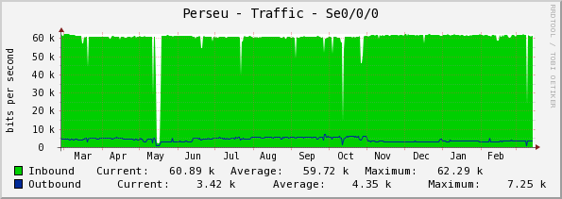
RTH Status
WASHINGTON
MESSAGE SWITCHING
FTP SERVER
POINT-to-POINT
64 kbps
WMO tcp
INPUT: ASC=787.448 – 27 MB; BIN=8.889 – 308 MB
OUTPUT: ASC=1.053 – 1.3 MB; BIN=646 – 2.2 MB
25/02/2014
MESSAGE SWITCHING
FTP SERVER
BRASILIA

Slide 6
RTH Status
MW Cluster
SELINUX
IPTABLES
ANTI VIRUS
ANTI VIRUS
INTERNET
or
point-to-point
IPS/IDS
FIREWALL
FTP SERVER
ANTI SPAM
SELINUX
IPTABLES

Slide 7
RTH Status
DWD, METEOFRANCE
MESSAGE SWITCHING
FTP SERVER
DWD
INPUT: ASC=1.486 – 3,7 MB - FILES = 179
OUTPUT: ASC=213 – 116 kB; FILES = 207
25/02/2014
INTERNET
METEOFRANCE
INPUT: ASC=8.618 – 16 MB; BIN=94 – 137 MB
25/02/2014
32 Mbps
MESSAGE SWITCHING
FTP SERVER
BRASILIA

Slide 8
RTH Status
VPN
AFD
FTP SERVER
INTERNET
INPUT: ASC=815 – 682 kB
OUTPUT: ASC=553 – 818 kB
25/02/2014
32 Mbps
MESSAGE SWITCHING
FTP SERVER
BRASILIA

Slide 9
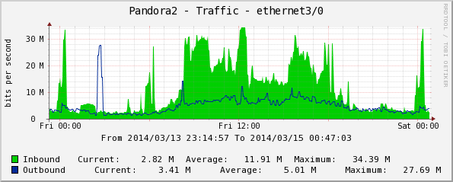
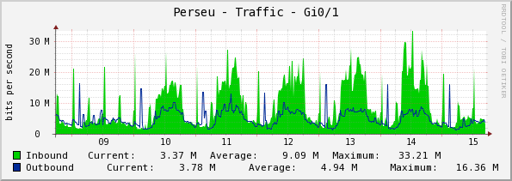
INPUT: 120.078 – 550 MBytes
OUTPUT: 550.427 – 2.7 GBytes
25/02/2014
NEW ACCESS LINK REQUESTED.
100 Mbps

Slide 10
Recommended Text
Replace the physical point-to-point connection between Brasilia and Washington and make it logical via RMDCN.
To look for a common way or method to represent the diagram of connections (spaghetti diagram).

Slide 11
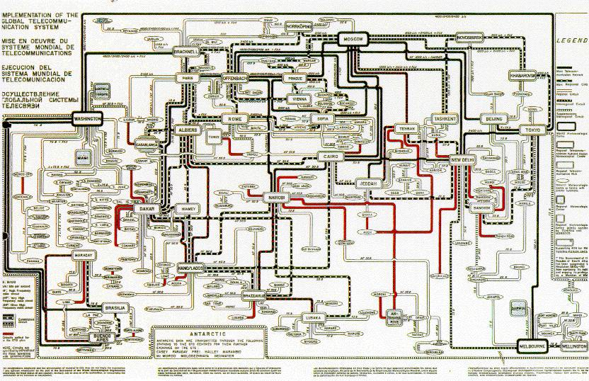
Spaghetti Diagram

Slide 12
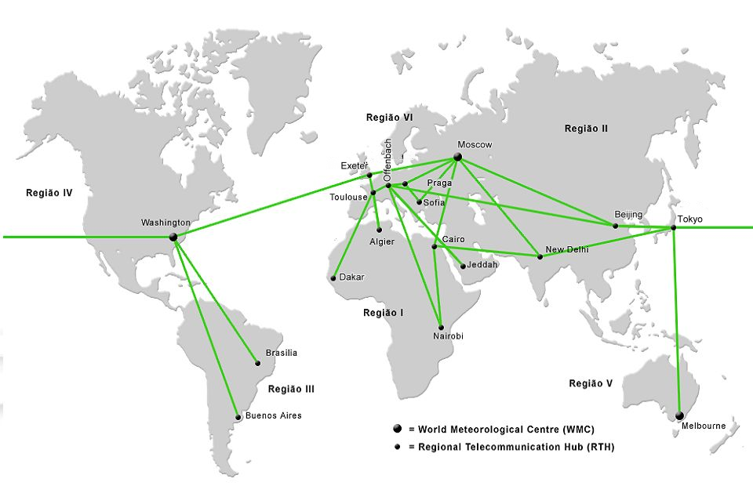
Main Trunk Network

Slide 13


