Slide 1
CAP over the GTS
(WMO's Global Telecommunication System)
Simon Elliott
EUMETSAT
Simon.elliott@eumetsat.int

Slide 2
Distribution of satellite products
EUMETSAT operates meteorological satellites
Satellite data are processed to derive a range of products (images, radiance data, wind information, soil moisture, fire detection, etc.)
Products are produced operationally in near real time in a variety of formats
BUFR - GRIB - JPEG - ASCII - netCDF - HDF

Slide 3
Distribution mechanisms
Several mechanisms are used to distribute satellite products
Global Telecommunication System, GTS
  Global network connecting NMHSs
  Limited access, highly controlled, well established
EUMETCast/GEONETCast
  Satellite DVB-S multi-cast service
  Easy access, many users, almost global coverage
Website access
Archive access

Slide 4
Volcanic Ash Detection
Infrared image data from METEOSAT are processed to detect the presence of volcanic ash
Products could be:
  GRIB or BUFR encoded for NWP community
  Graphically represented (e.g. JPEG) for Volcanic Ash Advisory Centre (VAAC) or internet presentation
  Described with a plain text bulletin or in XML
CAP can be used to encapsulate these formats

Slide 5
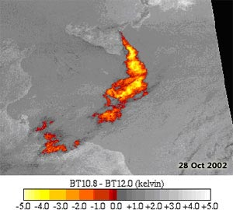
Volcanic Ash on EUMETCast
Style sheet reference
Graphics
CAP message
Text
CAP message contains standard information supplemented by hyperlinks to associated information

Slide 6
Volcanic Ash on GTS
CAP message in XML is wrapped with routing information for the GTS. The wrapper is removed after transfer to the destination to restore the original message.
GTS wrapper
Style sheet reference
Style sheet reference
Style sheet reference
CAP message
CAP message
CAP message
EUMETSAT
NWP Centre

Slide 7
Wrapping of CAP for GTS
<?xml version = "1.0" encoding = "UTF-8"?>
<?xml-stylesheet type="text/xsl“ href="cap_alert_eum.xsl"?>
<alert xmlns = "urn:oasis:names:tc:emergency:cap:1.1">
<identifier>EUM.MET09.VASH.1</identifier>
...
</info>
</alert>
<SOH>\r\n\rnnn\r\r\n[ABH]\r\r\n
<?xml version = "1.0" encoding = "UTF-8"?>
<?xml-stylesheet type="text/xsl“ href="cap_alert_eum.xsl"?>
<alert xmlns = "urn:oasis:names:tc:emergency:cap:1.1">
<identifier>EUM.MET09.VASH.1</identifier>
...
</info>
</alert>
\r\r\n<ETX>

Slide 8
Abbreviated Bulletin Headers for CAP
ABHs have the form
For volcanic ash data in CAP, this could be:
T₁ = W [Warning]
T₂ = V [Volcanic ash clouds (SIGMET)] or O [Other]
A₁A₂ = NT [North Atlantic area, case dependent]
ii = 01 [Essential data as per WMO Resn. 40]
CCCC = EUMG [EUMETSAT/MSG]
YYGGgg = 091345 [date & time, case dependent]
Several choices of T₁T₂ have been considered, including WV, FX, WX and WO. It is important that the data are not confused for an existing product. The most recent suggestion, after consultation with, among others, ICAO is T₁T₂ = WO.

Slide 9
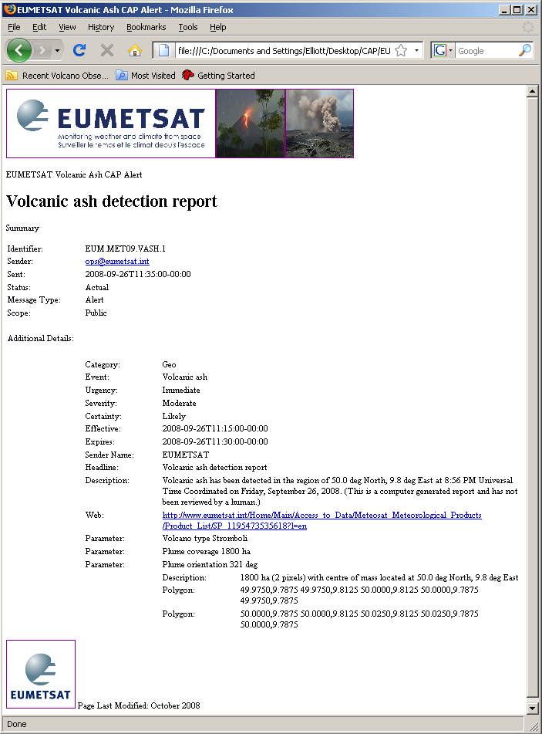
Sample web page containing a volcanic ash CAP message
Display is style sheet dependent

Slide 10
Conclusion
The intrinsic standardisation of CAP ensures syntactic and semantic interoperability of the data
CAP messages can supply the GTS community with information which can be understood and used in a variety of applications and disciplines
Dissemination of volcanic ash products using CAP on the GTS and via EUMETCast/GEONETCast allows one product to meet the requirements of different groups of users

