Slide 1
Metadata Catalogue Consistency
GISC Tokyo/JMA

Slide 2
Catalogue Sync Issues
Basic operation errors
  Add records with old datestamps
  Delete records without issuing “deleted” message
Metadata record representation and/or compatibility with OAI harvester:
  Case sensitive identifiers
  Default namespace declaration in the root element gmd:MD_Metadata
OAI provider implementation:
  Duplicated identifiers in verb=ListIdentifiers response
  Inaccurate datestamps in OAI headers
  Selective harvesting arguments issue

Slide 3
Case sensitive identifiers
Beijing’s response to verb=ListIdentifiers
urn:x-wmo:md:cn.gov.cma::cn.gov.cma.TIGGE.CMA_EPS.null.glob.cf.001.pl.0500.0036.t.grib2
Datestamp: 2013-08-04T11:06:56Z
Exeter’s response to verb=ListIdentifiers
urn:x-wmo:md:cn.gov.cma::cn.gov.cma.TIGGE.CMA_EPS.null.glob.cf.001.pl.0500.0036.t.grib2
Datestamp: 2013-09-24T18:47:33Z
urn:x-wmo:md:cn.gov.cma::cn.gov.cma.TIGGE.CMA_EPS.NULL.glob.cf.001.pl.0500.0036.t.grib2
Datestamp: 2012-07-25T08:52:29Z
Exeter’s ‘NULL’ records are redundant.

Slide 4
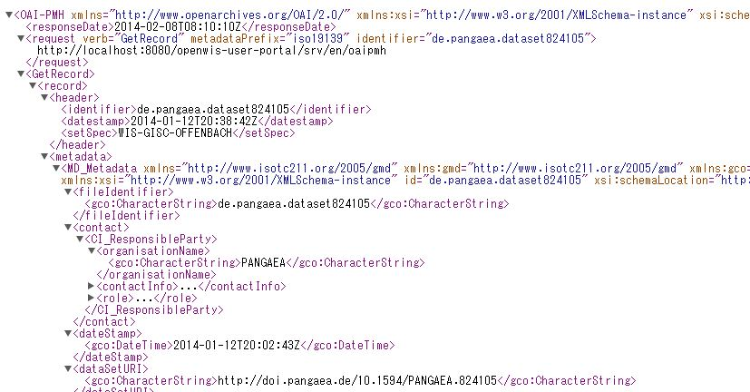
Default namespace declaration
WCMP ver. 1.2 allows to have
WCMP ver. 1.3 prohibits to have
Test results at: http://www.gisc.kishou.go.jp/toyoda/2013/1219default-ns-decl/

Slide 5
Duplicated identifiers
Response to verb=ListIdentifiers
  This response cannot be interpreted uniquely by harvesters and monitors
urn:x-wmo:md:int.wmo.wis::FQAU22AMMC |  | 2012-01-20T16:00:00Z
urn:x-wmo:md:int.wmo.wis::FQAU23APRF |  | 2012-01-20T16:00:00Z
urn:x-wmo:md:int.wmo.wis::FQFJ40NFFN |  | 2012-01-20T16:00:00Z
urn:x-wmo:md:int.wmo.wis::FQNG20AYPY |  | 2012-01-20T16:00:00Z
urn:x-wmo:md:int.wmo.wis::FQNV20NVVV |  | 2012-01-20T16:00:00Z
urn:x-wmo:md:int.wmo.wis::FQPS01NFFN |  | 2012-01-20T16:00:00Z
urn:x-wmo:md:int.wmo.wis::FQPS20NVVV |  | 2012-01-20T16:00:00Z
urn:x-wmo:md:int.wmo.wis::FQPS43NZKL |  | 2013-08-06T22:27:11Z
urn:x-wmo:md:int.wmo.wis::FQPS43NZKL | deleted | 2013-09-05T23:23:15Z | dup
urn:x-wmo:md:int.wmo.wis::FQPS44NZKL |  | 2013-08-06T22:27:00Z
urn:x-wmo:md:int.wmo.wis::FQPS44NZKL | deleted | 2013-09-05T23:22:58Z | dup
urn:x-wmo:md:int.wmo.wis::FQPS45NZKL |  | 2013-08-06T22:27:06Z
urn:x-wmo:md:int.wmo.wis::FQPS45NZKL | deleted | 2013-09-05T23:22:35Z | dup
urn:x-wmo:md:int.wmo.wis::FQPS46NZKL |  | 2013-08-06T22:26:55Z
urn:x-wmo:md:int.wmo.wis::FQPS46NZKL | deleted | 2013-09-05T23:22:16Z | dup

Slide 6
Inaccurate OAI datestamps
OAI datestamp
OAI header

Slide 7
Inaccurate OAI datestamps
Offenbach add
Beijing harvest
Exeter
Offenbach update
Beijing update
Seoul
Melbourne
Tokyo
Toulouse
Seoul
Exeter
Melbourne
Tokyo
Toulouse
12-17T16:41
12-18T00:44
12-17T16:41
12-16T16:38
12-16T16:38
12-16T16:38
12-17T19:37
12-17T16:41

Slide 8
Time filter “from” “until”
Used for “incremental harvesting”
Filtering records that were updated in a time frame defined by “from” and “until”
This filter ought to be done with OAI datestamps that represents the time when the record appeared/updated/deleted on that specific repository.

Slide 9
OAI datestamp
Some OAI datestams seem to inherit datestamps of original OAI providers when records are harvested from other OAI providers.
Filters seems to be done using another datestamp in an internal database and records returned are correct.
Harvesters and monitors cannot interpret datestamps that are contradictory to filter results.

Slide 10
OAI provider speed requirement
Monitor frequency | Minimum speed requirement (records/sec)
 | 150,000 records | 500,000 records
Every 3 hours completes in 1.5 hours | 300000/(60*60*1.5) = 56 | 1000000/(60*60*1.5) = 185
Every 24 hours completes in 12 hours | 300000/(60*60*12) = 6.9 | 1000000/(60*60*12) = 23

Slide 11
OAI provider speed test results
Test results using a same test program to list identifiers from each GISC
 | Test 1 | Test 2 | Test 3 | Test 4 | Average
GISC A | 173 | 169 | 164.9 | 157.8 | 166.2
GISC B | 110 | 130 | 22.7 | 22.5 | 71.3
GISC C | 24 | 25 | 33.7 | 24.5 | 26.8
GISC D | 535 | 464 | 128.8 | 123.2 | 312.8
GISC E | 25 | 30 | - (test failed) | - (test failed) | 27.5
GISC F | 564 | 555 | 750.3 | 722.0 | 647.8
GISC G | 187 | 187 | 28.6 | 29.9 | 108.1

Slide 12
Proposed conclusion
Case sensitivity of identifiers
OAI harvesters and monitors need to assess file identifiers as case-insensitive.
Avoid using identifiers with only case difference
When it is necessary
  Delete old records explicitly (with deleted message)
  And then, add new records

Slide 13
Proposed conclusion
Default namespace declaration
OAI harvesters need to be able to handle records with default namespace declaration
Encourage metadata creators to avoid using default namespace declaration when possible

Slide 14
Proposed conclusion
Known software issues
Duplicated identifiers of responses to verb=ListIdentifiers
Inaccurate OAI header date stamps
Selective harvesting arguments: “until” and “from”

