Slide 1
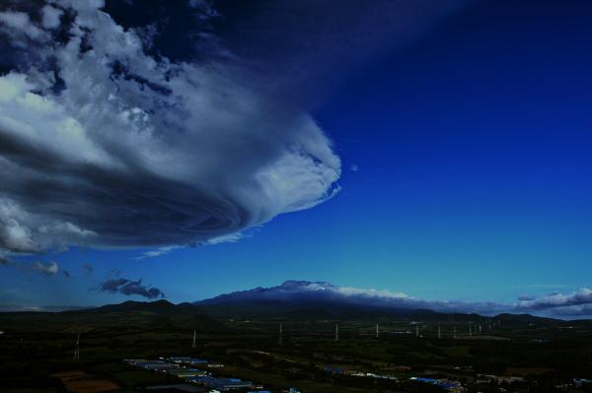

Expert Team on WIS Centres Task Team on GISC
GISC Seoul Status
Doc 26
http://gisc.kma.go.kr
Sung Soo, DO
ssdo@kma.go.kr
Korea Meteorological Administration
Republic of Korea
12 – 14 February 2014

Slide 2
Contents
Status of WIS Centre in GISC Seoul
Capacity Building
Improving Usability in GISC Seoul
Interactions with other organization

Slide 3
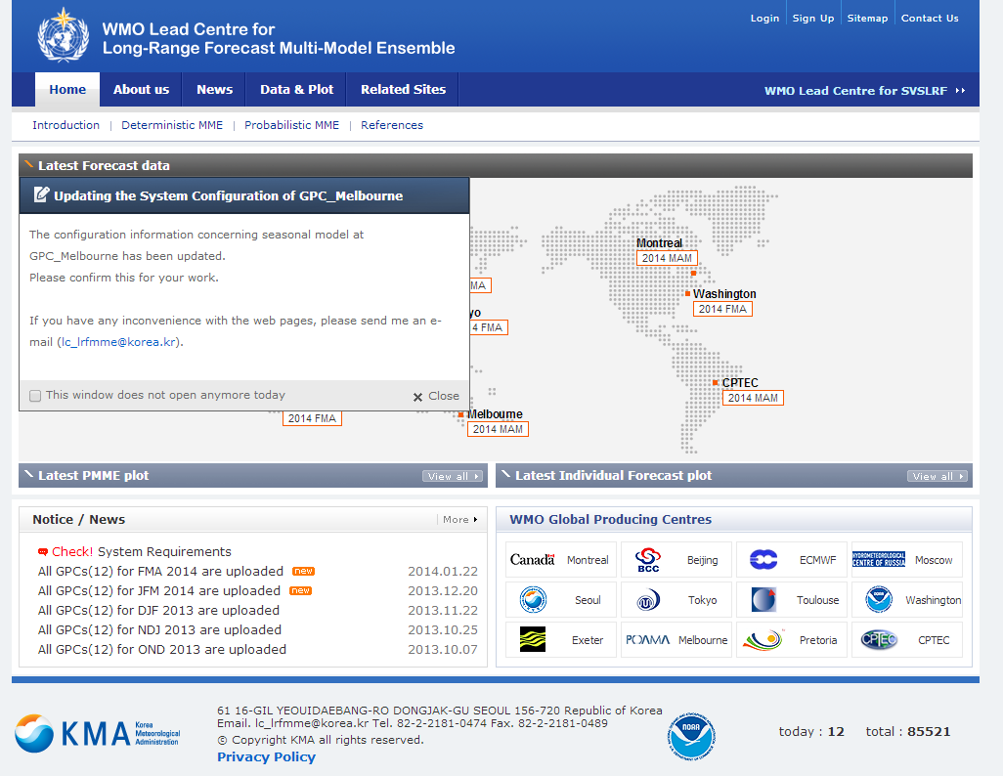
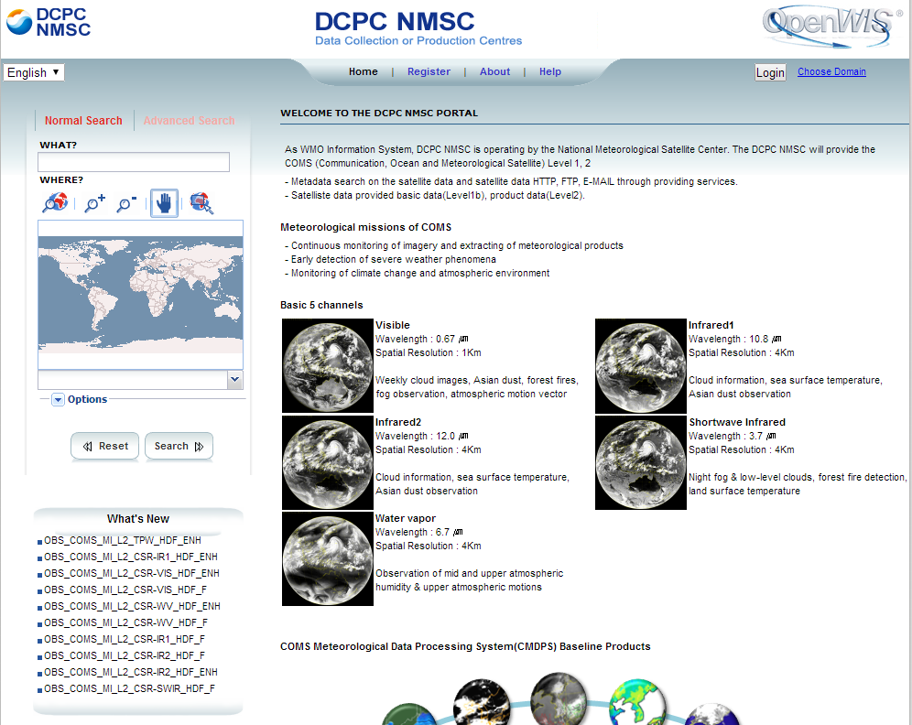
1. Status of WIS Centers in GISC Seoul
DCPC NMSC(Nation Meteorological Satellite Centre)
- Has operated since March 2013
DCPC LC/LRFMME(Lead Centre/Long Range Forecast Multiple Model Ensemble
- Creating and Managing MD for the products
- Pre-operation step on harvesting MD by GISC Seoul
- Plan to start operational step in April 2014

Slide 4
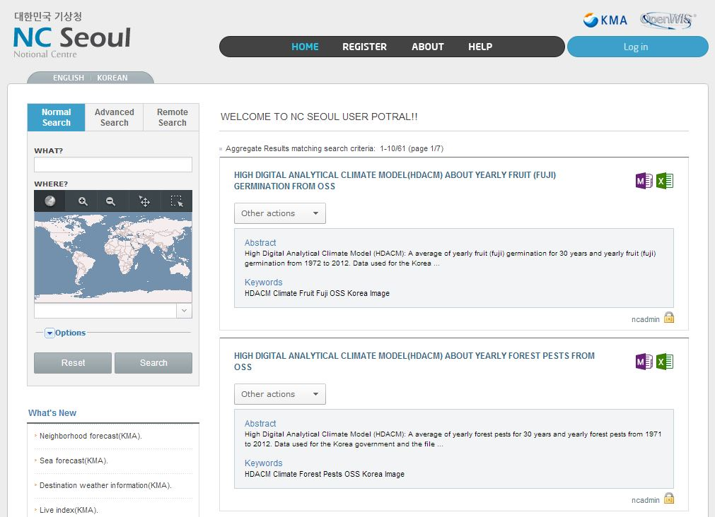
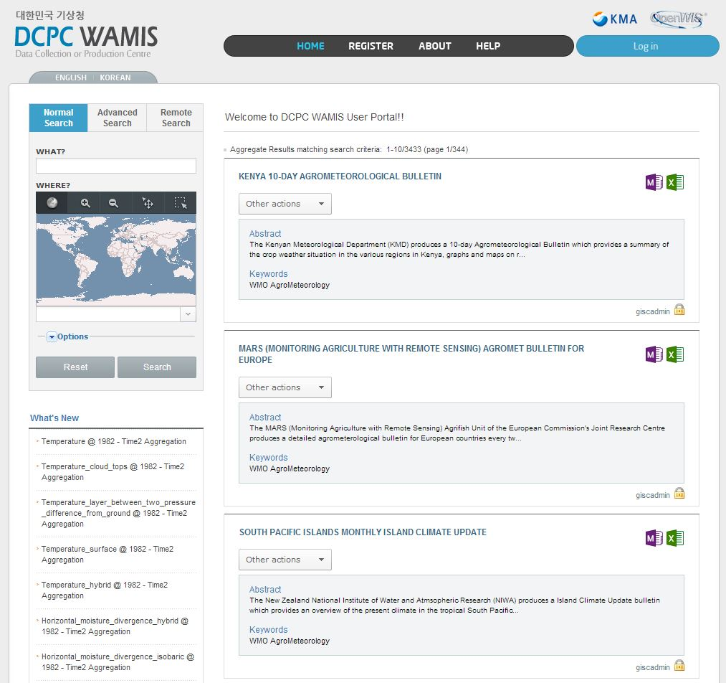
1. Status of WIS Centers in GISC Seoul
DCPC WAMIS(World AgroMeteorological Information Service)
- Deployed DCPC WAMIS based on OpenWIS in 2013
- Creating and Managing MD
- Providing access to WAMIS products
- Has cooperated with CAgM (validation of MD and operation plan)
NC Seoul
- Deployed NC Seoul based on OpenWIS in 2013
- Creating and Managing MD
- Disseminating information; national observation, climate data etc.
- Plan to start operational step in April 2014

Slide 5
2. Capacity Building
Domestic Training
- 2nd GISC Seoul Workshop September 2013
; status of each data centre, data policy, contribution to GFCS as CSIS
- Joint Meeting with K-GEO January 2014
; Introducing a benefit of WIS to other areas of data user (governmental decision maker)
International Training
- Training with invited experts form Uzhydormet November 2013
; WIS concept, Creating and managing MD etc.

Slide 6
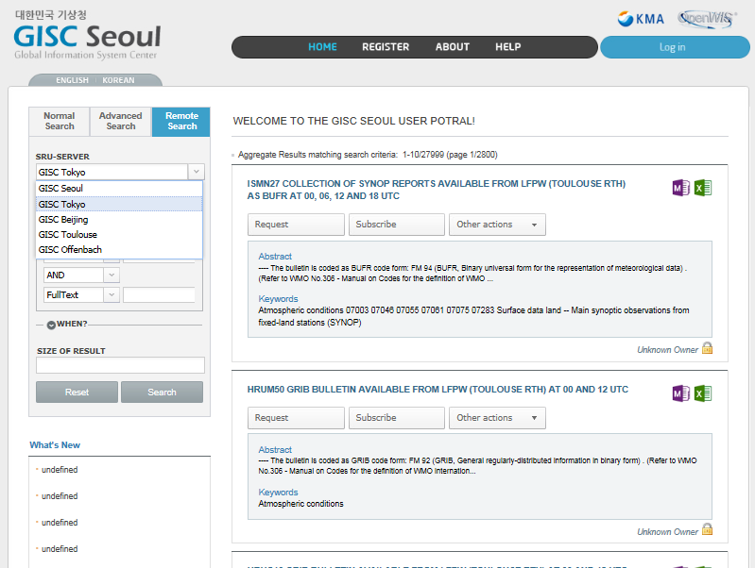
3. Improving Usability in GISC Seoul
Providing SRU service
- Easy to access and search other GISCs MD

Slide 7
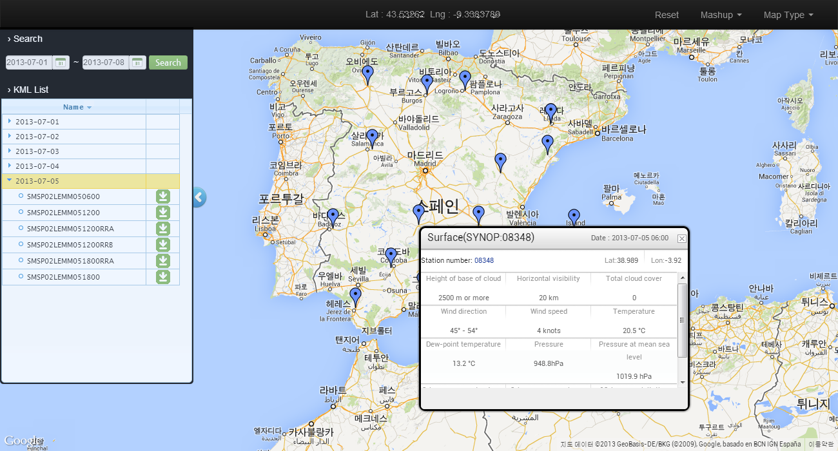
3. Improving Usability in GISC Seoul
Providing GIS Service
- Easy to understand what user want to search and retrieve
Search
Period
KML File Download
View of observing information
KML file
List

Slide 8
4. Interactions with other organization
GISC Seoul volunteered to be interface between WIS and GEOSS in September 2013
Has taken initiatives in terms of MD exchanging
Plays a role in harvesting GEOSS MD to GISC Seoul
Keeps on the cooperation with WIS and GEO

Slide 9
Expert Team on WIS Centres Task Team on GISC
Merci Beaucoup. Pour toute Question?
http://gisc.kma.go.kr
Sung Soo, DO
ssdo@kma.go.kr

