Slide 1
GISC Tokyo Status
(Short update)
Doc 23
GISC Tokyo/JMA

Slide 2
(short) Updates
Monitoring for identifying GTS bulletins that lack associated metadata records
  Mainly for NC and WIMMS of GISC Tokyo
  http://www.wis-jma.go.jp/cms/monitoring/
Monitoring of number of bulletins stored in cache
GISC backup
  GISC Beijing using GTS network since March 2013
  GISC Offenbach using internet since January 2014
  GISC Melbourne using GTS network, under progress

Slide 3
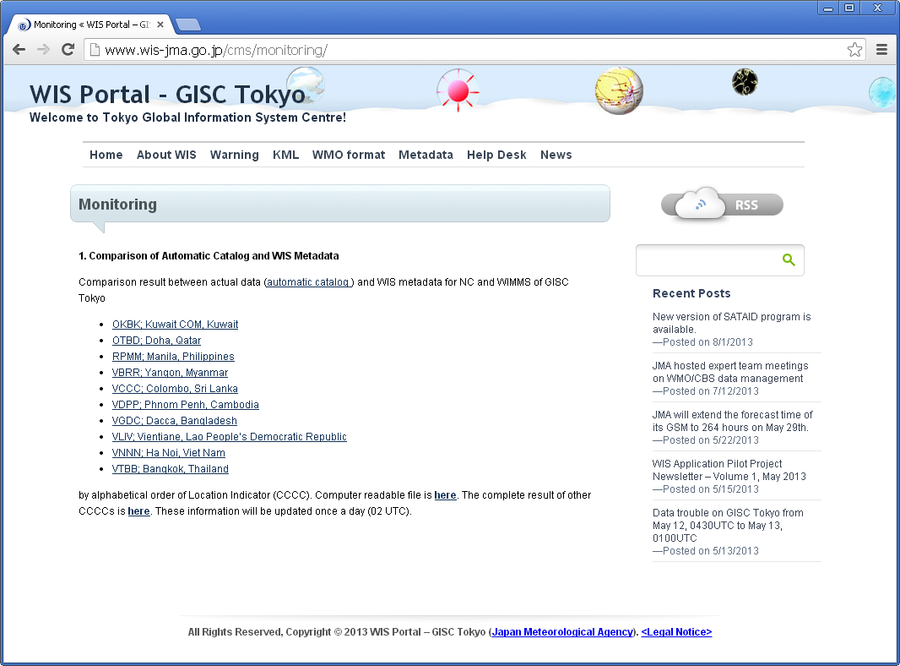
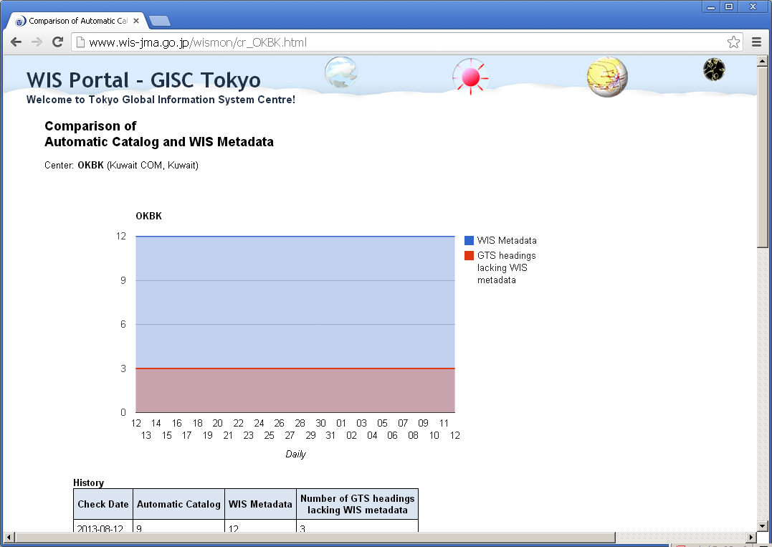
Comparison of
Automatic Catalog and WIS Metadata

Slide 4
Comparison of
Automatic Catalog and WIS Metadata
Computer readable file also available.
  Plain text format
  http://www.wis-jma.go.jp/wismon/compare_list.csv
  http://www.wis-jma.go.jp/wismon/compare_list_all.csv
OKBK,3,SAKW20,UGKW10,UPKW10,
OTBD,1,CSQT10,
RPMM,18,ISCC01,ISIC01,SIPH01,SIPH02,SMPH10,SMPH22,SNPH01,UEPH10,UEPH20,UGPH01,UGPH02,UHPH20,UKPH20,ULPH20,UPPH20,UQPH01,USPH20,WTPH01,
VBRR,7,CSBM01,ISMC01,SMBM20,UEBM01,UKBM01,ULBM01,USBM01,
VCCC,1,UASB31,
VDPP,2,CSKP01,ISMC01,
VGDC,2,ISCC01,ISMC20,
VLIV,0,
VNNN,0,
VTBB,8,FCTH31,FPTH02,FTAE31,FTAE32,FTAE33,FTTH31,SAAE31,SATH31,
ABCS,1,WSAU21,
ABRF,4,AXAU22,AXAU23,WCAU01,WSAU21,
ADRM,5,FXXT01,FXXT02,FXXT03,WCAU01,WSAU21,
AGGG,2,SISO01,SISO31,
…
ZUUU,1,WSCI36,
ZWWW,2,WSCI39,WVCI39,
ZYTK,0,
ZYTX,2,WSCI38,WVCI38,

Slide 5
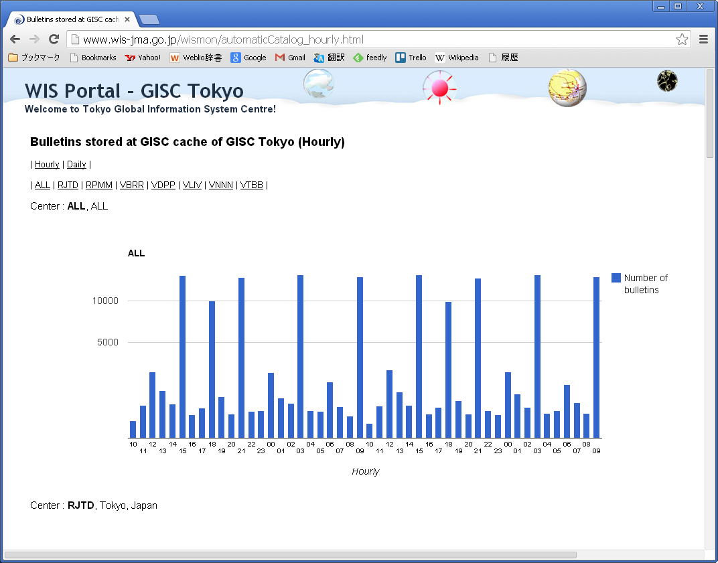
Bulletins stored at GISC cache of GISC Tokyo

Slide 6
GISC Backup – web ingest

Slide 7
Recommended text
Mr Shigeharu Nishikawa, reported some activities of GISC Tokyo. He introduced a new monitoring for identifying GTS bulletins that lack associated metadata records. The monitoring is mainly for the centers in the area of responsibility of Tokyo, but a list for all location identifiers (CCCCs) is updated every day. TT-GISC noted that this monitoring supports all the WIS centers to identify GTS headings that needs metadata records.
He also introduced a new monitor of the numbers of bulletins stored in GISC cache of GISC Tokyo. The meeting noted that this gives an idea of how GISC cache is monitored.
Mr Nishikawa reported the status of GISC backup of Tokyo, between GISCs Beijing, Offenbach and Melbourne. The meeting noted the progress of the arrangements that include periodical exchange of routing catalogues with Beijing and GISC Tokyo’s web ingest tool for backup collection of files via internet.

