Slide 1
Expert Team on WIS Centres Task Team on GISCs
(ET-WISC/TT-GISC)
Toulouse, France 12-14 February 2014
TT-GISC/2014- Agenda Item : 4
Doc 20
GISC CASABLANCA
Status Report
Submitted by: Rabia Merrouchi

Slide 2
Collection and dissemination services
Existing Hard and Soft components:
Dedicated AMSS: TRANSMET
Including Dissemination functions
Duplicated for high availability
Upgrade planned in 2014
New GISC solution fully compliant to WIS
Acquirement and implementation in 2014
Redundancy for high availability
Sufficient internal memory allowing a minimum cache of 24 hrs

Slide 3
Collection and dissemination services
Telecommunication:
Redundant high speed internet connection
  First High Speed Internet connection (FO): 4Mbps with the telecom operator: Maroc Telecom
  upgrade in 2014 to reach a flow rate of 8Mbps
  Redundant High Speed Internet connection (FO): 4Mbps with the telecom operator: INWI
  Additional ADSL internet Access: 20 Mbps
RMDCN connection (new generation with 2Mbps)

Slide 4
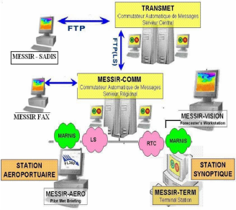
Discovery, Access and Retrieval function
Maroc Meteo is planning to implement the WIS solution interfaced with TRANSMET in 2014
(the official tender N°15/2013/DMN/SEGMA was launched in the end of the year 2013. the adjudication/tendering process is ongoing (decision by the end of February 2014)
The solution will be full compliant with GISC Technical Specification
GISC Toulouse was designated to be the Back up GISC,
Maroc Meteo hold the RA I Sub-Regional Workshop for WIGOS and WIS for North Africa (November 2013),
Training session concerning TDCF migration for Libyan Meteorological Service is planned for 2014.

Slide 5
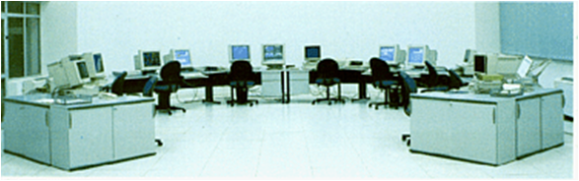
Robustness and reliability of components
The computer centre was a specially built facility and includes two back up systems:
One is the UPS, which is supported by a generator with backup procedures.
The computer facilities are supported by an external contractor with on call support
The computer centre has sufficient space and control of temperature and water conditions to assure continuity of operations.

Slide 6
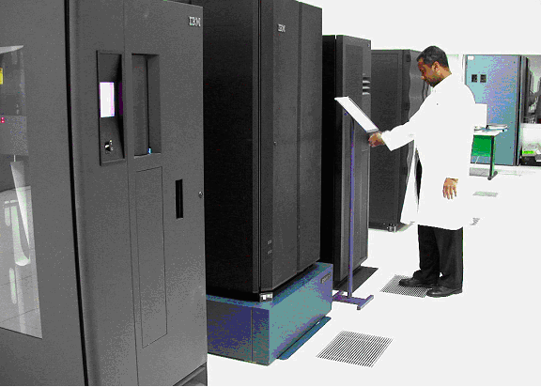
Robustness and reliability of components
DMN upgraded the computer systems (IBM HPC in 2011)
200TB robotic data storage and these include full support contracts.
The building is equipped with fire detection system.
Support includes 24*7 support for remedial maintenance of software and for both preventive and remedial maintenance of hardware

