Slide 1

It’s all about
Performance
Ian Bell
1 November 2012
iandbell@fastmail.fm

Slide 2
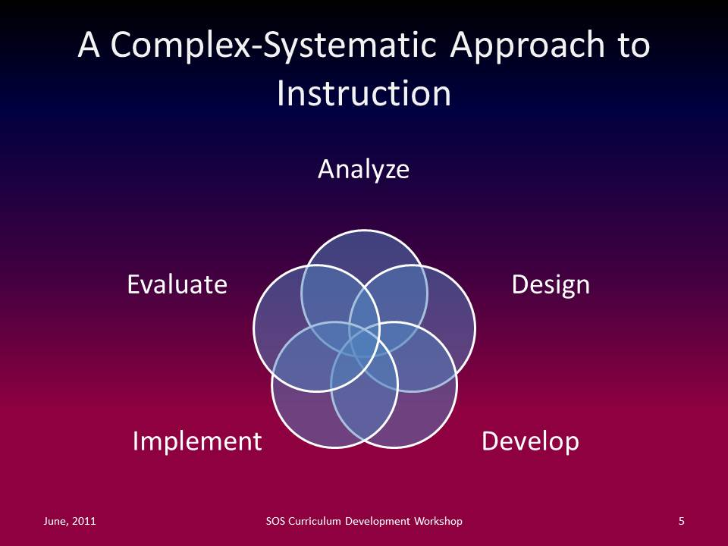

Slide 3
The Learning/ Training Cycle
Prepare or select training resources & activities
Plan
Learning experiences
Competencies
Performance criteria
Required Performance
Needs
Assess
Practice performance
Current Performance
Evaluate
all aspects
Notes:
Prototype
Simulate performance in as realistic conditions as possible
Consolidation

Slide 4
The Learning/ Training Cycle
Continue cycle until actual performance = required performance
Prepare or select training resources & activities
Plan
Learning experiences
Competencies
Performance criteria
Required Performance
Needs
Assess
Practice performance
Current Performance
Evaluate
all aspects
Notes:
Prototype
Simulate performance in as realistic conditions as possible
Consolidation

Slide 5
The Learning/ Training Cycle
Continue cycle until actual performance = required performance
Prepare or select training resources & activities
Plan
Learning experiences
Competencies
Performance criteria
Required Performance
Needs
Assess
Practice performance
Current Performance
Evaluate
all aspects

Slide 6
A
Learner’s
perspective

Slide 7
Student Centred Learning Framework
☺
Trainers
Stakeholders
☺
Workplace
Required performance
Learning experiences
People
Resources
Experts
Colleagues

Activities
Personal learning environment

Competencies – performance criteria
Current performance
Competencies – performance criteria
Infrastructure
Learning strategy
Course
Systems

Practice
☺
Learner

Assessment
Needs
Motivation
Preferences
Health
Personality
Habits
History:
- knowledge, skills, experiences
Culture
Self awareness
♥
Learning needs
Learning needs
Performance gap
Performance gap
Evaluate
Notes:
From a learner’s perspective

Slide 8
An
Instructor
or Trainer’s
perspective

Slide 9
Current performance
Trainer’s Role Supporting Learning
Plan, organise
Analyse
Create or select
Evaluate
Corporate learning environment
Deliver
Performance gap
Training needs
Training team
A D D I E*
Infrastructure
1 or more people

Assessment
Course
Systems

☺☺
Competency-based training objectives
Practice
Competency-based training objectives
Resources
Learning model
People

Learners
Trainers
Activities

Training activities
Required performance
☺
☺
Stakeholders
Learners
On-the-job performance
*ADDIE – Analyse, Design, Develop, Implement, Evaluate

Slide 10
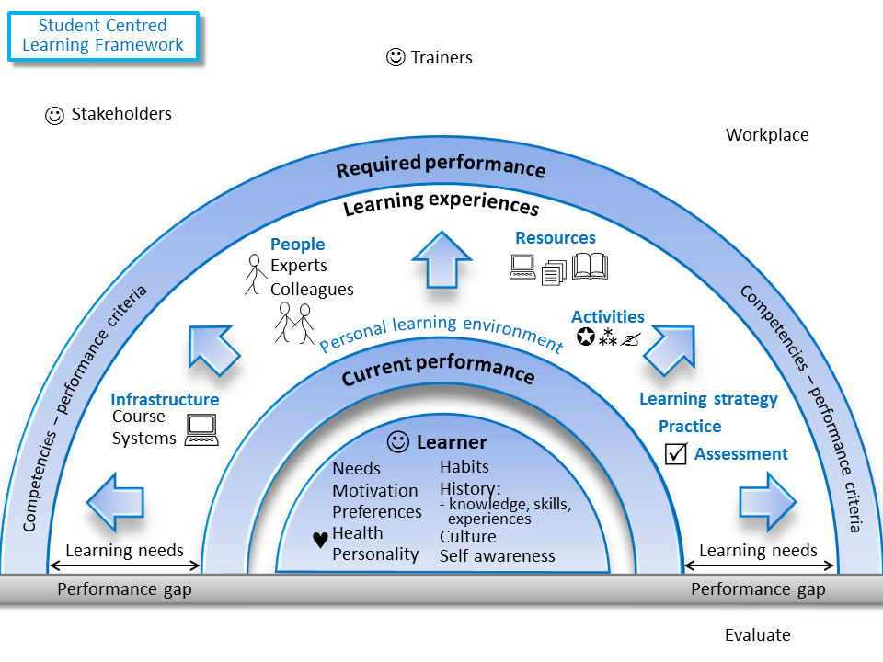
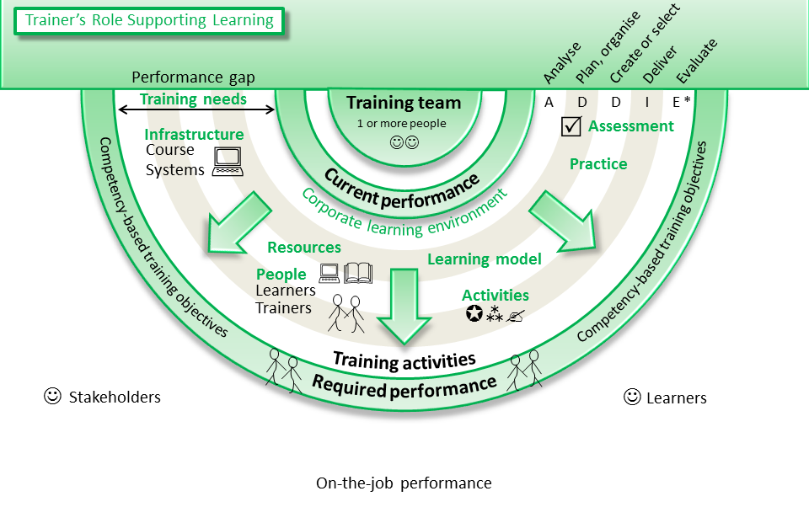

Slide 11


Slide 12
A performance gap is not always a training issue
Abilities
Competencies
Performance criteria
Required Performance
Conduct competency based training
Systems
Current Performance
Redesign hardware, software or procedures
Management
Lack of leadership and direction
Motivation
Organisational, management, personal, relationships, awareness of needs
Notes:
“Every performance failure is a learning opportunity”
Abilities – they don’t have the skills and knowledge to perform the task. Conduct competency based training.
Systems – if the systems or the interfaces are inadequate redesign them or provide performance support systems (help, checklists, etc). Training is not a solution for poor design
Management – Training may lead to only limited improvements if there is no support or roadblocks from above.
Motivation – the person is capable of performing the work effectively but lacks motivation. Determine and address the cause of the problem. Further training won’t help otherwise.

Slide 13
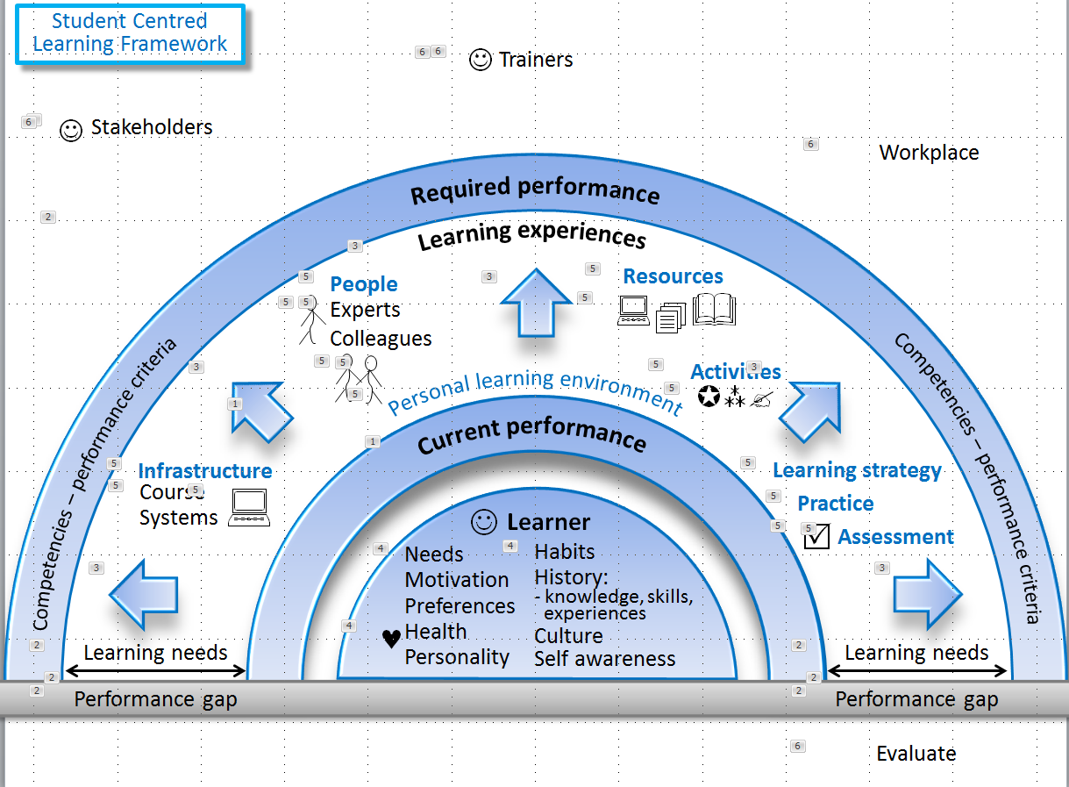
Just some of many extra points
Corporate learning environment
On-the-job performance
Formal (structured) or informal
Formal or informal
Approach to learning
- models, theories
Provides structure
Practice the job tasks
Consolidation and reinforcement
Access to / delivery of learning experiences and resources
Feedback on progress
(= formative assessment)
Final (= summative)
Against required performance – match conditions closely
Authentic
Bloom’s taxonomy
Decision theory
Automaticity
Learning velocity
Informal
I want or need to do X (that I can’t do now)
Formal
Needs analysis or awareness
Needs specification, eg, new skill or procedure required
Job requirements
Organisation’s needs
Individual attributes and differences
Need for learner to be active and in control of their learning
culture
Evaluate all aspects of the learning during the learning process to enable adjustments and at the end to make it more effective next time
Metacognition – learning wareness
Awareness of learning approach and effectiveness
Learning velocity / flow
Learning awareness / consciousness
Getting off the OK plateau to improve learning effectiveness
Language
Abilities/limitations that affect learning, eg vision, colour blindness, dyslexia, skills with tools
Alertness
Confidence
Recognition of prior competence = current performance
Provide tools and checklists for each component

Slide 14
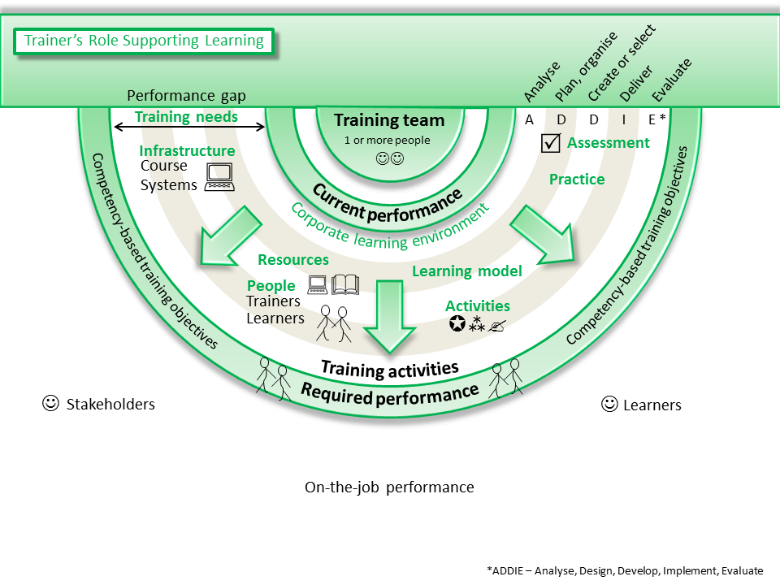
Trainers, subject experts, administration and management, IT support, designers (instructional, visual), assessors
All stages are required for each component
Evaluate
results against objectives
all aspects of the training
Training needs analysis:
Organisation’s requirements
Individuals’ learning needs
Set competencies, levels, performance criteria and training objectives
Identify target group (learners)
Set priorities, times (when, duration)
Assess individuals against competencies
Formative as they learn (provide feedback)
Summative (final)
Learners must be able to perform the required tasks
Approach to learning
models, theories
Training activities based on learning strategy
face to face, remote, on-the-job, a/synchronous
Provide support
Provide support and monitoring
Learning guides
= Traditional nomenclature

Slide 15
Trainer’s Role Supporting Learning
☺☺
Training team*
* May be
1 person
Analyse
Assess,
evaluate
Needs analysis:
organisation
individuals
Competencies, performance criteria
Resources, infrastructure
Priorities
Administration
Management
Designers
- Instruction
- Visual
Subject experts
Presenters
Assessors
IT support
Learners
Assess individuals against competencies
Evaluate
results against objectives
all aspects of the training
Learners
Plan
Conduct
training
Prepare
ANALYSE
Training objectives
Target group (learners)
Resources
trainers, infrastructure
Delivery mode
Times – when, duration
Teaching and learning activities
Design – visual, navigation
Learning guide
Deliver training activities based on proven learning models
face to face, remote, on-the-job, a/synchronous
Provide support
EVALUATE
Design and develop, or select, learning:
Experiences/activities
resources
environment
assessment
practice opportunities
Learning strategy
Infrastructure
Prototype, revise
Learners
Needs and attributes
Needs and attributes
DESIGN
IMPLEMENT
Pre- and post-course
Follow up –consolidation, reinforcement, on the job support
Corporate learning environment
DEVELOP
Notes:
Traditional – ADDIE: Analyse, Design, Develop, Implement, Evaluate

