Slide 1
Development of a GML Application Schema for data exchange supporting Meteorological Services for International Air Navigation
(WMO METCE & ICAO IWXXM)
see next talk from Aaron!
Jeremy Tandy
(on behalf of TT-AvXML)

Slide 2
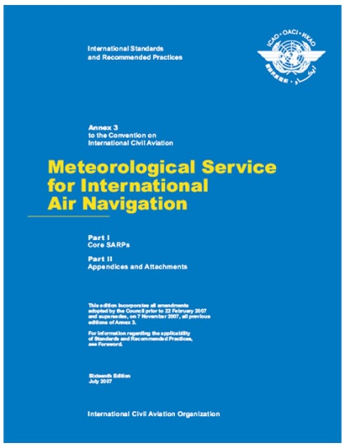
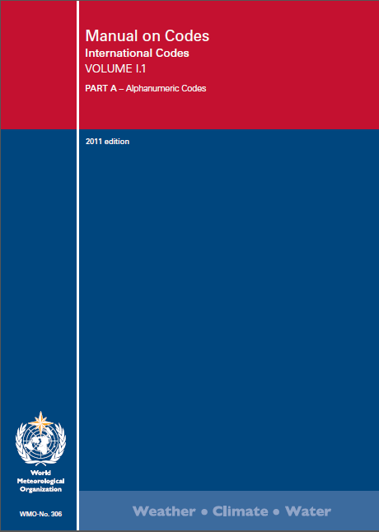
Context: Meteorological Services for International Air Navigation (Technical Regulation)
ICAO Annex 3 / WMO No. 49 II
Meteorological Service for International Air Navigation
Management of data exchange standards in support of meteorological services for international air navigation (OPMET) are delegated by ICAO to WMO
WMO No. 306 Vol I.1
Manual on Codes
Part A – Alphanumeric Codes

Slide 3

Amendment 76 to ICAO Annex 3 (Nov 2013)
ICAO Annex 3 / WMO No. 49 II
Meteorological Service for International Air Navigation
Amendment 76 (2013) to ICAO Annex 3 shall, for states in a position to do so to, permit bilateral exchange of OPMET data via XML
TAF
METAR/SPECI
SIGMET
WMO No. 306 Vol I.1
Manual on Codes
Part A – Alphanumeric Codes

Slide 4


Model-driven data exchange standards
ICAO Annex 3 / WMO No. 49 II
Meteorological Service for International Air Navigation
« formalised as »
Application Schema
(aka ‘conceptual model’)
TAF
METAR/SPECI
SIGMET
********
****
*******
XML Schema 1.0
Schematron .
« conforms to »
********
SCH
**
*******
**********
**
FullMoon
Validatable data products
*********
« derived from »
*********
Technology independent description of content and structure of information to be exchanged for a given application
Validation schema and rules

Slide 5





Standards-based approach: GML Application Schema
IWXXM (ICAO Weather Information Exchange Model): formal representation of ICAO Annex 3 reports (TAF, METAR/SPECI and SIGMET)
SAF (Simple Aeronautical Features)
OPM (Observable Property Model)
METCE (Modèle pour l’Échange des informations sur le Temps, le Climate et l’Éau)
« formalised as »
ISO 19100-series of International Standards
TAF
METAR/SPECI
SIGMET
« derived from »
« conforms to »
IWXXM
SAF
SCH
« derived from »
Aviation XML is a GML Application Schema
OPM
METCE
SCH
Geographic Information
[incl. ISO 19156 O&M]
(note: OMXML
OGC #10-025)
« derived from »
ISO19136
GML
OMXML

Slide 6
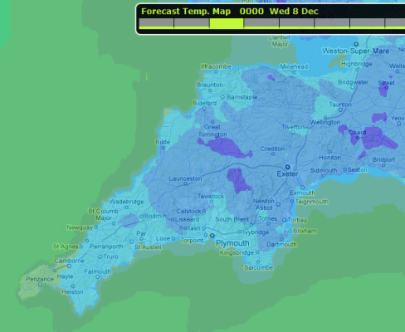
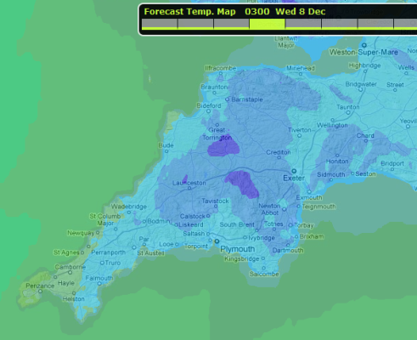
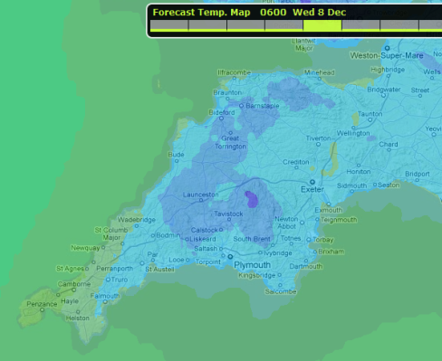
ISO19156 Observations and measurements:
also suitable for numerical simulations – including forecasts
forecast : OM_Observation
parameter.name = “analysisTime”
parameter.value = 2010-05-06T00:00Z
phenomenonTime.begin = 2010-05-06T00:00Z
phenomenonTime.end = 2010-05-09T12:00Z
resultTime = 2010-05-06T04:30Z
validTime [optional – not specified]
resultQuality [optional – not specified]
5-May
6-May
7-May
8-May
9-May
12Z
00Z
12Z
00Z
12Z
00Z
12Z
00Z
12Z
00Z
result
Notes:
Whilst the name of the model invokes a particular concept to meteorologists (e.g. ‘observation’, the measurement of physical phenomena with an instrument or sensor – disjoint from the concept of ‘forecast’) it is important to consider the semantics of the model. The class OM_Observation is defined as ‘an estimate of the value of some property of some Thing using some specified Process’. The process may be an instrument/sensor (directly) measuring some physical parameter or a numerical simulation predicting future values. Thus the ‘Observations and measurements’ conceptual model may be used to represent both observations and forecasts.

Slide 7
RC2 change!
WMO Logical Data Model:
Application Schemas under WMO governance
«http://def.wmo.int/2013/opm»
«http://def.wmo.int/2013/metce»
OPM………………..
Observable Property Model………………..
Enables one to describe how abstract physical quantities are qualified or constrained (e.g. explicitly state the averaging period for wind-speed, or the height of measurement above local ground for a screen temperature)
Developed within the OGC ‘Sensor Web Enablement’ Standards Working Group & INSPIRE Thematic Working Group
Tentative agreement with OGC that a stable version of OPM is managed under the governance of WMO
METCE
(Modèle pour l’Échange des informations sur le Temps, le Climate et l’Éau)
Provides a foundation of generic meteorological concepts, phenomena and entities upon which domain- industry- or community-specific Application Schema can be built:
specialised observation classes
simple observation procedure
meteorological features (e.g. volcano, ..tropical cyclone)
plus “miscellaneous” stuff
Intended to complement existing WMO Table-Driven Code Forms
OPM
METCE
simple observation procedure
*

Slide 8
METCE: specialisations of OM_Observation
Does the data collected (e.g. the ‘result’) from the Observation event:
Vary in space and or time?
«FeatureType»
OM_Observation
Describe multiple physical properties?
(ISO 19156)
+result
«Type»
Any
«FeatureType»
OM_ComplexObservation
«FeatureType»
OM_DiscreteCoverageObservation
(ISO 19103)
(ISO 19156)
+result
(ISO 19156)
+result
«Type»
Record
«Type»
CV_DiscreteCoverage
WMO METCE
(ISO 19103)
(ISO 19123)
«FeatureType»
SamplingObservation
«FeatureType»
ComplexSamplingMeasurement
«FeatureType»
SamplingCoverageMeasurement
No
Yes
Yes
B
A
Q
No
Notes:
WMO METCE provides three specialised types of OM_Observation; each of which enforce the constraints that 'featureOfInterest' shall refer to an entity of type SF_SpatialSamplingFeature (from ISO 19156), or subclass thereof, and 'procedure' shall refer to an entity of type Process (from WMO METCE), or subclass thereof.
SamplingObservation: subclass of OM_Observation providing a general purpose observation type;
ComplexSamplingMeasurement: subclass of OM_ComplexObservation for use where the observation event is concerned with the evaluation of multiple measurands at a specified location and time instant or duration - the result of this observation type shall refer to an entity of type Record (from ISO 19103), or subclass thereof; and
SamplingCoverageMeasurement: subclass of OM_DiscreteCoverageObservation for use where the observation is concerned with the evaluation of measurands that vary with respect to space and/or time - the result of this observation type shall refer to an entity of type CV_DiscreteCoverage (from ISO 19123).
Note:
SamplingCoverageMeasurement is based in the «informative» SamplingCoverageObservation (from ISO 19156)
The term ‘measurement’ is used in the name of two of the Classes in an attempt to mitigate pre-existing interpretations of the semantics from ‘observation’

Slide 9
Common constraints applicable to all WMO METCE Observation types
All specialisations of OM_Observation defined in WMO METCE require:
association role ‘featureOfInterest’ shall be of type SF_SpatialSamplingFeature
association role ‘procedure’ shall be of type Process (from WMO METCE)
«FeatureType»
GFI_FeatureType
«FeatureType»
OM_Observation
«FeatureType»
Process
+featureOfInterest
+procedure
(ISO 19156)
(ISO 19156)
(ISO 19156)
«FeatureType»
OM_ComplexObservation
(ISO 19156)
+result
«Type»
Record
WMO METCE
(ISO 19103)
«FeatureType»
SF_SpatialSamplingFeature
«FeatureType»
ComplexSamplingMeasurement
«FeatureType»
Process
+featureOfInterest
+procedure
(ISO 19156)

Slide 10
RC2 change!
METCE: Process
Process (from WMO METCE) provides a concrete implementation of the abstract OM_Process supporting the following requirements:
reference to supporting documentation,
specification of configuration parameters,
specification of the measurement resolution and/or measurement range for each measurand.
Simplified following feedback from RC1 public comment: removal of AbstractMeasurementContext and CompositeMeasurementContext classes
«FeatureType»
GFI_FeatureType
«FeatureType»
OM_Observation
«FeatureType»
Process
+featureOfInterest
+procedure
(ISO 19156)
(ISO 19156)
(ISO 19156)
«FeatureType»
OM_ComplexObservation
(ISO 19156)
+result
«Type»
Record
WMO METCE
(ISO 19103)
«FeatureType»
SF_SpatialSamplingFeature
«FeatureType»
ComplexSamplingMeasurement
«FeatureType»
Process
«FeatureType»
Process
+featureOfInterest
+procedure
(ISO 19156)

Slide 11
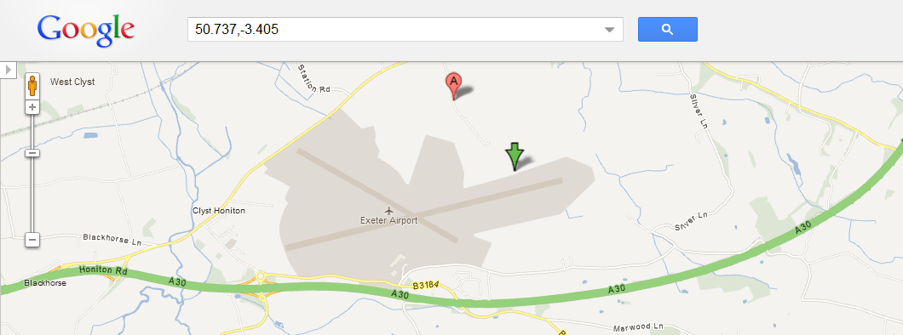
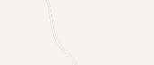
SamplingFeature as OM_Observation.featureOfInterest
In meteorology, we define a sampling regime that enables us to observe, measure or simulate the real-world. Sampling Features (from ISO 19156 ‘Observations and measurements’) provide a way to characterise this sampling regime and the relationship to the real-world.
84579:NamedPlace
name = “Exeter Airport”
03839:SF_SamplingPoint
:ComplexSamplingMeasurement
+sampledFeature
+featureOfInterest
+shape
:Point
@srsName “EPSG:4326”
pos = “50.737 -3.405”
Notes:
Meteorological observations or forecasts clearly relate to the real world. For example, we may observe the weather for Exeter or provide a weather forecast for the ‘North Atlantic European’ area. However, there is a level of abstraction to resolve:
An observation of the weather for the city of Exeter happens at some representative location within the city or some representative locale nearby
The forecast domain for ‘North Atlantic European’ is specified so that it covers the areas for which a forecast is required
In each case, the ‘observation’ event relates to some sampling regime that is a proxy for the real entity of interest (e.g. the site of the weather station, or the extent of the forecast domain). The observation or forecast is not directly related to real-world entities.
ISO 19156 ‘Observations and measurements’ provides a conceptual model for describing this layer of indirection: Sampling Features. Further specialisations of Sampling Feature are provided based on spatial topology (SF_SpatialSamplingFeature and sub-types thereof).
In all cases identified thus far in meteorology, it appears useful to describe an observation, measurement or forecast with respect to the sampling regime (e.g. the Sampling Feature) and indirectly refer to the real-world entity for which the Sampling Feature is a proxy.
Spatial Sampling Features are considered an essential part of WMO METCE: all observations, measurements and forecasts of meteorological phenomena shall define the ‘featureOfInterest’ as a concrete sub-type of SF_SpatialSamplingFeature.

Slide 12
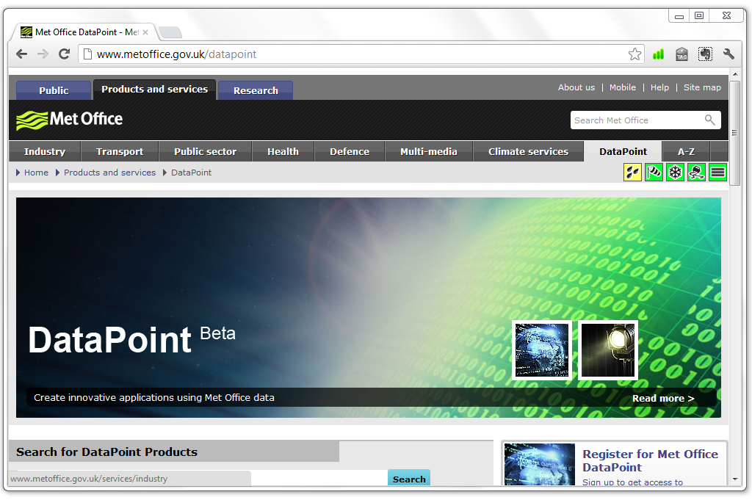


Example use of METCE: Met Office DataPoint
Illustrative example demonstrating how METCE provides a foundation to domain specific Application Schema …
UK hourly site-specific observations
Hourly observations for approximately 140 locations across the UK
Parameters:
  Air temperature
  MSLP
  Wind speed
  Wind speed (gust)
  Wind direction
  Visibility
  Weather type
DataPoint ^{Beta}

Slide 13

Which type of OM_Observation?
Does the data collected from the Observation event:
Vary in space and or time?
«FeatureType»
OM_Observation
Describe multiple physical properties?
(ISO 19156)
UK hourly site-specific observations
Hourly observations for approximately 140 locations across the UK
Parameters:
  Air temperature
  MSLP
  Wind speed
  Wind speed (gust)
  Wind direction
  Visibility
  Weather type
+result
DataPoint observation results:
_DO NOT_ vary in time or space – instantaneous observation at fixed location; and
_DO_ describe multiple physical properties (count = 7)
… use ComplexSamplingMeasurement
DataPoint ^{Beta}
«Type»
Any
«FeatureType»
OM_ComplexObservation
«FeatureType»
OM_DiscreteCoverageObservation
(ISO 19103)
(ISO 19156)
+result
(ISO 19156)
+result
«Type»
Record
«Type»
CV_DiscreteCoverage
WMO METCE
(ISO 19103)
(ISO 19123)
«FeatureType»
SamplingObservation
«FeatureType»
ComplexSamplingMeasurement
«FeatureType»
SamplingCoverageMeasurement
No
Yes
Yes
B
A
Q
No

Slide 14
Validatable data products: bespoke Record class
The Record class (from ISO 19103) provides a set of name-value pairs.
In GML, this can be implemented using SWE DataRecord …
However, in this example, we require validatable data products. Therefore, we need to generate an XML Type for the Record – which is derived from our Application Schema:
(ISO 19103)
UK hourly site-specific observations
Hourly observations for approximately 140 locations across the UK
Parameters:
  Air temperature
  MSLP
  Wind speed
  Wind speed (gust)
  Wind direction
  Visibility
  Weather type
Record
DataPoint ^{Beta}
DataPoint
WeatherObservationRecord
+airTemperature
+pressure
+windSpeed
+gustSpeed
+windDirection
+visibility
+weatherType

Slide 15

Aside: WMO No. 306 Manual on Codes and governance of authoritative definitions for meteorological properties
The Code-Tables underpinning WMO Table-Driven Code Forms (GRIB and BUFR) are WMO’s crown jewels …
Decades of expert effort have gone into establishing authoritative terminologies to describe meteorological phenomena
WMO CBS stressed the importance of ensuring a strong linkage between the TDCF Code-tables and the WMO data models. [CBS-Ext.(10)]
‘Strong linkage’: a critical objective for TT-AvXML

Slide 16


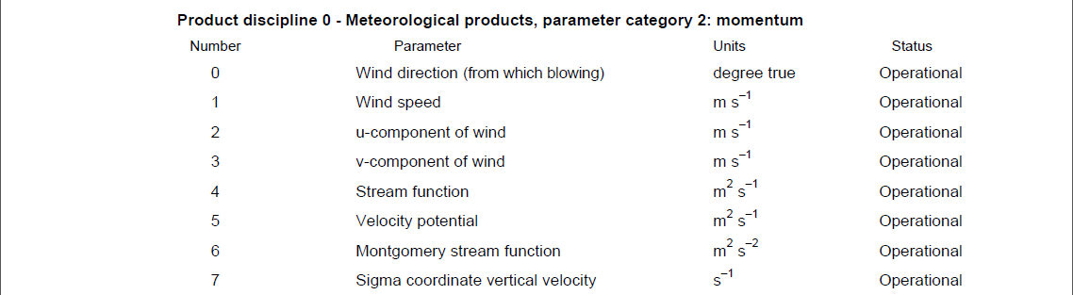
Publication of web-accessible definitions for meteorology
As the UN’s authoritative voice on weather, water and climate it within WMO’s mandate to publish authoritative on-line definitions of meteorological phenomena and properties
Each ‘concept’ will be assigned an HTTP URI identifier within the codes.wmo.int domain based on existing codes and structures from the WMO code-tables
It is anticipated that in RC2 the definitions of those physical properties required to support International Air Navigation will resolve to useful information …
RC2 change!
http://codes.wmo.int/grib2/codeflag/4.2/0.2.1
http://codes.wmo.int/grib2/codeflag/4.2/0.2.1
Excerpt from GRIB2 Code- and Flag-tables
Notes:
Note that within the published concept, the TDCF usage information (e.g. the mandated unit of measure) will be separated from the concept itself. This approach aligns with that used for the CF-standard names where the published concept provides the abstract physical quantity (e.g. wind_speed: http://vocab.nerc.ac.uk/collection/P07/current/CFSN0038). Furthermore, CF-standard names provide only a ‘canonical unit’ allowing data to employ any unit of measure that is compatible (e.g. has the same ‘quantity dimensions’).
This similarity in approach should greatly facilitate mapping of data between the WMO and CF communities.

Slide 17
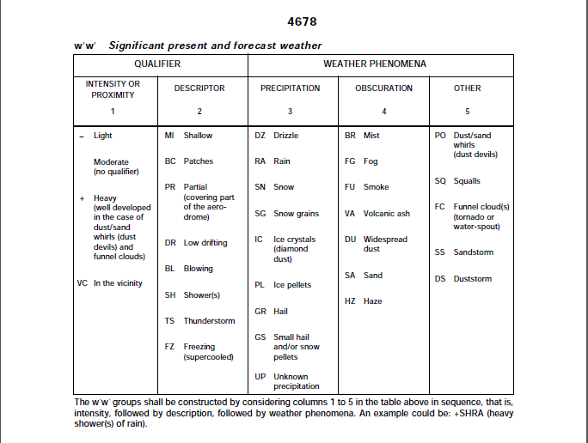
WMO code-tables published as web-accessible resources
Code-tables (and code-table entries) from WMO No. 306 Vol I.1, BUFR4 and GRIB2 are also in the process of being published as web-accessible resources …
http://codes.wmo.int/306/4678
http://codes.wmo.int/306/4678/+SHRA
Excerpt from WMO No. 306 Vol I.1

Slide 18
RC2 change!
Met-Basic removed from WMO model
Met-Basic was intended to ensure that the semantics defined in the WMO code-tables was applied within Application Schemas using METCE; this _was_ achieved through provision of a palette of reusable “quantity value” and «CodeList» classes …
However, in hindsight, coupling the model to the WMO code-tables was a poor design choice introducing unnecessary redundancy and inhibiting the flexibility of the model with respect to changes in the WMO code-tables.
For RC2, we propose that:
DataPoint
WeatherObservationRecord
+airTemperature : Measure
+pressure : Measure
+windSpeed : Measure
+gustSpeed : Measure
+windDirection : Measure
+visibility : Measure
+weatherType : PresentWeather
each quantity value property is specified with type “Measure” (from ISO 19103 Basic-types) or subclass thereof, and
a «CodeList» class is defined within the Application Schema for each nominal value property that shall be used as the specified type for that property.
«CodeList»
PresentWeather

Slide 19

Consistent application of semantics from WMO codes (1):
quantity values
Each quantity value property shall include the tagged value ‘quantity’ to refer to the appropriate concept from the WMO codes.
<complexType name=“WeatherObservationRecordType">
<complexContent>
<extension base="gml:AbstractGMLType">
<sequence>
…
<element name=“windSpeed" type=“gml:MeasureType“>
<annotation>
<appinfo>
<quantity>
http://codes.wmo.int/grib2/codeflag/4.2/0.2.1
</quantity>
</appinfo>
</annotation>
</element>
…
</sequence>
</extension>
</complexContent>
</complexType>
Tagged-values shall be visible within the XSD enabling information from the WMO codes to be used in data validation.
DataPoint
WeatherObservationRecord
RC2 change!
+airTemperature : Measure
+pressure : Measure
+windSpeed : Measure
+gustSpeed : Measure
+windDirection : Measure
+visibility : Measure
+weatherType : PresentWeather
tagged value: quantity = “http://codes.wmo.int/grib2/codeflag/4.2/0.2.1”
note change in guidance; where the unit of measure is defined within the Unified Code for the Units of Measure [http://unitsofmeasure.org] the symbol shall be used rather than a URI
«CodeList»
PresentWeather
<dp:windSpeed uom=“m/s">
3.6
</dp:windSpeed>
Notes:
Note: the use of gml:MeasureType is still under discussion as there is a requirement to be able to report missing values (e.g. if the limit of the sensor’s measuring range is exceeded) …
For example, currently the following XML fragment is not valid:
<iwxxm:airTemperature nilReason="http://www.opengis.net/def/nil/OGC/0/BelowDetectionRange"/>

Slide 20
Consistent application of semantics from WMO codes (2):
nominal values
Each «CodeList» class associated with a nominal value property shall include the tagged value ‘vocabulary’ to refer to the appropriate code-table from the WMO codes and the tagged value ‘extensibility’ to assert the validation regime to be used.
<complexType name=“PresentWeatherType“>
<annotation>
<appinfo>
<vocabulary>
http://codes.wmo.int/306/4678
</vocabulary>
<extensibility>
none
</extensibility>
</appinfo>
<documentation>
Significant present weather. See WMO No. 306 Vol I.1 code table 4678
</documentation>
</annotation>
<complexContent>
<extension base="gml:ReferenceType"/>
</complexContent>
</complexType>
DataPoint
WeatherObservationRecord
+airTemperature : Measure
+pressure : Measure
+windSpeed : Measure
+gustSpeed : Measure
+windDirection : Measure
+visibility : Measure
+weatherType : PresentWeather
Serialisation of «CodeList» classes follows practice from GML 3.3; gml:ReferenceType is used as extension base. Tagged values are included in schema documentation for developer reference.
«CodeList»
PresentWeather
tagged values:
vocabulary = “http://codes.wmo.int/306/4678”
extensibility = “none”
Notes:
Note: a «CodeList» class is used to indicate that permissible values for a property or attribute are taken from a specific controlled vocabulary governed externally to the model.
---
vocabulary: used to refer to the authoritative list of terms using an HTTP URI. This authoritative list may be implemented as a GML dictionary, SKOS concept scheme etc.
extensibility: indicates the governance regime applied to evaluation of terms used as values of the <CodeList> class; "none", "narrower" or "any". Basically, "none" implies _ONLY_ terms from the specified code list are permitted, "narrower" implies you can use terms with more refined definitions (e.g. narrower semantics), and "any" implies that anything goes and the specified code list is simply a recommendation!

Slide 21
Consistent application of semantics from WMO codes (2):
nominal values
GML documents shall use XLINK to refer to the appropriate term.
Crucially, note that in line with best practice, «CodeList» resources are managed externally to the model; in this case using the existing WMO TDCF governance processes.
<complexType name=“WeatherObservationRecordType">
<complexContent>
<extension base="gml:AbstractGMLType">
<sequence>
…
<element name=“weatherType" type=“dp:PresentWeatherType“>
<annotation>
<documentation>
Type of weather observed at the time of observation
</documentation>
</annotation>
</element>
…
</sequence>
</extension>
</complexContent>
</complexType>
DataPoint
WeatherObservationRecord
+airTemperature : Measure
+pressure : Measure
+windSpeed : Measure
+gustSpeed : Measure
+windDirection : Measure
+visibility : Measure
+weatherType : PresentWeather
<dp:weatherType
xlink:href=“http://codes.wmo.int/306/4678/+SHRA"
xlink:title=“Rain showers (heavy)”/>
«CodeList»
PresentWeather
tagged values:
vocabulary = “http://codes.wmo.int/306/4678”
extensibility = “none”

Slide 22

RC1 public comment feedback summary – thanks!
126 distinct issues (total)
29 issues requiring either clarification with originator (8) or direct response with additional information (21); the latter group may be candidates for FAQ
57 issues requiring amendments to the models (two-thirds of which relate to IWXXM)
8 issues requiring amendments to guidance or provision of additional examples
10 issues requiring amendments to associated material (e.g. registers)
22 "other" issues ranging from amendments that may affect all models to non-technical policy issues
Majority of issues citing minor modelling defects and documentation errors / ambiguities
Small number of more significant changes (some of which indicated earlier)

Slide 23
Open issues for METCE / OPM …
Publication of WMO code-tables as web-accessible registers; on-going work anticipated for partial completion for RC2.
Ongoing harmonisation between WMO METCE and INSPIRE Annex 3 data specification ‘Atmospheric Conditions / Meteorological Features’; similar but not quite … engagement with INSPIRE maintenance process?
Development of ‘coverage-type’ example products (e.g. high-fidelity gridded data for TRACON) to assess suitability of METCE for anticipated future products; pending resource availability.
Resolution of policy concerns (mandated use of polygons for describing SIGMET boundaries, reporting missing values, strict enforcement of ICAO SARPs or enforcement of common usage, bulletin validation, anticipated life-cycle of changes to IWXXM etc.); to be discussed with ICAO MARIE-PT.
Mapping METCE & IWXXM to TDCF; future work – out of current scope.
…

Slide 24
AvXML 1.0 standard development schedule
[1st Feb 2013] 1.0RC1 review closes
[1-8 Feb 2013] 1.0RC1 feedback clarification
[Feb-Mar 2013] Amendments incorporated for 1.0RC2
[Mar 2013] 1.0RC2 published for review
[Apr/May 2013 (tbc)] 1.0RC2 review closes
[July 2013] AvXML 1.0 published
!
!

Slide 25


Any questions?
  For more information regarding AvXML 1.0RC1 please refer to the release page:
  http://www.wmo.int/pages/prog/www/WIS/wiswiki/tiki-index.php?page=METCE-1.0RC1
  … including more detailed presentation for RC1: http://wis.wmo.int/doc=2125
  Please register with the CBS-TT-AvXML Google Group to be notified of developments and contribute to the RC2 public comment.

Slide 26
Thank you

