Slide 1
TT-AvXML-1.0RC1-Telecon
The WMO and ICAO
Logical Data Models
B.L. Choy
10 Jan 2013

Slide 2
A Bit of History
WMO decided to migrate from Traditional Alphanumeric Codes (TAC) to the Table Driven Code Forms (TDCF)
ICAO activities related to migration of OPMET data to BUFR were put on hold in 2008 to address concerns raised by aviation experts
WMO TT-AvXML was set up to create an XML representation of meteorological information (AvXML) that is compatible with both WMO and aviation systems
ICAO MARIE-PT was set up to carry out activities with respect to MET support to ATM

Slide 3
Part I – Overview of the LDMs

Slide 4
Context of AvXML-1.0
Should cover selected OPMET data only, viz METAR/SPECI, TAF and SIGMET
Should be derived from a platform-independent Logical Data Model
Should be based on ISO191xx series of international standard, in particular ISO19136 ‘Geography Mark-up Language (GML)’
Should be available in time to support the proposed Amendment 76 to Annex 3 (Nov 2013) which permit states in a position to do so to bilaterally exchange OPMET data via XML

Slide 5
WMO LDM shall be inferred from the TDCF* and maintained in synchronisation
ICAO LDM should import packages from WMO LDM as appropriate
* Authoritative terminologies in describing meteorological phenomena which are comprised of decades of expert effort

Slide 6
Logical Data Model (LDM)
Define the detailed structure of the data elements in a system and the relationships between data element
Typically represented using the Unified Modeling Language (UML) Class notation
Packages are used to group and organize elements of the data model

Slide 7
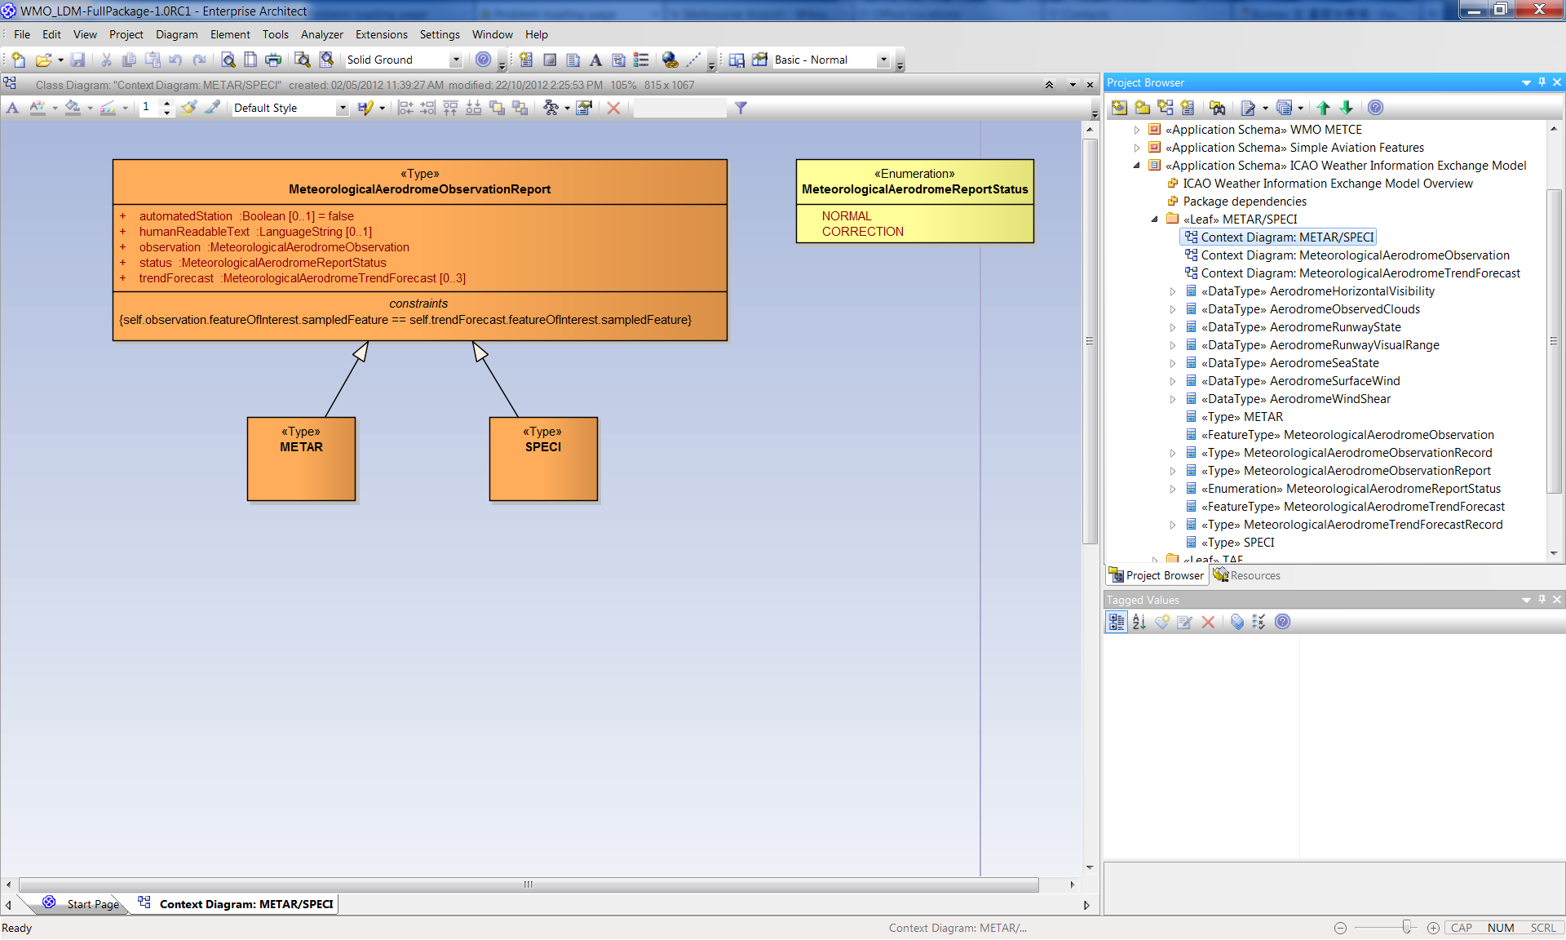
UML Class Diagram on EA

Slide 8
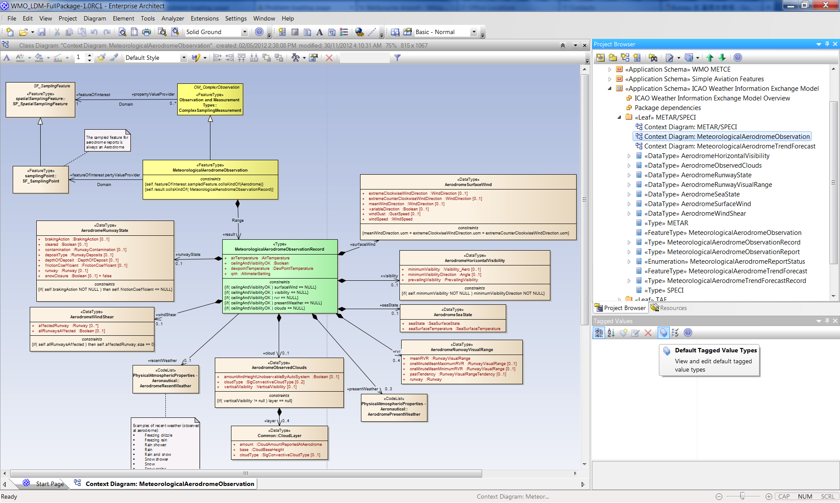

Slide 9
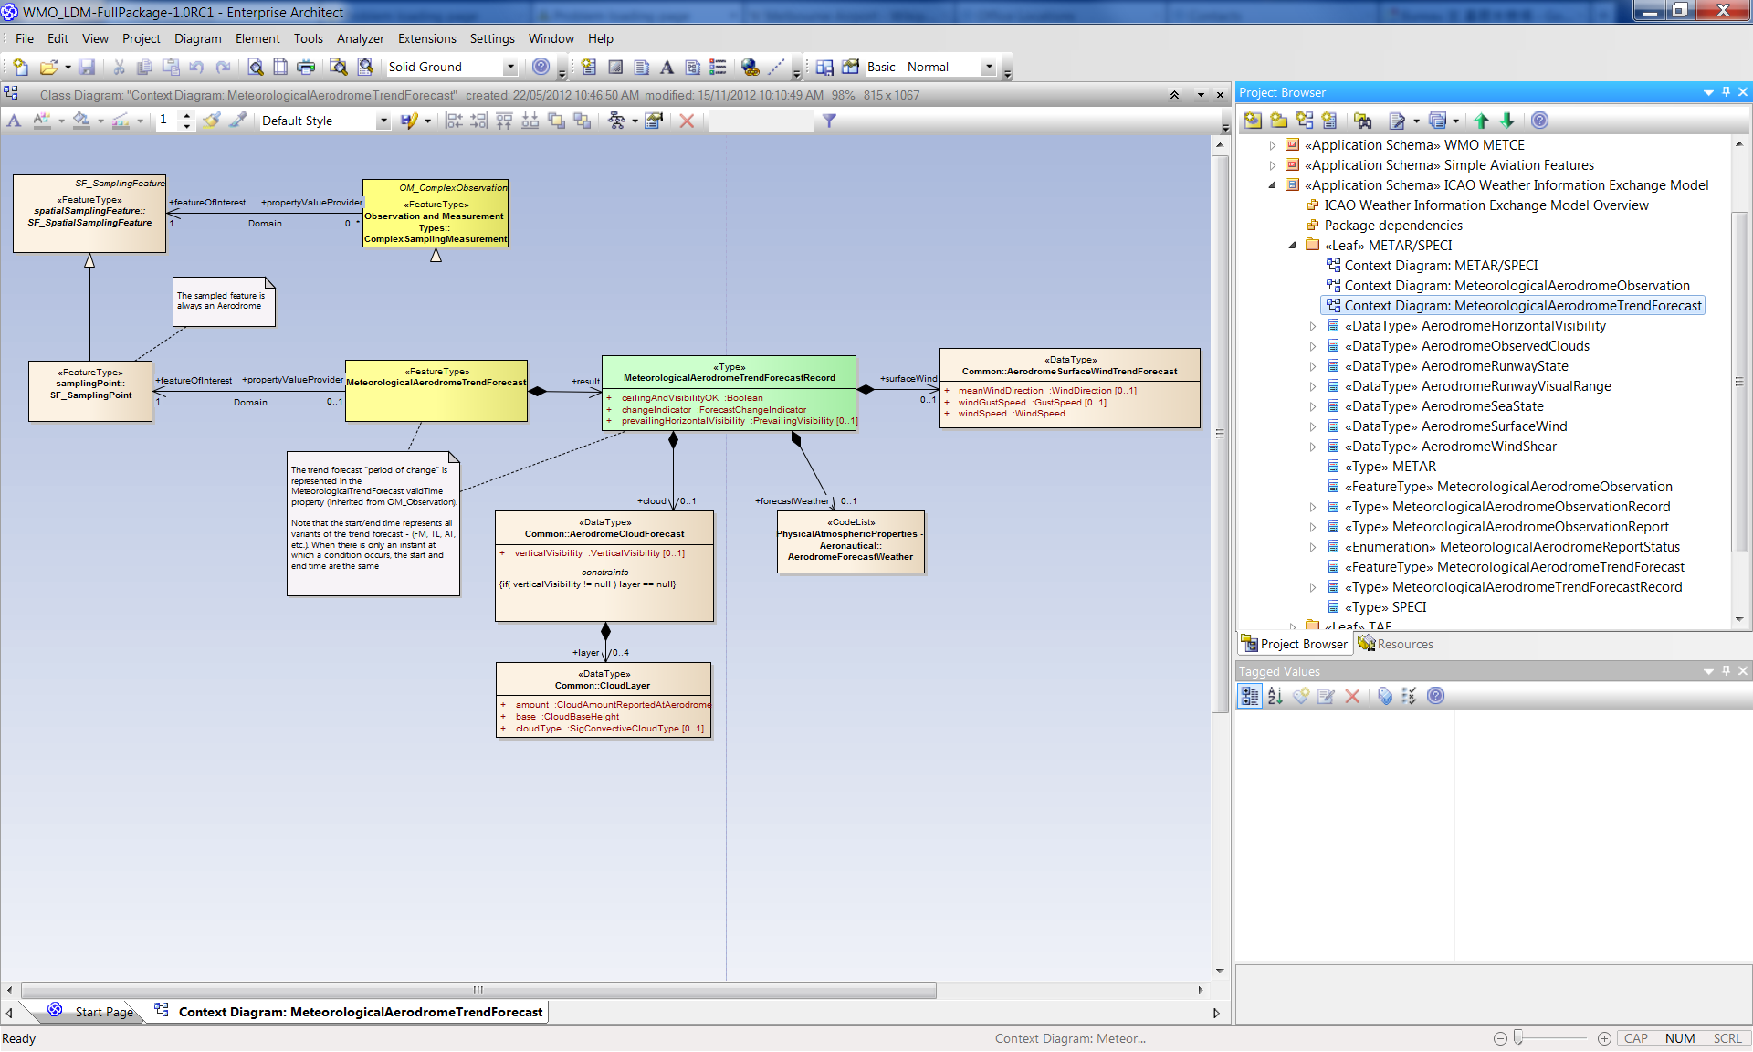

Slide 10
WMO and ICAO LDMs
The LDMs are developed with respect to the domain of governance
  WMO LDM: METCE (Modéle pour l'Échange de Temps, Climat et Eau)
    Generic MET definitions for use in different domains and industries
  ICAO LDM: IWXXM (ICAO Weather Information Exchange Model)
    Strict and complete representation of ICAO Annex 3 products (regulated products)
    Annex 3 business rules enforced
Governance
Body
Other aviation MET specific application schema (e.g. WXXM)
Other
ICAO LDM
(IWXXM)
ICAO
WMO LDM
(METCE)
WMO
ISO191xx, including ISO19136 (GML) and ISO19156 (O&M)
ISO/
OGC

Slide 11
WMO and ICAO LDMs
The LDMs are sub-divided into packages according to features
  METCE
    met-basic
    opm
    metce
  IWXXM
    saf
    iwxxm
Governance
Body
Other aviation MET specific application schema (e.g. WXXM)
Other
IWXXM
iwxxm
saf
ICAO
METCE
WMO
metce
opm
met-basic
ISO191xx, including ISO19136 (GML) and ISO19156 (O&M)
ISO/
OGC

Slide 12
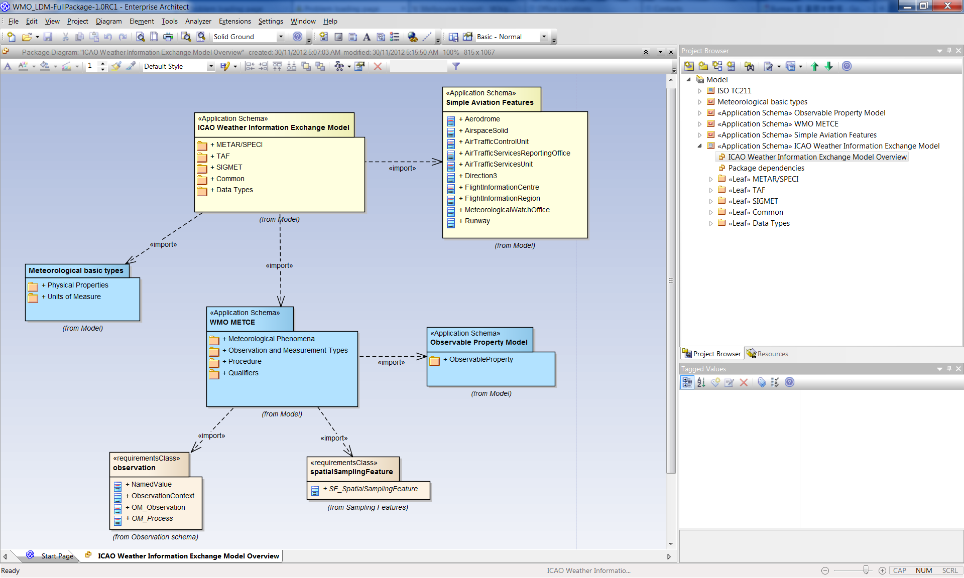
LDMs and Packages on EA
ICAO IWXXM
WMO METCE
ISO191xx

Slide 13
Part II – LDMs in Detail

Slide 14
METCE and its Packages
Package ‘Meteorological basic types’ (met-basic)* contains:
  a palette of classes specializing Measure (or subclasses thereof) for meteorological, hydrological and oceanographic physical properties
  a palette of «CodeList» classes for expressing nominal values of meteorological, hydrological and oceanographic physical properties
  various other common basic types used in describing meteorological phenomena
* This is where most of the TDCF information kicks in

Slide 15
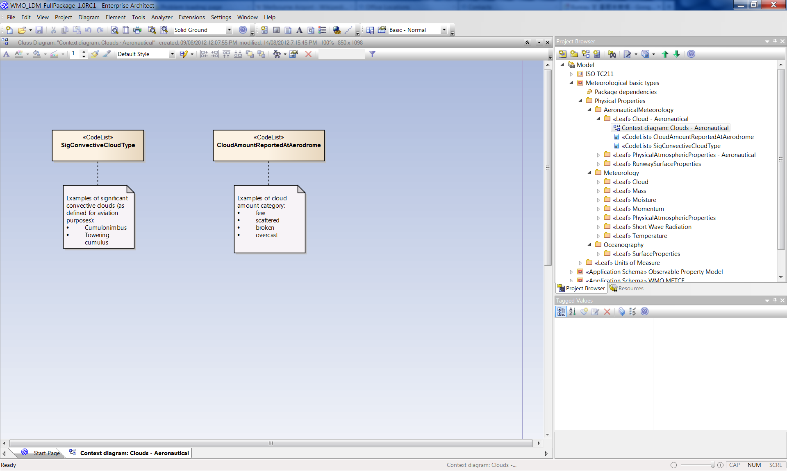

Slide 16
Note:
  ‘met-basic’ is designed to supplement ISO19103 ‘Basic types’. Together they provide a set of classes and XML types required to described the physical qualities of interest to meteorologist
  As GML is currently specified, ISO19103 ‘Basic types’ cannot be specialized. Therefore definition of quantity-value classes is illegal with respect to GML and hence ‘met-basic’ is published as a separate package outside the scope of METCE

Slide 17
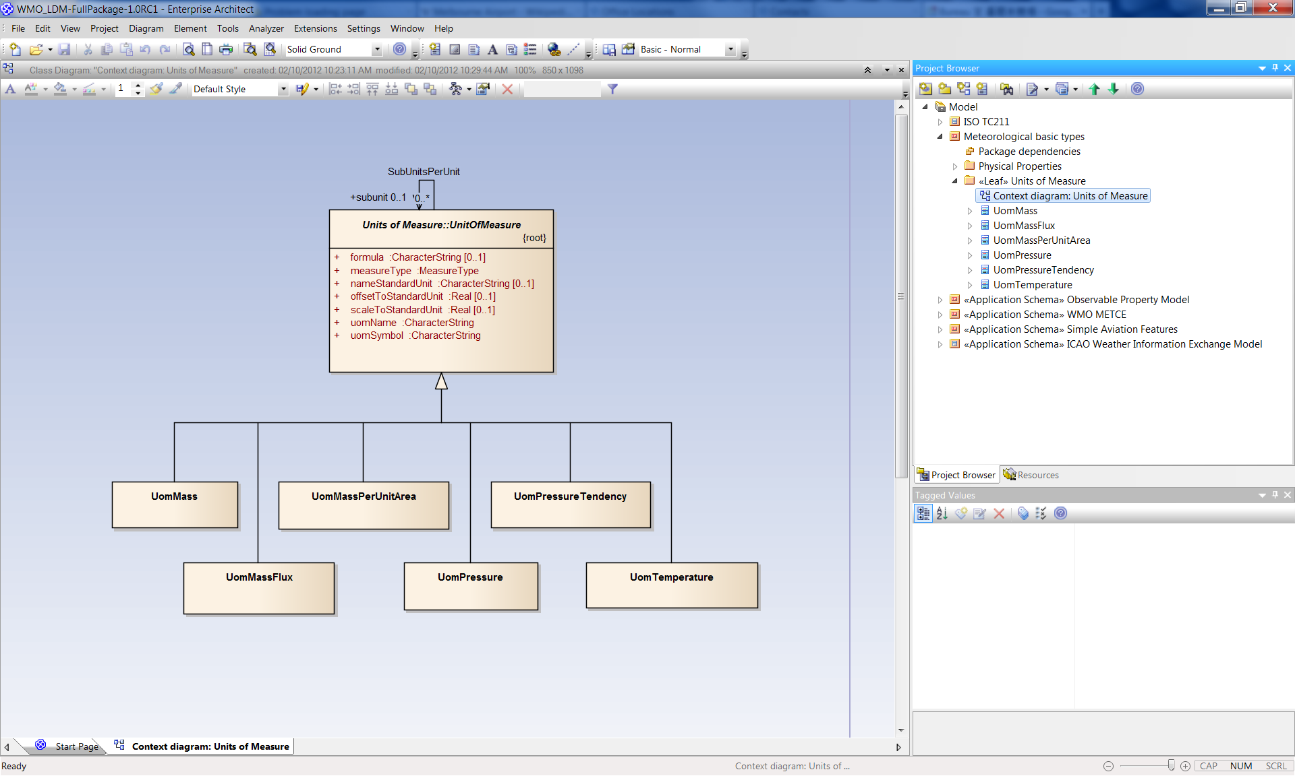

Slide 18
METCE and its Packages
Package ‘Observable Property Model’ (opm):
  Provides a framework for qualifying or constraining physical properties. (e.g. "air temperature" qualified as "daily maximum air temperature" by specifying an aggregation period of 24-hours using the "maximum" statistical function).
  Derived from work undertaken in the OGC Sensor Web Enablement SWG
  As an interim measure, the WMO Logical Model includes the Observable Property Model. Further discussions on the governance arrangements of this model is being made

Slide 19
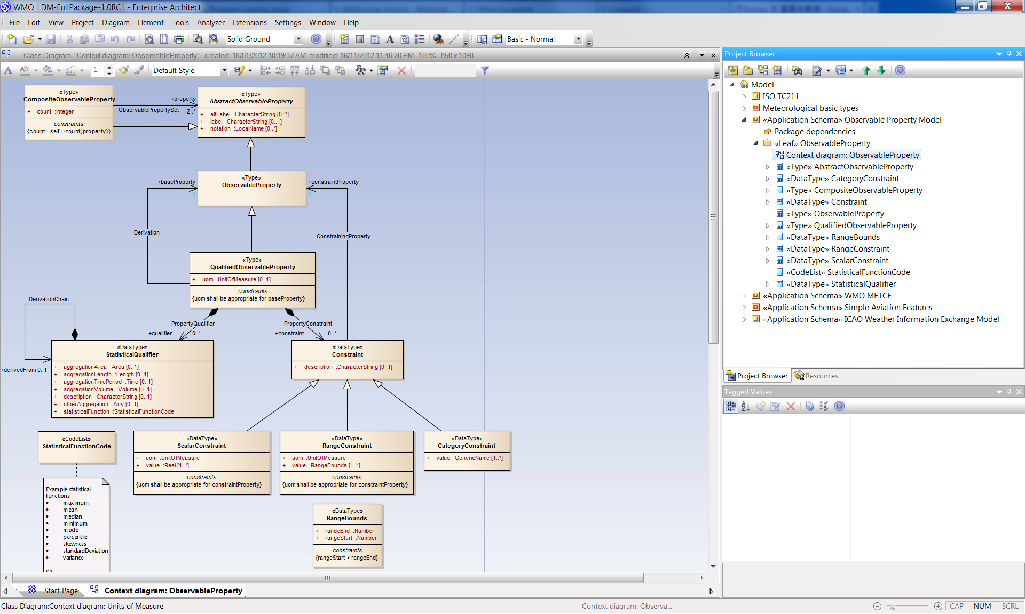

Slide 20
METCE and its Packages
Package ‘METCE’ (metce):
  Intended to provide conceptual definitions of meteorological phenomena, entities and concepts in order to underpin semantic interoperability in the weather, climate and water domain
  Includes:
    specialisations of OM_Observation, OM_ComplexObservation and OM_DiscreteCoverageObservation classes (from ISO 19156)
    a concrete implementation of OM_Process (from ISO 19156)
    a number of meteorological feature types and categorisation schemes thereof
  Typically be imported to provide a baseline conceptual model framework upon which community-specific Application Schema are based

Slide 21
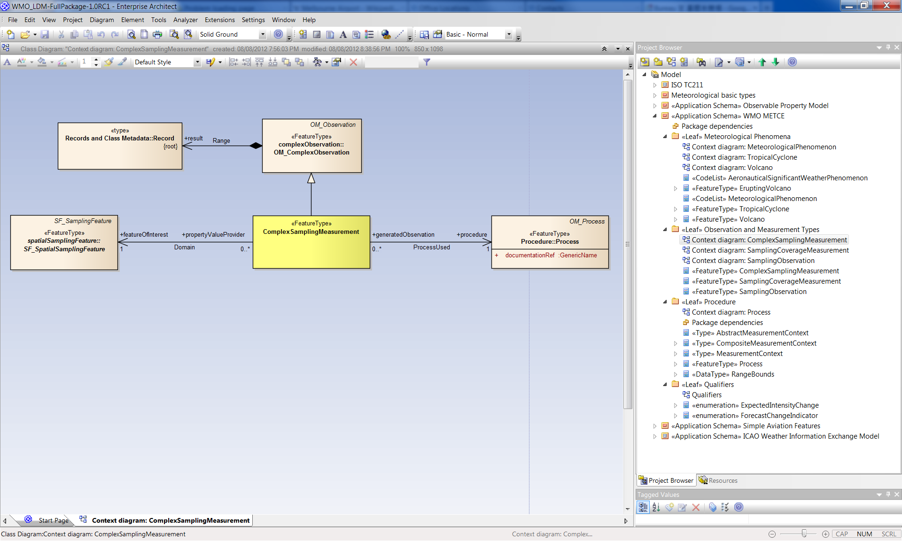

Slide 22
IWXXM and its Packages
Package ‘Simple Aviation Features’ (saf):
  Simplified features from the aviation domain, such as aerodrome and runway.
  These features are not intended for storage or transmission, merely simplified variants of aviation concepts that can be referenced from other packages

Slide 23
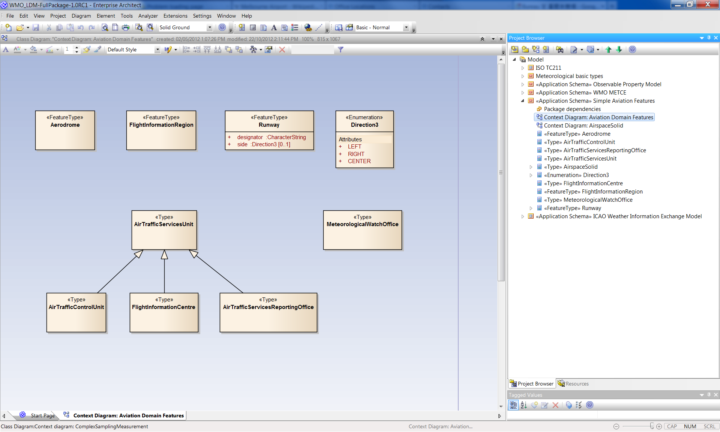

Slide 24
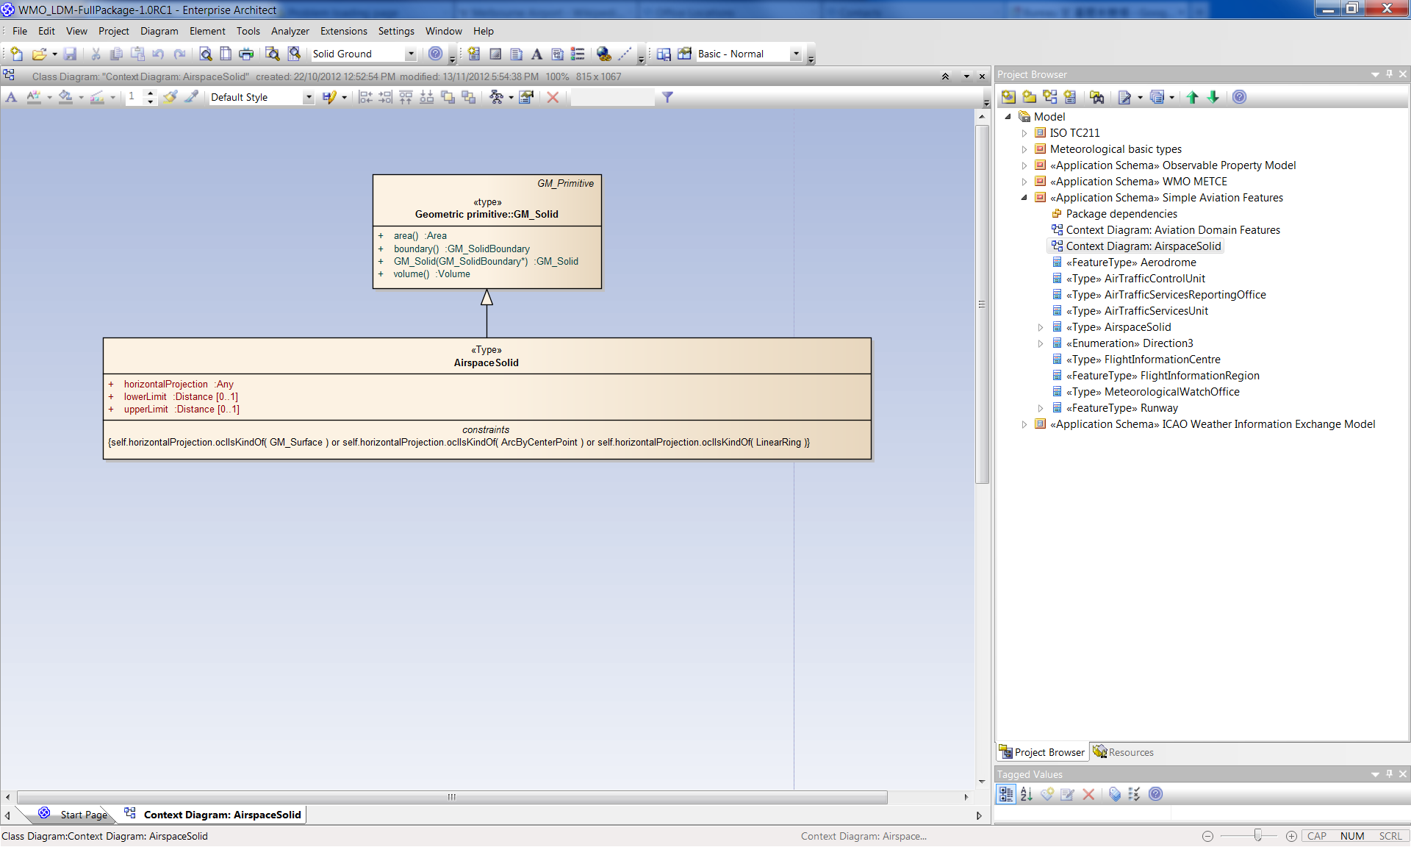

Slide 25
IWXXM and its Packages
Package ‘ICAO Weather Information Exchange Model’ (iwxxm):
  ‘Top level’ package built upon previous and ISO191xx series of packages
  Includes METAR, SPECI, TAF, and SIGMET reports as defined in ICAO Annex 3, 17th edition. This may be expanded in a future version

Slide 26
METAR/SPECI

Slide 29
METAR Example

Slide 30
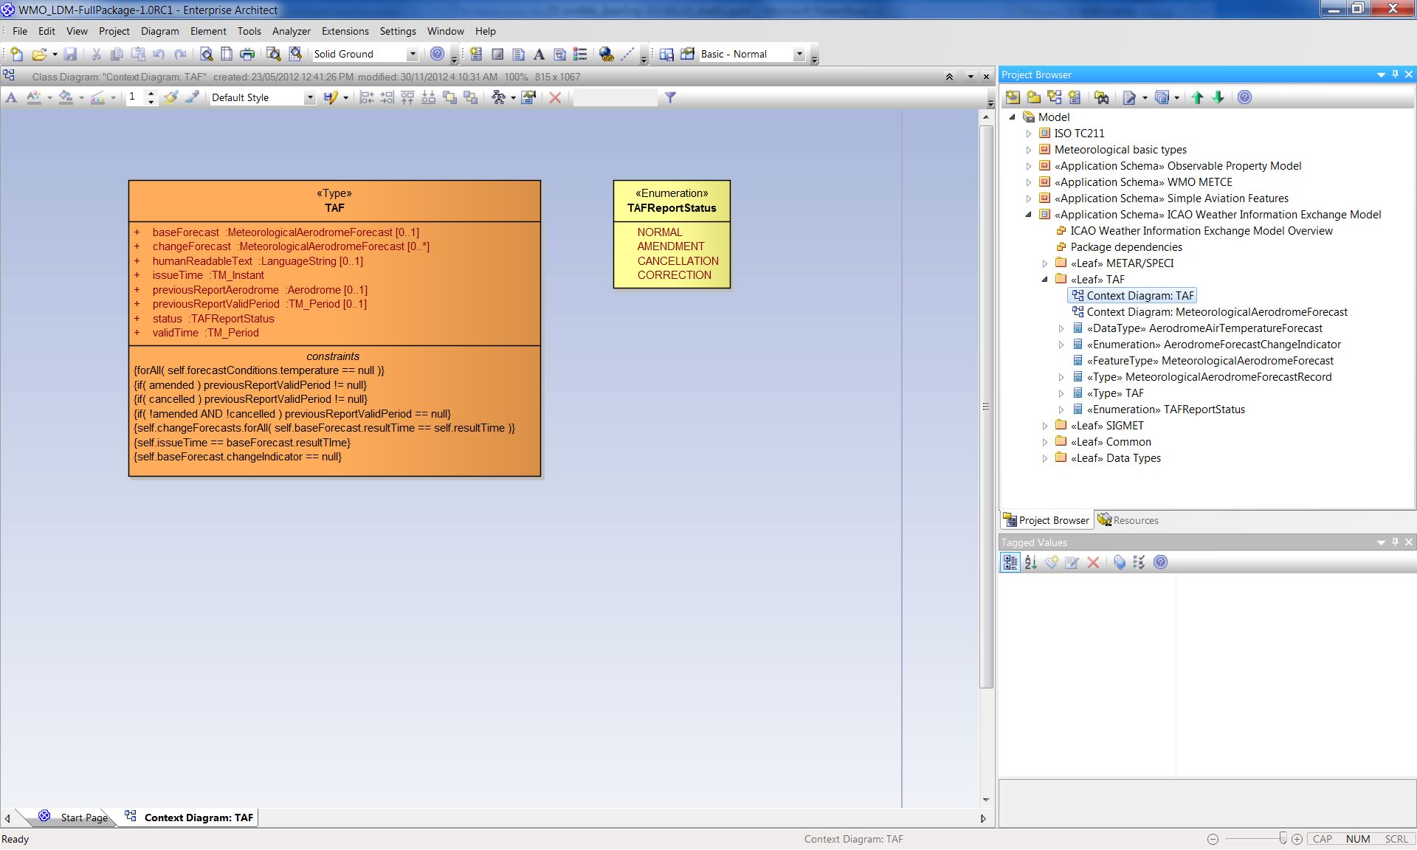
TAF

Slide 31
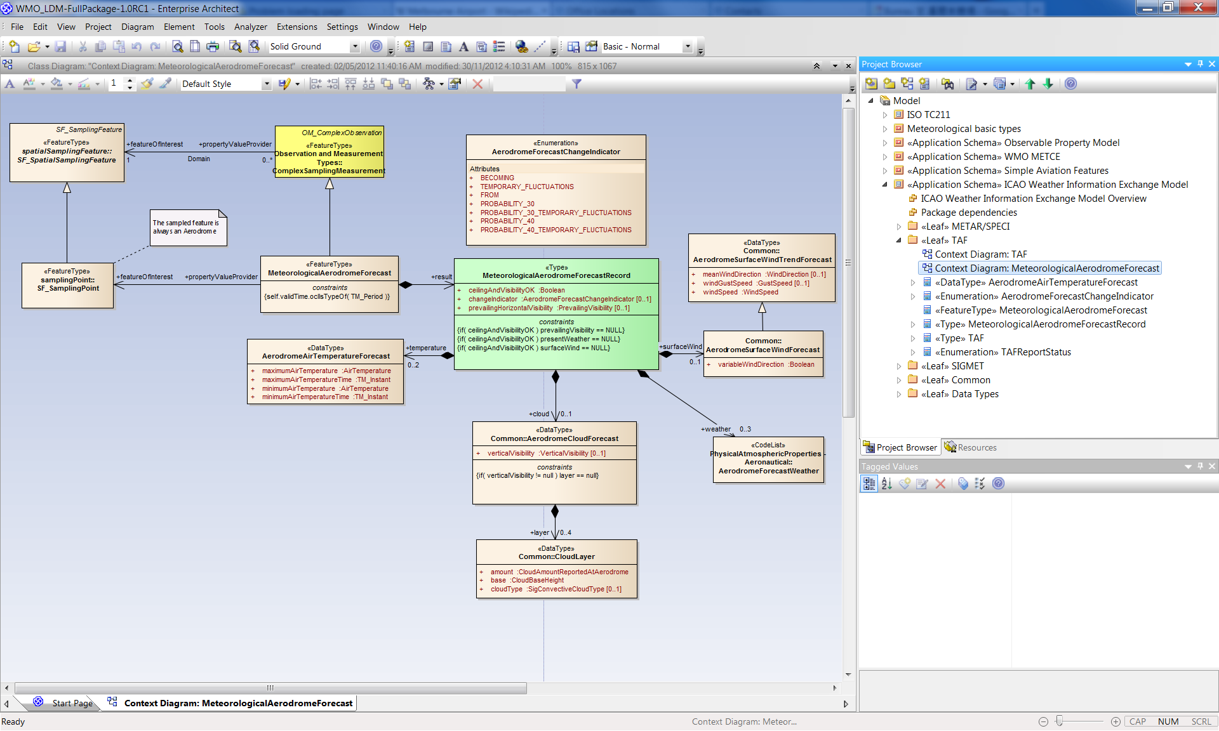

Slide 32
TAF Example

Slide 33
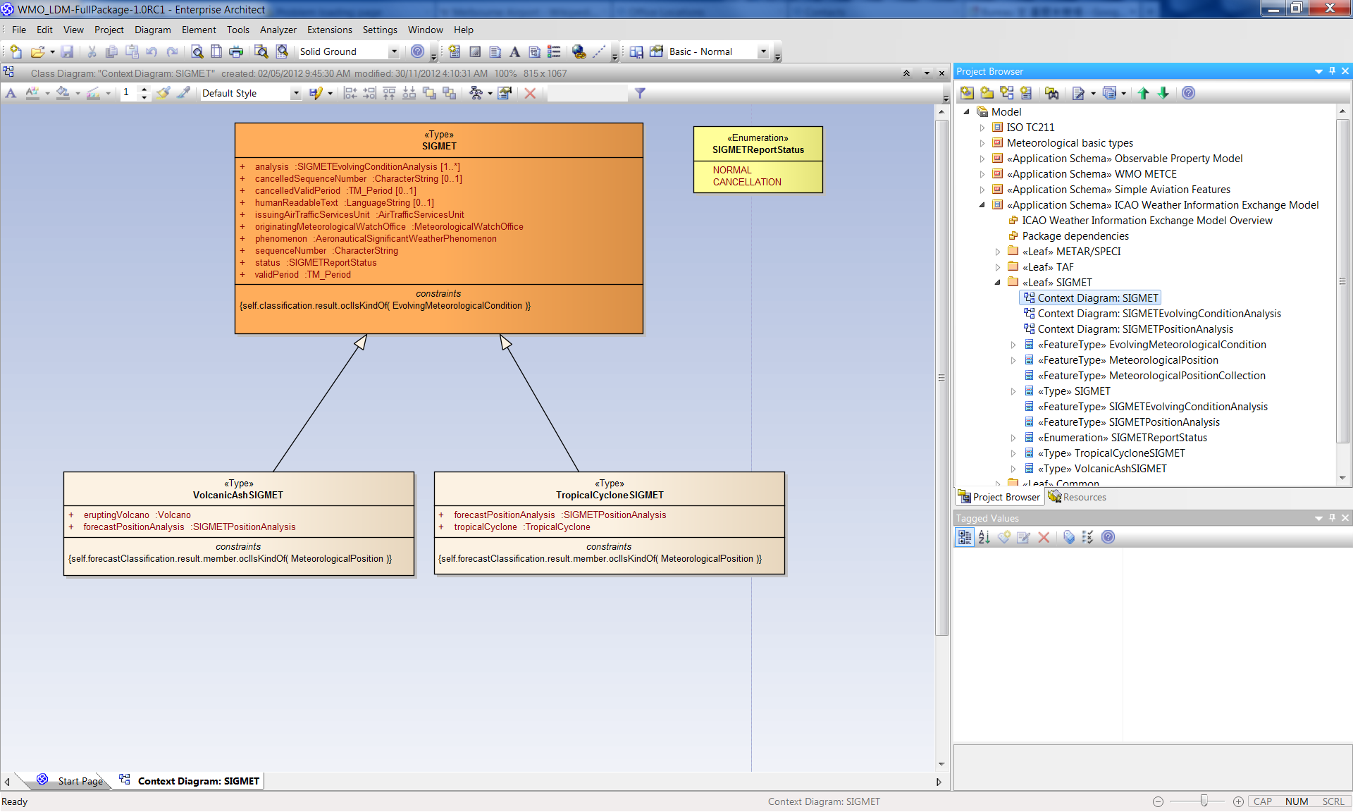
SIGMET

Slide 34
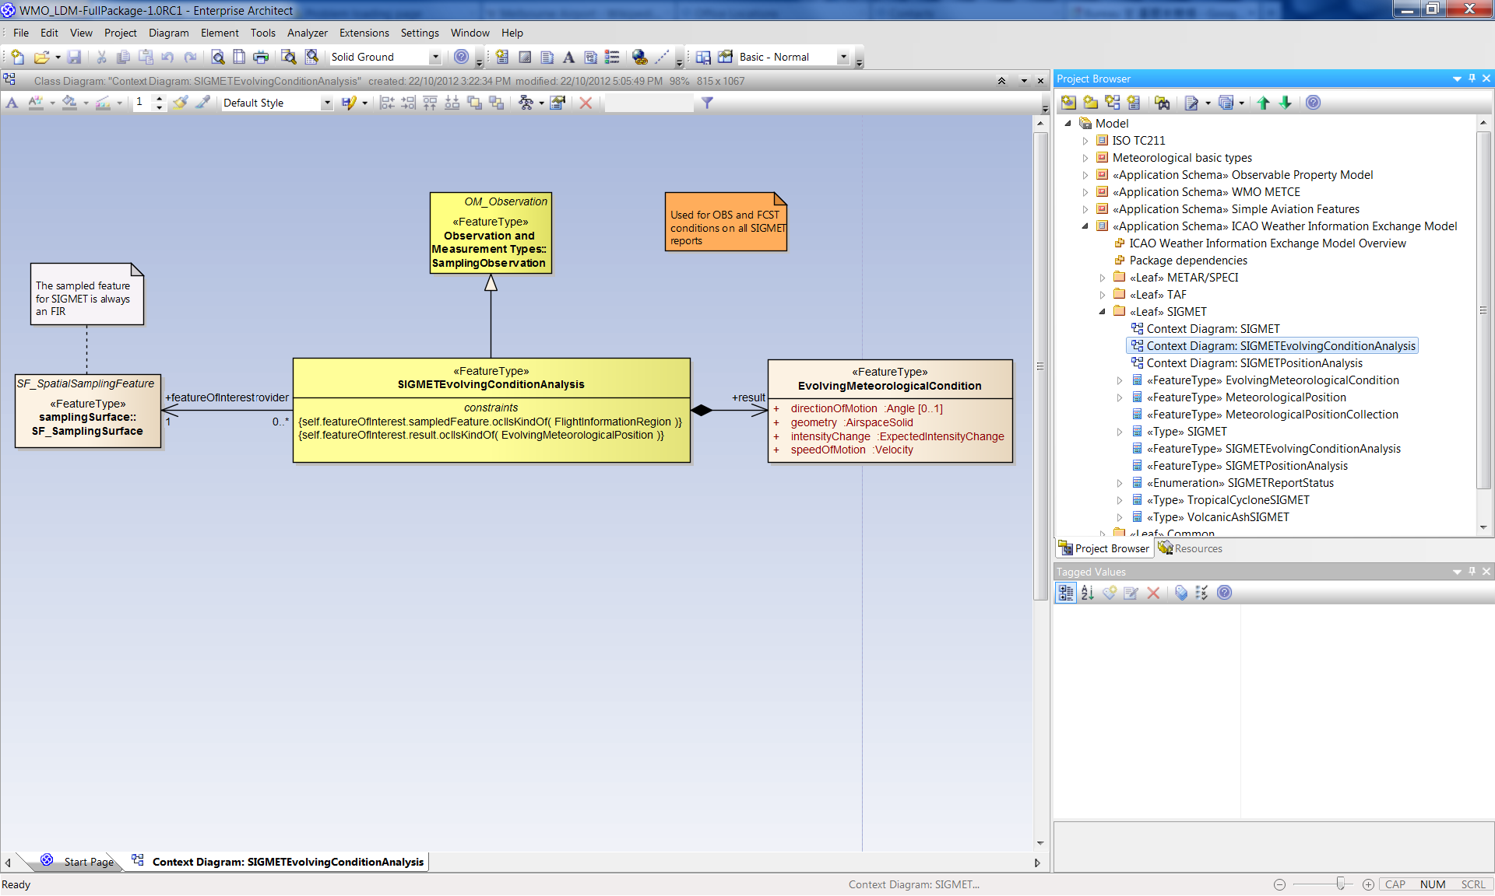

Slide 35
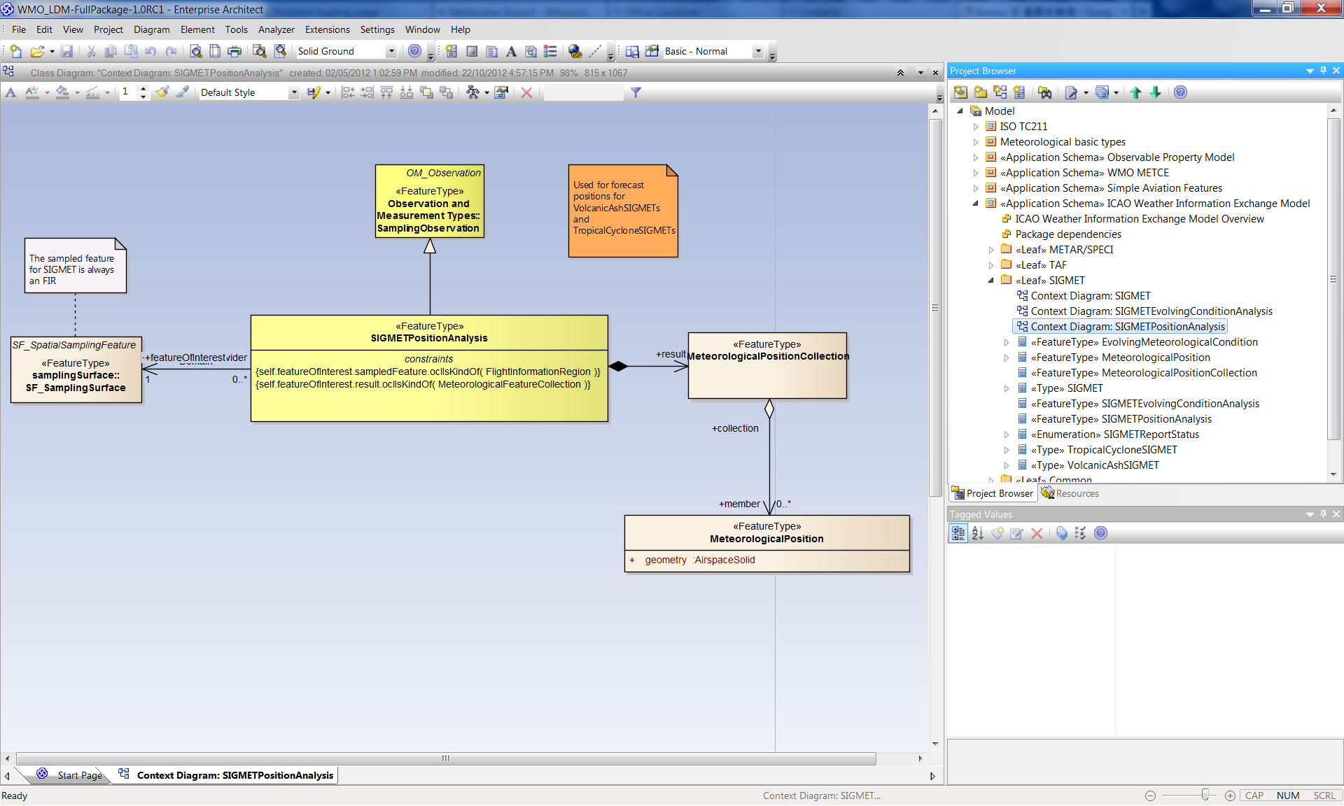

Slide 36
SIGMET Example

Slide 37
Questions and Feedbacks?
Or sent to cbs-tt-avxml@wmo.int
Please start the subject line of your comment with the text [1.0RC1-feedback]

Slide 38
Thank you

Slide 39
Part III – UML to XML Schema Transformation

Slide 40
UML to XML Schema
Transformation
Automatic transformation from UML to XML Schema is carried out by FullMoon
Adapted to realize METCE/IWXXM specific serialization of XML Schema
Further adaptions are required to handle the non-”standard compliant” part of ‘met-basic’ package

Slide 41
Part IV – Instance Generation and Validation

Slide 42
Instance Generation
A preliminary test suggested that a number of XML editors like Liquid XML Studio , NetBeans and <oXygen/> XML Editor are able to create XML Instances with AvXML schemas
To facilitate automatic and/or offline generation of XML instances, a XML-Java binding is made available

Slide 43
Instance Validation
Validating an XML instance with AvXML schemas can be done with XML editors like <oXygen/> XML Editor
Remember to tell the XML editor to also execute the embedded schematron rules during validation

Slide 44


