Slide 1
AvXML 1.0 Release Candidate 1 IWXXM and METCE
Aaron Braeckel
Jan 2013
(on behalf of ICAO and WMO)

Slide 2
Overview
Background
UML and XML
Model Walkthrough
Schedule

Slide 3
Assumptions
Basic understanding of UML
Basic familiarity with Traditional Alphanumeric Codes (TAC)
Basic familiarity with ICAO/WMO OPMET products in ICAO Annex 3 (METAR, TAF, SIGMET)

Slide 4
Components of 1.0 RC1
AvXML 1.0RC1 is published for review at the WMO wiki:
  http://www.wmo.int/pages/prog/www/WIS/wiswiki/tiki-index.php?page=METCE-1.0RC1
AvXML 1.0 RC1 includes:
  Release notes
  Conceptual model (UML)
    Enterprise Architect Project File (EAP)
    XMI format
    HTML documentation package (requires local deployment)
  XML Schemas
    Published online
    Compressed file bundle
  Java bindings for XML Schemas
  Simple tutorial describing METAR and VA SIGMET XML instances

Slide 5
Further information on Release Candidate 1
FAQ page:
  http://www.wmo.int/pages/prog/www/WIS/wiswiki/tiki-index.php?page=METCE-1.0RC1-FAQ
Moderated public review comments:
  CBS-TT-AvXML Google Group
  Note that comments on AvXML 1.0RC1 should be submitted to the Google group using a subject line beginning with the text “[1.0RC1-feedback]”
Temporary HTML hosting
  http://www.ral.ucar.edu/staff/braeckel/avxml/1.0RC1/

Slide 6
ICAO Annex 3
ICAO
WMO
International Civil Aviation Authority
Set aviation weather requirements
World Meteorological Organization
Develop and maintain appropriate code forms to meet requirements

Slide 7
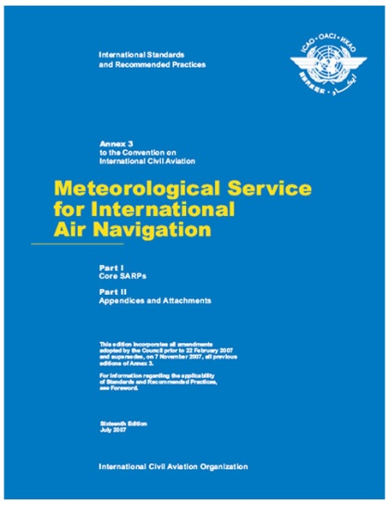
ICAO Annex 3
Amendment 76 – Nov 2013
“States in a position to do so should exchange METAR, SPECI, SIGMET and TAF in a digital form” (XML/GML)
Amendment 77 – Nov 2016
“METAR, SPECI, SIGMET and TAF should be exchanged in a digital form”

Slide 8

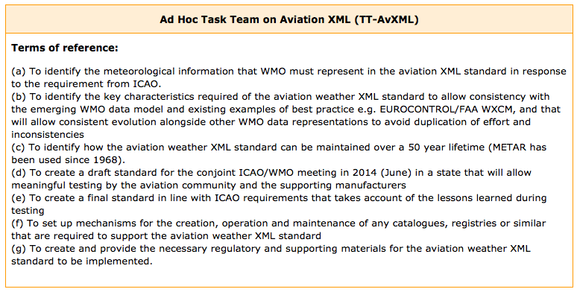
WMO TT-AvXML
Formed to address ICAO requirements
Mutually agreed that ICAO will develop and maintain aviation XML models, WMO will develop and maintain meteorological XML models

Slide 9
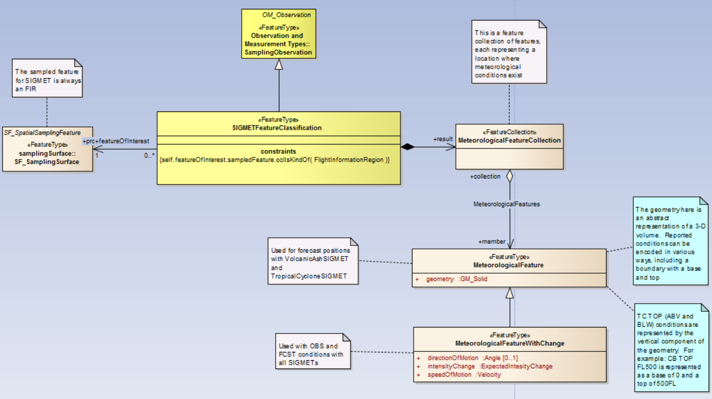

Conceptual Model Components (UML)
Diagrammatic
Abstract
Object-oriented

Slide 10
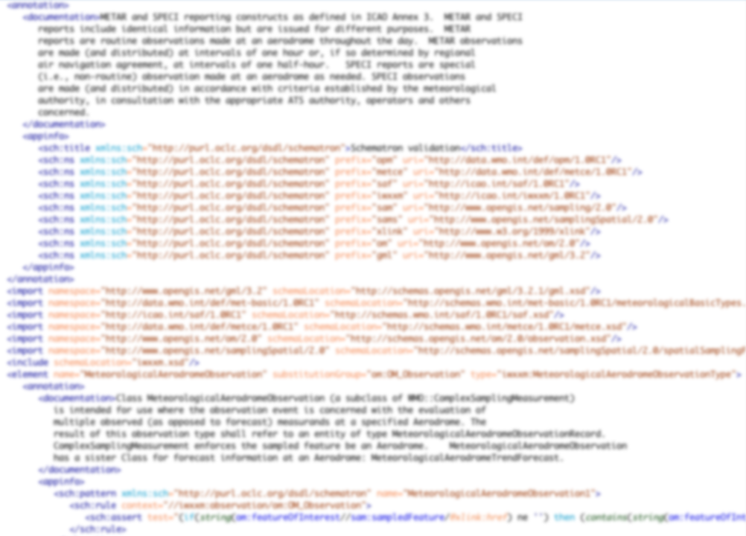
XML Schema Components
XML schema representation of the conceptual model, including Schematron representations of logical rules
Formal description of the expected XML structure of exchanged information

Slide 11
XML
The de-facto, textual standard for encoding structured information
Well-developed, with many other related standards
  XSLT,
  XPath,
  XQuery,
  XML Schema,
  …

Slide 12
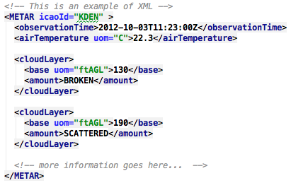
XML Example
A contrived example… No relationship to
ICAO/WMO models

Slide 13

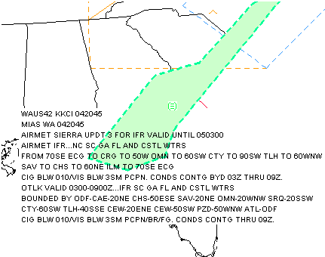
AIRMET Flow
Created as points
TAC-encoded (VORs/waypoints)
TAC locations decoded
Graphics generated
…FROM JNC TO 40NW LAA TO 30ESE TBE TO 50NE TCC TO…..
Human-readable -> Machine-readable = DIFFICULT
Machine-readable -> Human-readable = STRAIGHTFORWARD

Slide 14

Model Packages
ICAO Weather Information Exchange Model (IWXXM)
METAR, SPECI, TAF, and SIGMET representations
Simple Aviation Features (SAF)
Simplified features from the aviation domain, such as aerodrome and runway (relationship to AIXM)
Meteorological Community Exchange Model (METCE)
WMO logical data model, specifically Observations and Measurements (O&M) specializations
MET Basic Types (Met-basic)
Measures, CodeLists and other meteorological basic types
Observable Property Model (OPM)
Qualifications and constraints on observed properties

Slide 15
Standardization
  UML/XML Modeling (ISO 19103)
  Basic types (ISO 19103/GML)
  Space and time (ISO 19107, 19108, 8601/GML)
  Geo-referencing (ISO 19136/GML)
  Units and Measures (ISO 19136/GML)
  Observations and Measurements (ISO 19156/OMXML)

Slide 16
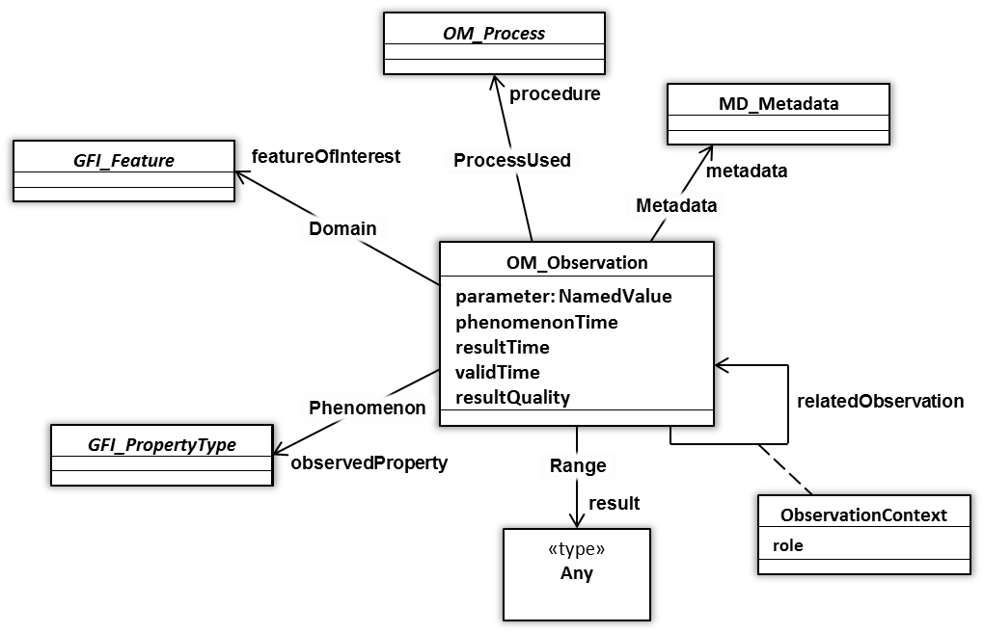
ISO19156 Observations and measurements
OM_Observation: an EVENT whose RESULT is an estimate of a value of some PROPERTY of some THING obtained using a specified PROCEDURE …
Notes:
ISO 19156 ‘Observations and measurements’ provides a conceptual schema for observations and the features involved in sampling when making observations, and specifically designed to support the exchange of information describing both the observing event and the results of the observation between different scientific and technical communities.

Slide 17
Why O&M?
The need to represent a set of phenomena (wind direction and speed) with a time (16Z), a valid period of use (16:30Z to 17:30Z), and other metadata is quite common

Slide 18
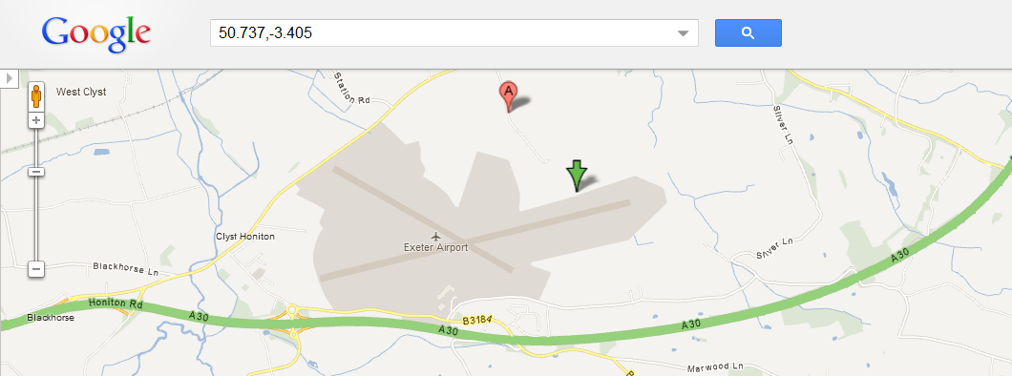
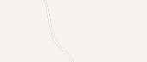
Sampling Features
In meteorology, we define a sampling regime that enables us to observe, measure or simulate the real-world. Sampling Features (from ISO 19156 ‘Observations and measurements’) provide a way to characterise this sampling regime and the relationship to the real-world.
84579:NamedPlace
name = “Exeter Airport”
03839:SF_SamplingPoint
:ComplexSamplingMeasurement
+sampledFeature
+featureOfInterest
+shape
:Point
@srsName “EPSG:4326”
pos = “50.737 -3405”
Notes:
Meteorological observations or forecasts clearly relate to the real world. For example, we may observe the weather for Exeter or provide a weather forecast for the ‘North Atlantic European’ area. However, there is a level of abstraction to resolve:
An observation of the weather for the city of Exeter happens at some representative location within the city or some representative locale nearby
The forecast domain for ‘North Atlantic European’ is specified so that it covers the areas for which a forecast is required
In each case, the ‘observation’ event relates to some sampling regime that is a proxy for the real entity of interest (e.g. the site of the weather station, or the extent of the forecast domain). The observation or forecast is not directly related to real-world entities.
ISO 19156 ‘Observations and measurements’ provides a conceptual model for describing this layer of indirection: Sampling Features. Further specialisations of Sampling Feature are provided based on spatial topology (SF_SpatialSamplingFeature and sub-types thereof).
In all cases identified thus far in meteorology, it appears useful to describe an observation, measurement or forecast with respect to the sampling regime (e.g. the Sampling Feature) and indirectly refer to the real-world entity for which the Sampling Feature is a proxy.
Spatial Sampling Features are considered an essential part of WMO METCE: all observations, measurements and forecasts of meteorological phenomena shall define the ‘featureOfInterest’ as a concrete sub-type of SF_SpatialSamplingFeature.

Slide 19



Simple Aviation Features (SAF)
Simplified representations of aviation features (runway, aerodrome, flight information region, air traffic services unit)
… simplified, referenceable versions of existing AIXM constructs
…developed in a cross-domain manner with AIXM and FIXM developers (aeronautical information and flight information groups)
… based on conceptual modelling framework from ISO 19100 series
SAF
SCH
Geographic Information / Geomatics

Slide 20
IWXXM
ICAO Annex 3 Reports
… encoding of the ICAO Annex 3 reports (METAR, SPECI, TAF, SIGMET) using ISO, OGC, and WMO models
… based on conceptual modelling framework from ISO 19100 series
IWXXM
SAF
SCH
Geographic Information / Geomatics

Slide 21
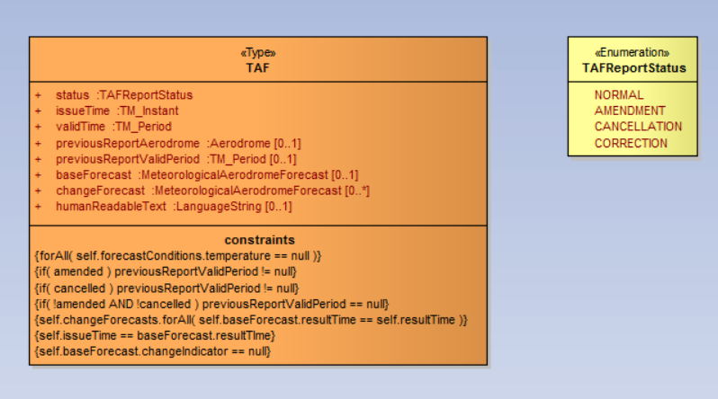
IWXXM Reports
METAR, SPECI, TAF, SIGMET
Reports contain one or more observations and forecasts

Slide 22
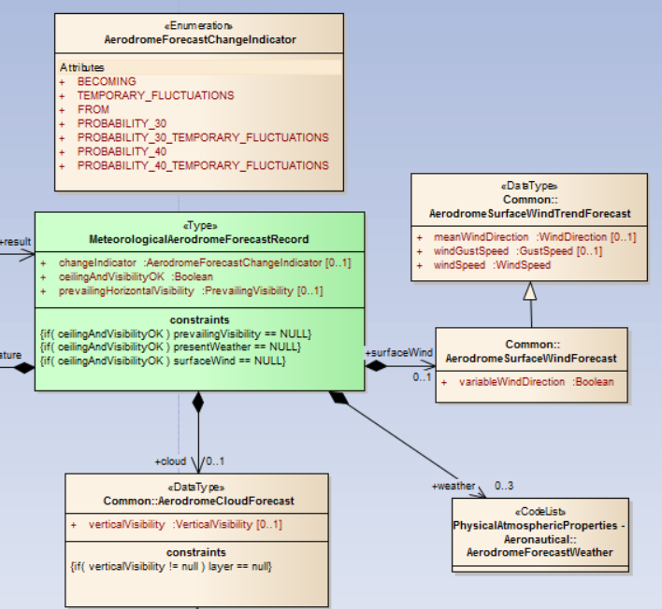
IWXXM Observation and Forecast
Observation results
In the case of IWXXM, they are called Records
TAF Record
(details omitted)

Slide 23

METCE
WMO Logical Data Model:
… provides foundation of generic meteorological concepts, phenomena and entities upon which domain- industry- or community-specific Application Schema can be built
… based on conceptual modelling framework from ISO 19100 series
… scope intended to match WMO UN mandate: weather, climate and water
… intended to complement existing WMO Table-Driven Code Forms
IWXXM
SAF
SCH
METCE
SCH
Geographic Information / Geomatics

Slide 24
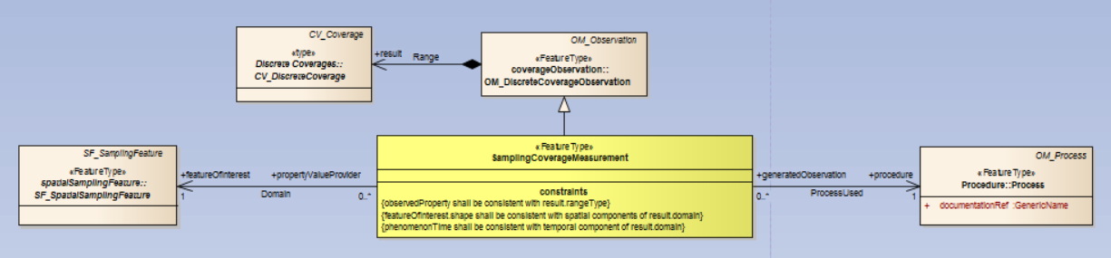
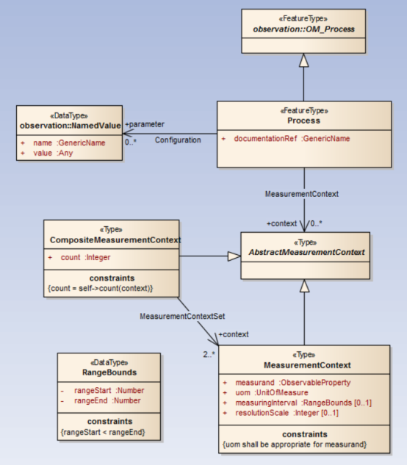
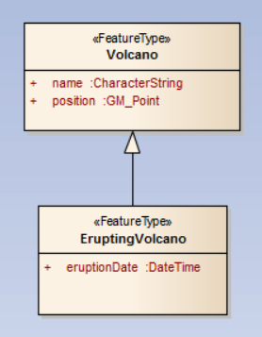
METCE
O&M specializations (observation, process, result)
Meteorological features (cyclone, volcano)

Slide 25

OPM: Observable Property Model
The Observable Property Model (OPM) has been developed under the leadership of Dominic Lowe (UK) within the OGC ‘Sensor Web Enablement’ Standards Working Group & INSPIRE Thematic Working Group
As an interim measure, a stable version of this information is managed under the governance of WMO
Discussions between WMO and OGC regarding the management and maintenance of the authoritative version of OPM are pending
Given that OPM is likely to be managed under a different governance regime, the model has been factored into a separate Application Schema
IWXXM
SAF
SCH
METCE
OPM
SCH
Geographic Information / Geomatics

Slide 26
Observable Property Model Examples
Reported data values are between -40 and +60 Celsius
Reported data values are either “X”, “Y”, or “Z”
Reported data values are the average water surface temperature for Lake Michigan
Reported data values are the minimum observed over Colorado over a two hour period

Slide 27
Met-basic: meteorological basic types
Met-basic provides:
a palette of quantity value classes specialising Measure (from ISO 19103), or subclasses thereof, for meteorological, hydrological and oceanographic physical properties; and
a palette of «CodeList» classes for expressing nominal values of meteorological, hydrological and oceanographic physical properties.
These classes describing meteorological, hydrologic and oceanographic quantity values and nominal property values are derived from the WMO code-tables and governed by WMO.
Currently, Met-basic _ONLY_ includes properties required to support International Air Navigation. In future iterations, it is expected that all terms from WMO TDCF will be included.
IWXXM
SAF
SCH
METCE
OPM
Met-basic
SCH
Geographic Information / Geomatics

Slide 28
MET Basic Examples
Measure – a measured value with associated unit
Vertical visibility
Aeronautical visibility
CodeList – an enumerated string value
Present weather conditions (fog, funnel cloud, etc.)
Cloud amount reported at aerodrome
Runway visual range
Category of braking action associated with runway surface
…
Air temperature
…

Slide 29



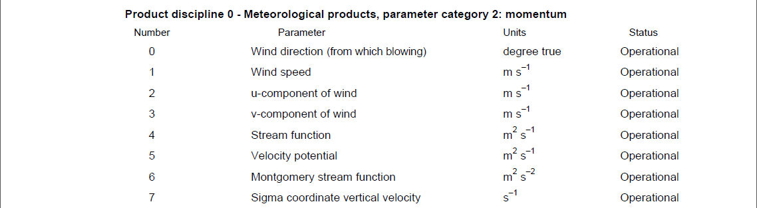
Publication of web-accessible definitions for meteorology
It is within WMO’s mandate to publish authoritative on-line definitions of meteorological phenomena and properties
Each ‘concept’ will be assigned an HTTP URI identifier within the wmo.int domain based on existing codes and structures from the WMO code-tables
It is anticipated that in RC2 the definitions of those physical properties required to support International Air Navigation will resolve to useful information …
http://data.wmo.int/def/grib2/codeflag/4.2/0.2.1
Excerpt from GRIB2 Code- and Flag-tables

Slide 30
Dictionaries/Registers
Information managed outside of the data model in a web-accessible form (ICAO and WMO)
  Code lists
  Coordinate Reference Systems definitions (if needed)
  Units of measure
  Observing/measurement process descriptions
  Measured parameters (air temperature, wind speed, etc.)
  Nil reasons
Different representations:
  Human-readable (HTML)
  Semantic (RDF/SKOS)
  Machine-readable (XML and others)

Slide 31
Standards Relationship
Data Model
Component Agility
Standards Governance Body
High
(months)
Eurocontrol-Specific Components
North American-Specific Components (NAWX)
Europe-Specific Components
Other Stakeholder Components
Individual Organizations
Aviation-Specific Weather Components (WXXM)
Eurocontrol, FAA,
and others
Annex 3 Aviation-Specific Weather Components (ICAO IWXXM)
International Civil
Aviation Organization (ICAO)
General Purpose Weather Components
(WMO METCE)
Meteorological Measures and Code Lists
(WMO Met-basic)
Observable metadata (WMO or OGC OPM)
World Meteorological
Organization (WMO)
GML
ISO 19136
Observations and Measurements
ISO 19156
ISO / OGC
ISO 19103, 19107, 19108, 19115, 19123, …
XML
UML
W3C / OMG
Low
(years)

Slide 32
METAR A3-1 Example
(light reading)
Simple METAR tutorial on WMO TT-AvXML page

Slide 33
Annex 3 Differences
A number of state differences to Annex 3 have been filed with ICAO
For testing and validation of the model, US extensions have been encoded in a US extension to IWXXM
No XML Schema has yet been generated, work in progress

Slide 34
XML Validation
XML schemas may be used to describe valid structure, and therefore validate that an XML document has the expected structure and contents
Validation results in a true/false decision:
True: a specific XML document has the expected structure
False: a specific XML document does not have the expected structure
Note: schemas may be different for different uses!

Slide 35
Validation Cases
Validation can be used to support many different scenarios:
  Strict ingest validation – data entering the system is rejected if it does not meet requirements (compliance through enforcement)
  Lenient ingest validation – data entering the system causes a warning if it does not meet requirements (compliance through annoyance)
  Strict consumption validation – as data is consumed by consumers, any invalid data is rejected
  Lenient consumption validation – as data is consumed by consumers, invalid data is flagged for later investigation or for other purposes
  Data entry validation – validate data when it is entered by humans
  …

Slide 36
Efficient XML
Uncompressed XML introduces additional data volume over TAC code forms due to:
Basic representational changes
Additional encoded information beyond what is available in TAC
There are multiple solutions (depending on the use case) including:
GZIP compression
W3C EXI encoding
…

Slide 37
AvXML 1.0 standard development schedule
[1st Feb 2013] 1.0RC1 review closes
[1-8 Feb 2013] 1.0RC1 feedback clarification
[Feb-Mar 2013] Amendments incorporated for 1.0RC2
[Mar 2013] 1.0RC2 published for review
  Note that further information and training sessions are planned for the ‘4th Workshop on the use of GIS in meteorology’ to be hosted at ECMWF, Reading, UK in early March 2013
[July 2013] AvXML 1.0 published
Meeting regulations described in ICAO Annex 3 is the priority
IWXXM Report and Record types

Slide 38
Tools
UML Browsing
  Enterprise Architect (UML) – free reader
  Reads .EAP files and .XMI files
  http://www.sparxsystems.com/products/ea/downloads.html
  Your web browser
  Reads the .HTML files
UML Editing
  Enterprise Architect (UML) – commercial version
  http://www.sparxsystems.com/products/ea/purchase.html
  Other UML tools (untested)
  Reads .XMI files

Slide 39
Tools (continued)
XML
  Any text editor/viewer
  Oxygen XML Editor
  http://www.oxygenxml.com/
  XML Spy
  http://www.altova.com/xml-editor/

Slide 40
Any questions?
  Please provide your AvXML 1.0RC1 feedback and comments to the CBS-TT-AvXML Google Group
comments on AvXML 1.0RC1 should be submitted to the Google group using a subject line beginning with the text “[1.0RC1-feedback]”
Thank you

