Slide 1
WORLD METEOROLOGICAL ORGANIZATION _________________________
^{COMMISSION FOR BASIC SYSTEMS}
OPAG ON INFORMATION SYSTEMS & SERVICES
Implementation Coordination Team on Information Systems and Services
^{Geneva, 13 Jun– 15 Jun 2012}
^{ICT-ISS/Doc. 3 (12} ^{VI 2012) ____________}
^{Item 3}
^{ENGLISH only}
Report on ET-CTS
(submitted by R.GIRAUD – ECMWF)
12 June 2012

Slide 2
Summary
Review of GTS/WIS summary in all sites
Manual on the GTS
Multicast tests
IPv6 Project
Update on guides (IT security, VPN, FTP,…)
Potential use of ISO 3166 two letter country codes in GTS Manual
RMDCN Next Generation Project
WMO website

Slide 3
Manual on the GTS (1)
Important outcomes of this meeting were some recommended amendments to the Manual on GTS Volume I and its guides, including recommendations for the removal of some obsolete guides from the WMO web pages and consolidation of GTS and WIS web pages.
The meeting strongly emphasised that Volume II of the Manual on GTS is over 10 years out of date and needs to be addressed as a matter of priority by CBS and possibly withdrawn.
Noting that many components of the Volume II are obsolete but that some elements were still needed, possibly by inclusion in Manual on GTS Volume I, it agreed to the ET-CTS member from RA I to revise the sections WMO No. 386, Vol II, B.I-1 to B.I-15 in consultation with RA I Members and to present as an information paper to CBS as an indication of the amount of revision required across all sections of Volume II.

Slide 4
Manual on the GTS (2)
  It reviewed the Manual on GTS (WMO No 386) and the Manual on WIS (WMO No 1060) and recommended updating the Manual on GTS to include an explanatory note clarifying the definition of a GTS circuit. It recommended to add following text in Manual on GTS in section 1.3, at the end of principle 2:
  Note that in this document, the word circuit is traditionally understood to represent a physical link between two Centres, but in today’s modern telecommunication systems, could also be understood to represent a logical stream of data between two Centres which are interconnected using a network. In this latter situation, several circuits could be implemented from a given Centre over a single physical connection to a network.

Slide 5
Multicast tests: background
Multicast:
    Efficiently transferring one copy of some data to multiple destinations
    Replication takes place within the network
This RMDCN trial will add experience of dealing with:
    Service Provider (OBS) requirements gathering
    Performance constraints (site’s connection speed)
    Multicast Software Applications
Multicast support is a requested feature for the Next Generation RMDCN
EUMETSAT conducted successful Internet/GEANT2 multicast trials in 2011
Two “independent” tests: UFTP (open source) and Tellicast (commercial)

Slide 6
EUMETSAT Tests – Using Tellicast
EUMETSAT product dissemination scenario
One site (EUMETSAT) sends data files
    Other sites receive data files (or request block retransmission)
    Eventually all sites have a synchronised set of files
Software for testing
    Laptop distributed to all sites
    Primary test will be Tellicast software
More details on these test in a separate paper

Slide 7
ECMWF Tests – Using UFTP
GISC-GISC data exchange scenario
One site (ECMWF) sends data files
    Other sites receive data files (or request block retransmission)
    Eventually all sites have a synchronised set of files
Software for testing (similar to current RMDCN Test PC)
    Based on Ubuntu Linux with additional software
    Available as VMware disk image, or bootable CD-ROM ISO
    Primary test will be uFTP software (file copy)
    Supporting tests with dbeacon, ssmping (network availability)

Slide 8
Multicast issues summary
Multicast over the IPv4 Public Internet is unlikely being available due to the need for multicast support across all hops between source and end users
UFTP and Tellicast seem to be the two candidate protocols for multicast file transfer
What would Tellicast cost and what is the risk of a single provider solution across WIS?
UFTP has some potential performance issues which need to be studied in RMDCN testing
A key application of multicast is likely to be GISC to GISC exchange
Multicast should be available as an option on the RMDCN by 2016. The meeting agreed to report to CBS XV on the progress of the multicast trials and recommend that the outcome of studies should be reviewed in 2014 in order to begin implementation if the decision is to proceed with multicast.

Slide 9
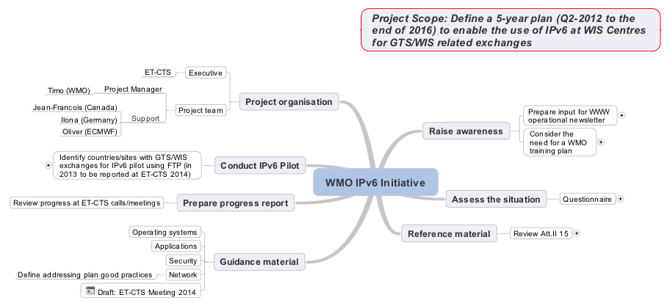
IPv6 Project

Slide 10
Update on guides
Guide on VPN
Guide on IT Security
  Have been updated and will be maintained
Guide on Internet practices
  Is very outdated
  A lot of documents are available on the Internet
  The ET will select some web pages that are considered relevant
Guide on FTP
  The current guide is outdated
  The ET will review its content to include SFTP/FTPS aspects
  Content of the Guide might be merged into another guide

Slide 11
Potential use of ISO 3166 country codes
Attachment II-5 of the Manual on the GTS defines two letter geographical designators for use in abbreviated GTS headings. The table is divided into two parts. Table 1 has country or territory designators, while table 2 contains area designators.
ISO 3166 also defines two and three letter country codes and questions if it would be easier for WMO to utilize these two and three letter codes rather than maintain its own set.
The meeting noted that an overriding principle in WIS is to seek to adopt international standards were possible rather than making up and maintaining special WMO solutions.
However, it was concerned that the migration would still require extensions to meet the needs of the GTS switching so that benefits are unlikely to justify the effort.
It recommended not to adopt ISO two letter country codes at this time, but to check with ET-OI just in case ET-OI could provide a better idea of the cost/benefits.

Slide 12
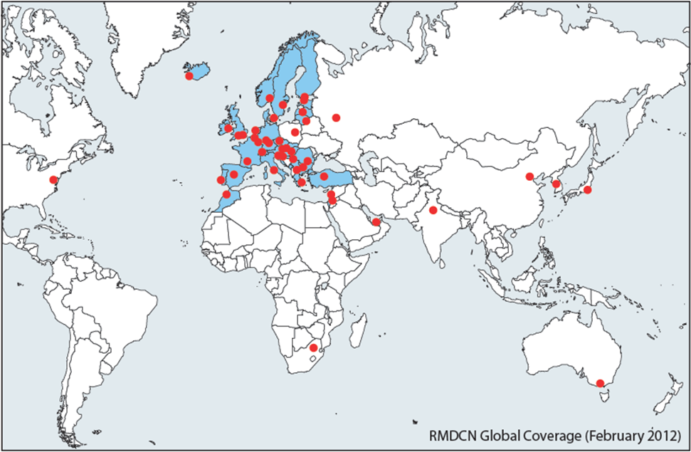
RMDCN : current geographical coverage

Slide 13

RMDCN : procurement process plan
Plan presented to the TAC Committee at its 42nd session (October 2010) to initiate a procurement process for a new RMDCN
Phase 1, preparation of the requirements, took place in 2011. They were reviewed by the ECMWF committees in October 2011 and the plan was approved by ECMWF Council in December 2011.
Phases 2, ITT documents have been published on February 15th, answers were received on April 23rd
Phases 3, after ECMWF Council approval in December 2012, migration will start in 2013

Slide 14
RMDCN : Timeline

Slide 15
RMDCN : 2013 planning
Deadline to submit orders to be part
of the Initial Deployment
1 July
Project Kick-Off
January
Orders for pilot sites
15 March
Payment will start for all pilot sites
Global network Acceptance Test
December - mid-January 2014
Operational Service Commencement Date
mid-October
Acc. Agreement
for pilot sites (if needed)
January - March
Individual handover of sites
before mid-December
Tests for pilot, including pilot reliability acceptance tests
mid-May – mid-October
For each site payment will start after site reliability acceptance tests
Pilot sites agreed
January

Slide 16
GTS and WIS web pages
The meeting noted the multiplicity of web pages under the GTS, WWW, and WIS with links to manuals and guides, many of which need updating.
Noting that the Secretariat is in the process of obtaining a content management system which will facilitate the integrating of the WIS and GTS pages and their maintenance, the meeting requested the Secretariat to, at least for the time being, rationalize and simplify the current web pages and links to a common page
It noted that this also applies to the right hand side bar.
It also requested that, subject to CBS approval of the ET-CTS recommendations, the Secretariat should remove the links to the old guides.

