Slide 1
ICT-ISS (Geneva, 13/15-Jun-2012)
Doc 5.2(4): Report from IPET-MDI
Jeremy Tandy

Slide 2




Establishing Application Schema for OPMET
Met CC (Meteorological
Common Constructs)
ICAO MetCC
GML Schema
«derived from»
ICAO Application Schema for aviation OPMET.
WMO Logical Data Model:
… provides foundation of generic meteorological concepts, phenomena and entities upon which domain- industry- or community-specific Application Schema can be built.
… based on conceptual modelling framework from ISO 19100 series.
… scope intended to match WMO UN mandate: weather, climate and water.
… intended to complement existing TDCF.
METCE (Modéle pour l'Échange
de Temps, Climat et Eau)
«imports»
«derived from»
WMO METCE
GML Schema
«imports»
OMXML
GML Schema
ISO 19103 Conceptual schema language
ISO 19107 Spatial schema
ISO 19108 Temporal schema
ISO 19111 Spatial referencing by coordinates
ISO 19115 Metadata
ISO 19156 Observations and measurements
«derived from»
GML 3.2
XML Schema

Slide 3

TT-AvXML delivery schedule
Release Candidate 1 (RC1)
  [2012/07/01] WMO METCE RC1
  [2012/08/01] WMO GML Schema RC1
  [2012/09/01] ICAO Met CC RC1
  [2012/09/01] ICAO GML Schema RC1
[2012/09-2012/12] TESTING
Release Candidate 2 (RC2)
  [2012/12/01] WMO METCE RC2
  [2013/01/15] WMO GML Schema RC2
  [2013/02/01] ICAO Met CC RC2
  [2013/02/01] ICAO GML Schema RC2
[2013/02/01] Freeze models WMO
[2013/04/01] Freeze models ICAO
[2013/07/01] Formal publication
Delivery of WMO METCE and associated GML Schema are intended only to support ICAO requirement at this stage.
DISCLAIMER: WORK IN PROGRESS!
Future: aim for an approach to publish data that can be communicated using the Common Alerting Protocol (CAP)

Slide 4
TT-AvXML modelling procedure (summary)
Begin with BUFR Table D Templates; these define structure and content of BUFR messages (albeit with additional encoding info).
Use Generalised Coordinates / Significance Qualifiers to modularise TAF, METAR/SPECI and SIGMET Templates on implementation Class-models expressed in UML.
Implementation model is tightly coupled to BUFR format.
More abstract Logical Data Model (‘sympathetic’ to original BUFR Templates) derived from implementation model.
Strong linkage between Logical Data Model and TDCF retained: UML Tagged Values reference BUFR descriptors, «CodeList» Classes reference TDCF Code-tables. [impending issues regarding mismatch of TDCF Code Tables with ICAO Annex 3 requirement]
Sympathetic Logical Data Model restructured into ‘harmonised’ model based on ISO 19156 ‘Observations and measurements’.
Requires TDCF Codes published as web-accessible resources.

Slide 5
Application Schema applicability
WIGOS metadata != discovery metadata
Station metadata != discovery metadata
Next steps for METCE: develop Application Schema for Climate Observations including Logical Data Model for observing stations (Requirement from CCl).
… may lead to revamp of Stations Gazetteer (Vol A): Register of observing station entities conformant with Application Schema
Need for well-defined interface with initiatives from other Technical Commissions to be determined (WaterML2.0 co-developed by OGC and CHy)

Slide 6
METCE relationship with TDCF
Benefits of a model-driven approach to defining data-exchange standards accepted by IPET-DRC and IPET-MDI.
Model-driven approach and TDCF encoding provide complementary benefits – approaches are not exclusive.
Application Schema (aka Logical Data Model) describes content and structure of information to be exchanged – similar role to TDCF Templates.
Can model-driven approach be applied more broadly to WMO data exchange standards?
More work required to understand how the model-driven approach should be applied to operational data exchange; no proposal to retrofit model-driven approach to existing code-forms.
WMO Regulation does not require use of TDCF Templates … but use of TDCF Templates has been essential to achieve consistent & interoperable data exchange between Members during Migration to Table-Driven Codes. Do Regulations need changing?

Slide 7
Derivation of platform-specific encoding
TT-AvXML: GML Schema for OPMET will be automatically derived from UML using software components.
Best practice encoding rules for a specific technology platform can be systematically defined and codified in software to support automated derivation of platform-specific encoding from the Logical Data Model.
If it works for GML …
Logical Data Model defines which BUFR descriptors are necessary to encode information in BUFR (UML Tagged Values: “bufrDescriptor”).
Proposal: it should be possible to automatically generate BUFR Templates by processing the UML model …
Significant scepticism regarding capability for fully automated derivation of TDCF templates.
More work required to develop the approach before assessment of applicability can be made.

Slide 8
IPET-MDI and IPET-DRC recommend in principle the approach of using a Logical Data model to drive the development of data representations – especially with respect to communities outside the World Weather Watch. IPET-MDI and IPET-DRC ask that OPAG-ISS recommend to CBS that CBS should consider endorsing the approach in principle, and that CBS should task an Expert Team to further develop the approach by 2016 [including the development of an approach for automated derivation of TDCF Templates from the Application Schema]. The Expert Team should include domain experts from Hydrology and Climatology.
Enforcing the use of TDCF Templates (specifically BUFR Table D Sequences) in data representations would be a far more productive approach for interoperability in the short-term. Such a change would require updating the Technical Regulations.
IPET-MDI will discuss with OGC and ISO how they can work together with WMO to create thematic standards for the weather, climate and water domains.

Slide 9
Publication of TDCF Codes and Code-tables as web-accessible Registers
Well-governed, open-standard data exchange formats and controlled vocabularies are central to interoperable exchange of information about weather, climate and water.
TDCF Code-tables … Register: “an official list or record”; a list governed by some Authority.
WMO codes and concepts are not published in a web-accessible form. Focused on World Weather Watch.
Organisations beginning to publish fragments of TDCF Code-tables on behalf of WMO. Ad-hoc publication may lead to a fragmented patchwork of definitions with poor or non-existent provenance lacking assured maintenance.
WMO should provide authoritative definitions for meteorological concepts and phenomena for use by the global community – not just World Weather Watch.
Note: ET-WISC and TT-AvXML requirements

Slide 10
Technical requirements: global identifier
Each individual entity, definition or code shall be uniquely identifiable within a global context.
Term ‘#6’? … resolution of the term needs context:
  GRIB Code-table 4.2, Discipline 0 (meteorology), Category 0 (temperature), term #6 = ‘Dew-point temperature’.
Global identifier: HTTP URI
  <http://data.wmo.int/def/GRIB/Code+Flag/4.2/0.0.6>
Hackable HTTP URIs – truncating the identifier forms a valid identifier for the Code-tables within which it is published …
  GRIB Code-table 4.2: <http://data.wmo.int/def/GRIB/Code+Flag/4.2>
  GRIB Code- & Flag-tables: <http://data.wmo.int/def/GRIB/Code+Flag>
  etc.

Slide 11

Internet access not required …
<http://data.wmo.int/def/GRIB/Code+Flag/4.2/0.0.6>
Opaque identifier; reference to a definition somewhere.
HTTP URI: use the web to find the definition.
Authority: «wmo.int» domain-name provides provenance.
… but it’s still only an identifier!
  <urn:ogc:def:nil:OGC::AboveDetectionRange>
  [0 12 003]
URNs and BUFR descriptors are Identifiers too – you need to know a priori how to resolve them.
HTTP URI: an Identifier with a definition that’s easy to find.
No Internet access for operational systems: cache a local copy; use DNS-magic …

Slide 12


Human-readable identifiers? Choices …
Opaque identifier: machine-readable …
  <http://data.wmo.int/def/GRIB/Code+Flag/4.2/0.0.6>
Alternative identifier: human-readable …
  <http://data.wmo.int/def/GRIB/Code+Flag/4.2/dewpoint>
Human-readable identifiers good for developers; easier to understand.
Issues: (a) error prone encoding / typos, (b) internationalization, (c) number of characters, and naming conflicts are harder to avoid.
Opaque, human-readable … or both: multiple identifiers?
Should identifiers be “opaque” or “human readable”?

Slide 13
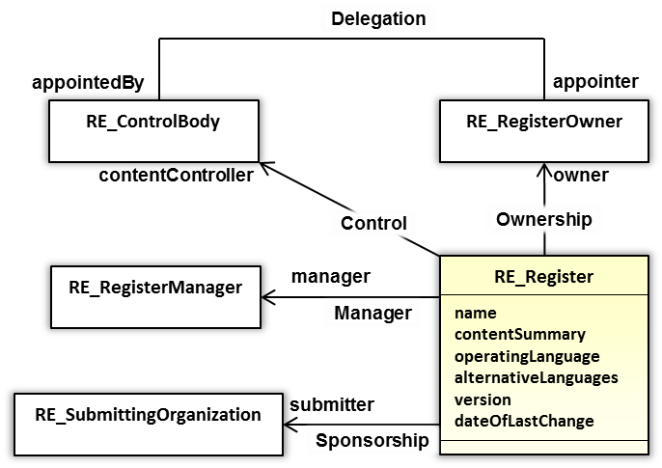
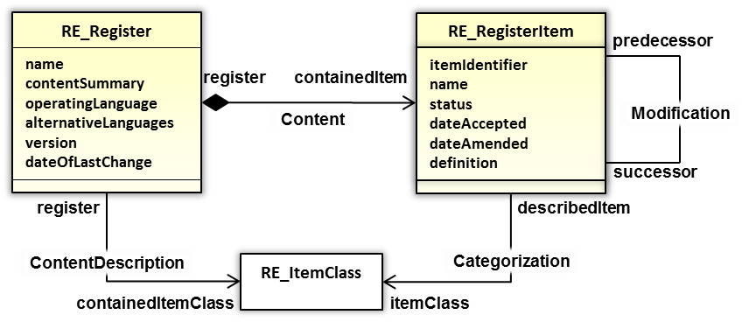
ISO 19135 Procedures for item registration
ISO 19135 ‘Geographic information – Procedures for item registration’ specifies procedures to be followed in establishing, maintaining and publishing registers of unique, unambiguous and permanent identifiers, and meanings that are assigned to items of geographic information.
TDCF Code-table = Register, TDCF Code ≈ RE_RegisterItem

Slide 14





ISO 19135 Procedures for item registration
NMHS’s etc.
WMO Secretariat
IPET-DRC
WMO CBS
RE_SubmittingOrganization
RE_RegisterManager
RE_ControlBody
RE_RegisterOwner
sponsor
proposal
RE_ProposalManagementInformation
dateProposed
justification
status
disposition
controlBodyDecisionEvent
controlBodyNotes
registerManagerNotes
proposedChange
{amendmentType}
Process / workflow for managing change to Register is highly analogous to Software Change / Defect management.
Web-based tooling is commonplace.

Slide 15
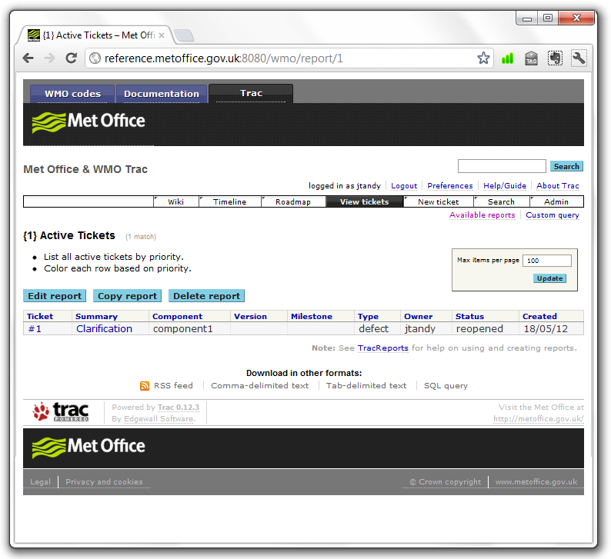
RE_RegisterManager
RE_ControlBody
Wiki enables online collaboration for proposal resolution
RE_SubmittingOrganization

Slide 16


Met Office pilot implementation
Pilot implementation of web-accessible register concept.
Domain name: «reference.metoffice.gov.uk»
HTTP URI path … substitution:
    <http://data.wmo.int/def/grib/code+flag/4.2/0.0.6>
    <http://reference.metoffice.gov.uk/grib/code+flag/4.2/0.0.6>
        Deployed on Amazon EC2 (small) instance
        BUFR Table A, BUFR Table B Classes 11, 12 & 20 + assoc. Code-table
        GRIB Code-tables 0.0, 4.1 & 4.2
        Common Code-tables C-1, C-6, C-11, C-12 & C-13.
        Software components developed by Met Office for the pilot implementation shall be made available to WMO and Members under open-source license.
        Met Office is prepared to host the registry of TDCF codes on behalf of WMO
16

Slide 17
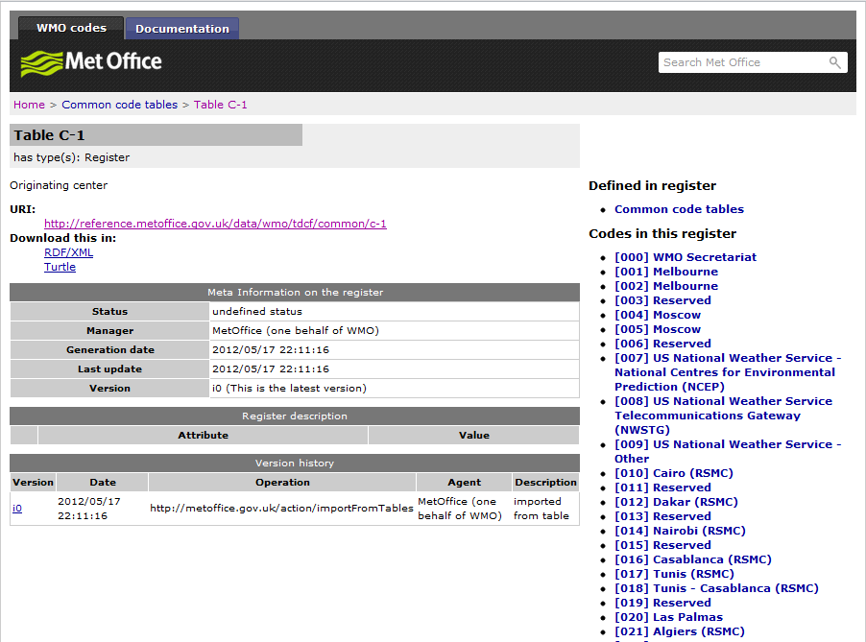

Slide 18
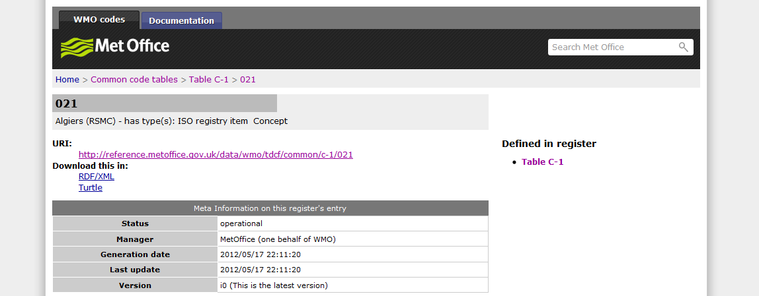
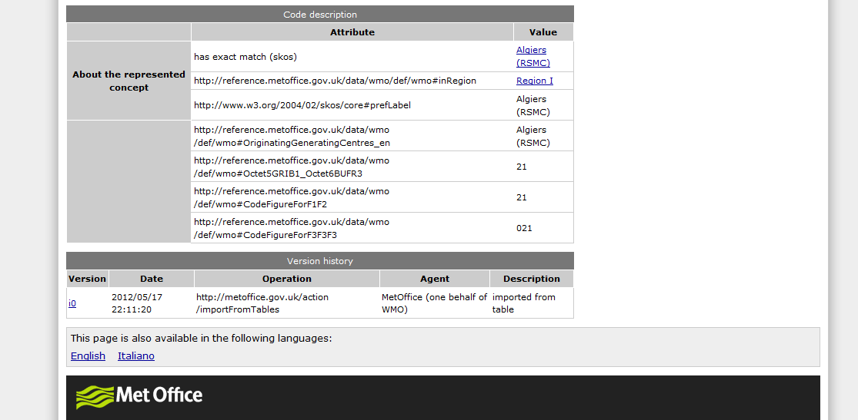

Slide 19
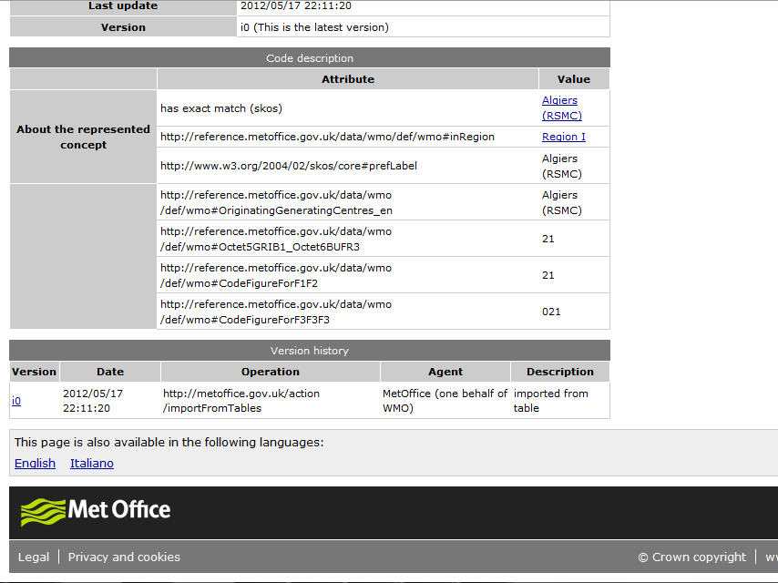
Notes:
versioning support; access can be provided to snapshots of the Code or Code-table as necessary
multilingual support; only English and Italian for now!

Slide 20
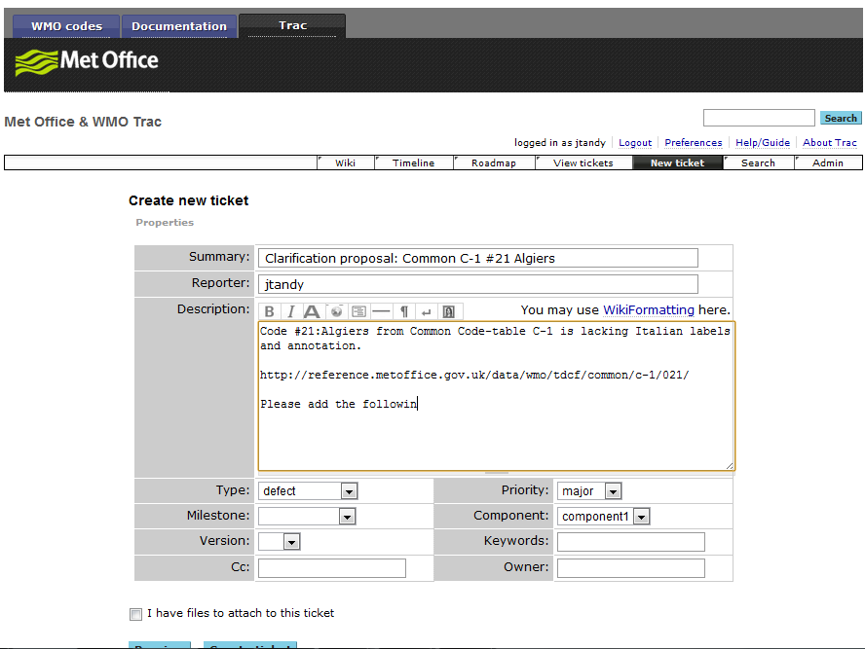
clarification
Notes:
TRAC process configured to match ISO 19135 procedures; particularly Proposal types and status-codes

Slide 21
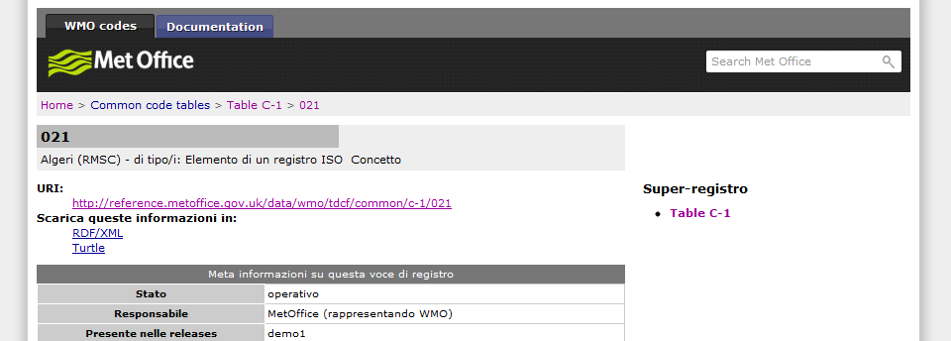
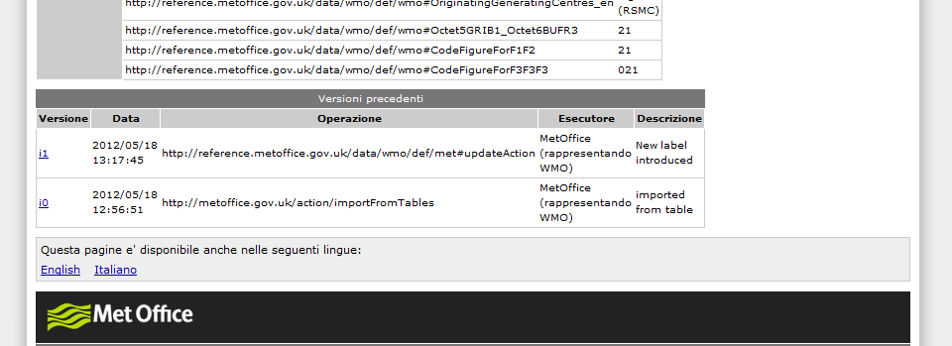
Notes:
Code updated; new version i1 … date of update, reason, responsible agent and description of change included

Slide 22
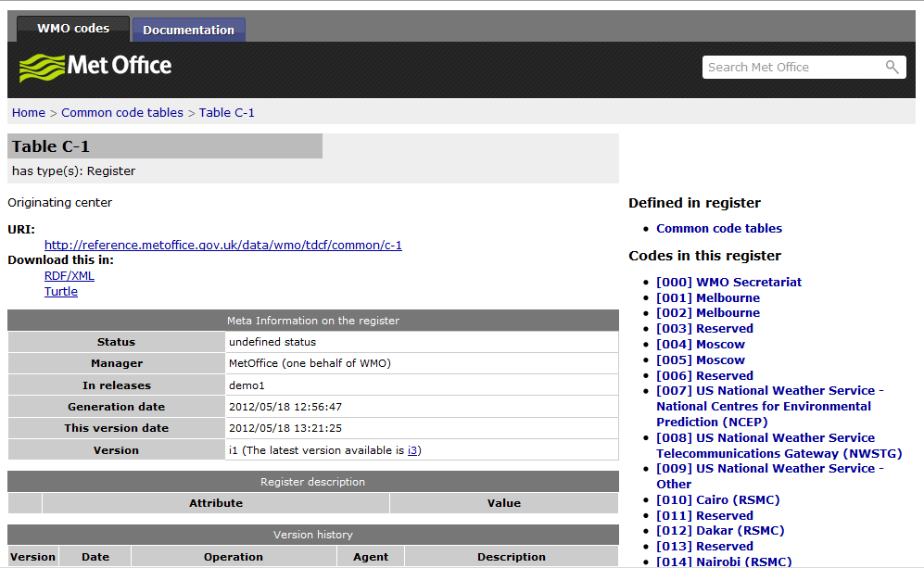
Notes:
release ‘tagging’: i1 is marked as [In release] “demo1”

Slide 23
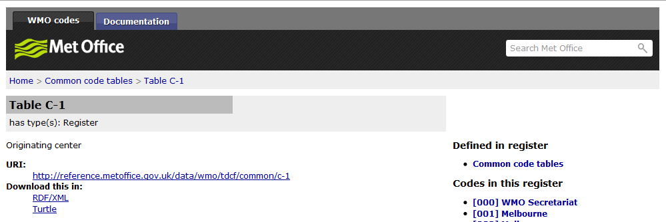
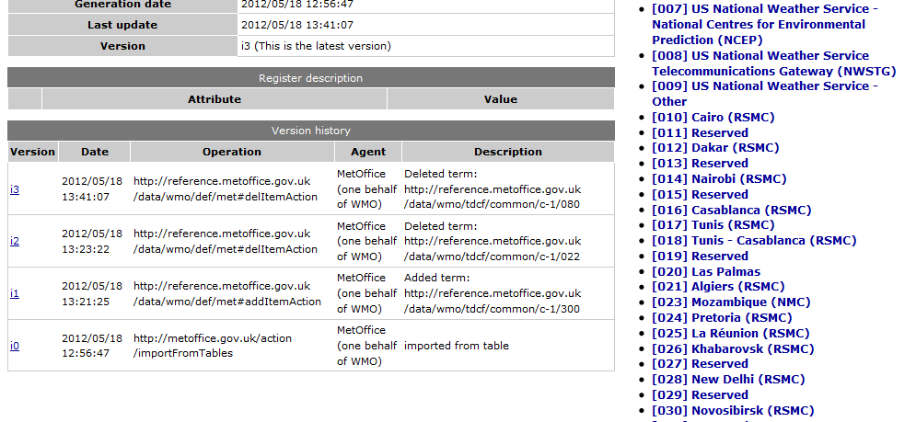
Notes:
current version i3 excludes term #22
version i3 is not in release “demo1”

Slide 24
IPET-MDI and IPET-DRC recommend in principle the approach of using a web-accessible register to publish, and possibly maintain, the TDCF Codes. However, further work is required (sponsored by OPAG-ISS) to validate the proposed register structure, ensure that the entries are correctly specified, implement the remaining Code-tables and to check that the registry is fit for purpose, prior to formal adoption by WMO.
The work should also examine deployment options for ‘high-availability’ & ‘private network’ (e.g. no internet access) in support of operational data exchange …
Timescales must reflect ICAO requirement to support bilateral exchange of OPMET information via XML from mid-2013.
The discussion on on-line change/defect management tools was inconclusive.

Slide 25
New Common Code-tables?
GRIB, BUFR and CREX overlap in scope; physical parameter, statistical operations etc.
No generalised mapping between GRIB and BUFR or CREX.
Multiple definitions of similar concepts; each precisely defined according to usage in the TDCF encoding specification.
Non-expert users may not understand the nuances of each variation … why are there so many choices?
BUFR Table B
[0 12 003] Dew-point temperature | Kelvin | 0.1
[0 12 024] Dew-point temperature | Celsius | 1
[0 12 103] Dew-point temperature | Kelvin | 0.01
GRIB Code-table 4.2 (Parameter)
[Meteorology (0) Temperature (0) #6]
Dew-point temperature | Kelvin

Slide 26
New Common Code-tables?
Propose: new Common Code-tables C-15 ‘Parameter category’ and C-16 ‘Parameter’.
Abstract definition of physical phenomenon (e.g. no unit of measure specification).
BUFR Table B
Base on GRIB Codes … better categorisation than BUFR?
Superior basis for mapping with external (3rd party) definitions.
[0 12 003] Dew-point temperature | Kelvin | 0.1
[0 12 024] Dew-point temperature | Celsius | 1
[0 12 103] Dew-point temperature | Kelvin | 0.01
Common Code-table C-16 (Parameter)
------SKOS:broader------
[Meteorology (0) Temperature (0) #6]
Dew-point temperature
GRIB Code-table 4.2 (Parameter)
[Meteorology (0) Temperature (0) #6]
Dew-point temperature | Kelvin

Slide 27
…
No decision regarding Common Code-tables minuted …

Slide 28
WMO Core Metadata Profile – overview
WMO Core Metadata Profile (version 1.2) is now officially endorsed by Presidents of Technical Commission (PTC).
As WIS has entered an operational phase, the Metadata standard now enters a new phase of its lifecycle where operational systems depend upon it. It is essential to provide rigour in change management of the Metadata standard.
Provision of tooling alone is insufficient to drive the adoption of best-practice metadata publication and management. Tooling must be supplemented with outreach and deployment of metadata specialists within metadata organisations who publish and maintain metadata.
Outreach only recently started with TT-ApMD.
Incremental change to version 1.3 proposed for CBS 2012 (minimal change, backward compatible).

Slide 29
WMO Core Metadata Profile – formal requirements vs. guidance
IPET-MDI recognise difficultly for users to validate WIS Discovery Metadata records against WMO Core Metadata Profile.
Formal Requirements for WMO Core Metadata Profile (version 1.3) to be published as a tightly defined Specification – including (normative) Abstract Test Suite. [DRAFT available for review*]
Guidance to be published [in progress] to WIS wiki:
  <http://www.wmo.int/pages/prog/www/WIS/wiswiki/tiki-index.php?page=Metadata+Style+Guidelines>
Schematron validation test suite for Formal Requirements and Guidance to be published [in progress] … the “Rubric”. [this will be stored in a GitHub repository]
Monitoring enables the ‘style’ of metadata to be assessed against best practice. Where community practice diverges from best-practice, Guidance can be published are required to encourage standardization and consistency of metadata.
CMA’s analysis of the content of metadata records identified many inconsistencies between the approaches taken by different centres. This is the first example of ‘metadata monitoring’.
Notes:
* includes definition of how to determine data that is published for Global Exchange via WIS.

Slide 30
WMO Core Metadata Profile – lifecycle of formal requirements and evolving guidance
Publish formal requirements as a versioned release of the WMO Core Metadata Profile
Monitor metadata publication for compliance against the formal requirements [who has this responsibility; ET-OI?]
Define areas of inconsistent metadata implementation based on insights from monitoring
Publish Guidance that supplements the formal requirements to improve consistency of metadata; Guidance will indicate the capabilities that are supported when metadata records comply with the guidance (e.g. to incentivise the adoption of the guidance)
Publish automated validation tests (e.g. schematron); the validation test should include examples of metadata records that result in passes and failures of the validation test
The automated validation tests should provide Guidance on how to improve metadata that ‘fails’ the guidance
The Guidance material and Rubric will evolve over time
Notes:
Example guidance material, containing approximately 270 pages of information about ISO 19115 metadata, can be found at the NGDC wiki: https://geo-ide.noaa.gov/wiki/

Slide 31
WMO Core Metadata Profile – xlinks
IPET-MDI concluded that using xlinks to reference remotely managed ‘fragments’ of metadata would simplify metadata management and thus improve the quality of metadata within the WIS DAR Catalogue. Use of xlinks is also demonstrated to reduce the volume of typical discovery metadata records by approximately 50%.
A “White Paper” on xlinks is needed to identify issues associated with xlinks, and which elements are recommended for xlinks, and how the xlinks should be governed and managed. Dr Habermann will lead this activity, supported by Dr Seib, Mr Burek and Dr Toyoda.
Drs Seib and Toyoda to identify a GISC and/or DCPC to pilot xlinks as proposed by Dr Habermann.

Slide 32
WMO Core Metadata Profile – versioning
To simplify the adoption of new versions of the metadata standard, it is clear that GISCs must support multiple versions of the WMO Core Metadata Profile simultaneously.
GISCs should assess metadata records for compliance against the supported versions metadata standard.
A metadata record that declares compliance with a deprecated version of the metadata standard shall be deemed non-compliant.
gmd:metadataStandardName and gmd:metadataStandardVersion will be used to identify which version of WMO Core Metadata Profile a metadata record declares compliance with.
WIS will need to support more than one version of the metadata standard. ET-OI should be asked for guidance on how many versions need to be supported at the same time. The initial view of IPET-MDI is that old versions need to be supported for six years (that is, the current version and two old versions). The implication is on the support costs at WIS centres for both software and for updating metadata records. Retaining more versions reduces the cost of updating metadata, but increases the cost of maintaining software.

Slide 33
WMO Core Metadata Profile – Vol C1
TT-ApMD will [initially] produce the metadata requirements for SYNOP and GRIB for bulletins so that the Volume C1 information can be created [This will be published as Guidance on the WIS wiki].
ET-OI should be consulted to see whether it is necessary to reproduce the format of Vol C1 table contents exactly.

Slide 34
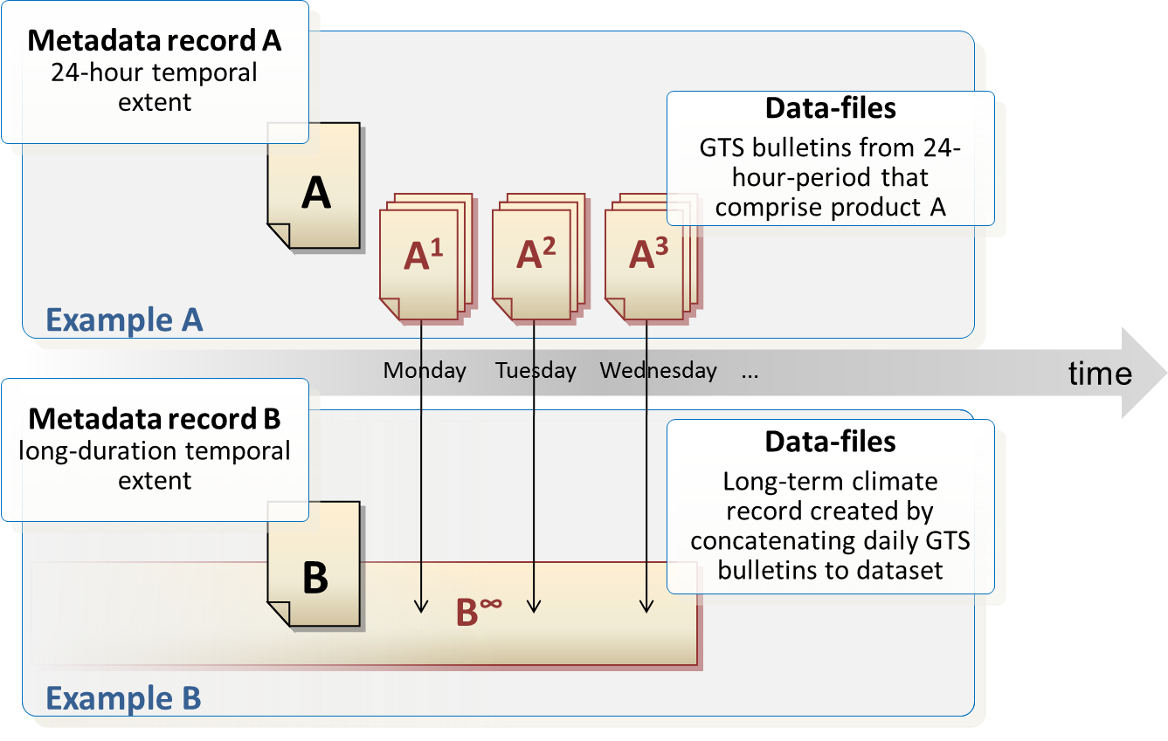
WMO Core Metadata Profile – temporal extent
The temporal extent within metadata for bulletins exchanged in real time currently reflects the date at which real time exchange started, rather than the current availability of the bulletins currently travelling within the WIS. A separate record is required for the real time bulletins and for an historical record of the data in the bulletins. The transient nature of the bulletins should be reflected by using a temporal extent in the metadata that indicates the rolling 24h cache of bulletins. A method of doing this is required. (Issue is expressing “now” in ISO 8601 - Toyoda).

Slide 35
Illustration of metadata record types & associated datasets
Metadata record A 24-hour temporal extent
Data-files
GTS bulletins from 24-hour-period that comprise product A
A
A¹
A²
A³
Example A
time
Monday
Tuesday
Wednesday
...
Metadata record B long-duration temporal extent
Data-files
Long-term climate record created by concatenating daily GTS bulletins to dataset
B
B∞
Example B

Slide 36
WMO Core Metadata Profile – procedure for maintaining multi-lingual metadata
Translations of metadata remain a challenge.
The rules on handling metadata are clear: only the data owner may edit the metadata. Any other centre creating a translation must not update the record on the GISC or promulgate it through the WIS.
ET-OI need to produce a procedure to be followed for updating translations of metadata if this is required, to allow data owners to incorporate translations prepared by other centres into the metadata record, taking account of the need for internal consistency.

Slide 37
WMO Core Metadata Profile – comparison with OGC Aviation metadata profile
Metadata profiles _NOT_ incompatible except …
Aviation metadata profile requires the use of Cyclic Redundancy Check (CRC).
CRC is intended to allow a dataset to be validated for transmission error. By contrast, the metadata records typically defined within WIS define dataets series (e.g. set of messages). One cannot calculate a CRC for a dataset series.

Slide 38
WMO Core Metadata Profile – beyond ISO 19115:2003/Cor. 1:2006
IPET-MDI recommend the adoption of ISO 19115-1:2013(E)
ISO 19115-1:2013(E) …
  Offers significant improvements over ISO 19115:2003, fixing the majority of known issues
  Will offer stability for a 10-year period.
IPET-MDI recommend adoption of ISO 19115-2:2009
Both ISO 19115-1:2013(E) and ISO 19115-2:2009 are necessary to support emerging requirements from WMO Programmes and Technical Commissions:
  Harmonisation with JCOMM Marine Metadata Profile – will be migrating to ISO 19115-1:2013(E)
  WIGOS, GSICS & CCl require capture of more detailed information about data acquisition, platforms, sensors and instruments and the lineage thereof.

Slide 39
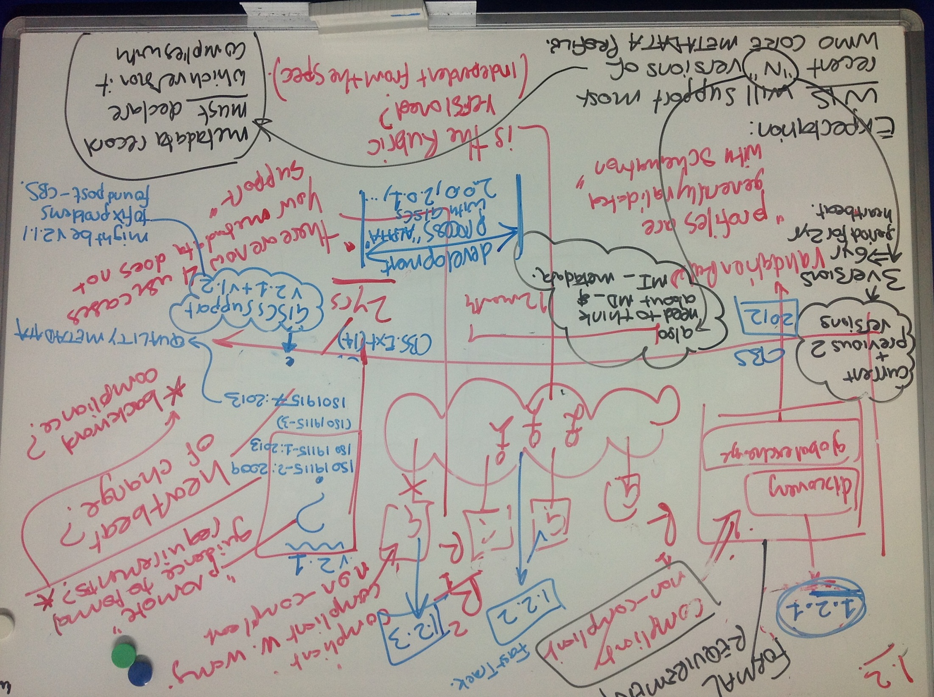
WMO Core Metadata Profile – roadmap
Fast Track can be used for changes that do not impact on users […] [e.g. incremental a.b.c releases] such as to add new items to code lists.
The Secretariat must introduce a mechanism for tracking change requests.
The Chair will ask the OPAG-ISS which tools should be used for change tracking and configuration management as part of the report to ICT-ISS.

Slide 40
WMO Core Metadata Profile – roadmap
2012 | Documentation and formal guidance for approval by CBS-15; This includes version 1.2 (approved by PTC), with additions (to create 1.3). | 1.3 would be a formal recommendation to PTC. The changes from 1.2 need to be annotated. The move to 1.3 is justified because of the introduction of validation procedures
2013 | Fast track additions to code lists; incrementing version numbers 1.3.1, 1.3.2, 1.3.n etc. | Additional guidance and associated validation tests are published routinely through period 2012-2014.
2014 | Version 2.1. This will include support for ISO 19115-1:2013, ISO19115-2:2009 and 19157:2013. The associated schema will be 19115-3 (assuming it is formally published in time). | Version 2.0 will be developed in collaboration with GISC centres; it will be considered a development version and wil not be published as an endorsed standard. Various 2.0.x versions will be defined as the development of the next major release of the metadata standard progresses. Version 2.1 will have all known issues resolved. This version will be proposed to CBS for endorsement.
2015 | Incremental release 2.1.1 to correct errors (agreed through the between-CBS-sessions route) | CBS will specify when version 2.1 is to become operational. During the intervening period, amendments may be made to the metadata standard to correct issues arising.
2016, 2018 | Versions 2.2 and 2.3 to consolidate changes that directly support WMO Programme requirements.
The change process for ISO 19115-2 may start in 2015, but would take 5 years. There are no other major changes expected that would justify a change to 3.1.
It is imperative that a mechanism is established NOW to engage the GISC implementation community in the development of WMO Core Metadata Profile 2.0.

Slide 41
Thank you
Questions and answers

