Slide 1
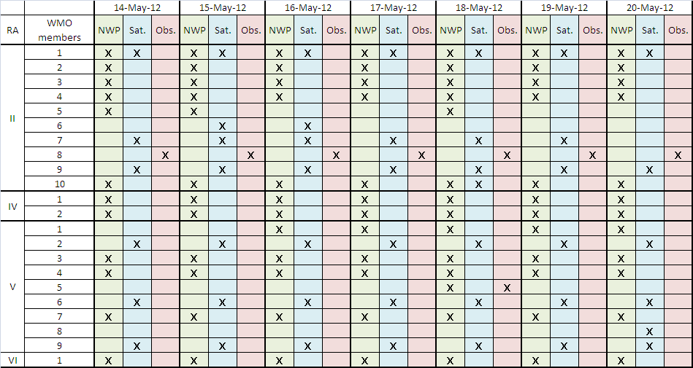
Status of GISC Cache Download at Tokyo
Access Status of Registered Users (regular access)
NWP: Numerical Weather Prediction (Global Spectral/Wave Model)
Sat.: Satellite Data (SATAID data)
Obs.: Observational data (Synop/Temp/Ship/etc.)

Slide 2
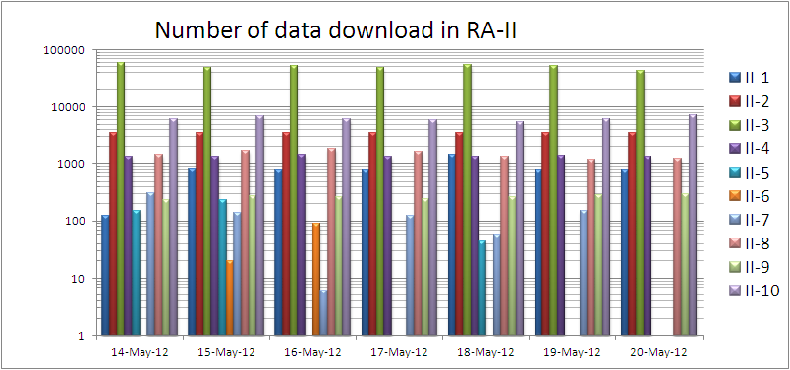
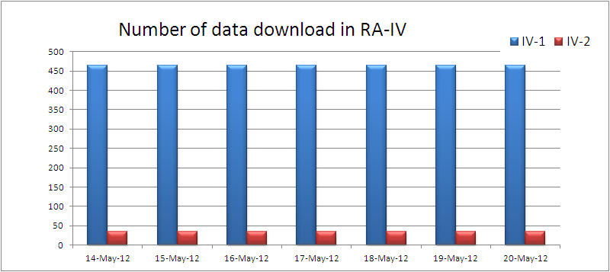

Slide 3
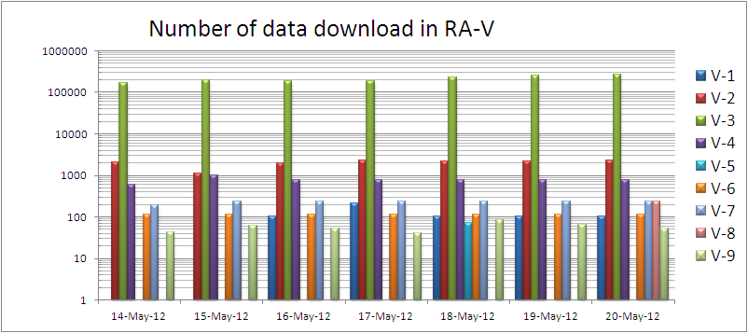
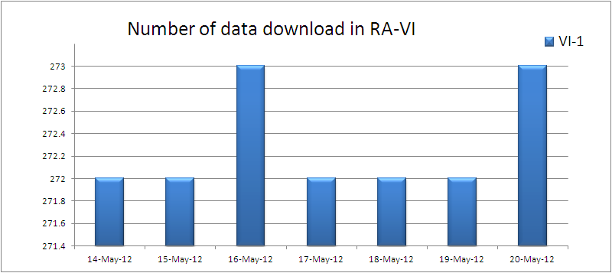

Slide 4
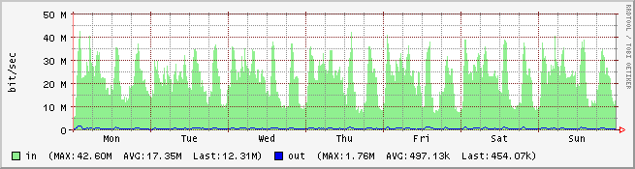
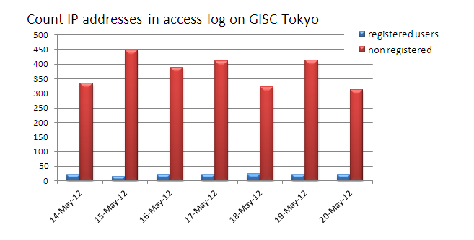
Status of GISC Tokyo
Internet Traffics for WIS ( btw 14-May-12 and 20-May-12 )
Count IP addresses

