Slide 1
MTN routeing
Kenji TSUNODA
RTH Tokyo
ET-OI Moscow 29-31 May 2012

Slide 2
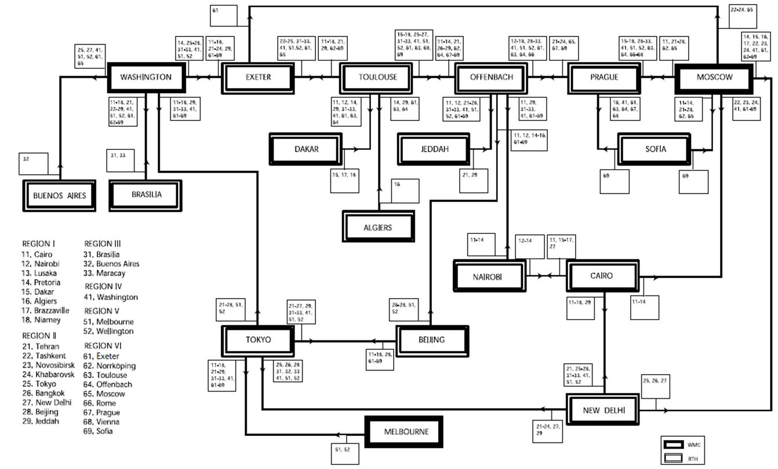
2009 edition
Notes:
Focus
RMTN (RA-I and RA-VI:Norrkoping data is transmitted to Moscow directly)
Data routeing from Washington to BuenosAires

Slide 3
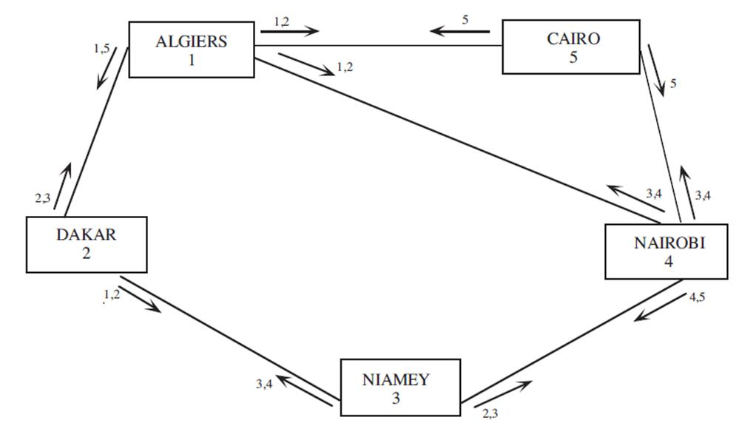
RMTN routeing in RA-I

Slide 4
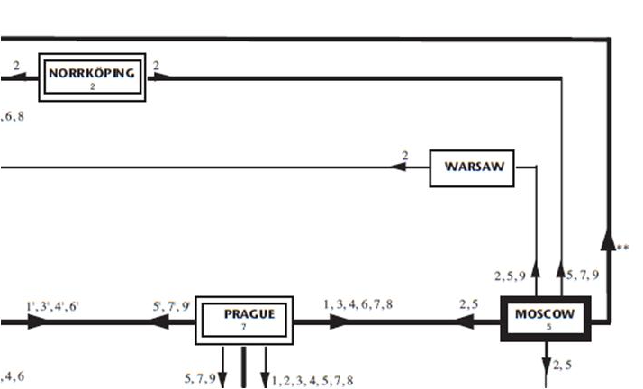
RMTN routeing in RA-VI

Slide 5
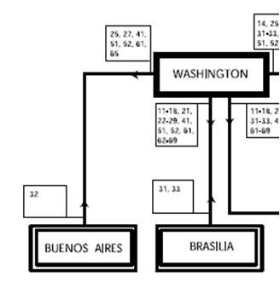
Buenos Aires
Notes:
Buenos Aires only receive seven RTH’s from Washington

Slide 6
CHECK SHEET

