Slide 1
Status of implementation for WIS in Beijing
CMA WIS TEAM
National Meteorological Information Centre，China Meteorological Administration

Slide 2
OUTLINE
GTS - RTH Beijing Status
CMA’s WIS Service - GISC Beijing
CMA’s WIS Service - DCPCs in Beijing

Slide 3
GTS - RMDCN upgraded to 4 Mbps ；New Internet Connection with NESDIS, Islamabad and HongKong；Establishing Video and Data Leased Line to HongKong
RTH
Offenbach
RTH
Tokyo
EUMETSAT
Darmstadt
WMC
Moscow
RTH
New Delhi
NESDIS
Islamabad
WMC Washington
2Mbps
RTH
Khabarovsk
3Mbps
512Kbps
2Mbps
RMDCN
MPLS VPN CLOUD
128Kbps
Alma-Ata
Internet
WMC
Melbourne
4Mbps
250Mbps
RTH
Offenbach
RTH Beijing
64
Kbps
64
Kbps
64
Kbps
256
Kbps
4Mbps
Video+data
RTH
Tokyo
64
Kbps
EUMETSAT
Darmstadt
RTH
Bangkok
Hanoi
Pyongyang
Ulan Bator
Seoul
HongKong
Ulan Bator
Leased line
The GTS circuits connected with RTH Beijing
Hanoi

Slide 4
GTS Software Changes in 2011
GTS protocol between Beijing and Tokyo was migrated from TCP sockets to FTP in Dec 2011
In addition to A/N, BIN and FAX channels, the A/N-urgent channel has been established.

Slide 5
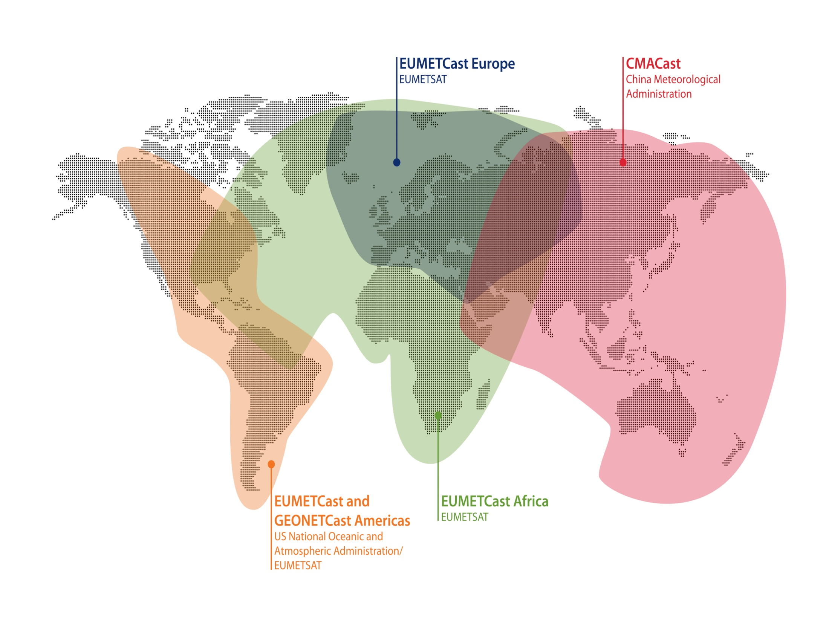
CMACast
Based on DVB-S2 standard technology
Rent a whole 36MHz C-band transponder
Up to 70Mbps date rate
More than 400GB daily data transmission
Enhanced user registration strategy
Enhanced date flow control and management
Improved interoperability with EUMETCast and GEONETCast Americas

Slide 6
TDCF Migration Progress in RTH Beijing
Cat.1 | Cat.2 | Cat.3
SYNOP(Nov.2007) | FY-2(D/E) AMV(2005) | AMDAR (2012)
TEMP(Nov.2007)
CLIMAT(Nov.2007)

Slide 7
BUFR Bulletin Disseminate To
Progress in RTH Beijing Responsible Area
RTH Offenbach
RTH Tokyo
WMC Moscow
RTH New Delhi
RTH Bangkok
NMC Seoul
NMC Pyongyang
NMC Ulan Bator
CCCC | T1T2A1
MNUB | ISM, ISI, IUS
DKPY | ISM, ISI, IUK, IUF
VHHH | ISM, IUA, IUP, INA
VMMC | ISM

Slide 8
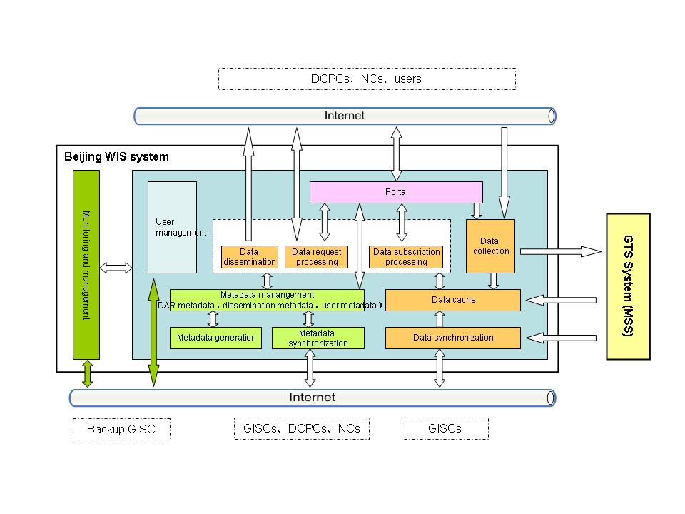
2009 - Initiated to develop WIS services in CMA
It is fully compliant with WIS technical specifications and standards.
DAR metadata: WMO Core Profile 1.2
Metadata synchronization: OAI-PMH, FTP
Data: TAC, BUFR, CREX, GRIB, NetCDF, ….
Data collection and dissemination: TCP sockets, FTP, HTTP, SMTP/POP3, multicast, …
It adopts J2EE framework and layered modular design, yields simple structure and easily scalable components, and owns user-friendly web interface for accessing metadata and data services

Slide 9
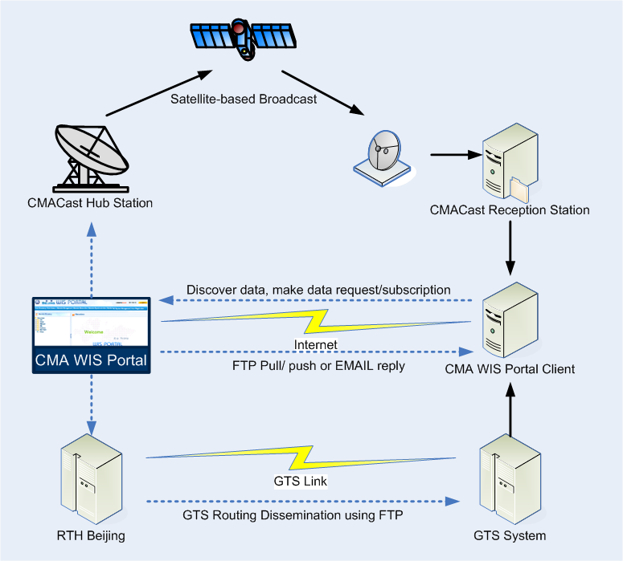
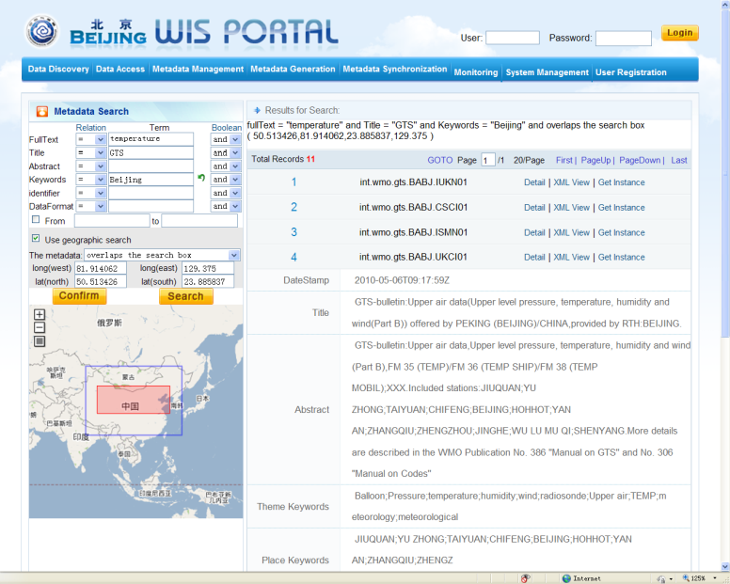
2011- Integrated with the data services of CMACast
Metadata Search
Full-text Retrieval
Metadata List
Metadata Bounding Box
Data dissemination
  GTS – to other WIS/GTS centers via FTP,
  Internet – to other centers, end-users via FTP, HTTP, SMTP
CMACast – to other centers, end-users

Slide 10
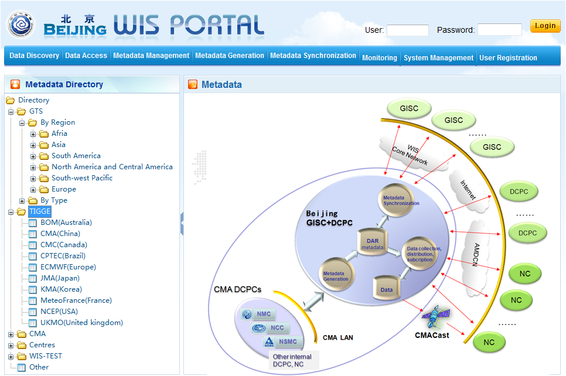
GISC Beijing approved by Cg-XVI in May, 2011
In July, CMA PR sent letter to RA II member to inform them that GISC Beijing will start its operation as from 15 August 2011.
The letter was also copied to the users of CMACast in other region and WMO Secretariat.

Slide 11
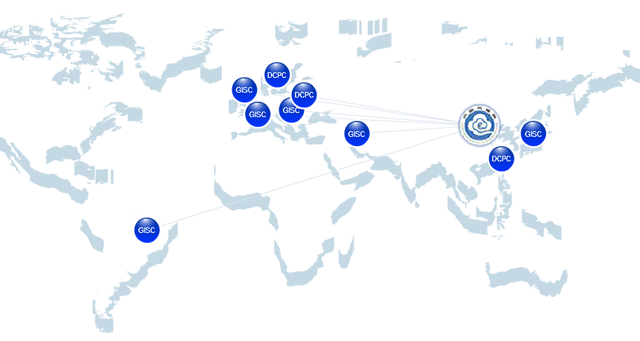
Exchanging metadata with DWD, INMET, JMA, Meteo France, HKO
Available services: metadata search, data subscription, data request/reply, web data ingest, metadata ingest, …
Welcome to access GISC Beijing services
    http://wisportal.cma.gov.cn
If you have any requirement, comment or question, please contact us
    giscadmin@cma.gov.cn

Slide 12
Available data: global exchanged data, CMA NWP products, FY satellite data, TIGGE products (from 10 product centers), …
Data Type |  | CMACast | CMA WIS Portal
GTS data | surface observations | Yes | Yes
 | upper air observations | Yes | Yes
 | other observations | Yes | Yes
 | NWP products | Yes | Yes
TIGGE products |  | - | Yes
Satellite data | FY-2D/E data | Yes | Partly
 | FY-3A data | Partly | -
 | other satellite data | TDB | -
Others |  | TDB | -

Slide 13
Since Feb. 2012 - Offer WIMMS
4 approaches to maintain metadata and to support WIMMS service
metadata online editor
metadata upload via web form
metadata harvesting via OAI protocol
metadata harvesting via FTP protocol

Slide 14
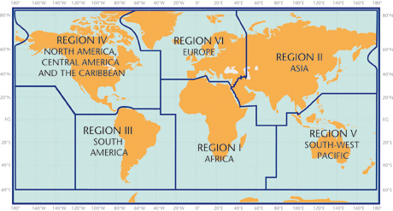
User Registration Until 26th, May 2012
4/6
19/40
0/0
2/3
3/3
0/0
Member number/ User number

Slide 15

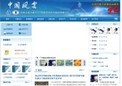

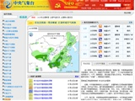

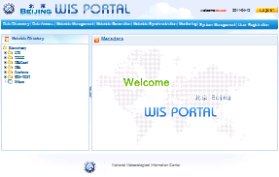


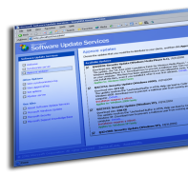









Next step
  Develop internal DCPCs, and provide their products via GISC Beijing portal
  Ready to be assessed by ET-GDDP around June of 2012
CMA DCPC
End Users
GISC Beijing
Metadata
Data
Other GISCs

Slide 16
DCPC NMC (National Meteorological Centre)
No. | Product
1 | Marine weather information broadcast
2 | Tropical cyclone waring advisory
3 | Tropical cyclone FAX
4 | The Global Medium-range weather prediction T639L61
5 | Tropical cyclone ensemble prediction product

Slide 17
DCPC BCC (Beijing Climate Centre)
No. | Product
1 | Global Unusual Monthly Mean Temperatures and Precipitation
2 | Global Monthly Mean Temperatures and Anomallies
3 | Global Monthly Precipitation Totals and Percentage Anomalies
4 | Monthly Mean Sea Level Pressure and Anomalies
5 | Monthly Mean Sea Surface Temperatures and Anomalies
6 | Indices for Regional SSTA

Slide 18
DCPC NSMC (National Satellite Meteorological Centre)
No. | Satellite | Product
1 | FY3B | MWHS/MWRI/TOU/IRAS/VIRR/MERIS/SBUS/MWRI/ERM/SIM/MERIS/MWTS Level 1 Product
2 |  | MWHS/MWRI/TOU/IRAS/VIRR/MERIS/SBUS/MWRI/ERM/SIM/MERIS/MWTS Level 2 Product
3 | FY2E | Cloud Motion Vectors Product derived from FY2E WV Image
4 |  | Normalized Geostationary Projection data from FY-2E 5 spectral channels.
5 |  | Cloud Motion Vectors Product derived from FY-2E IR Cloud Image.
6 |  | Outgoing Longwave Radiation Product.
Notes:
MWHS/MWRI/TOU/IRAS/VIRR/MERIS/SBUS/MWRI/ERM/SIM/MWTS
MicroWave Humidity Sounder
MicroWave Radiation Imager
Total Ozone Unit
InfraRed Atmospheric Sounder
Visible and InfraRed Radiometer
MEdium Resolution Spectral Imager
Solar Backscatter Ultraviolet Sounder
MicroWave Radiation Imager
Earth Radiation Measurement
Solar Irradance Monitor
MicroWave Temperature Sounder

Slide 19
Thanks for your attention!

