Slide 1
The Lifecycle of RMDCN-NG
Isabella Weger
Head of Computer Division
ECMWF

Slide 2
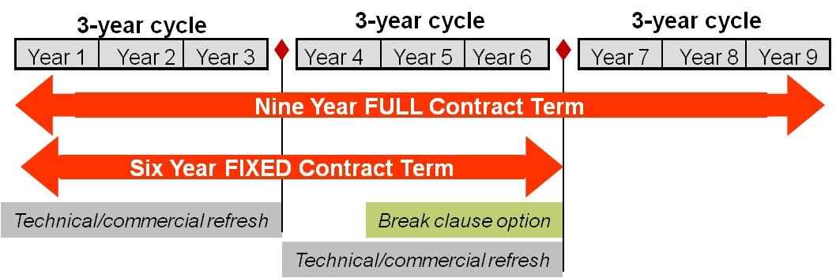
Contract duration
Full contract term of nine years with a break clause at the end of the sixth year to allow termination
Technical/commercial refresh with a set of technology and/or cost benefits to the RMDCN
  after three years
  after six years (if the break clause is not used)

Slide 3
Value for Money - 1
The solution must provide “Value for Money” for the full contract term
As part of the ITT response, tenderers provide a committed proposal for bandwidth upgrades, service enhancements, and/or price reductions that could be implemented at the beginning of year 4 of the operational service
There will also be two Technical and Commercial Refreshes (TCR):
  First TCR after 2½ years of operational service
  Second TCR after 5½ years of operational service (if the 6-year break clause is not used)

Slide 4
Value for Money - 2
Therefore:
During Q3/Q4 2016:
  Beginning of year 4 of the operational service
  Supplier implements bandwidth upgrades, service enhancements, and/or price reductions (subject to the outcome of the first TCR)
  Supplier provides a committed proposal for bandwidth upgrades, service enhancements, and/or price reductions that could be implemented at the beginning of year 7 of the operational service
During Q3/Q4 2019:
  Beginning of year 7 of the operational service
  Supplier implements bandwidth upgrades, service enhancements, and/or price reductions (subject to the outcome of the second TCR)

Slide 5
Outlook to 2016 – 2018
Decision to terminate the contract after 6 years of service or to go for the full 9 years
mid-October
Proposal for the 1st Technical and Commercial Refresh
mid-April
2016 |  |  |  | 2017 |  |  |  | 2018 | …
Implementation of the agreed Technical/Commercial refresh solution
Individual handover of sites (New sites, Upgrades…)
Individual handover of sites (New sites, Upgrades…)

