Slide 1
RMDCN Acceptance Software Appliance (RASA)
Oliver Gorwits
Networks and Security - ECMWF
Notes:
You are familiar with current RMDCN Test PC for site installation or upgrade
RMDCN-NG is a good opportunity to re-evaluate Test PC software
I will review what we have automated in the site acceptance process
Also show limitations in current Test PC and detail the new system which we call RASA

Slide 2
Site Acceptance for RMDCN-NG
The proposal is detailed in Chapter 10 of ITT-207
    Functional Acceptance Test (software)
    Reliability Acceptance Test (30 days’ SLA)
    Pilot and Global Scope Tests (30 days’ SLA)
Linux distribution created by ECMWF containing test software
Used to verify the CPE and PE configurations
    IPv4 routing
    TCP/IP protocol tests
    SLA parameters (round trip delay, packet loss ratio)
    Overall throughput tests
    CoS/QoS repartition implementation
Notes:
There are three parts to acceptance testing, as detailed in the ITT documentation
Software is only used for the Functional tests. The other tests are based on breaches of the SLA.
The software tests various parameters of the circuit and therefore that the hardware is configured correctly by the service provider.
Since the migration to IP VPN ECMWF has used a custom Linux distribution with software tools written by ECMWF to automate these tests.

Slide 3
Current Site Acceptance Software
Bootable Linux CD based on Slax – http://www.slax.org/
    Slackware OS
    Minimal toolset
    Does not support some modern hardware
    Not easy to re-build or update
Custom Test Software
    Tests all parameters necessary for Site Acceptance
    ...Plus some features we never use
    Does not use existing well-known open-source tools
Notes:
The current Acceptance Software, sometimes known as the Test PC, is based on Slackware.
This is not a very popular Linux distribution which means
it’s not easy to find all the software we might want,
and also it does not always support the latest hardware.
The design of the current software system is deliberately lightweight and so there are few tools on the system.
We investigated updating the Slax system but it would be quite a lot of work, and so we looked at alternatives.
We also wrote quite complicated software because when the RMDCN migrated to MPLS we didn’t know what would need to be tested.
We now know that we can simplify the test software greatly.

Slide 4
RASA Principles
RMDCN Acceptance Software Appliance
General-purpose appliance instead of single-purpose tool
Install many useful tools by default
Use existing, available software for Acceptance Tests
    iperf / netperf
    ping / traceroute / tcpdump / FTP
Bootable Linux Live-CD
Virtual Machine Disk (VMware VMDK)
Can be run permanently at the User Site for diagnostic/troubleshooting
  ECMWF will run two instances permanently
Notes:
The new acceptance software for RMDCN-NG is called RASA
We wanted to emphasise that this is an appliance which can have many uses, not only the very short acceptance test
It is a general purpose, modern Linux system with useful software installed
I will cover some technical details in the next slide
There are two editions of RASA
A bootable CD just like the existing Test PC
A VMware disk and configuration file in case you want to run the appliance on an existing PC
I will give a demo of the VMware system at the end of this presentation
ECMWF will run two instances of RASA permanently so user sites always have a system available as a target for network testing

Slide 5
Technical Details of RASA
TurnKey Linux – http://turnkeylinux.org/
    Based on Ubuntu (good hardware support, includes many applications)
    Well-documented tools for rebuilding images (part of TurnKey)
    VMware VMDK edition, or bootable Live-CD
    Runs with 256MB RAM
On first boot, asks for IP address, Netmask, Gateway
    Then is fully configured and ready
Simple console menu
    Written in Python, so we can easily customise
    Reconfigure networking
    Run test scripts
    Install to hard disk
Notes:
TurnKey Linux is a project which makes versions of Ubuntu pre-installed with useful applications
For example pre-installed with Apache and PHP, or Joomla, etc
We are using their tools to make a version of Ubuntu pre-installed with our Acceptance Test scripts
It is very easy to customize the operating system
We can make a bootable Live CD or a VMware disk image
The system needs only 256MB of RAM at a minimum. This means it can easily run on your laptop, for example.
When the system boots it asks for the network configuration
There is a menu to run some commands or you can access the shell as root.
We do not restrict access to the system – you can log in and use it for anything
Here are some screenshots....

Slide 6
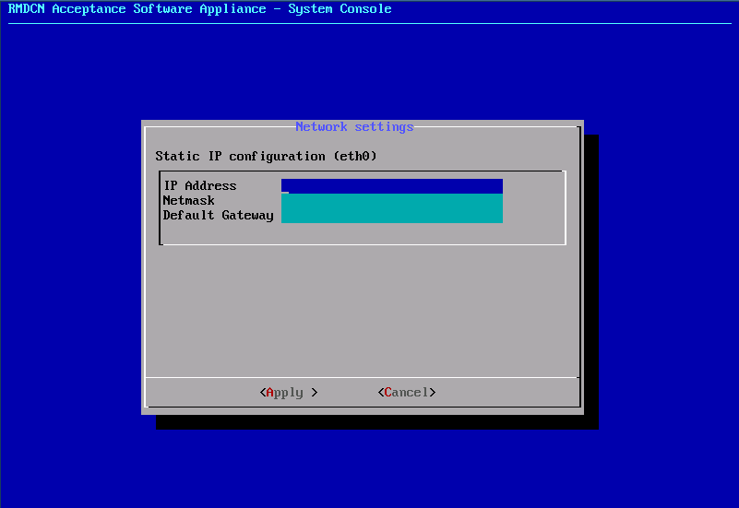
RASA Screenshot (1)
Notes:
When you boot the system it asks for the network configuration

Slide 7
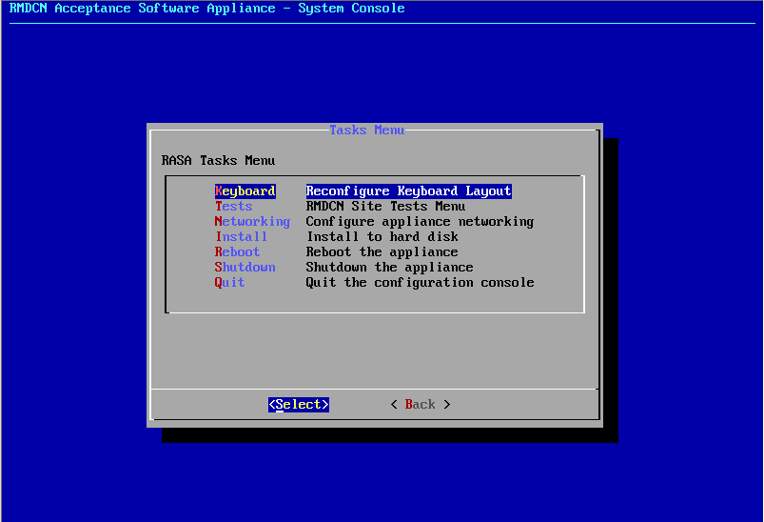
RASA Screenshot (2)
Notes:
After that there is this menu which has options for
Reconfiguring the keyboard for your local language
Running some network tests
Reconfiguring the network
Installing to a system hard disk
Access the shell

Slide 8
Example – RMDCN Multicast Trial
Six sites testing ASM and SSM multicast on RMDCN for three months
EUMETSAT and ECMWF (source and receiver)
Sweden, Germany, Japan, Bulgaria (receiver)
Need to run and manage tests between ECMWF and other sites
Added a couple of tools to the “beta” RASA image
    dbeacon, asmping/ssmping, uFTP
    Ubuntu provides almost anything we need
Small web server for the monitoring beacon
Very easy to script new tests, transfer files, etc
Notes:
Our goal is that the RASA is flexible and can be used not only for Acceptance Testing
We are currently running a Multicast trial on RMDCN
This requires software to do file transfers between sites, and other monitoring of multicast
TurnKey Linux and Ubuntu makes RASA very flexible
We can easily add new software tools and rebuild the bootable Live CD
We added some tools and a web server application to monitor and show the multicast status
Using standard tools such as ssh and FTP we can gather results from our tests.

Slide 9
Next Steps
Many good lessons learned from the Multicast Trial
    The principle of RASA is good
Write scripts to run Acceptance Tests
    Based on ITT-207 Chapter 10 and RMDCN-NG provider feedback
    Some polish for the user interface
    Test will be run from ECMWF and results transferred back via FTP
RASA “beta” edition is available for download
    http://rmdcn.ecmwf.int/RASA/ecmwf-rasa-operations-guide.pdf
Any comments are welcome! wan@ecmwf.int
Notes:
So in conclusion we are happy that the new RASA system will work well for RMDCN-NG
We need to complete the acceptance test scripts which will be used for the migration and new site connections
These will take into account the feedback of the selected provider for RMDCN-NG
A beta edition of the software is available
This is what we have been using for the multicast trial
If you would like, please download the image and give it a try and let me know how it goes

Slide 10
End
Thank you for listening – any questions?
Notes:
Demo of VMware RASA

