Slide 1
DMVPN-based infrastructure as a backup for the RMDCN
Ahmed Benallegue
Network and Security Section

Slide 2
Background – Previous projects 1/3
2002: IPSec feasibility study:
  ECMWF, Germany, Greece, France and the Netherlands
  Guidelines and recommendations for building secure connections over the Internet
2005: IPSec-based VPN as a backup for the RMDCN study
  ECMWF, Bulgaria, China, France, Germany, Sweden, the Russian Federation and the UK
  Provides a framework for an operational RMDCN backup solution using an Internet-based IPSec VPN – Only static rerouting considered
2007-2008: IPSec VPN Backup for the RMDCN project:
  ECMWF, Belgium, China, Germany and Turkey
  Using and IPSec-based VPN infrastructure to transport operational RMDCN traffic between RMDCN sites as an alternative to the RMDCN network itself

Slide 3
Background – Previous projects 2/3
2007-2008: IPSec VPN Backup for the RMDCN project
  Conclusion – Recommendations
    Using dedicated IPSec box should to be considered in an operational environment
    Using one device type or at least one device brand for an operational deployment
    The traffic re-routing has to be fast, automatic and reliable. Only dynamic routing processes can ensure this in an operational environment

Slide 4
Background – Previous projects 3/3
ROC-14 – Recommendations (June 2008):
  Any backup solution must maintain the any-to-any connectivity.
  Dedicated IPSec equipment is needed for the RMDCN backup.
  The same type of equipment will be used by all sites.
  The networking equipment will be managed locally by the sites.
  Portfolio of backup solutions will be:
    RMDCN mission critical sites
    ISDN NAS backup within the managed network (to be phased out in the future)
    Backup over the Internet
  ECMWF will continue to provide a gateway function and “re-inject” third-party traffic, so that connectivity between sites using different backup solutions will be maintained.

Slide 5
The DMVPN Project – Definition
ROC-14 – Actions (June 2008):
  A test environment for DMVPN including 6 or 7 routers will be set up at ECMWF.
  If tests are successful, 3 or 4 routers will be sent to volunteers sites in Q4-2008 to try DMVPN over the Internet; DMVPN would then be used to create the IPSEC VPN solution to backup the RMDCN.
  During Q1-2009 the results of these tests would be made available to the ROC.
  If overall tests are successful, a recommendation of Cisco Routers using DMVPN for the backup of the RMDCN should be considered. Otherwise, a market survey would be conducted to find another solution.
  During the next ROC-15 meeting in spring 2009 an agreement on the future solution and on the equipment should be reached.

Slide 6
The DMVPN Project – Scope
Scope
  “This project focuses on using a DMVPN-based VPN infrastructure to transport operational RMDCN traffic as a backup to the RMDCN network itself. The traffic re-routing between the two infrastructures has to be done in a fast, automatic and reliable manner.”
Project plan
  Phase 1: Q4-2008: building the DMVPN-based infrastructure.
  Phase 2: Q1-2009: using the DMVPN-based VPN infrastructure as a backup for the RMDCN in an operational context.
Participating sites: ECMWF, Bulgaria, China, Greece, Lithuania, Norway and Poland

Slide 7
The DMVPN Project – Technology/Topology
DMVPN technology
  Dynamic Multipoint VPN
  Proprietary Cisco Internetwork Operating System (IOS) solution for building IPSec and GRE (Generic Routing Encapsulation) VPN that relies on two Cisco technologies:
    Next Hop Resolution Protocol (NHRP): a “hub” maintains a database of all the “spoke” real (public interface) addresses
    Multipoint GRE Tunnel Interface
DMVPN topology
  Based on a star topology: each “spoke” site has a connection with at least one “hub” site. Spoke-to-spoke traffic can be initiated without going through the hub.
  The design is based on a single DMVPN/dual hub topology.
  ECMWF is the primary hub site, Sweden the secondary one

Slide 8
The DMVPN Project – Phase 1: building the infrastructure
Phase 1 goals:
  Built the DMVPN-based infrastructure over the Internet:
    Following the recommendations of the ROC 14 meeting
    Based on the IPSec technical specifications
    Based on the tested and selected DMVPN topology
Phase 1 results
  No major issues in the deployment of the infrastructure
  The DMVPN infrastructure was fully operational on all sites
    NAT was used in Greece and Lithuania
    A firewall was deployed between the CE and the DMVPN routers in China

Slide 9
The DMVPN Project – Phase 2: using the infrastructure 1/7
Phase 2 goals:
  Use the DMVPN-based infrastructure:
    As a day-to-day operational backup infrastructure
    For performance and reliability tests
    For a “real-life” re-routing of operational RMDCN traffic:
      Operational tests
      In a controlled environment

Slide 10
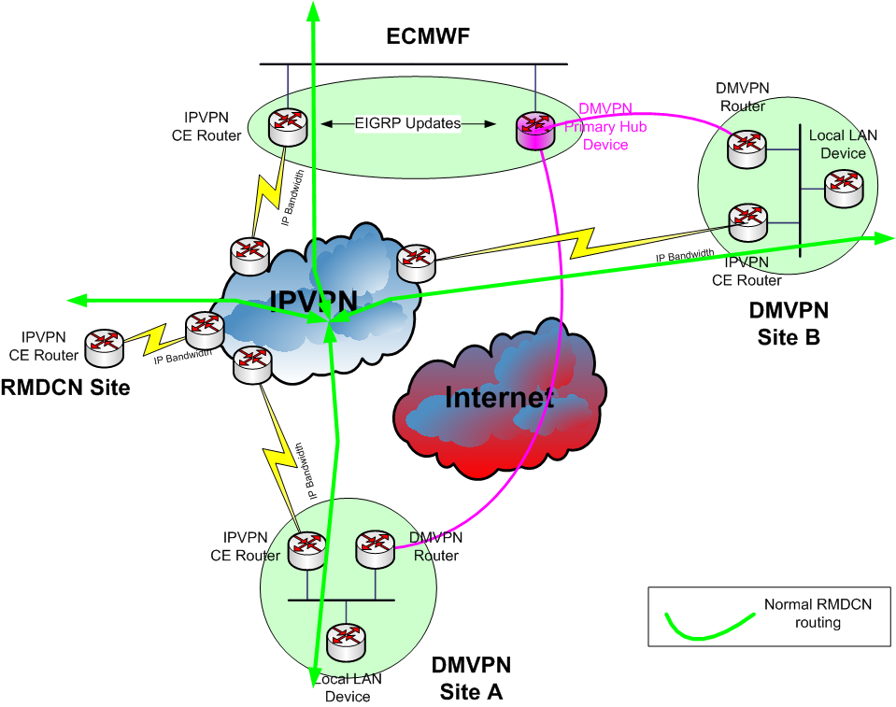
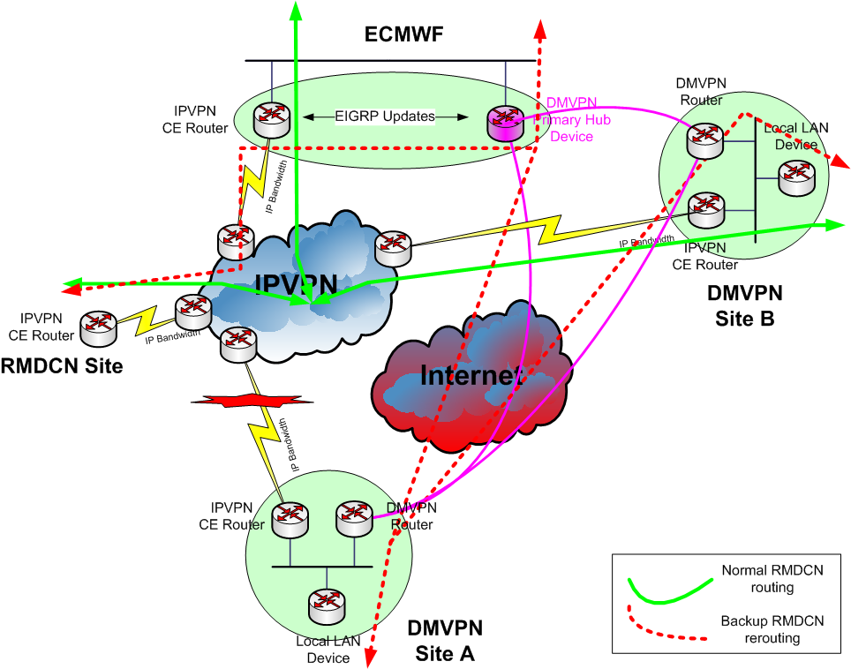
The DMVPN Project – Phase 2: using the infrastructure 2/7
Operational RMDCN traffic re-routing at a DMVPN site

Slide 11
The DMVPN Project – Phase 2: using the infrastructure 3/7
Operational tests
  Performed in a controlled environment with the participation of OBS
  Involving operational RMDCN traffic
  NAS BU router is switched off
  Following a test procedure that defines 4 separate test cases:
    Test case #1: traffic re-routing throughout the RMDCN for a DMVPN site experiencing an RMDCN outage
    Test case #2: reliability and resilience of the DMVPN infrastructure configuration
    Test case #3: traffic re-routing between two DMVPN sites through the RMDCN

Slide 12
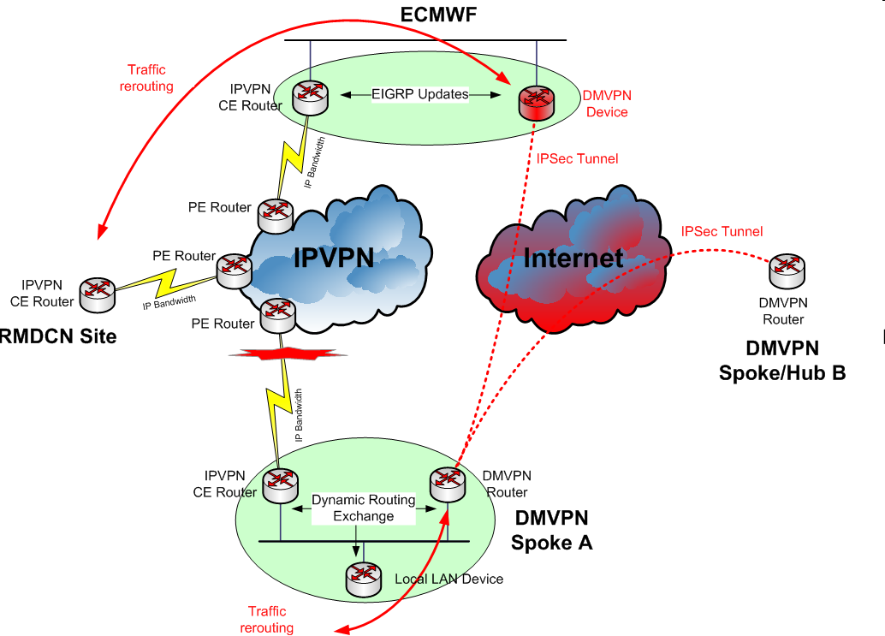
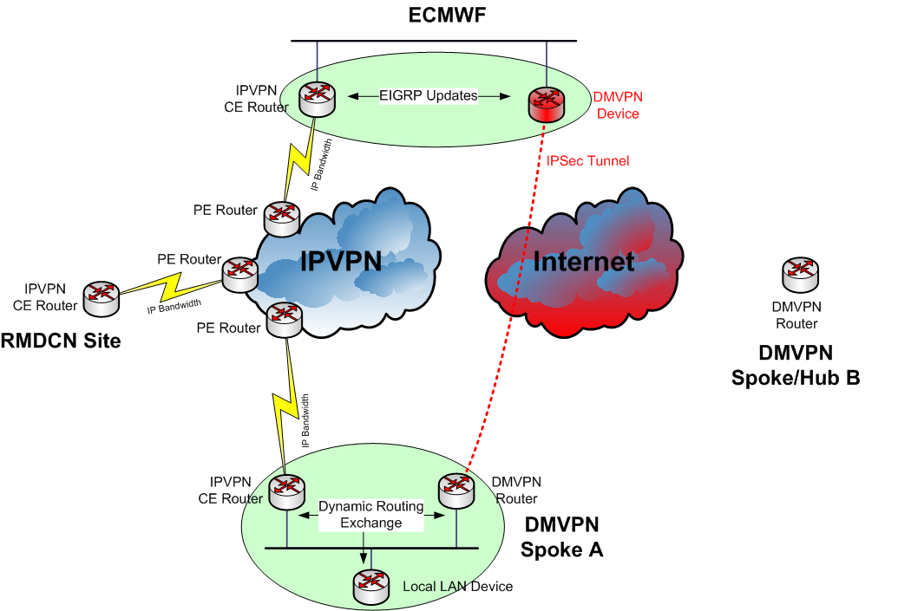
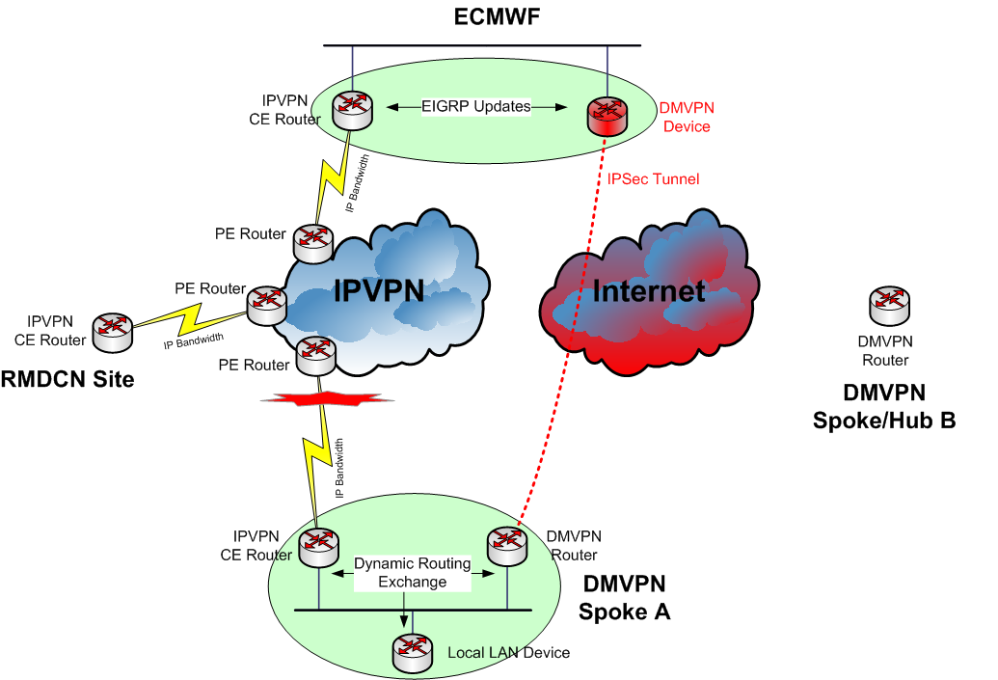
The DMVPN Project – Phase 2: using the infrastructure 4/7
Test Case #1 – Traffic re-routing throughout the RMDCN for a DMVPN site experiencing an RMDCN outage

Slide 13
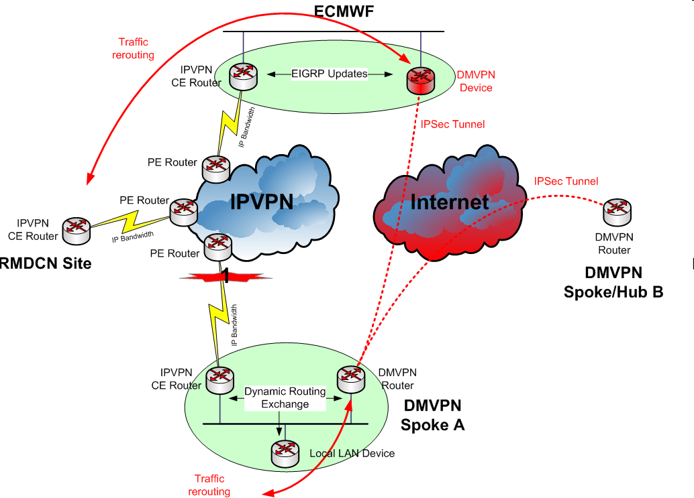

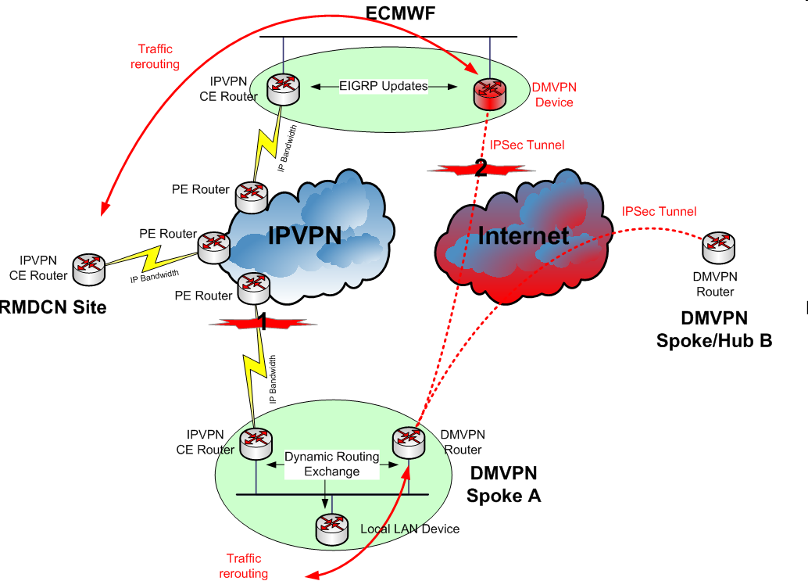
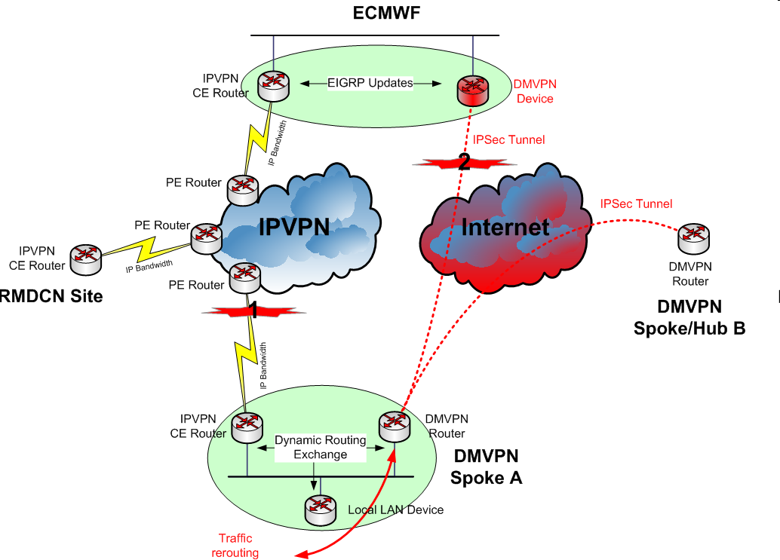
The DMVPN Project – Phase 2: using the infrastructure 5/7
Test Case #2 – Reliability and resilience of the DMVPN infrastructure configuration

Slide 14
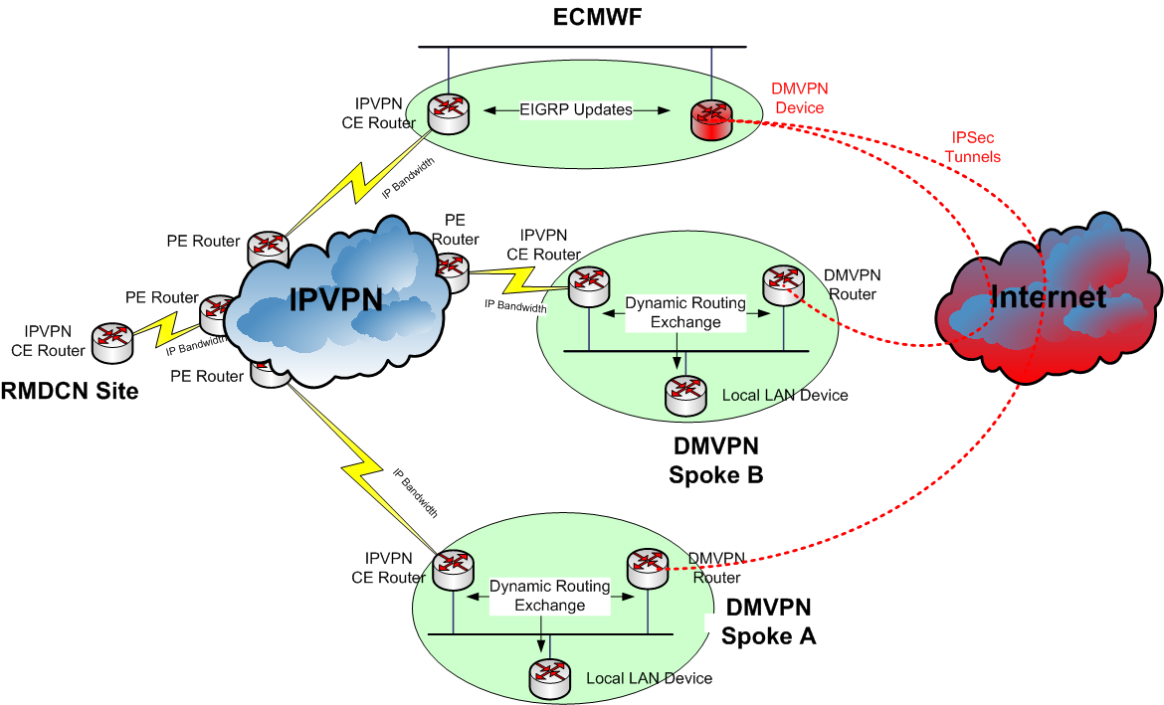
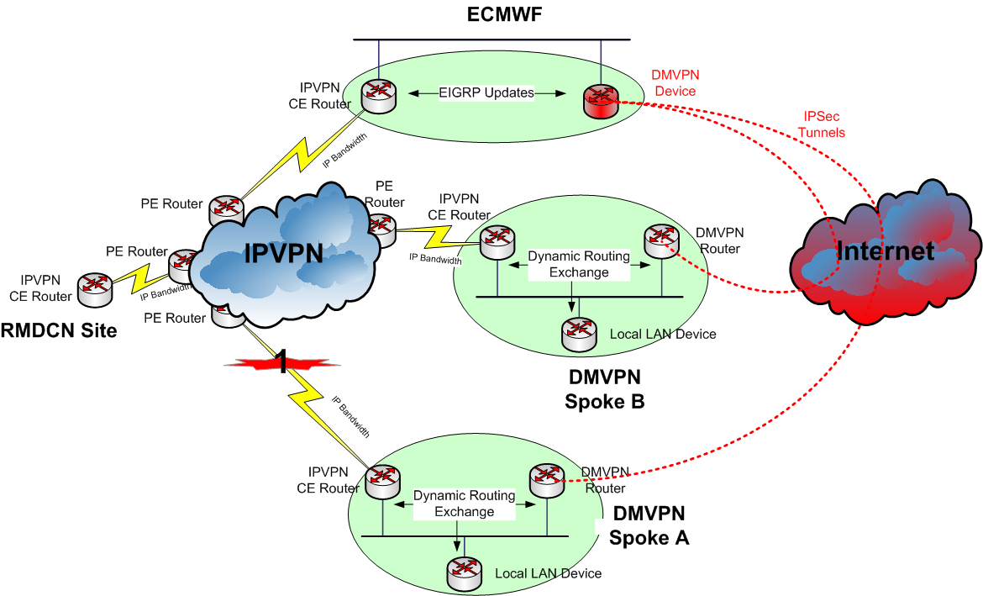
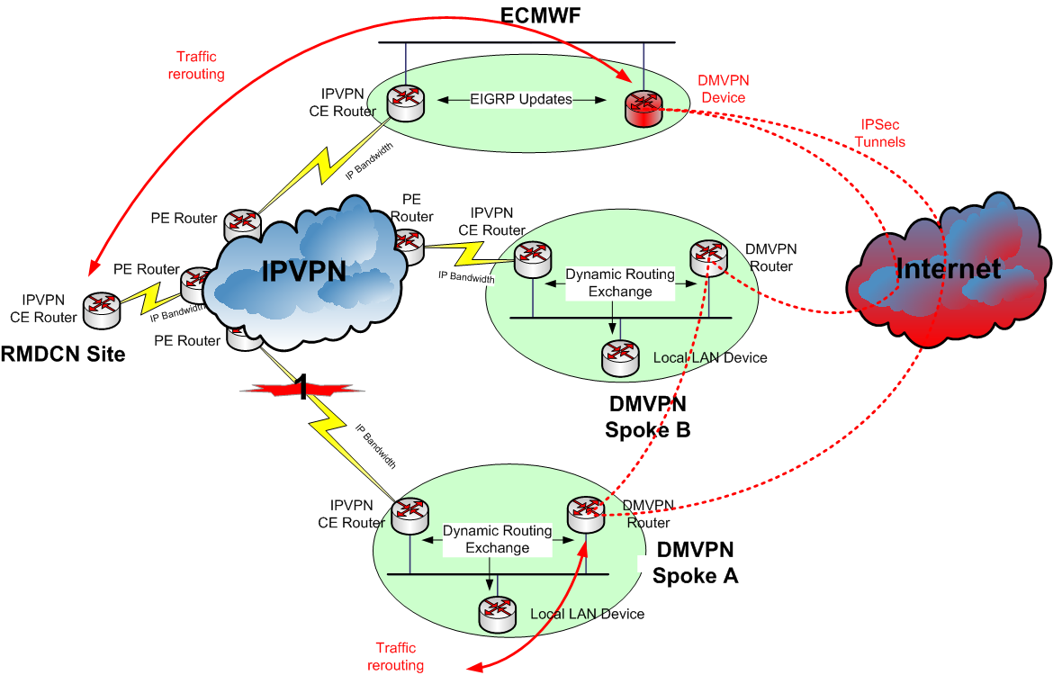
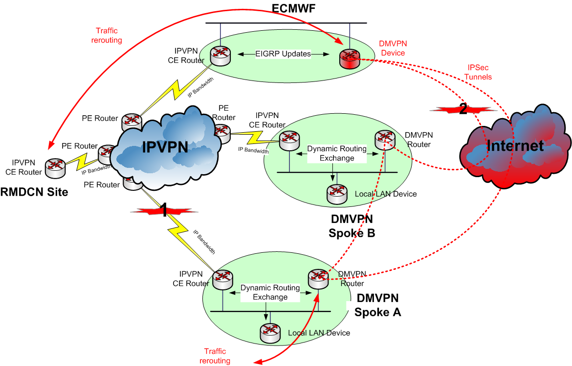

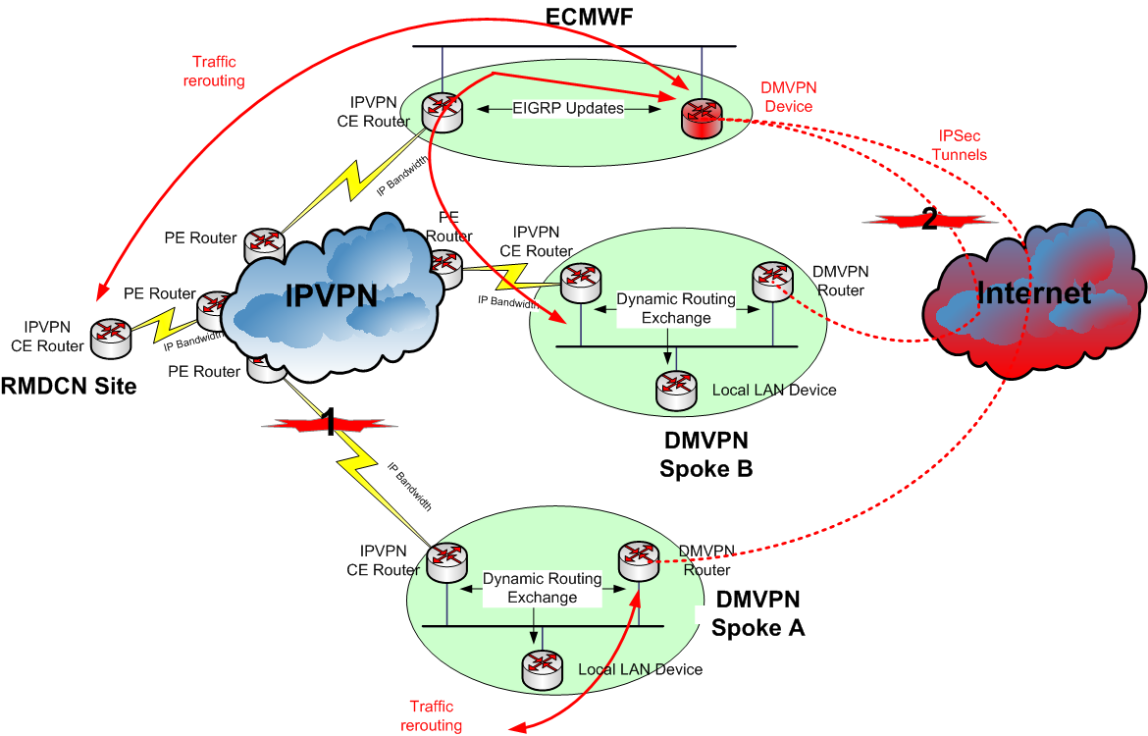
The DMVPN Project – Phase 2: using the infrastructure 6/7
Test case #3: traffic re-routing between two DMVPN sites through the RMDCN

Slide 15
The DMVPN Project – Phase 2: using the infrastructure 7/7
Phase 2 results
  No major issues in the testing of the infrastructure in an operational environment
  The DMVPN infrastructure was successfully tested

Slide 16
The DMVPN Project – Conclusion
A DMVPN-based infrastructure could be a viable backup solution for the RMDCN
  Fast, automatic and reliable
A RMDCN site that would like to install a DMVPN router will have to follow the technical requirements of this solution
  Facilitate the configuration/installation
  Facilitate the debug/troubleshooting
ECMWF is the primary DMVPN HUB and the gateway site
Sweden is the secondary DMVPN HUB site
Prior to an operational deployment, it was crucial to assess the impact that this solution could have on the current SLA defined in the RMDCN contract

Slide 17
RMDCN + DMVPN – Architecture – MCS 1/2
The DMVPN router will be added the dual CE1/CE2 and is the THIRD option
Use of HSRP or a dynamic routing protocol for traffic re-routing

Slide 18
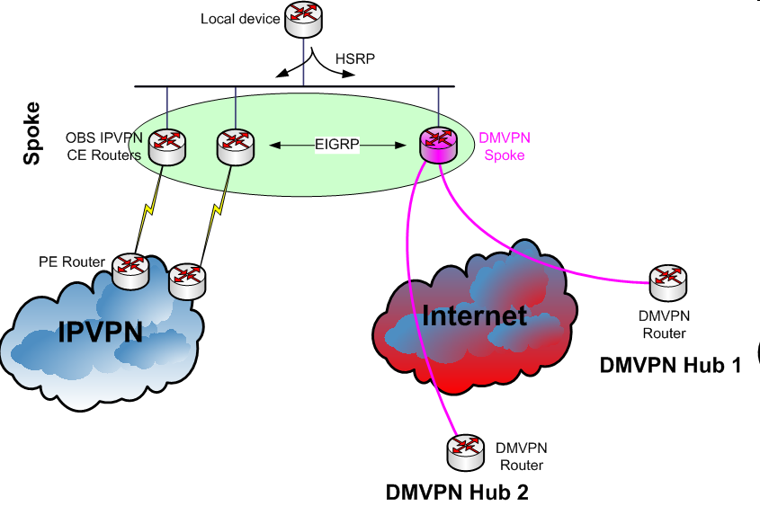
RMDCN + DMVPN – Architecture – MCS 2/2
3. DMVPN backup
or
Traffic with sites on DMVPN backup
1. Normal operation
2. MCS backup

Slide 19
RMDCN + DMVPN – Architecture – Enhanced 1/2
For “Enhanced” sites:
  The DMVPN router will be deployed between the CE and the NAS backup router
  The NAS backup router must be kept
  Use of HSRP for traffic re-routing (to be agreed with OBS)

Slide 20
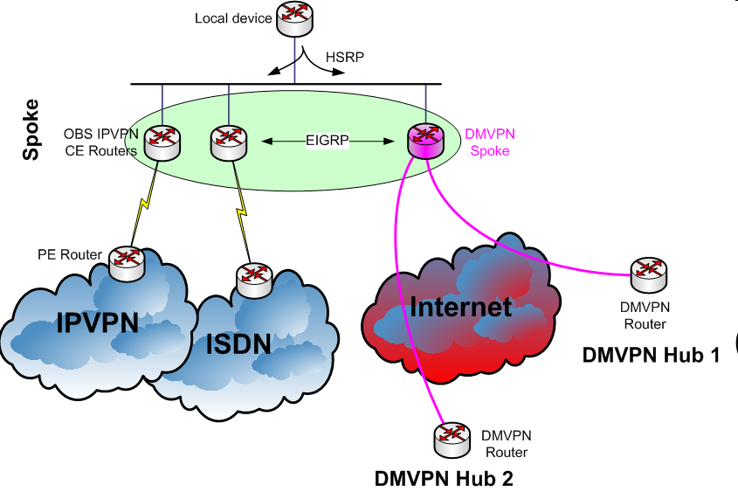
RMDCN + DMVPN – Architecture – Enhanced 2/2
2. DMVPN backup
or
Traffic with sites on DMVPN backup
1. Normal operation
3. ISDN backup

Slide 21
DMVPN Workshop in October 2009
“Hands-on” practice
  How to deploy a DMVPN router
  How to troubleshoot re-routing issues
5-6 October 2009
Around 20 participants
Slides available on the RMDCN web site (restricted access):
  http://rmdcn.ecmwf.int/News_and_Events/Meetings/DMVPN_Workshop/

Slide 22
Update – May 2012
The large-scale pilot is operational since October 2010
Currently seven operational countries
  ECMWF (primary hub-site)
  Sweden (backup hub-site)
  Bulgaria: November 2010
  Italy: November 2010
  Norway: December 2010
  Romania: March 2011
  Germany: December 2011
Several operational use of the infrastructure:
  February and March 2011 in Italy
  March 2012 in Norway

Slide 23
Main results 1/2
During deployment
  Changes on ALL RMDCN-DMVPN sites – Anticipated
  DMVPN router behind a firewall in Romania – Anticipated
Operational usage
  Only minor incidents not related to the DMVPN configuration (certificates, occasional necessary reboot…)
    A dream for any network team: we never hear from the DMVPN box
No impact on the RMDCN SLA
  Example: Italy, Norway: usual SLA credit
  OBS is happy with this extra backup option
Challenges
  The solution needs to fit with the site’s security policy
  Local technical constraints, e.g.: third party Internet access

Slide 24
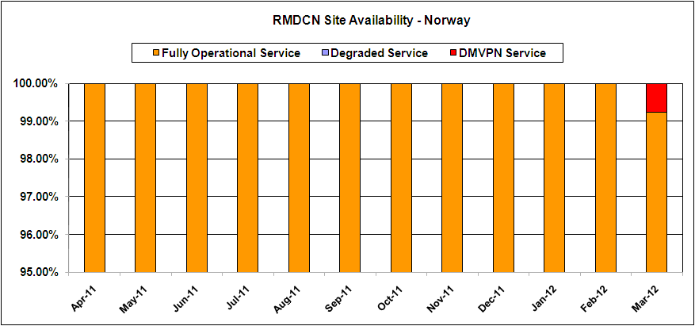
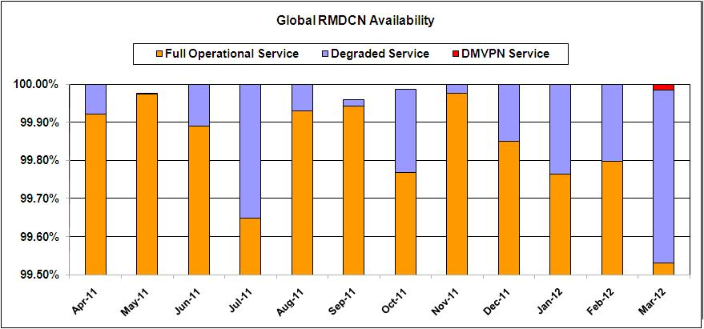
Main results 2/2
Provides that “extra bit” of availability per site and globally
  Normal operations
    Cost effective
    Easy to deploy
  Transition periods
    Upgrade
    Migration
    Fast
    Automatic
    Reliable

Slide 25
How to be part of the DMVPN ? (1/2)
You must be connected to the RMDCN
Inform ECMWF about your intention to be join the DMVPN trial
ECMWF will then send a letter to the nominated RMDCN User Representative to specify the technical and management requirements:
  Technically:
    Type of CISCO router to buy 892 (£££) or 3845 (££££)
    Architecture required to install the router
  Management:
    Roles and responsibility of ECMWF and local site
The UserRep will sign the document and send it back to ECMWF

Slide 26
How to be part of the DMVPN ? (2/2)
Management and monitoring responsibilities
  The site will configure the router with a “vanilla” configuration provided by ECMWF
  ECMWF will then perform the full configuration of the router through an SSH access via the RMDCN
  ECMWF manages the DMVPN boxes operationally
  Local sites to have “enable”-access to the DMVPN router for emergencies
  ECMWF in charge of the monitoring of the DMVPN boxes:
    Appropriate procedure to be put in place in coordination with DMVPN sites and local ECMWF operators
      Mon-Fri 8-5

Slide 27

DMVPN in “troubled times”
Late 2013 – early 2014, based on the current schedule, the migration will take place
All connected sites, ECMWF, the current provider and the new provider will be on board to make sure that the transition is as smooth as possible… however, this will be a risky period
Having an additional secure connexion method between our sites will give us all an extra level of confidence
“Only” 7 sites are part of the pilot
All other sites are invited to join… it is not too late!
Join Now !!

Slide 28
Questions?
Additional information (restricted access):
  http://rmdcn.ecmwf.int/News_and_Events/Meetings/DMVPN_Workshop
  http://rmdcn.ecmwf.int/Documentation/DMVPN_Operation_Guide/index.html

