Slide 1
The Pilot Phase and the
Accelerated Incremental Migration (AIM)
Oliver Gorwits
Network and Security Section

Slide 2
Foreword
All the following is based on the solution as described in the technical requirements (Vol. II) and the draft contract (Vol. III)
Depending on further discussions with the future provider some of these principles can be modified/adjusted (e.g. duration of the various acceptance periods)…

Slide 3
Project planning - reminder
Pilot phase
  ECMWF plus 5-6 sites
  First half of 2013
Accelerated incremental migration (AIM) – four months
  One gateway site (ECMWF)
Acceptance Tests
Initial Deployment
  Cutoff date for orders 1 July 2013

Slide 4
Initial deployment
Roll-out of RMDCN-NG will be called the “Initial Deployment”
Comprises:
  network specified in the contract (to be signed Dec 2012)
  all firm orders placed by 1 July 2013
  configuration details for the ECMWF Basic Package
  plus a number of chosen options for ECMWF Member States, as well as those for other sites prepared to join as part of the Initial Deployment
Includes provision of a pilot network
  gain early experience with installation and operational issues

Slide 5
Pilot Phase
5-6 sites (names to be confirmed late 2012):
  ECMWF
  2-3 sites in Europe
  2-3 sites outside Europe
Timetable:
  Q1-2013: agreement of configurations
  February-March 2013: signing of accession agreements where necessary
  April-June 2013: delivery, installation and handover
  June-July 2013: functional and reliability acceptance tests
  August 2013: pilot network reliability acceptance test, leading to the start of OPERATIONAL SERVICE
  September 2013 - invoicing begins for all pilot sites

Slide 6
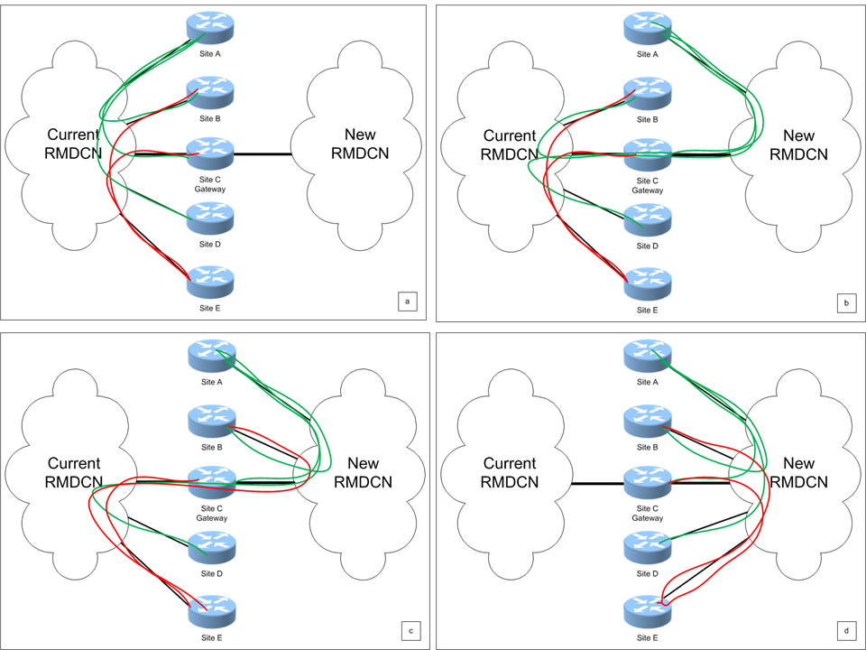
Accelerated Incremental Migration (AIM)
A graphical representation of incremental migration

Slide 7
Accelerated Incremental Migration (AIM)
Key elements:
  Each site migration is independent of other sites
  Site connections can be ordered as soon as configuration agreed
  Migration is easier to manage
  Gateway site is required between the old and new networks during migration (ECMWF)
  Four months from September to December 2013
Handover of sites during AIM (and following AIM)
  After successful Site Reliability Acceptance Test invoicing can start

Slide 8
Acceptance Tests – Site
Site Functional Acceptance Test (SFAT)
  Aim: verify the proper working of all the features of the connection
  Start as soon as the connection is “delivered”
  Will take few hours to complete but will be repeated as often as required until successful completion
  To be completed within 15 days of handover (otherwise Liquidated Damages)
Site Reliability Acceptance Test (SRAT)
  Aim: verify if service meets SLA for a site
  Will last a minimum of 30 calendar days
  Will restart if SLA is breached
  To be completed within 60 calendar days following handover (otherwise Liquidated Damages)

Slide 9
Acceptance Tests – Network
Pilot Network Reliability Acceptance Test (PNRAT)
  Aim: verify SLA of all pilot sites – restart if SLA of two sites fail
  Will last at least 30 calendar days
  To be completed within 60 calendar days of its start (LD)
  Acceptance means start Operational Service (payment will start)
Global Network Reliability Acceptance Test (GRAT)
  Aim: verify that the network is fit for purpose and that we can terminate the current service with confidence
  Point of no return as notices to terminate OBS’ service will be given
  Starts when 20 User Sites have passed Site Reliability Acceptance Test
  Will last at least 30 calendar days
  Global service degradation service levels as acceptance criteria
  (e.g. 15% of connected sites fail SLA)
  Must be completed within 45 days of its start (LD)
Notes:
Acceptance of GRAT is “point of no return”, i.e. from then on we no longer have the option to terminate/cancel contract.

Slide 10
Acceptance Test Period and invoicing
Pilot
Acceptance:
Start Operational Service
and invoicing for Pilot sites
SFAT
1 – 15 days
SRAT
30-60 days
GRAT
30-45 days
Best – 61 days
GRAT (“Point of no return”)
1
30
30
Start invoicing (site by site basis)
Worst – 105 days
GRAT
15
45*
45
Start invoicing (site by site basis)
*) Although SRAT is 60 days in draft contract we expect/hope that 20 sites to have finished
within 45 days so the GRAT should start within 45 days

Slide 11
Dual running costs
Sites will start paying for the new network and will still be charged for OBS’ connection
  90 days notice period with current provider (Supplement 5)
Sites must not give notice before GRAT (“point of no return”)
When does a site start paying for the new network?
Site | When | Dual running costs
Pilot site | After Pilot acceptance | Between 151 days – 195 days (90 days after acceptance of GRAT)
Part of GRAT | After SRAT | Between 120 days – 135 days (90 days after acceptance of GRAT)
Not part of GRAT | After SRAT | Maximum of 90 days (could be reduced if site decides –at a risk- to give notice while the new connection is not fully accepted)
Notes:
For sites not part of GRAT dual running costs could even be reduced to 30 days if SRAT run for full 60 days and site has given notice after SFAT.

Slide 12
Timeline

