Slide 1
How to be connected to the RMDCN?
Rémy Giraud
Network and Security Section

Slide 2
Eligibility
In December 2008, ECMWF Council decided that the following categories of sites could join the RMDCN should they so wish:
ECMWF Member States and Co-operating States
RA VI countries not currently connected to the RMDCN
Countries operating MTN centres in the framework of the IMTN (Improved Main Telecommunications Network), including future GISCs
Countries outside RA VI connected to a RA VI country as part of the GTS, upon request by the RA VI country concerned

Slide 3
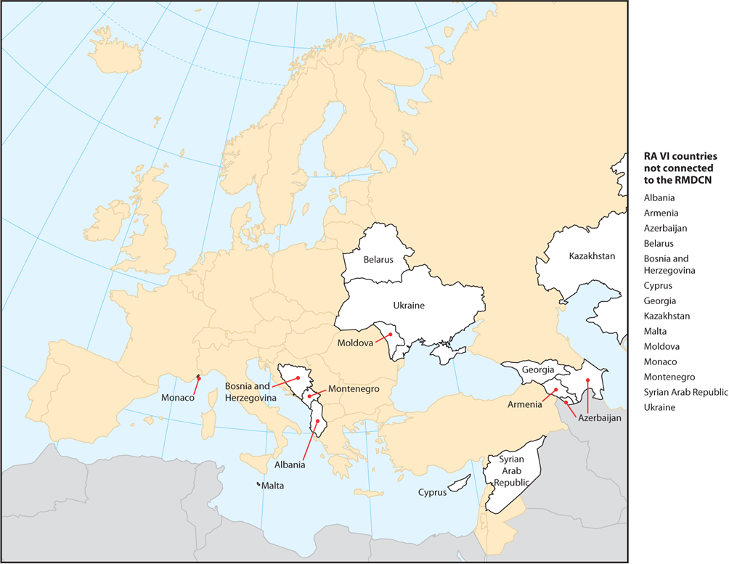
MS, CS and RA VI
Montenegro is the only Co-operating states not connected to the RMDCN.
The RA VI countries not currently connected to the RMDCN:

Slide 4
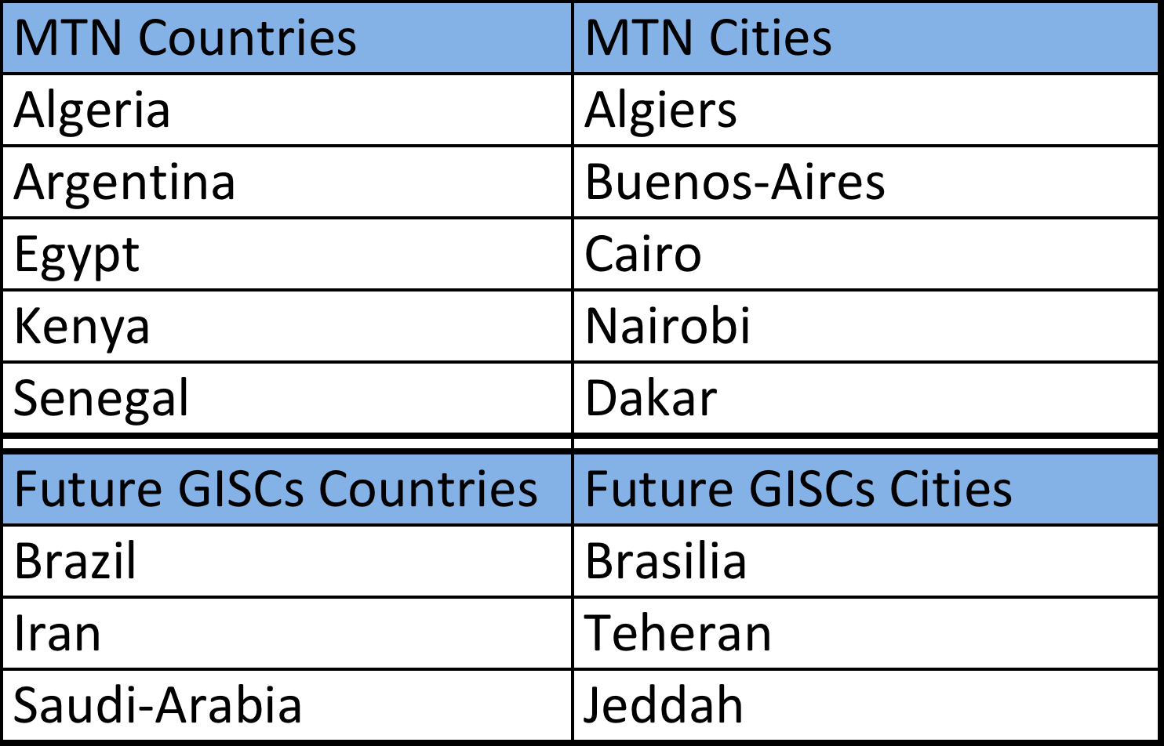
MTN and (future) GISCs
The MTN countries and potential future GISCs not currently connected to the RMDCN:

Slide 5
For all other countries:
Countries outside RA VI connected to a RA VI country as part of the GTS, upon request by the RA VI country concerned
The following procedure has been defined:
  The interested parties write to ECMWF Director General to request the connection to the RMDCN
  The RA VI country willing to “sponsor” the potential new member also writes to ECMWF Director General
  ECMWF then requests approval by the RA VI GTS coordinators (L.Bewrik and C.Little)
  If approved, ECMWF confirms to the interested country that their accession has been approved

Slide 6
Defining the configuration
In liaison with the WAN team at ECMWF (wan@ecmwf.int) defining the configuration
  Among the available site types
  Speed of the connection
In order to get the price, the following information are required:
  Exact postal address where the connexion will be installed
  Main phone number
ECMWF liaise with the provider to obtain the pricing information and forward them to the interested site

Slide 7
The accession agreement
With the exception of ECMWF Member States and Co-operating states wishing to be invoiced via ECMWF, all connected sites must sign an Accession Agreement
A draft accession agreement will be part of the contract signed between ECMWF and the provider
The acceding party can request amendments to the Accession Agreement
The required changes must be approved by the provider and by ECMWF
Once approved by all parties and the configuration is defined and its cost known, the accession agreement will be signed by the provider and the acceding party.

Slide 8
The local technical configuration (1)
Before the installation can be completed by the provider, the site must define:
  IP address(es) of the CPE
  LAN addresses to be announced on the RMDCN
  Routing protocol between the CPE and the LAN, including the IP local gateway address
  SNMP addresses (if needed) for local monitoring

Slide 9
The local technical configuration (2)
The class of service configuration
The network, by default, will offer any to any configuration. However, in order to “protect” the critical traffic, the sites must define the classes of service
If, as it is the case on the current RMDCN, we have 3 classes of service available then, the Class of Service classification will look like:
Class of Service | IP Source | IP Port source | Address mask | IP Destination | Address mask | IP Dest. port
D1 | IP(MSS) | Any | 28 | IP(MSS) | 32 | any
 | IP(Radar) | Any | 24 | IP(Radar) | 24 | 21
D2 | IP(mgmt) | Any | 32 | Any | Any | Any
D3 | Any | Any | Any | Any | Any | Any

Slide 10
The acceptance tests
The acceptance tests are required to prove that the configuration delivered is consistent with the order
ECMWF has prepared the RMDCN Acceptance Software Appliance (RASA)
In order to use this appliance you can either:
  Boot the ISO image on a PC and run the live CD (no modification on the hard drive of the PC)
  Install vmplayer (free from VMWARE) and use the “vmdk” version of the appliance
RASA should be installed on the same LAN as the CPE will be installed by the provider.
ECMWF will then test if the bandwidth ordered has been delivered, the routing is in place and the class of service a correctly configured.

Slide 11
The potential IP address migration
Some sites are using OBS addresses either as addresses on the LAN interface of the CPE, or even on internal hosts, so that they can be reachable on the RMDCN
At 09:30 tomorrow, we will have a dedicated session on this problem
In short:
  No real issue for the migration
  Removal of these OBS IP addresses should take place once the migration is completed

