Slide 1
RMDCN - 12 years of operational service: a (brief) history
Isabella Weger
Head of Computer Division
ECMWF

Slide 2
Establishment of the RMDCN (1)
Jan 1993 –
necessity to reorganize GTS in RA VI (WMO RA VI working group on Planning and Implementation of the WWW in RA VI)
Subgroup on Regional aspects for the GTS made first proposal for global modernisation of RMTN to be known as
“Regional Meteorological Data Communication Network”
May 1994 –
RMDCN Steering Group (RA VI General Assembly, 11th session, Oslo)
1995 –
Steering Group recommended that ECMWF participate in this Steering group
  ECMWF constituted a “critical mass” of partnerships
  RMDCN and ECMWF requirements very similar
  ECMWF has got agreed set of rules and procedures

Slide 3
Establishment of the RMDCN (2)
Jul 1996 - France made a request to ECMWF Council to consider a proposal for a Joint Telecommunications Network between ECMWF and GTS in WMO RA VI
Sep 1996 – 2nd meeting RMDCN Steering Group
  ECMWF to undertake procurement, implementation and operation of network
  RA VI Contract Advisory Committee (CAC) to advice ECMWF
  Establish a RMDCN Operation Committee (ROC)
  Conclude an agreement between WMO and ECMWF
Oct 1996 – ECMWF TAC established a Subgroup on RMDCN

Slide 4
Procurement of the RMDCN service – 1998
ECMWF TAC Subgroup on RMDCN
  Reported to TAC 24 (July 1997) that a managed network could provide a viable solution for a telecommunications service to the ECMWF member States
  Assisted in preparation and review of procurement documents
  Prepared draft of WMO-ECMWF agreement
Council 47 (Dec 1997) approved ITT for the provision of the RMDCN
ITT issued 6 March 1998
Council 49 (Dec 1998) approved selection of EQUANT Network Services Ltd to provide the RMDCN
  Best value for money
  Best coverage for the whole WMO RA VI

Slide 5
WMO – ECMWF Agreement
Following the approval of a Resolution by RA VI General Assembly (12th Session) and approval during 48th ECMWF Council:
July 1998 –
Exchange of letters between Director ECMWF and WMO Secretary-General
  ECMWF will provide a meteorological network to its Member States and is willing to extend this service to all RA VI members
  RMDCN to be part of GTS regarding RA VI telecommunication requirements
  ECMWF will carry out procurement and monitoring of the RMDCN (including monitoring of SLA and Quality of Service)
  Underlying transport layer will not change for 5 years
  Only for GTS and related traffic

Slide 6
Evolution of the RMDCN – Contractual Changes (1)
Contract with Equant (now OBS) – Dec 1998
Supplement 1 – Dec 1999: minor changes
Supplement 2 – Jun 2002:
  Extension of the service beyond RA VI to other relevant NMCs or organisations (background was if requested by WMO to implement connections to improve the GTS MTN).
Supplement 3 – Dec 2002:
  major speed upgrade (incl. ECMWF funded “basic package” to 384 kbps)
Supplement 4 – May 2006:
  Transition to IPVPN MPLS technology
  Major changes to Service Level:
    Availability: Mission Critical sites (100%) & sites with ISDN backup (99.9%)
    2 hour repair time
  Upgrade ECMWF funded “basic package” to 768 kbps

Slide 7
Evolution of the RMDCN – Contractual Changes (2)
Supplement 5 – June 2011:
  Flexible termination related to procurement and migration
    Site-by-site termination with 90 days’ notice
    In the event of unexpected ITT delay, the price review mechanism defined in Supplement 3 (annual price reviews and biennial contract review) would come into force again
    In the event of major ITT delay, OBS obliged to provide the RMDCN service until 31 March 2016; ECMWF has the right to terminate at any time with 6 months’ notice
  Upgrade ECMWF funded “basic package” to 2 Mbps IP Bandwidth

Slide 8
Evolution of the RMDCN – Architecture
Initial RMDCN service based on Frame Relay technology
ECMWF checked regularly the status of new network architectures
2004 proposal to migrate to MPLS
  Any-to-any connectivity with Class of Service concept
  Doubling of the access bandwidth
  Contract extension to March 2009
  Thereafter on a rolling basis for successive terms of 12 months
Following signature on 8 May 2006, the implementation took a year and on 18 June 2007 the RMDCN was using a new IPVPN MPLS architecture

Slide 9
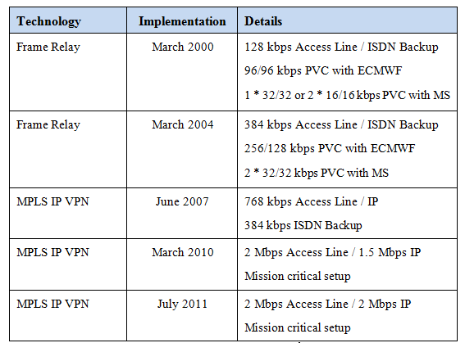
Evolution of ECMWF Basic Package

Slide 10
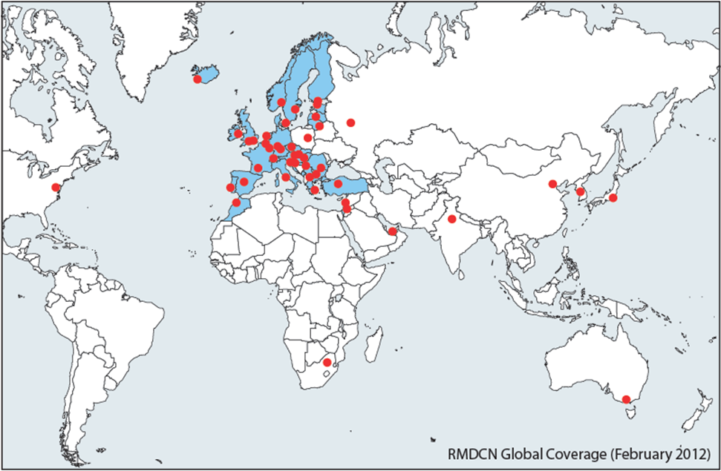
Geographical coverage

Slide 11
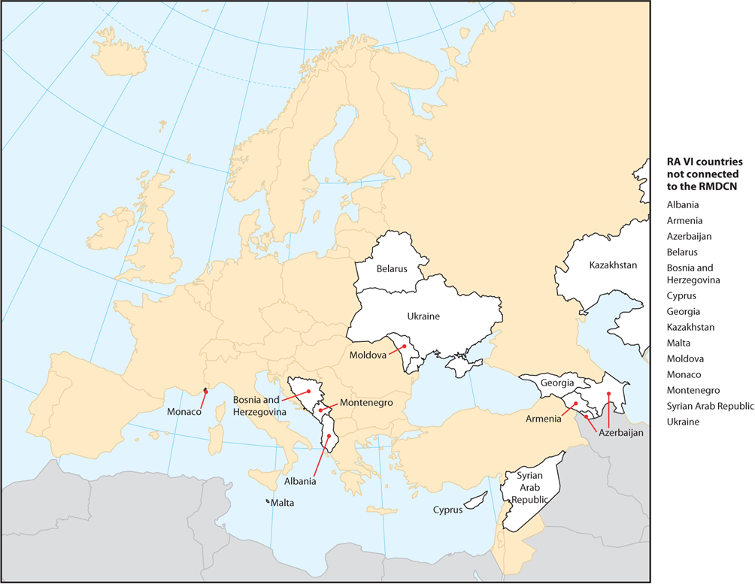
RA VI countries not connected to the RMDCN

Slide 12
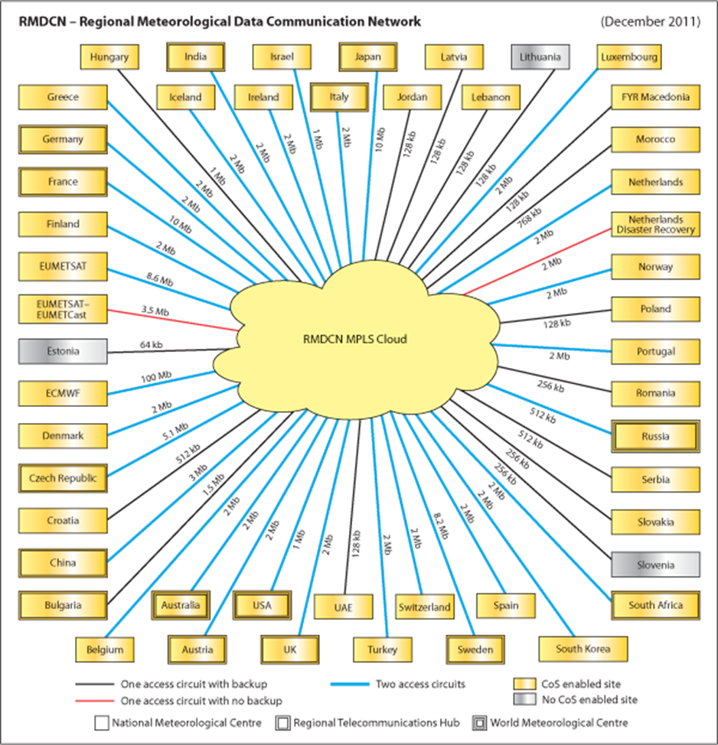
RMDCN Configuration

Slide 13
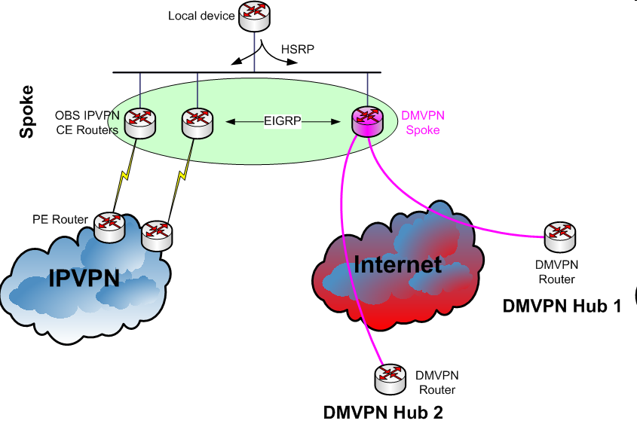
DMVPN Pilot Service
Large-scale operational DMVPN pilot project
  additional backup of the RMDCN over the Internet
  operational since October 2010
  Connected sites
  ECMWF (primary hub-site)
  Sweden (backup hub-site)
  Bulgaria (since 2 November 2010)
  Italy (since 25 November 2010)
  Norway (since 8 December 2010)
  Romania (since 16 March 2011)
  Germany (since 9 December 2011)

Slide 14

Procurement of the “Next-Generation RMDCN”
RMDCN operational service since 2000
Plan presented to the TAC Committee at its 42nd session (October 2010) to initiate a procurement process for a new RMDCN
Phase 1 concluded in 2011 – Requirements reviewed by the ECMWF and discussed with WMO Task Team on RMDCN
Procurement plan approved by ECMWF Council in December 2011
Phase 2 started in early 2012
Phases 2 and 3 will be discussed later in this workshop …



