Slide 1
Status of GISC Beijing and CMACast System
Lang Hongliang
langhl@cma.gov.cn

Slide 2
Offenbach
Tokyo
EUMETSAT
Moscow
New Delhi
NESDIS
Islamabad
US
3Mbps
2Mbps
512Kbps
128Kbps
2Mbps
RMDCN
MPLS VPN
Internet
4Mbps
250Mbps
GISC Beijing (RTH Beijing)
64
Kbps
64
Kbps
64
Kbps
64
Kbps
256
Kbps
4Mbps
Video+data
Bangkok
Hanoi
Pyongyang
Ulan Bator
Seoul
Hongkong
Leased line
The GTS circuits connected with GISC Beijing (RTH Beijing)

Slide 3
GISC Beijing
Started official operation as from August 15, 2011
  Exchanging metadata with BOM, DWD, INMET, JMA, Meteo France, NWS, HKO
  Available services: metadata search, data subscription, data request/reply, web data ingest, metadata ingest, …
  Available data: global exchanged data, CMA NWP products, FY satellite data, TIGGE products (from 10 product centers), …
Data dissemination
  GTS – to other WIS/GTS centers via ftp, tcp sockets
  Internet – to other centers, end-users via ftp, http, smtp
  CMACast – to other centers, end-users

Slide 4
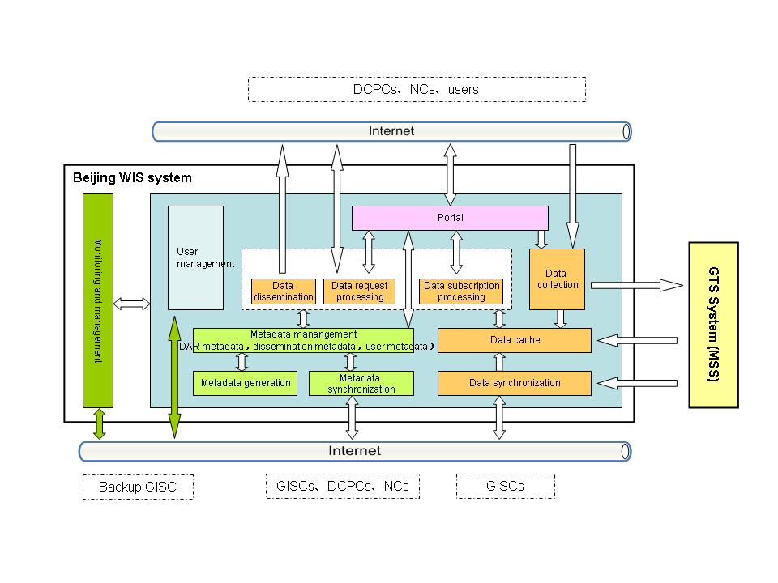

Slide 5
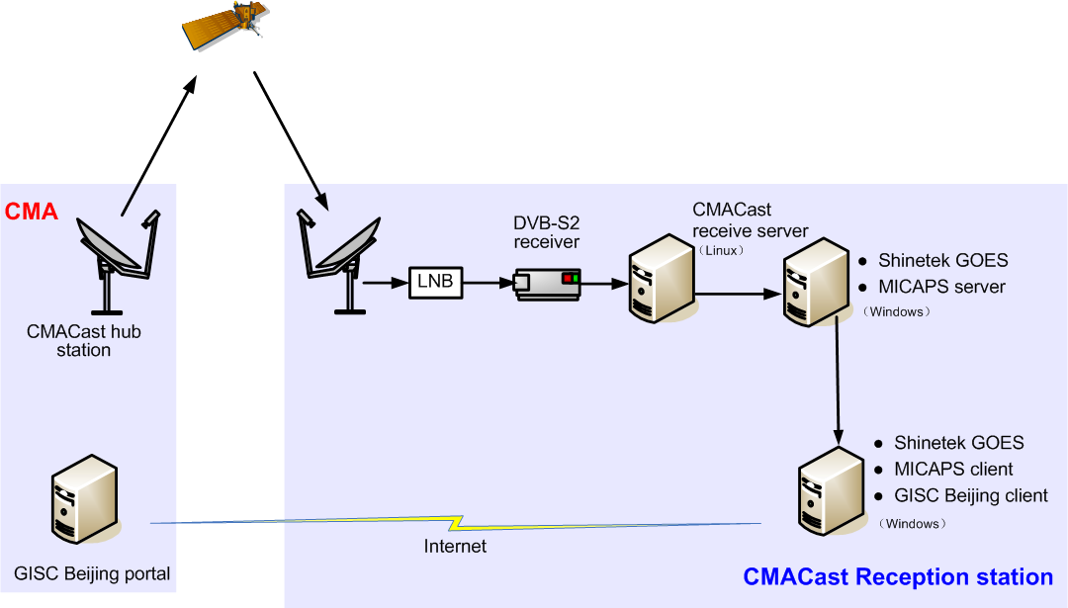
Integrated with the data services of CMACast
subscribed data
subscribed data
discover data, make data subscription

Slide 6
CMA Internal DCPCs
Next step
Developing internal DCPCs, include NMC (National Meteorological Centre) DCPC, NCC (National Climate Centre) DCPC, NSMC(Nation Satellite Meteorological Centre) DCPC
Providing internal DCPC’s products via GISC Beijing portal

Slide 7
CMACast System
C-band DVB-S2 data broadcasting system
Maximum data broadcasting capacity is about 70Mbps
Three types of user:
  CMA internal users, 31 province-level stations, 350 city-level stations, 2070 country-level station
  External users, 234 stations
  Asia-Pacific users, 20 stations
Business operation will be started in May, 2012

Slide 8
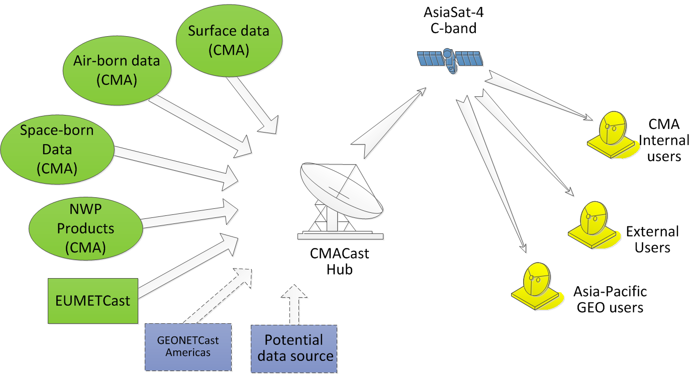
CMACast System

Slide 9
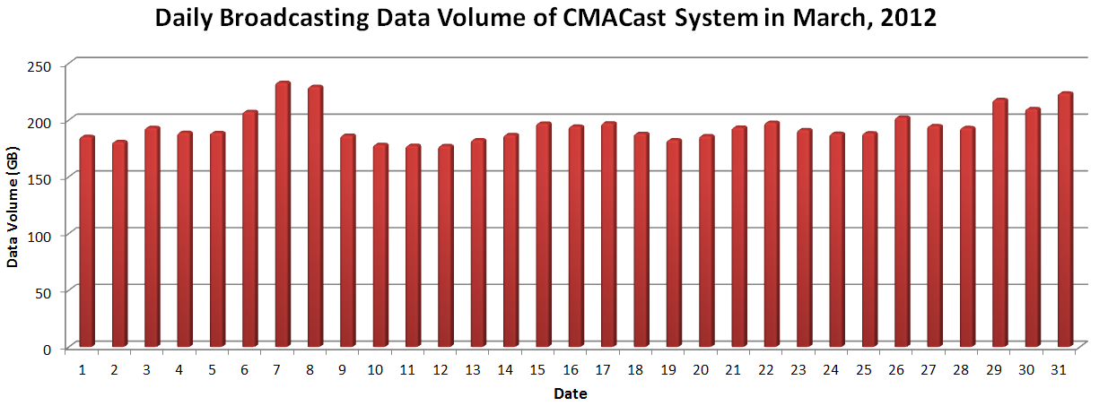
Statistics of CMACast system in March, 2012
Data Volume | Maximum Daily (GB) | Minimum Daily (GB) | Average Daily (GB) | Monthly Total (TB)
 | 232.92 | 177.20 | 194.82 | 6.0
File Number | Maximum Daily (K) | Minimum Daily (K) | Average Daily (K) | Monthly Total (K)
 | 1021 | 748 | 868 | 26901

