Slide 1
Request for Information
RFI 1501-18 (OBS)
Cache in and through the cloud
« Cache in the cloud » team
December 2018

Slide 2
Purpose and Objective
This RFI is a procurement exercise to conduct a market survey in order to obtain information (from the market) that can be used to identify available or potential solutions for fulfilling identified needs which may include information on cost (budget) and delivery time;
The main purpose of this RFI is to request vendors to provide an estimated not-to-exceed (NTE) cost for this project and is intended only for budgetary purposes;
This RFI is entirely non-binding to the WMO and does not represent a commitment of any kind towards any vendor who will respond to this RFI;
Considering WMO context, it is important for the interested members to know in advance the NTE amount of the project;
This presentation describes the project from a high level perspective;
The result of this RFI will then be used to decide whether it is commercially and technically viable to go for an official tender;
WMO (World Meteorological Organisation) plans to launch an official tender for the benefit of its members in late 2018;
This RFI does not constitute a commitment from the vendors that their proposal, if they decide to bid, will be capped by this amount;

Slide 3
What is the WIS ?

Slide 4
A brief description of the WIS
The WMO Information System (WIS) is the name of the service used within the meteorological services around the world to exchange and then make available data and metadata to their users
It is based on 15 centres (called GISC) around the world that have a particular responsibility in the system.
The GISC must collect data from centres in their area of responsibility and distribute the data with global interest to all other GISC to constitute a cache of data
The global cache then exists in 15 versions (one in each GISC)
The GISC support the connected centres in the creation and maintenance of the metadata records.
Metadata in then exchanged between all GISCs to maintain an identical catalogue at each GISC
Further information can be found on WMO website: http://www.wmo.int/pages/prog/www/WIS/overview.html

Slide 5
A simplified view of the architecture

Slide 6
List of the GISCs
Beijing (China)
Brasilia (Brazil)
Casablanca (Morocco)
Exeter (UK)
Jeddah (Saudi-Arabia)
Melbourne (Australia)
Moscow (Russia)
New Delhi (India)
Offenbach (Germany)
Pretoria (South-Africa)
Seoul (Republic of Korea)
Tehran (Iran, Islamic Republic of)
Tokyo (Japan)
Toulouse (France)
Washington (USA)

Slide 7
GISC, cache and metadata within WIS
Among other activities, the GISCs have the responsibility to maintain a cache of data for the last 24 hours and the catalogue of all data available within WIS
This RFQ is about a service that will facilitate the GISC to maintain both the cache of data and the metadata catalogue
The only users of the service will be the GISCs.
The required protocols mentioned in this document are the protocols currently used by the GISCs to fulfil the functional requirements of the WIS.

Slide 8
A step toward WIS 2.0
The WIS is currently evolving toward a new architecture where in addition of the data exchange, services will be proposed by the WIS in its version 2.0
It is considered that the cache in the cloud is one of the first step in the implementation of the WIS 2.0 system
Considering the timeline of the implementation of WIS 2.0, the contract for the desired service will last 3 years 2019 - 2022
Initial stage
Evolution
stage
Final stage
2025-?
2022 – 2025 ?
2019 - 2022

Slide 9

Shared cache between GISCs
GISC
GISC
NC
DCPC
NC
NC
DCPC
NC
Each GISC collects data from its connected centres (the collection of data from these centres is out of scope of the project)
The data intended for GlobalExchange must then be available in a cache kept locally by each GISC.
The service required will facilitate the exchange of data between the GISCs to create the 15 local caches
Notes:
Evolution and Final Stages represent possible expansion of participant base.

Slide 10
Metadata catalogue
Each GISC helps the data producers within its area of responsibility to describe their data with metadata (ISO19115 compliant) record
The GISC harvest the metadata catalogue from other GISCs using OAI-PMH and establish a global catalogue

Slide 11
Project timeline
The results of this RFI will be discussed with various WMO bodies in the first half of 2018.
If the project is approved, it is anticipated that the official tender will be launched in Q4-2018
The service will then start for a 3-year period in Q2-2019
The tender will only cover the « Initial Stage »

Slide 12
Summary: what are we looking for?
A fully managed cloud based service to support the GISCs in creating the shared cache and the metadata catalogue as described in the WMO Information System

Slide 13
Functional and technical requirements

Slide 14
Guiding principles
Adherence to WIS technical specifications (maintain technical interfaces currently in places - architecture, protocols,…).
Evolutionary – support current protocols, evolve to support new ones over time, seek opportunities for improving efficiency
Address both data and metadata exchange requirements
Consider governance, performance, reliability, security, administration, monitoring, and financial aspects of the project
Must respect local legislation of each GISC in term of networking connectivity

Slide 15
Data requirements in the cloud
Performance
  Global data is to be available at all GISCs within 15 minutes. The largest files to distribute are less then 200MB.
  High priority data is to be available at all GISCs in 1 minute. The data in this case a very small (a few kilobytes maximum).
Scalability
  The total volume cache is estimated to be less than 200GB per day in files varying a lot in sizes (from 1kB to 200MB).
  Each GISC contribute to a fraction of the volume. However, the volume provided by each GISC varies greatly (a factor of at least 20 exists between to heavy contributors and some others)
Data exchange
  Must use agreed protocol to exchange data: FTP, SFTP, HTTP, HTTPS for GISCs
  Persistence of the cache
  In addition to receiving and pushing the data in real time to the GISC, a copy of the data will be made available so that GISC can re-access old (up to 5 days old) individual files received by all GISCs (using the agreed protocols FTP, SFTP, HTTP, HTTPS). In total this cache will be less than 1TB (200GB per day x 5 days)
Notes:
Reference documents:
WIS-TECHSPEC-3: Centralization of Global Distributed Data
According to WIS-TECHSPEC-3 of “Centralization of Global Distributed Data”.
As the performance metrics global information is some of the operation-critical data intended for global distribution is to be transmitted end-to-end within two minutes.
Data flow, Inputs is Global information, and outputs is Cached Global information.
In the notes, Global data is required to be all GISCs within 15 minutes.

Slide 16
Metadata requirements in the cloud
Metadata exchange
    Must use agreed protocols to exchange metadata (OAI-PMH)
    Will harvest once a day the updates of catalogue of all 15 GISCs
    Will make this catalogue available for harvesting by all GISCs
  Once a day, a compressed copy of the catalogue will be prepared and made available to the GISCs using FTP, SFTP, HTTP or HTTPS
    The GISCs will be able to download this compressed copy of the catalogue
    The volume of the compressed catalogue will be less than 1GB

Slide 17
Administration requirements
Configuration and management of IT environment
Configuration and management of software packages that are required by the service
Management of access rights
  A very small number of systems and users will need to have access to the service
Activity monitoring – The service should propose a mechanism (API, access to logs,…) so that GISCs can integrate the service monitoring into their own system
Data availability and timeliness
  Monitoring & statistics

Slide 18
Security requirements
The security of the service is a must
State of the art measures must be in place in order to guarantee that only the GISCs will have access to the service. This includes, but is not limited to:
    Access control lists/firewall rules so that only known GISCs can access the cache service.
    Only advertise the protocols needed to run the service
    “Harden” the platforms so they do not run unnecessary services
    Patching and updating policies
    …
The design should also include anti-DDOS service

Slide 19
Networking requirement - RMDCN
All GISCs except Brasilia, Tehran and Washington are connected to a private MPLS network, provided by Interoute, called the RMDCN (https://www.ecmwf.int/en/computing/our-facilities/rmdcn)
The RMDCN has a very high SLA
It is anticipated that many GISCs may prefer to use the RMDCN for the exchange of data
Ideally, an interface between the cloud service and the RMDCN should be proposed. Vendors are invited to confirm whether they can connect the proposed solution to the RMDCN and to include this in the « not to exceed » figure.

Slide 20
Networking requirements
The Internet will be used for the exchange of data and metadata between the cloud service and the GISCs, either exclusively or as a complement to the RMDCN
Each GISCs will have the responsibility to get its own (normally redundant) Internet connection
The data centres hosting the service must have redundant Internet access
All cloud servers and IT environment required by the service must be interconnected by a highly reliable networking solution. The anticipated solution must be described.

Slide 21
Required protocols
The protocols that can be used between the GISCs and the cloud service are:
  FTP, SFTP, HTTP, HTTPS for data
  OAI-PMH for metadata
In addition, it is possible to use additional protocols within the cloud service to distribute the data and metadata between the various components of the service

Slide 22
SLA
The WIS is a critical system that is used 24/7 by all National Meteorological Services around the world.
Therefore, the « Cache in the cloud » service must have a very high SLA – 99.95% (including planned maintenance)
It means that the service must be designed in a highly redundant manner in order to achieve the required SLA

Slide 23
A potential architecture

Slide 24
Information
The following slides present a potential architecture and software solution that can be used in providing the service
They are based on practical experience from the members
However, it is the responsibility of the provider to design the solution in order to fulfil the requirements
As such, these are only indicative and shouldn’t be considered as the requested design
Notes:
Baseline services are the minimum capabilities required to store and exchange data meeting the capacity of the existing WIS cache. This does not include failover and other services needed to fulfill other certification requirements such as availability.

Slide 25
Example of IT architecture
Considering the geographical repartition on the GISCs, a solution can be based on:
  Two servers in two different data centres per “region”
  Three regions:
      Americas for the collection of data/metadata of GISC Brasilia and Washington
      Europe/Africa for GISC Casablanca, Exeter, Moscow, Offenbach, Pretoria, Toulouse
      Asia/Oceania for GISC Beijing, Jeddah, Melbourne, New Delhi, Seoul, Tehran, Tokyo
Each GISC send data one server in its region. A failover mechanism is in place to fall back to the second server in case of an issue
Each server in a region fetches metadata record from the GISCs in the region (once a day)
Servers synchronize data and metadata within the cloud service
One server send data to all GISCs within the region
GISCs fetch metadata on a server of its region (once a day)
Notes:
Baseline services are the minimum capabilities required to store and exchange data meeting the capacity of the existing WIS cache. This does not include failover and other services needed to fulfill other certification requirements such as availability.

Slide 26
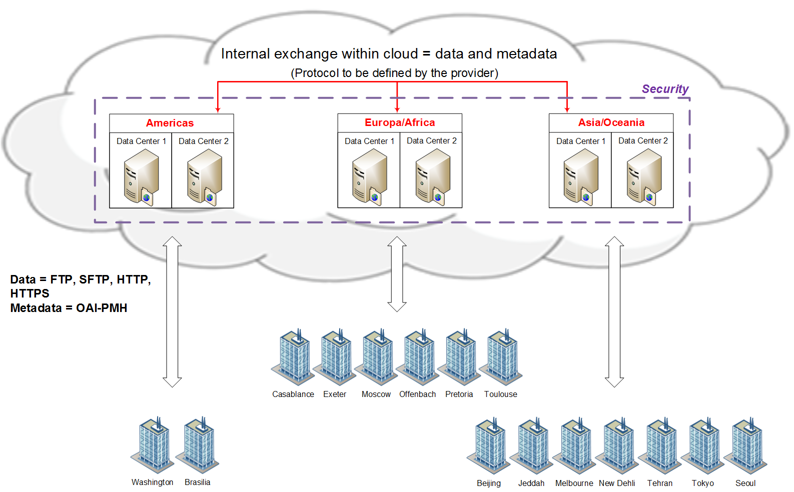
A possible design

Slide 27
Example of software
AFD (Automatic File Distributor, https://www.dwd.de/AFD/) is an open source software widely used within the WMO community
  It can be used to redistribute data using FTP, SFTP or get data using HTTP, HTTPS
  It also handles to notion of urgent message
  It is known to be very reliable
pycsw (http://pycsw.org/) is an open source software to handle metadata records
  It implements OAI-PMH
  It is a very lightweight and simple to deploy software
These are just examples of software that are known to be able to do the required functions. Using them is not a mandatory requirement

Slide 28
Conclusions and next steps

Slide 29
Next steps
Align the process with the upcoming WMO official bodies (ICT-ISS, CBS TECO 2018, EC-17, Cg-18)
Define requirements and constraints for the tender process
Develop position papers related to cache in and through the cloud and the proposed path forward, for approval by WMO governing bodies
Execution of the tender and selection of successful bidder
Implementation of cloud environment and connections to GISCs
Operational monitoring of cloud environment
Progress through phases of implementation described previously

Slide 30
Planned approach toward the « Initial Phase » - 1
ICT-ISS - January 2018
  Present the project and the plan
Obtain ”not to exceed” budget by potential tenderers – January 2018
TECO – March 2018
  Get approval on the project and the plan
Starts working on the future tender documents – March 2018
Evaluate budget for the overall 3-year contract – April 2018
  Include management cost, cloud infrastructure running cost, WMO management cost (contract, tender,…)
Paper for EC including – April 2018:
  Expected WMO support/role
  Description of the project and expected benefits
EC - June 2018
  Endorse the concept and allow CBS to proceed once the financial commitment from the GISCs has been received

Slide 31
Planned approach toward the « Initial Phase » - 2
Approval from GISCs with commitment to pay – October 2018
WMO issue a “Expression Of Interest” allowing pre-selection of potential bidders – October 2018
Complete tendering documents – November 2018
WMO to issue the documents to the selected bidders – January 2019
Answers received – March 2019
Analysis of the answers and prepare tender report - May 2019
WMO to choose the successful tender – June 2019
Operational service to start - Autumn 2019

