Slide 1
Draft GISC Audit Criteria
Kevin ALDER
Agenda item 4(2)
ICT-ISS 2018
16-18 January 2018, Geneva

Slide 2
Proposed Audits
Reduced emphasis on technical aspects and IT infrastructure
More focus on GISC activities that deliver value to WIS Community, and users in GISC AOR.
Questionnaire to be developed using Survey Monkey.
Survey to include questions on management of risks within GISC operations.

Slide 3
Proposed Audit Criteria
Elements of GISC Operations to be audited will be based on a matrix of:
The six management functions listed in the ISO9001:2015 standard.
WMO No 1061, Annex D, para 2.1.1 – Scope of GISC Audits
ET-WISC Workplan – Actions 1-10
Audit criteria will be submitted via ICT-ISS to CBS-MG for approval by the president of CBS.

Slide 4
ISO9001:2015
ISO 9001:2015 focuses on six organisational management functions:
Clause 5 – Leadership
Clause 6 – Planning
Clause 7 – Support
Clause 8 – Operation
Clause 9 – Performance evaluation
Clause 10 – Improvement
And then wraps these in risk-based thinking

Slide 5
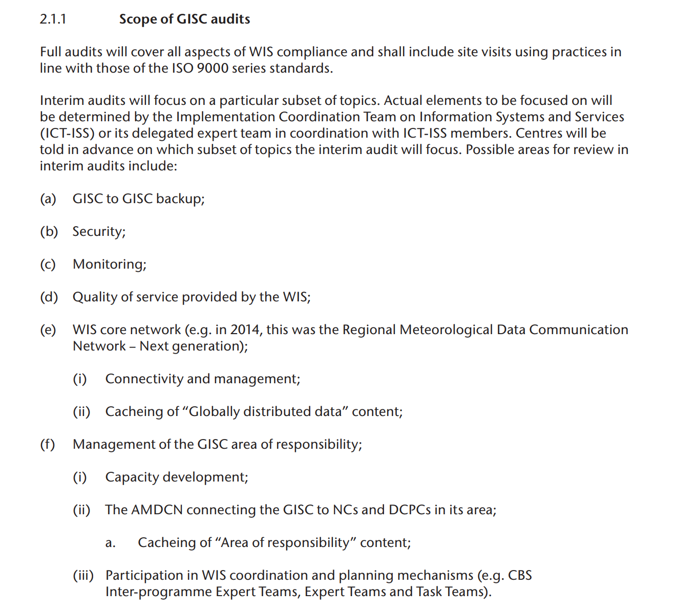

Slide 6
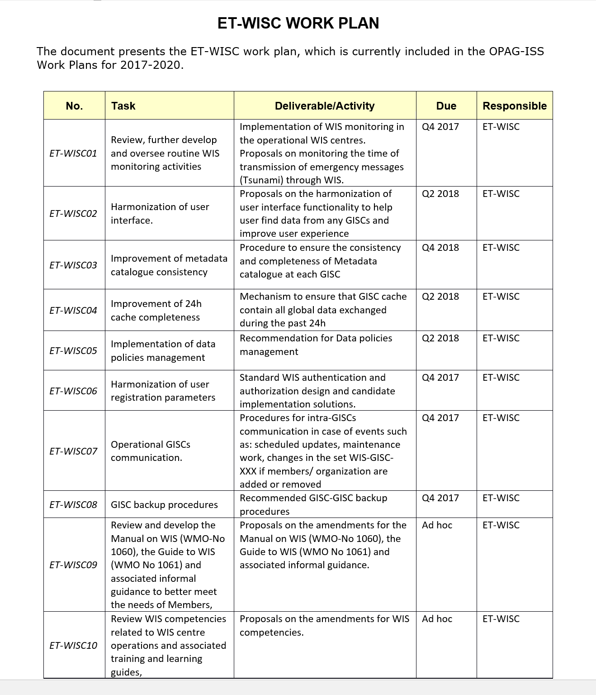

Slide 7
1. Leadership
Commitment of organisation
Resourcing - financial, technical, personnel
Participation in WIS planning and co-ordination mechanisms
Management practices - Quality Management and Risk Management activities

Slide 8
2. Planning
IT Programme Governance, Strategy and Design in reference to WIS
Implementation and incorporation of WMO regulations and recommendations in operations
Personnel planning and competencies - WIS Competencies and staff training activities in relation to WIS
Security planning and programme
WIS Core Network - planning and capacity management

Slide 9
3. Support
Service Management - Service Desk support and incident response processes
Development and Training Activities within Area of Responsibility
GISC to GISC Support and Communications

Slide 10
4. Operation
IT Operations - Resilience of Infrastructure Services, including redundancy
IT Operations - Change Management processes
IT Operations - Contract Management
Security Practices - system patching, user management, user awareness and education, network monitoring

Slide 11
4. Operation
Compliance with WIS Technical Specifications
Management of GISC Area of Responsibility - AMDCN connectivity, regional cache and information dissemination
Management of GISC-GISC functions and activities, including 24 hour cache and GISC-GISC backup
Procedures to manage metadata consistency and completeness
Operational documentation and procedures

Slide 12
5. Performance Evaluation
Management reporting and metrics
WIS performance monitoring and reporting activities
Quality of Service metrics

Slide 13
6. Improvement
Continuous Improvement programme
Follow-up on previous audit recommendations (if any)
WIS Programme Internal Audits Reports and follow-up actions

Slide 14
To Do
Finalise audit criteria with ET-WISC.
Develop online questionnaire based on criteria.
Revise existing audit procedure documents and reporting templates including evidence checklists to align with the new criteria.

Slide 15

Thank you
Kia Ora

