Slide 1
Guidance for managing international
cryospheric information
David Gallaher
NSIDC/University of Colorado Boulder
Agenda item: 5.9 Time 17:00

Slide 2
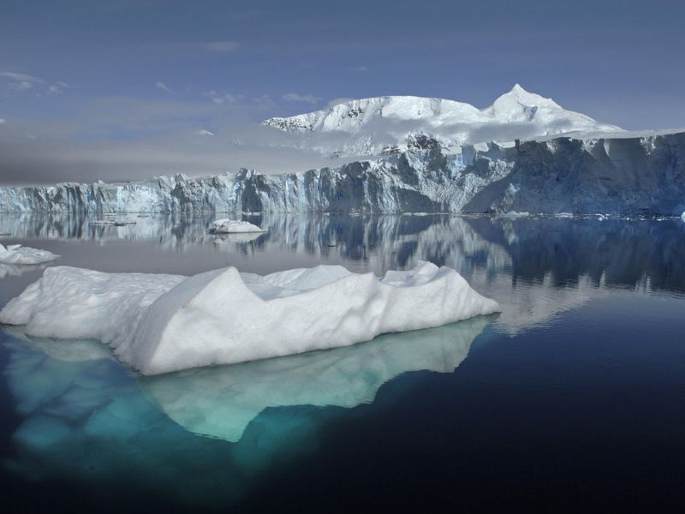
Data Management Guidelines/List of Practices
Standards/Formats
Data Quality
Data Accession/De-accession
Branding
Data Set Versioning Guidelines
Data Set DOI Guidelines
Data Set Citation Guidelines
Issues & Limitations
Legal Concerns
Example Cryospheric data

Slide 3
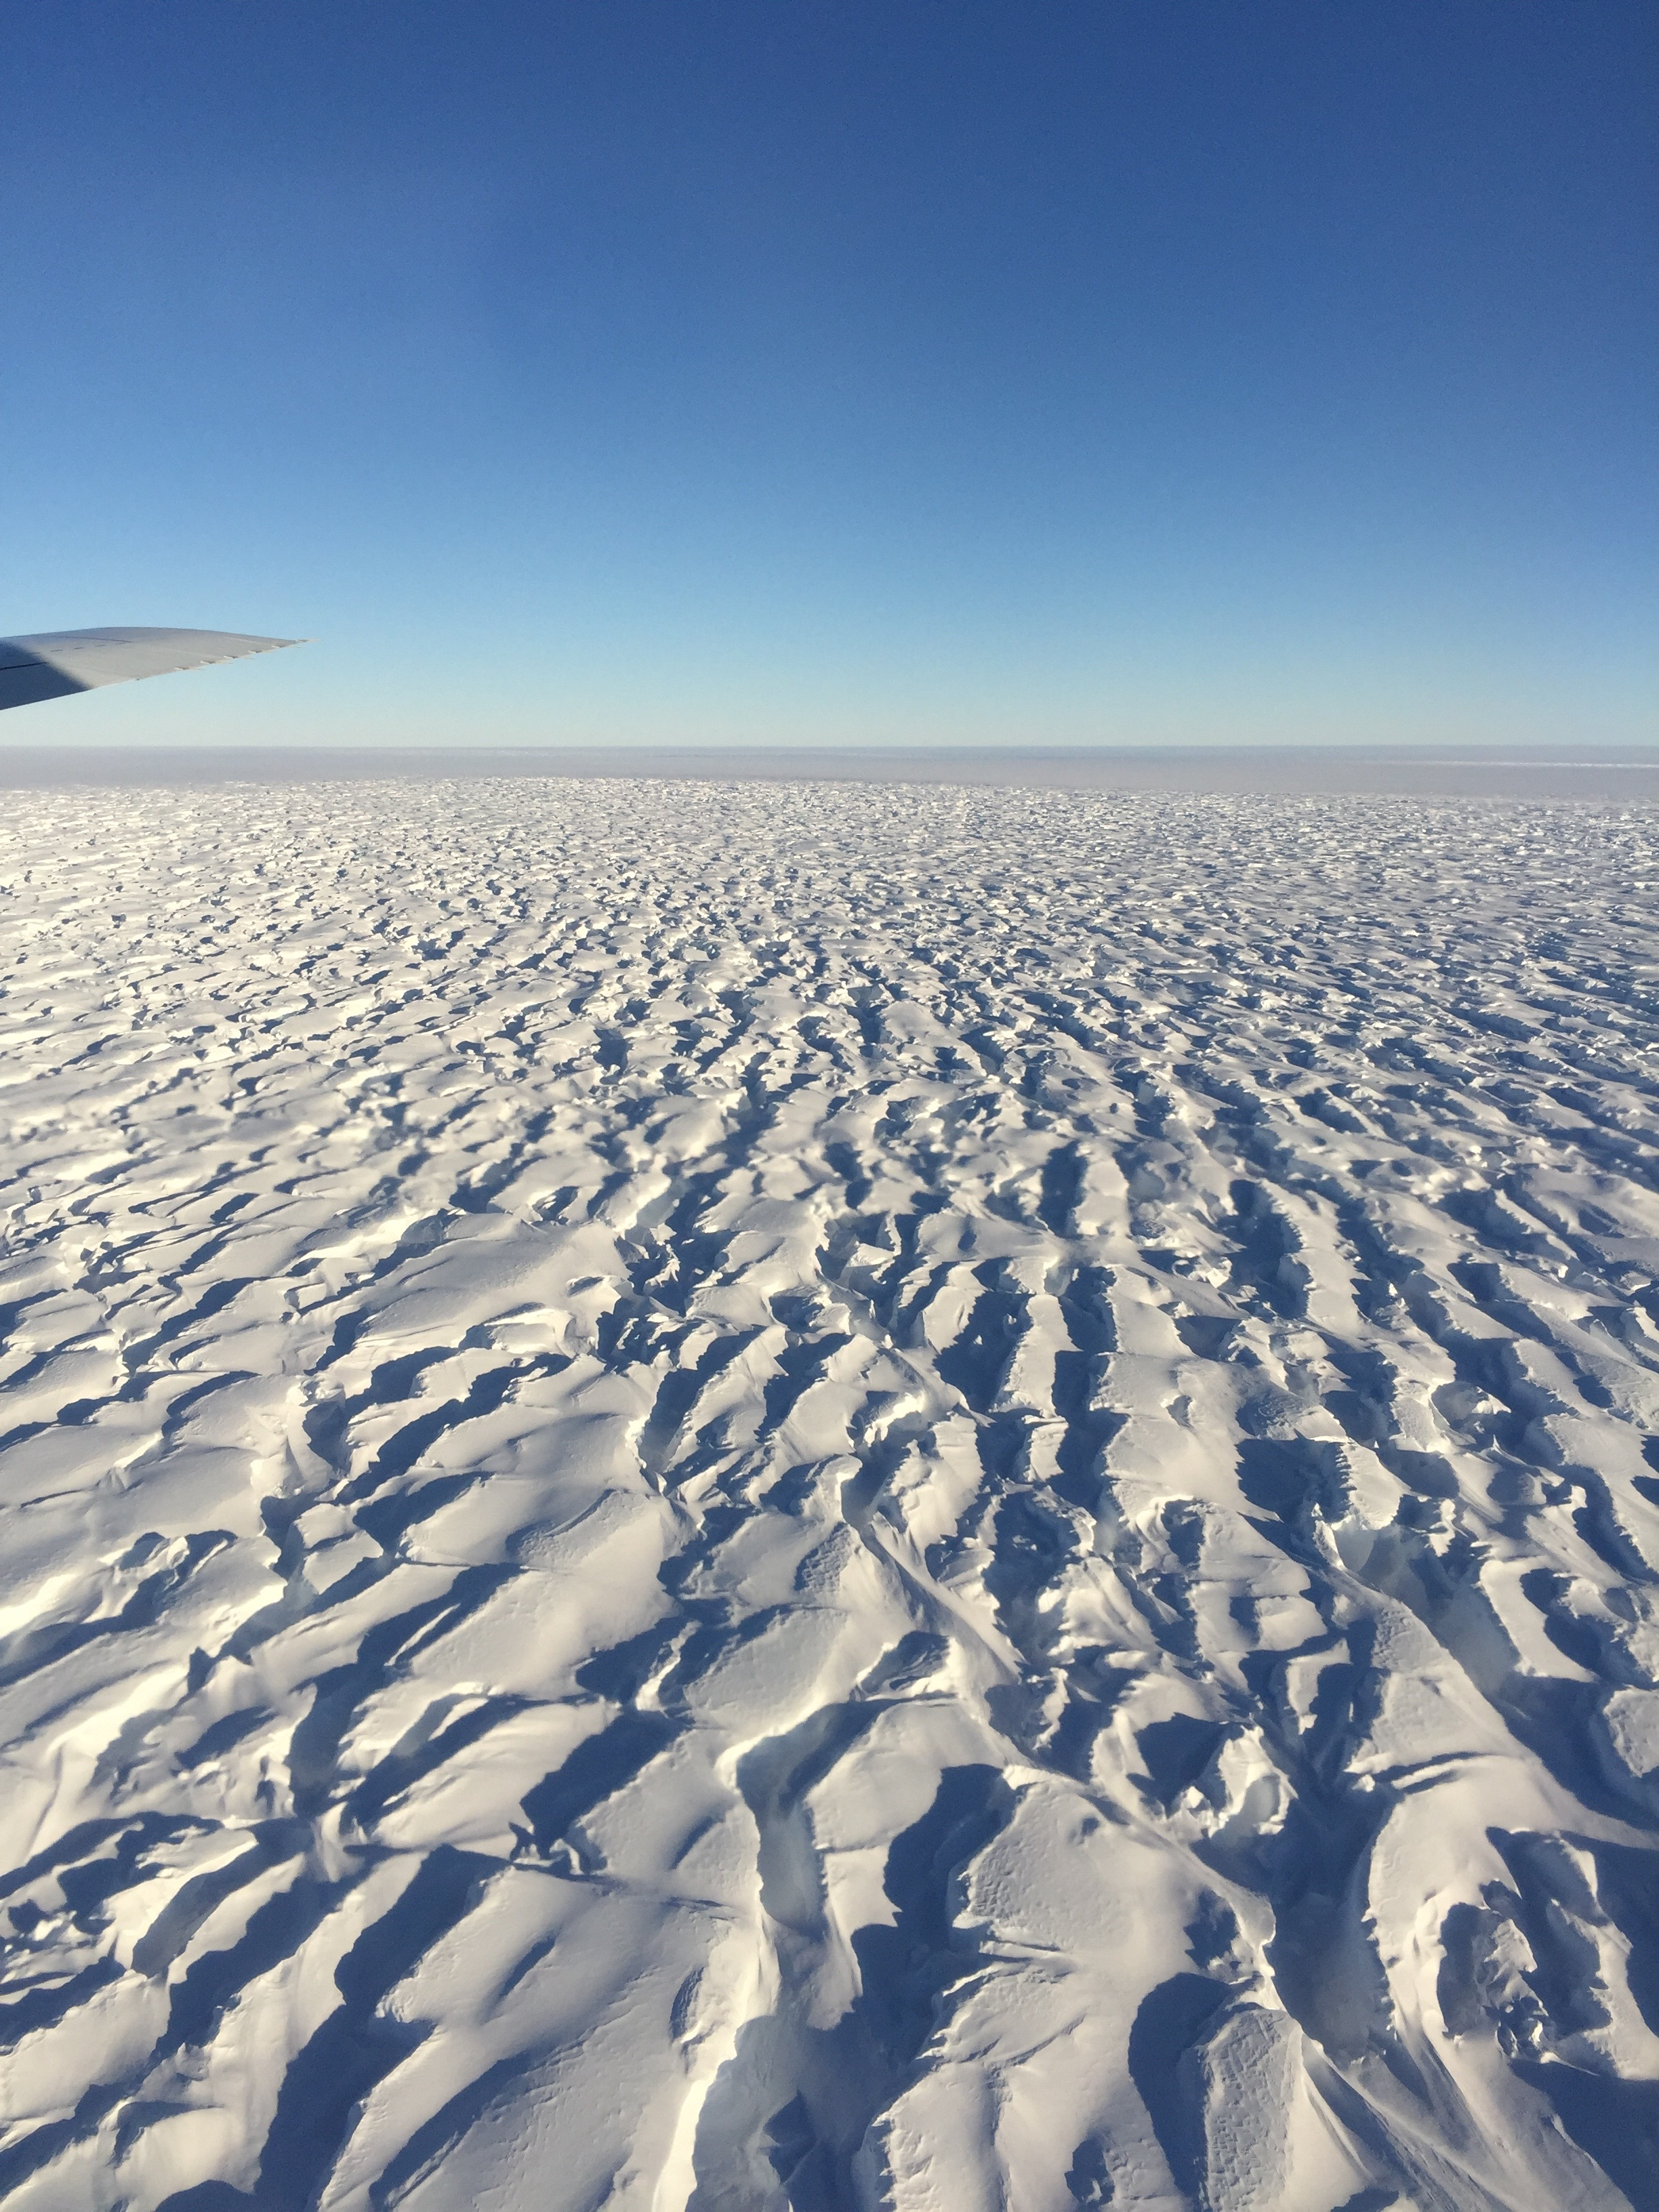
Standards/Formats
Encoding:
HDF, NetCDF, Binary, Geotiff,
shape, KML
Access Protocols:
OPeNDAP, FTP, HTTP, HTTPS,
OGC web services (W*S)
Metadata:
ISO 9115
Catalog Services:
OpenSearch, OAI-PMH

Slide 4
Data Quality
QA4EO:
Quality indicators, Traceability, Reference Standard, Uncertainty
Other quality measures in use include:
Error bars , Signal to noise, Documentation, Data Audits (how often is a parameter populated?)
Condensate Processing:
The search for anomalies in a dataset (either as real events or artifacts)
Levels of Service Minimum:
Provides checksum, Data integrity monitoring, On-site backups, Inventory metadata

Slide 5
Data Accession/De-accession

Slide 6

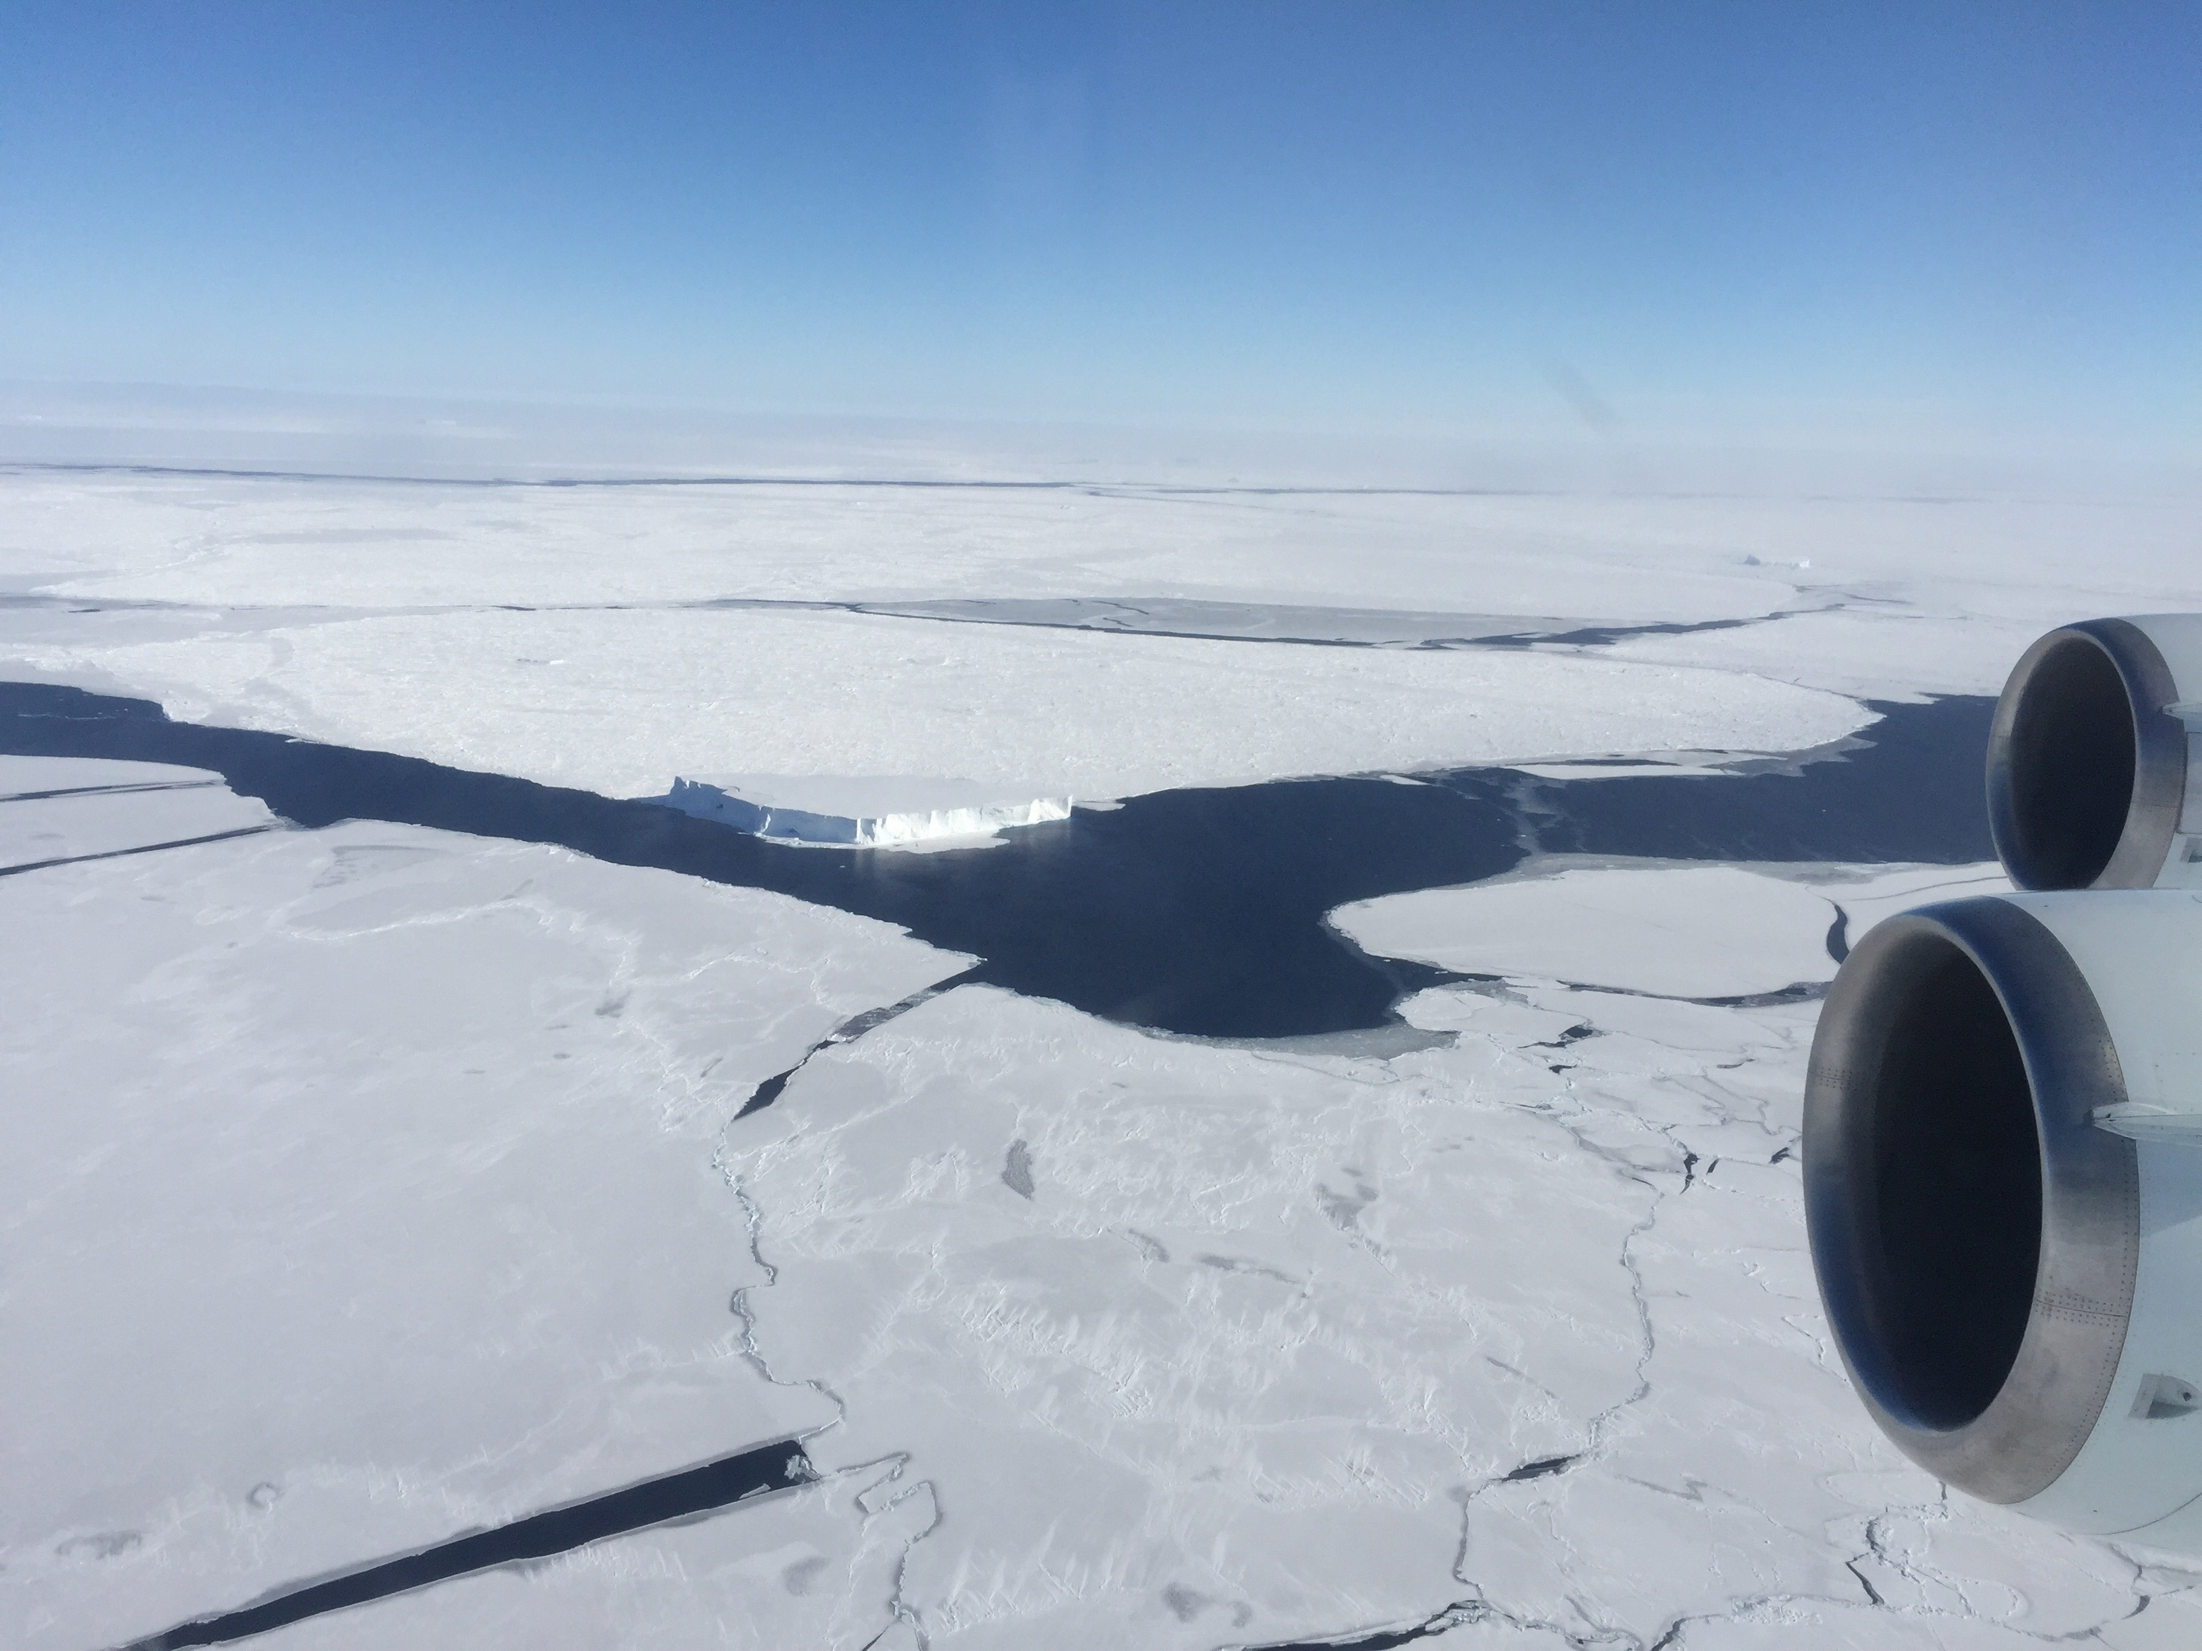
Data Branding
What is branding?
A brand encompasses the uniqueness and
value of a product or organization.
When an organization has a successful brand, people attach all of the brand attributes to everything the organization does or produces.
A brand does not describe a product line. It tells people what kinds of things they can expect.
A brand is not a logo. However, logos, graphic elements, colors, and so forth create a strong visual association that connects people immediately with brand attributes.

Slide 7
Data Set Versioning Guidelines

Slide 8
Data Set DOI Guidelines
What is a Digital Object Identifier (DOI)
Per Wikipedia, "A digital object identifier (DOI) is a character string (a "digital identifier") used to uniquely identify an object such as an electronic document. Metadata about the object is stored in association with the DOI name and this metadata may include a location, such as a URL, where the object can be found. The DOI for a document is permanent
When to Assign a DOI
To a data set when it is first published or released. This would include limited or embargoed releases.
To each new major version. A new major version also results in a new metadata record. See Data Set Versioning Guidelines for more information on data set version.
  The DOI and metadata record for past versions should be maintained and point to the corresponding data set landing page.
.

Slide 9
Data Set Citation Guidelines
In general, NSIDC adheres to the ESIP guidelines for Data Set Citations.
For Example: merely referencing and acknowledging “Sentinel” is insufficient; acknowledging ESA but not also Copernicus is also insufficient.
The Sentinel data usage document provides the following acknowledgement formats:
When presenting/distributing un-modified data:
"Copernicus Sentinel data [Year]' for Sentinel data, processed by ESA"
When presenting/distributing data that have been adapted or modified:
Contains modified Copernicus Sentinel data [Year] for Sentinel data, processed by [processing agency/PI]
Ex. Contains modified Copernicus Sentinel and Landsat data (2015–16), processed and analyzed by Humboldt University Berlin/P. Griffiths (ESA Living Planet Research Fellow).

Slide 10
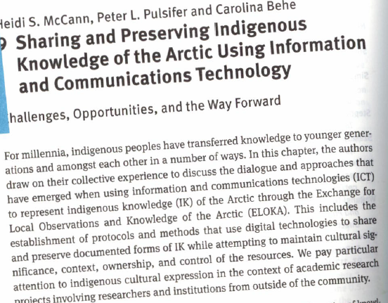
Issues and risks: ethical
Arctic peoples indigenous knowledge of climate issues
Can use of documented Indigenous knowledge cause harm?
Establishing free, prior and informed consent
Ownership, control, access and possession
Knowledge appropriation
Loss of cultural significance through transformation
Need prior informed consent

Slide 11
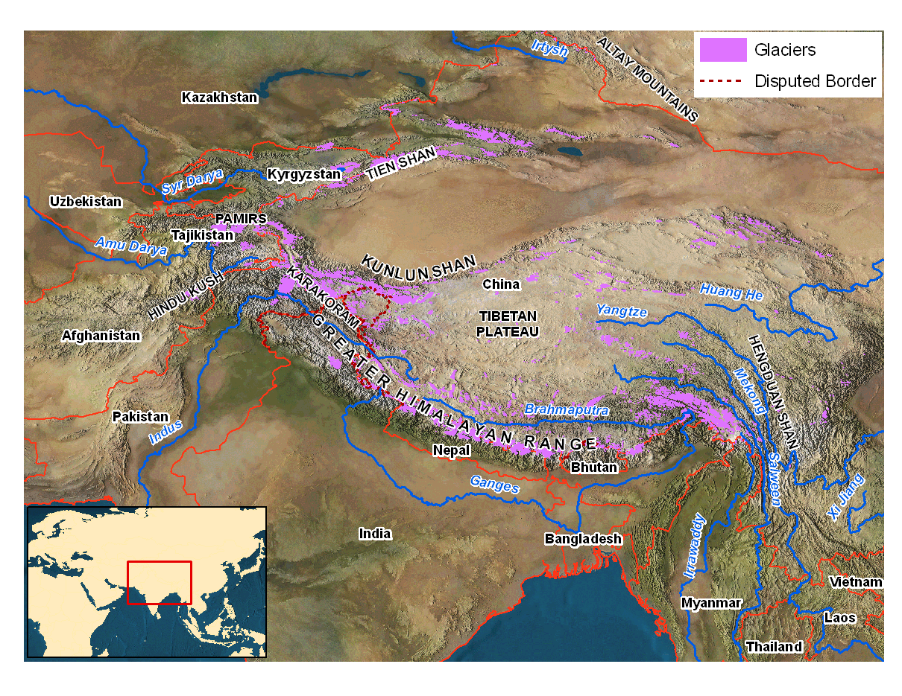
Legal Access Issues
NSIDC DAAC distributes data from JAXA’s AMSR (2003) on ADEOS-II. When the agreement to distribute AMSR data was established, it required a users acceptance agreement. This was removed in 2014 and made the data open.
The Contribution to High Asia Runoff from Ice and Snow, or CHARIS, project is systematically assessing the role that glaciers and seasonal snow play in the freshwater resources of High Asia. Water runoff data is considered highly confidential.

Slide 12
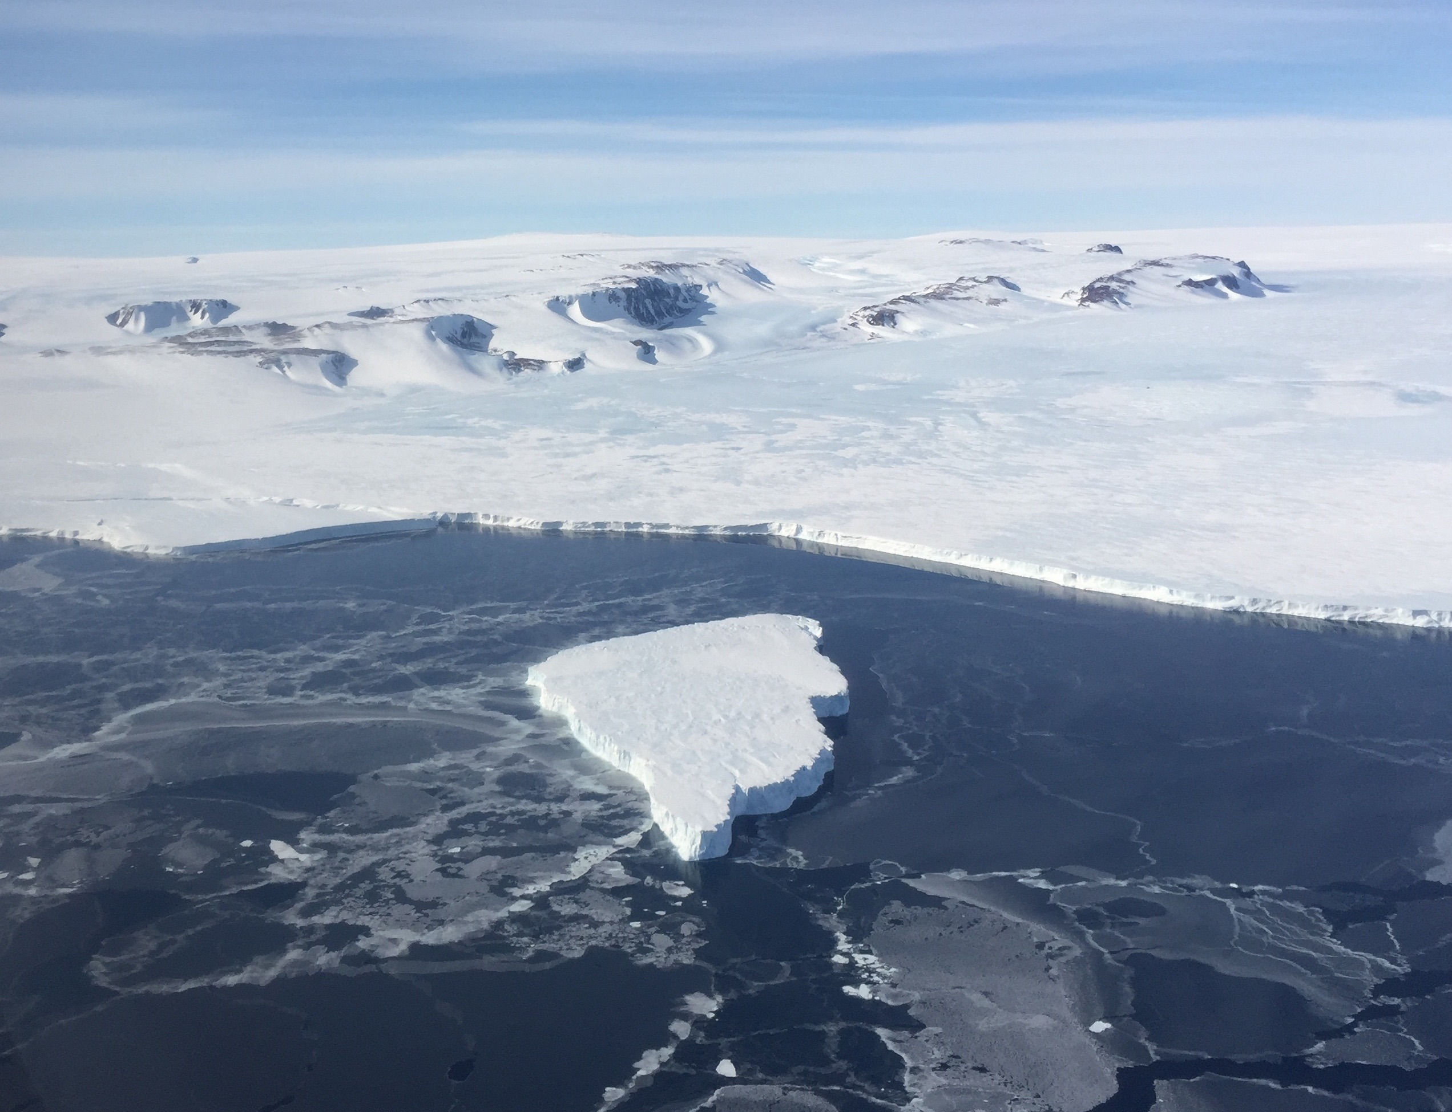
Examples of NSIDC Cryospheric climate-related data sources
Passive microwave 1979-present (NOAA, DMSP)
Sea Ice Extent 1979-Present
MODIS 2001 to present (NASA Terra)
IceSat II (NASA)

Slide 13
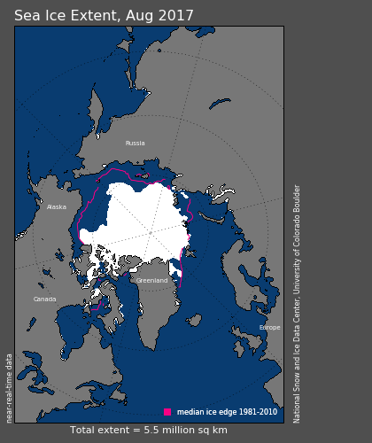
Monthly Sea Ice extent 1979 to present
The monthly Sea Ice Index provides a quick look at Arctic-wide changes in sea ice. It is a source for consistently processed ice extent and concentration images and data values since 1979. Monthly images show sea ice extent with an outline of the 30-year (1981-2010) median extent for that month (magenta line). Other monthly images show sea ice concentration and anomalies and trends in concentration.

Slide 14
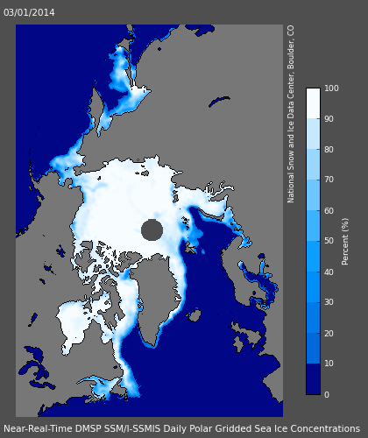
Sea Ice Concentrations from Nimbus-7 SMMR and DMSP SSM/I-SSMIS Passive Microwave Data
This data set is generated from brightness temperature data and is designed to provide a consistent time series of sea ice concentrations spanning the coverage of several passive microwave instruments. The data are provided in the polar stereographic projection at a grid cell size of 25 x 25 km.

Slide 15
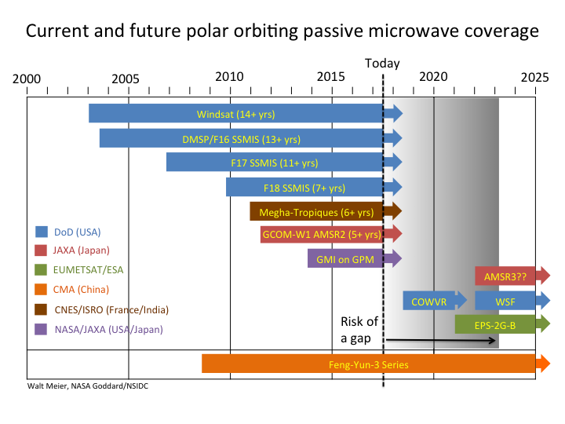

Slide 16
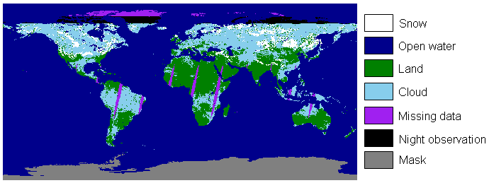
MODIS/Terra Snow Cover Daily L3 Global 500m Grid, Version 6
This data set contains daily, gridded snow cover and albedo derived from radiance data acquired by the Moderate Resolution Imaging Spectroradiometer (MODIS) on board the Terra satellite. Snow cover is identified using the Normalized Difference Snow Index (NDSI) and a series of screens designed to alleviate errors and flag uncertain snow cover detections.
The Rutgers Northern Hemisphere Snow and Ice Climate Data Records may be a better choice

Slide 17
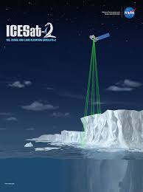
IceSat II
The ICESat-2 mission will deploy a spaceborne sensor to collect altimetry data of the Earth's surface in 2018. ICESat-2 will continue the important observations of ice-sheet elevation change, sea-ice freeboard, and vegetation canopy height begun by ICESat in 2003 and continued by Icebridge to the present.

Slide 18
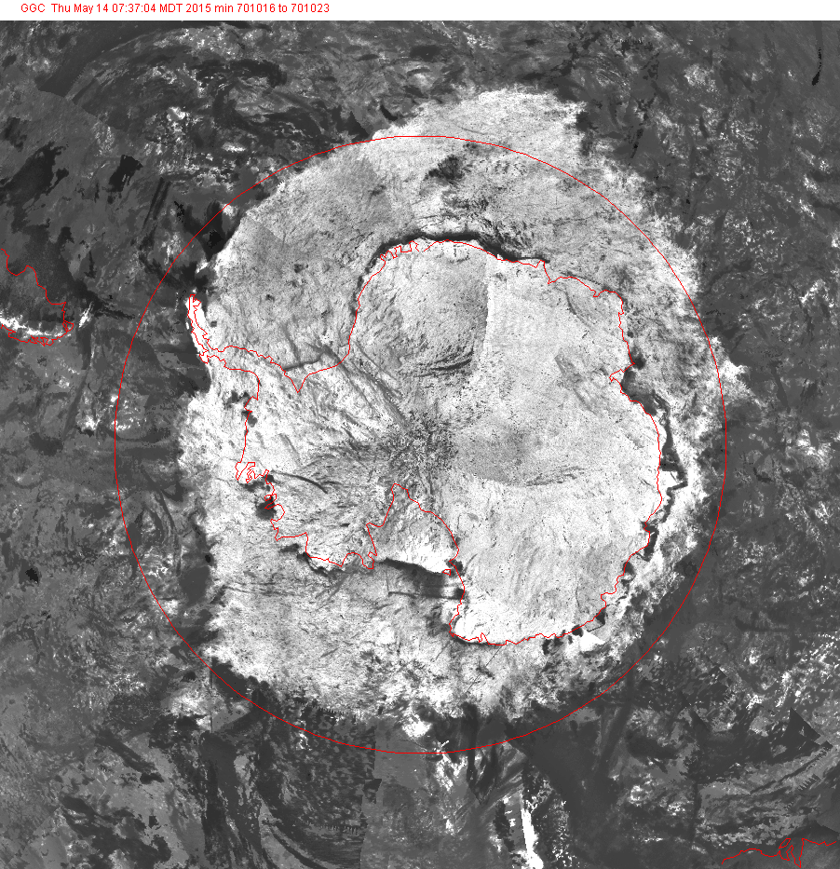
Other Global Cryospheric Data sets
Military – Space Based Infrared
New commercial datasets (Planet, Satlantis, Astro Digital etc)
Historic Nimbus 1-7
Canadian Ice Charts
AVHRR
MODIS
CryoSAT
RadarSAT
Sentinel
LandSat
Glacial Photos
And many others….
Antarctica 16-23 October 1970 Nimbus III

Slide 19


Thank you
Merci

