Slide 1
ET-CTS - Cache in and through the cloud
ET-CTS / ET- WISC Plenary Session
Novembre 2017

Slide 2
History
For GISC to GISC communication and in particular for exchange of « GlobalExchange » data the current architecture is based on an any to any unicast based solution
The solution is:
  Politically very challenging (some bilateral links are virtually impossible to set up)
  Technically difficult to establish, to monitor and to maintain
  Financially unattractive as the same data is sent multiple times on an expensive network
In 2014, at TT-GISC and ET-CTS, a solution using a cloud based approach was presented
It was then agreed to run a pilot in 2015 to assess whether this option was viable
  Suitability of this solution will be established based on:
  The technical outcome of the pilot
  The result of a questionnaire (it appears that some organisations forbid the storage of their data into the cloud)
  The financial and contractual aspects
  The agreement of the GISCs to proceed with such a solution

Slide 3
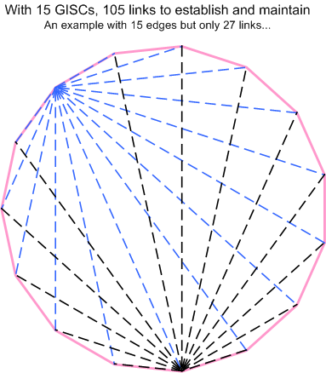
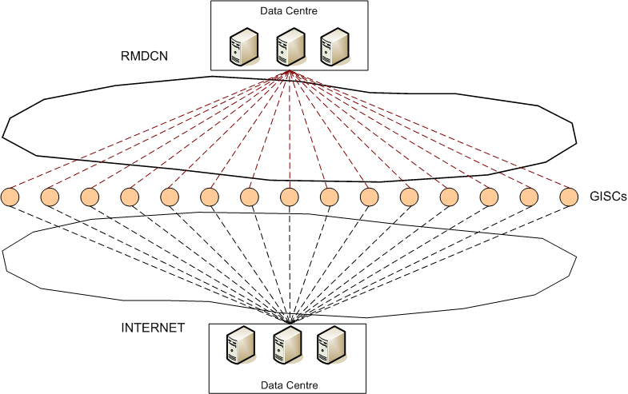
The should and the may
What we should have now…
What we may have tomorrow…

Slide 4
The Pilot (2015-2016)
The pilot has been managed by ET-CTS with the support of DWD
From a technical point of view, we have been using AFD (Automated File Distribution).
Used Internet only
Pilot limited to data exchange, not to metadata
GISC C
GISC D
GISC B
INTERNET
GISC E
GISC A
AFD in the cloud
cloud.1.teganet.eu
GISC F

Slide 5
Final report of ET-WISC 2016
The meeting noted that target solution should be scalable and should not rely on one host. Should be based on technical functionality and reliability. It should address security and other related risks such as denial of service attack
TT-GISC decided, as a consequence, to establish a working group lead by Meteo France and including the following experts UK, Republic of Korea, Japan, China tasked to prepare the requirements, to define the potential architecture, to prepare a workable financial and manageable solution, and to establish the required elements for the implementation of an operational service starting in mid-2018 at the latest.
This document presents the outcome of the working group described above

Slide 6
Background
As a follow-up to the successful cache in and through the cloud pilot, follow-up activities were undertaken in the following areas:
Definition of key functional and technical requirements for operating the WIS cache (data + metadata) in and through the cloud
Analysis of financial and service level implications (costs, areas of uncertainty, service level management)
Analysis of requirements for executing management functions necessary to operate the cache in and through the cloud
Development of a proposed implementation strategy
Highlight remaining concerns to be investigated going forward

Slide 7
Approach

Slide 8
Proposed approach - Iterative
Operation of the cloud service should be step-by-step transition (as prescribed by the WIS 2.0 implementation strategy)
Initial stage:
  All GISCs participate.
  Add data meant for Global Exchange.
  Add Metadata to the cloud.
Evolution stages:
  Incorporate some of the concepts of WIS 2.0.
Final stages:
  Subscription to data/products by users.
  Meet WIS 2.0 requirements.
Initial stage
Evolution
stage
Final stage
2025-?
2022 – 2025 ?
2019 - 2022
Notes:
Scope of data included in each phase of the project and access are controlled by metadata keywords set by originating centre/data provider:
WMO_DataLicenseCode – whether or not the data is considered essential and if the data has associated licensing/access constraints
WMO_DistributionScopeCode – level of data exchange (global, regional, centre)
WMO_ProductCategoryCode – GTS priority level (also determines if QoS mechanisms are required)

Slide 9

Participating centres by implementation phase
Initial stage: GISCs
Evolution stage: DCPC/NCs
Future stage: Users
GISC
GISC
DCPC
NC
NC
NC
DCPC
NC
GISC
GISC
DCPC
NC
NC
NC
DCPC
NC
GISC
GISC
User
DCPC
NC
NC
NC
DCPC
NC
User
Notes:
Evolution and Final Stages represent possible expansion of participant base.

Slide 10
Functional and technical requirements for « Initial Phase »

Slide 11
Requirements – Guiding principles
Compliance with certification requirements of WIS centres
Adherence to WIS technical specifications (maintain technical interfaces currently in places - architecture, protocols,… -)
Evolutionary – support current protocols, evolve to support new ones over time, seek opportunities for improving efficiency
Address both data and metadata exchange requirements
Consider governance, performance, reliability, security, administration, monitoring, and financial aspects of the project

Slide 12
Data requirements in the cloud
Performance
  Global data is to be available at all GISCs within 15 minutes
  High priority data is to be transmitted end-to-end within two minutes (when priority data is included)
Scalability
  Currently, individual instance of data cache is estimated to be less than 200GB (assuming 24 hour cache, higher should data throughput increase or should the period covered by the cache be increased from 24 hours)
  Decision to extend service will be at least partially driven by cost
Data exchange
  Must use agreed protocol to exchange data (FTP, SFTP, HTTP, HTTPS) based on a « push » approach
  Data repository in the cloud is not a user accessible service (e.g. via subscription, etc.) – this is the role of the GISC portal
Notes:
Reference documents:
WIS-TECHSPEC-3: Centralization of Global Distributed Data
According to WIS-TECHSPEC-3 of “Centralization of Global Distributed Data”.
As the performance metrics global information is some of the operation-critical data intended for global distribution is to be transmitted end-to-end within two minutes.
Data flow, Inputs is Global information, and outputs is Cached Global information.
In the notes, Global data is required to be all GISCs within 15 minutes.

Slide 13
Metadata requirements in the cloud
Metadata exchange
    Must use agreed protocol to exchange metadata (OAI-PMH)
    Facilitates synchronization of the WIS catalogue via a central point of exchange
Metadata information in the cloud does not consititute a user searchable metadata catalogue – this is the role of the GISC portal

Slide 14
Administration requirements in the cloud
IT environment (hosts, VM, firewalls,…)
  Operating System level + maintenance including system resources (CPU, storage, …) monitoring
  Software packages that are dependent on by WIS service
Configuration
Roles and Rights
  Authentication and authorization
Activity monitoring
Data availability and timeliness
  monitoring & statistics
Capacity (of resources)
  Procurement/provisioning
Cybersecurity
Reliability
Notes:
Reference documents:
WIS-TECHSPEC-4: maintenance of user identification and role information
WIS-TECHSPEC-5: consolidated view of distributed identification and role information
WIS-TECHSPEC-6: authentication of a user
WIS-TECHSPEC-7: authorization of a user role
WIS-TECHSPEC-15: reporting of quality of service
Typical competencies for “Managers”
Virtual Machine (IT maintenance)
Experienced IT admin skills
Dedicated routine works?
Configuration Management
(at least) Familiar with WIS business
(at least) Familiar with business application (e.g. AFD)
Users, Roles, and Rights
Authority or authorized points that can “officially verify” the users identity
(at least) Familiar with WIS rules for user roles and rights
Data availability and timeliness
(at least) Familiar with WIS business
Capacity (of resources)
(at least) Familiar with VM resources and WIS business

Slide 15
Proposed implementation approach

Slide 16
Architecting and implementing the solution
Public cloud providers use similar approaches for configuring and procuring services (storage, compute, network, application services, security services, etc.), and use tiers to allow customers to balance capabilities against costs.
Public cloud providers were reasonably consistent in terms of costing for baseline services.
Niche players provide other capabilities, but public cloud provides were more open/consistent in pricing, approach, tools.
It is recommended that a single solution provider be engaged to handle the implementation and management of the service.
Along with commercial vendors, NMHSs (e.g. those operating GISCs) may choose to respond to the tender.
Notes:
Baseline services are the minimum capabilities required to store and exchange data meeting the capacity of the existing WIS cache. This does not include failover and other services needed to fulfill other certification requirements such as availability.

Slide 17
Delivering the solution
  The current recommendation is to employ a tendering process to solicit bid from qualified solution providers to deliver the solution (deliver on SLA)
  Execute a 3 – 4 year contract
  Solution provider is responsible for architecting and delivering a solution which complies with the needs of WMO
  The solution provider is responsible for the solution design to meet WMO requirements (e.g. certification requirements for GISCs, application of interfaces based on requirements to be defined by WMO, in line with subsequent updates from time to time)

Slide 18
Compliance with WIS 2.0
WIS 2.0 implementation strategy as presented and endorsed both at CBS-16 and EC-69 includes a step by step approach
WIS 2.0 includes the provision of cloud-based services
The “cache in and through the cloud” is part of this strategy and as such is considered to be the first of the cloud services that are likely to be included in the WIS 2.0 implementation

Slide 19
Procurement requirements and options

Slide 20
Proposed financial strategy
For expedience during « initial phase », WMO to run a tender on behalf of the 15 GISCs
A « trust fund » mechanism to be implemented to handle the money stream
Provisionally, split costs equally between the participating GISCs.
GISCs require a level of certainty in terms of cost implication with this solution
Outstanding actions: Execute the tender, determine successful vendors, and determine baseline costs
Check with GISCs regarding “value for money” of the solution before contracting with the proposed vendor

Slide 21
Planned approach toward the « Initial Phase »
ICT-ISS - January 2018
TECO – March 2018
Version 2 of Specification for tender - May 2018
Paper describing expected WMO support/role - May 2018
EC-70 - June 2018
Responses from tender - December 2018
Deliver tender report - April 2019
Translation - Before May 2019
Cg-18 - May 2019
Expected initial phase commissioning – 2019 – 2020
Amend Technical Regulation to require use of Cache-service 2020
Expected initial phase operation – 2020 – 2022
Prepare for next phase - ~2021
By 2022, we should know what WIS 2.0 will look like and will be prepared for any required changes through the evolution phase

Slide 22
Project Gantt chart

Slide 23
Conclusions and next steps

Slide 24
Next steps
Align the process with the upcoming WMO official bodies (ICT-ISS, CBS TECO 2018, EC-17, Cg-18)
Define requirements and constraints for the tender process
Develop position papers related to cache in and through the cloud and the proposed path forward, for approval by WMO governing bodies
Execution of the tender and selection of successful bidder
Implementation of cloud environment and connections to GISCs
Operational monitoring of cloud environment
Progress through phases of implementation described previously

Slide 25
Questions?

