Slide 1
Status of IQWMA Software
CMA/WANG Peng, HAN XinQiang
Expert Team WISC
ET-WISC2017
13-17 November 2017, Geneva

Slide 2
IQWMA Software
Integrated Quantitative WWW Monitoring Analysis (IQWMA)
  Developed by CMA
  Used by the WMO Secretariat
  To analyse the reports for AGM、IWM、SMM and SAM captured by the RTHs
  VolA, VolC1, RBSN/RBCN etc as input

Slide 3
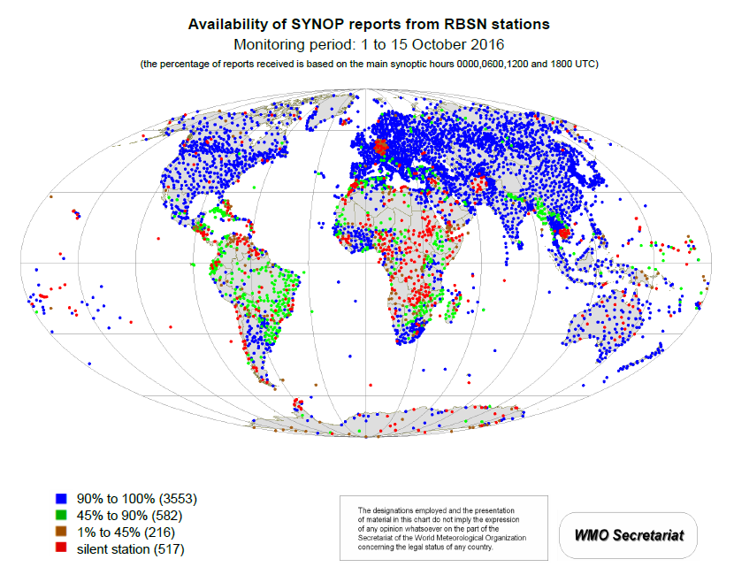
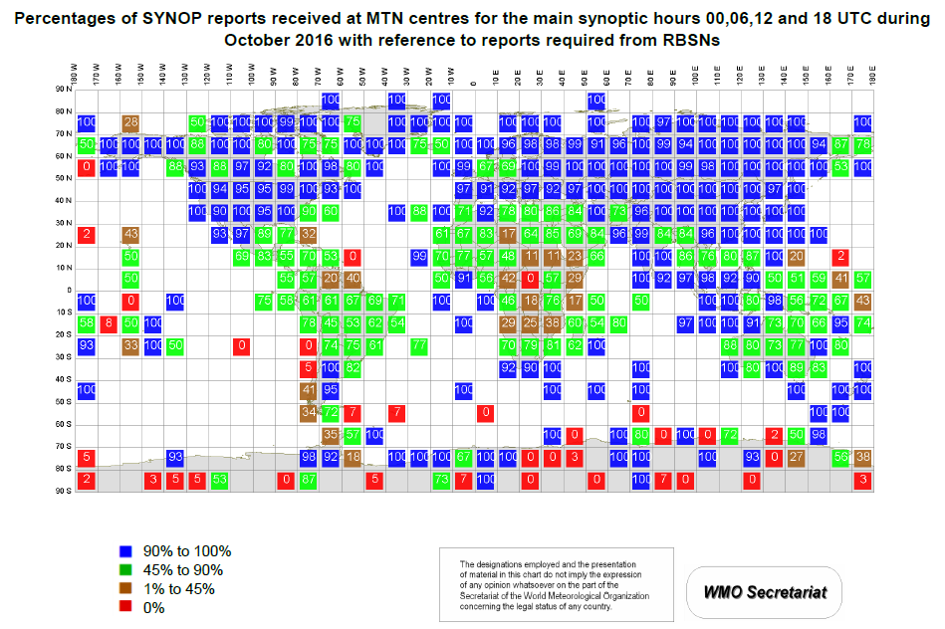
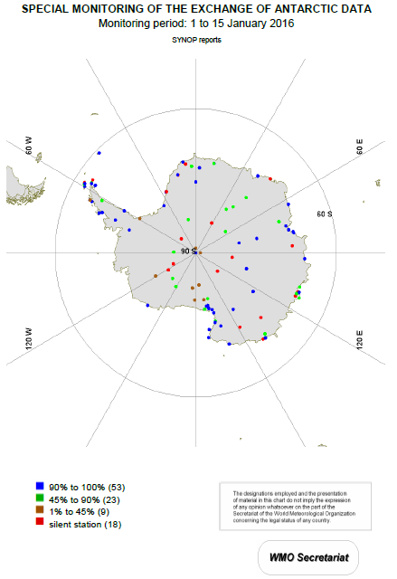
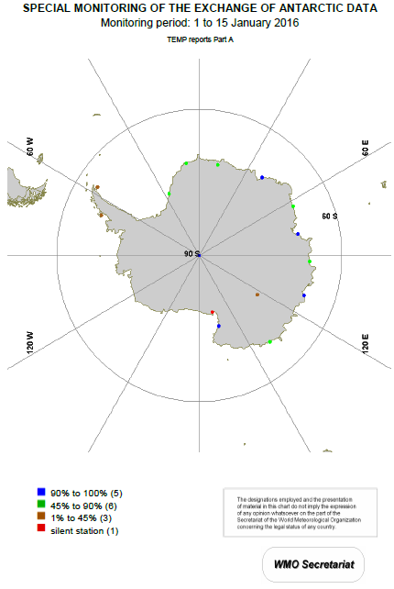
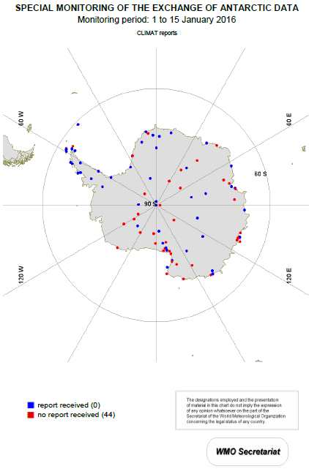
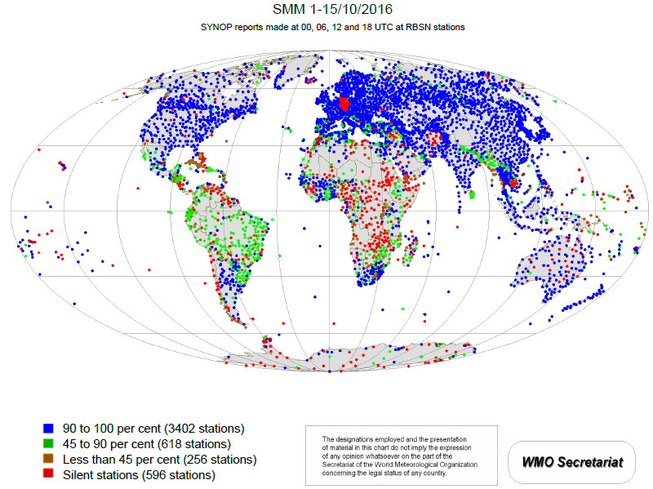
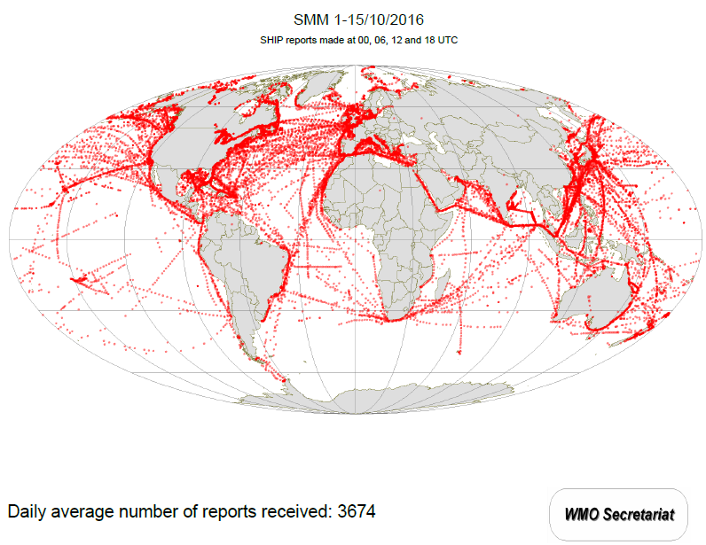
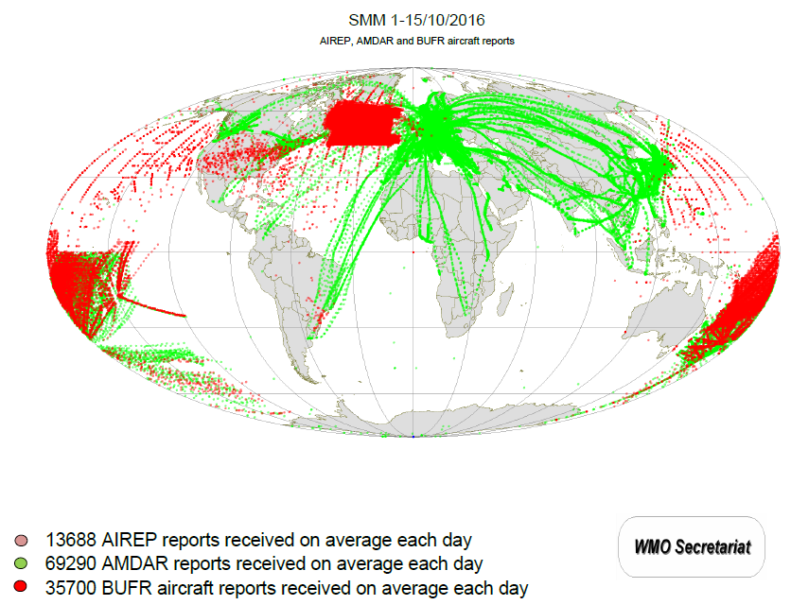
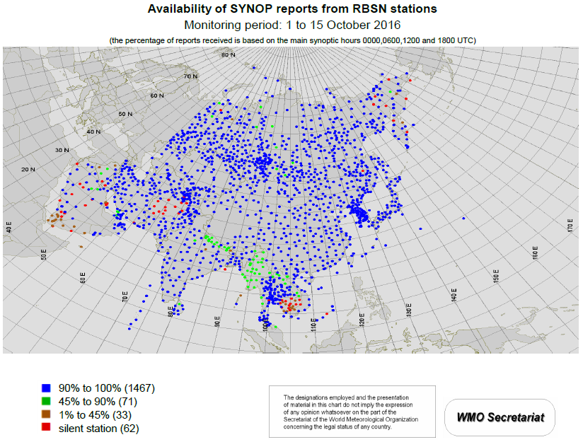
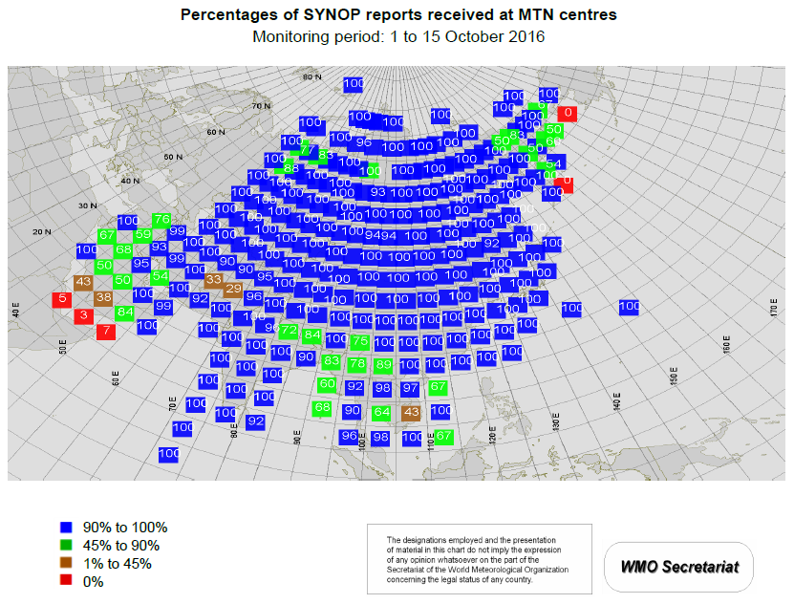
IQWMA Samples
IWM Analysis Samples
SAM Analysis Samples
SMM Analysis Samples
SYNOP TEMP CLIMAT
fixed stations mobile stations at sea mobile stations from aircraft
IWM Analysis Sample
SMM Analysis Sample
SAM Analysis Sample
Global
Regional

Slide 4
Action from ET-WISC2016
ET-WISC Action No. | Decision/recommendation/ action | Responsible | Objective / deadline
WISC-16/1-4 | … b) CMA advise if potential impact to IQWMA software | a) … b) CMA | a) … b) Next meeting of ET-WISC

Slide 5
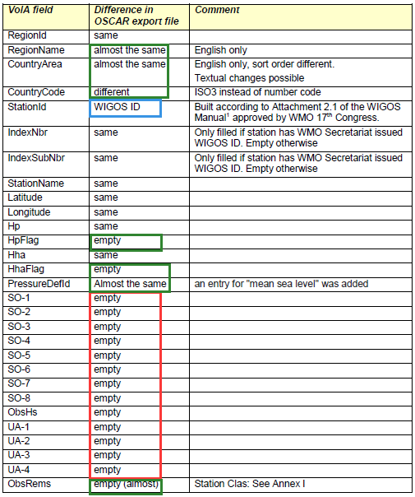
Impact of transferring to OSCAR
21 differences between VolA field and OSCAR export file.
Case 1:
  No effect
Case 2:
  Need code-review/test
Case 3:
  Affect the results

Slide 6
Impact Case 1
Case 1:
  7 differences have no effect on IQWMA.

Slide 7
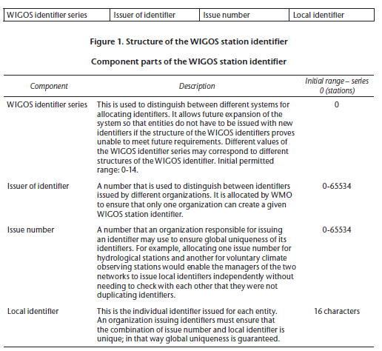
Impact Case 2
Case 2:
  1 difference need code-review/test on the processing logic of software.
VolA field | OSCAR export file
StationID | WIGOSID
5 digits Like “54511” | 4 components (see WMO-NO.1160)

Slide 8
Impact Case 3
Case 3:
  13 differences between VolA field and OSCAR export file have impacts on the results.
  No more OBS remarks, The frequency of observation is not clear.
  Some results of IQWMA which use reports at hours 00,06,12 and 18 UTC as indicated in Volume A will not be very ideal.

Slide 9
Work Plan
Change the software to adapt to OSCAR
 | Deadline
Development | 2017/12/25
Test | 2018/01/15

Slide 10

Thank you
Merci

