Slide 1
User Interfaces
Kai Wirt
ET-WISC 7.3.3
Expert Team on WIS Centres
ET-WISC2017
13-17 November 2017, Geneva

Slide 2
OpenData
July 25th change of “Deutscher Wetterdienst Act”
DWD now allowed to distribute data freely
Data made available via https
Data to be incl. in German Geodata Catalogue
Different version of metadata standard for WIS and Geodata
Compatibility issue to be solved in 2018

Slide 3
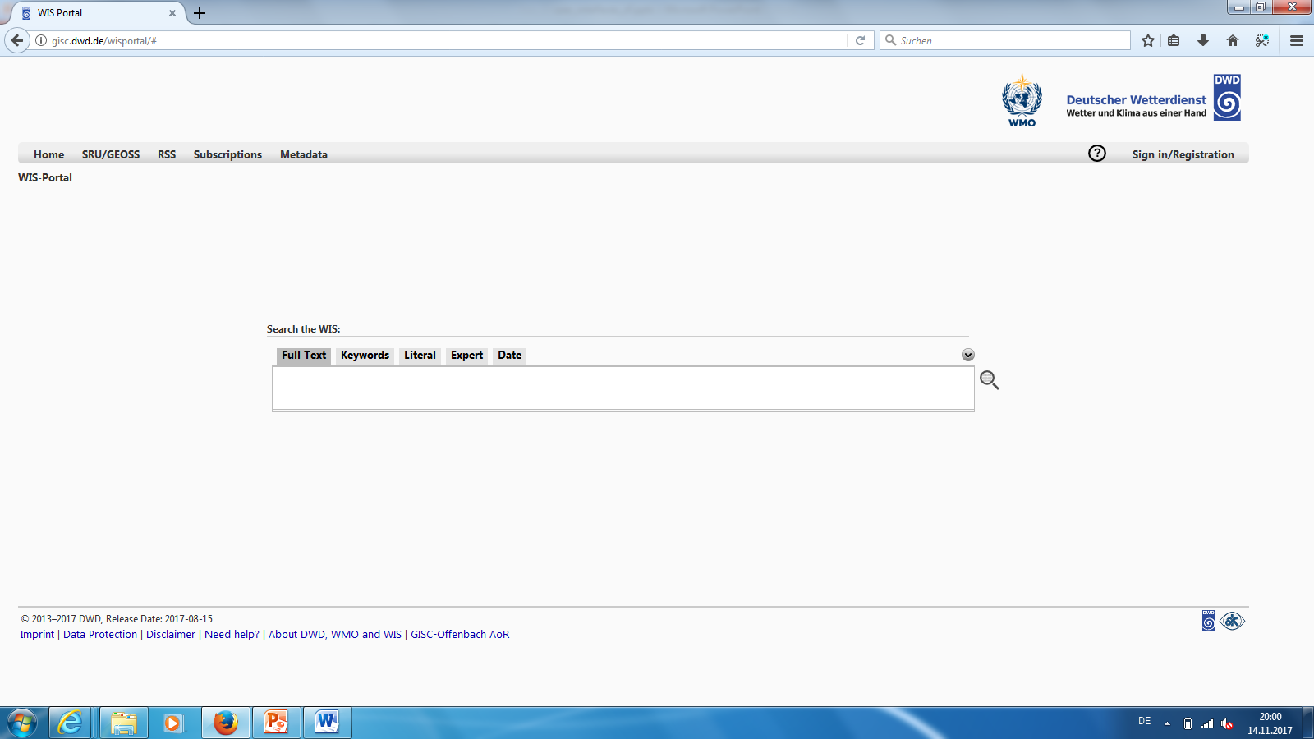
GISC

Slide 4
GISC
Simple interface
„Google + Amazon“
Search, cart, delivery

Slide 5
GUI thoughts
Advantage of diversity
  Respect Regional / Cultural Differences
  “One size never fits all”
  Restrictions based on corporate design
  Not only design patterns. But also offered services

Slide 6
GUI thoughts
Instead of same look and feel set of common features?
  What information should be available?
  What functions should be available additionally to metadata research?
  How to take a step forward from managed to self-service?

Slide 7
Between DC and GISC
Data transfer is manually established
Mostly using DWDs AFD software or IBL MW
Metadata is
  Delivered
  Harvested using OAI
  Created using GISC OFs metadata editor
  Generated automatically

Slide 8
Automatic MD Generation
Automatic metadata generation for DWDs AoR using Volume C generator
If no metadata is available we use “draft metadata”
  Generated when unknown message arrives
  Allows us to distribute data without having original metadata
  Eases the process of “getting things going”
  Automatically deleted or overwritten

Slide 9

Thank you
Merci

