Slide 1
An improvement of
WIS metadata synchronization
Shigeharu NISHIKAWA, JMA
Agenda item 5.3
Task Team GISC
TT-GISC2017
13-17 November 2017, Geneva

Slide 2
Current synchronization
GISC A
GISC B
15 GISCs
Full mesh Sync
15*14*2＝420
OAI-PMH
GISC D
GISC C
Weak Point

Slide 3
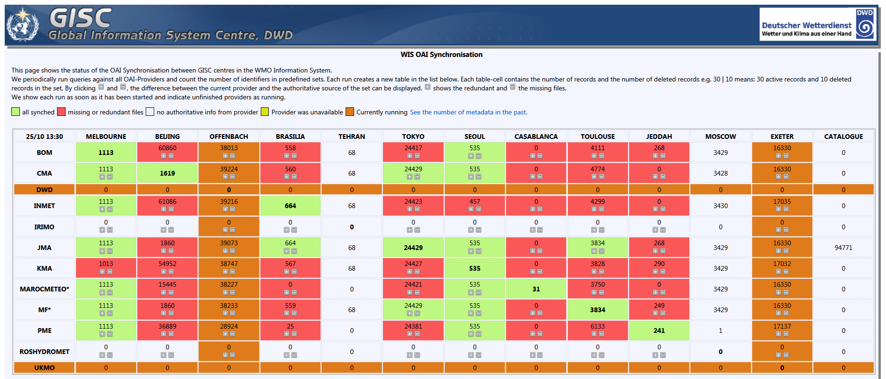
Metadata Monitor
DWD GISC Oai-Monitor
http://oai.dwd.de/oaimonitorgui/#complete
We have NEVER shared WIS Metadata with each other perfectly!

Slide 4
Idea 1 (Centralization)
GISC X
Pickup from GISC as WIS Metadata center?
Store all 15 GISCs OAI-SET
Harvest only from GISC X via OAI-PMH
GISC A
GISC B
GISC C
GISC TOKYO
Keep own OAI-SET only
OAI-SET
WIS-GISC-[CITYNAME]
OAI-SET
WIS-GISC-TOKYO
WIS-UNASSOCIATED

Slide 5

Idea 1 (Centralization)
How to search WIS metadata
1. User access metadata search page
GISC A
2. Redirect to WIS Metadata center’s page
GISC A
4. Back to GISC A
GISC B
GISC B
3. Get result
GISC X
GISC C
WIS Metadata Center
Metadata search page
SRU
GISC C
GISC TOKYO
GISC TOKYO

Slide 6
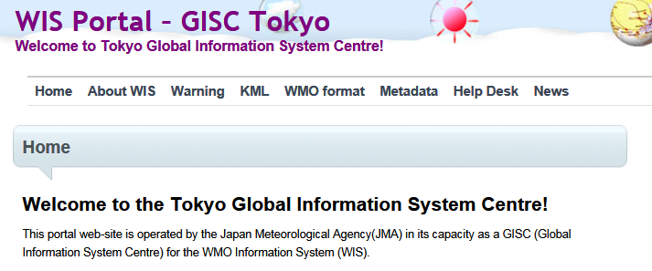
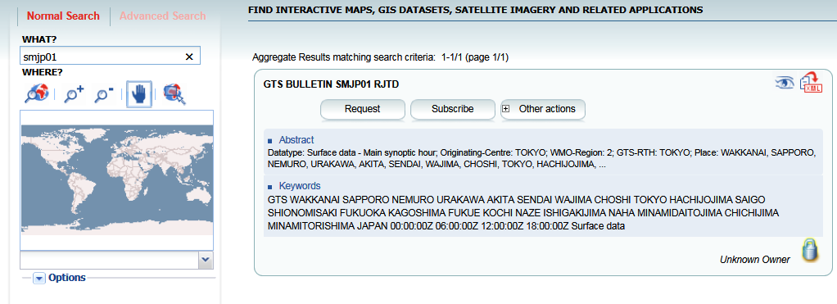
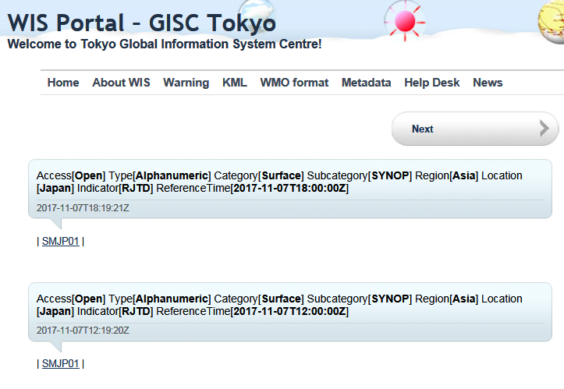
Idea 1 (Centralization)
User want to get “SMJP01”
User access GISC Tokyo.
Click “Metadata”
Redirect to WIS Metadata center
GISC Tokyo
Download from GISC Tokyo
WIS Metadata center
Type “SMJP01” and search
Click “Download from GISC Tokyo”
Back to GISC Tokyo
GISC Tokyo

Slide 7
Idea 1 (Centralization)
Pros
  Escape from Full mesh synchronization
  Reduce function/development from each GISCs
    Search page, SRU
  User Interface
  Division of GISC’s roles
    WCD, Metadata, WIMMS…
Cons
  Development for Search page, SRU at WIS Metadata center
  Little complex to users (can not complete in one site)

Slide 8
Idea 2 (Sync but NOT full mesh)
GISC X
Pickup from GISC as WIS Metadata center?
Store all 15 GISCs OAI-SET
Harvest ONLY from GISC X via OAI-PMH
GISC A
GISC B
GISC C
GISC D
Keep ALL GISCs OAI-SET
OAI-SET
WIS-GISC-MELBOURNE
WIS-GISC-BEIJING
WIS-GISC-BRASILIA
WIS-GISC-TEHRAN
WIS-GISC-TOKYO
WIS-GISC-SEOUL
WIS-GISC-TOULOUSE
WIS-GISC-JEDDAH
WIS-GISC-MOSCOW
WIS-GISC-EXETER
WIS-GISC-CASABLANCA

Slide 9
Idea 2 (Sync but NOT full mesh)
Pros
  No (or small) impact to GISC’s development
    Adjustment to Harvesting (OAI-PMH)
    Keep using own Search page, SRU
Cons
  Number of harvesting times is still 15
    From one server (WIS metadata center), Each OAI-SET
  No effect to reduce GISC development
    Still developing Search page and SRU

Slide 10
WIS Metadata center
Need at least of 2 centers like WCD?
Can “Cache in and through the cloud” be a WIS Metadata center?
  Integration of Cache in the cloud & WIS metadata

Slide 11
Summary (Text for report)
Mr. Shigeharu NISHIKAWA, JMA introduced his idea of improvement of WIS metadata synchronization. He mentioned that the weak point of WIS metadata synchronization is “Full mesh sync with all 15 GISCs”. He proposed 2 type of improvements, the one is “Centralization” , the other is “Sync but not full mesh” and he also explained the benefit of these ideas.
The meeting reviewed his presentation and ….

Slide 12

Thank you
Merci

