Slide 1
Revised GISC Audit Program
Kevin ALDER
Agenda item x.x.x
Expert Team on WIS Centres
ET-WISC2017
13-17 November 2017, Geneva

Slide 2
Proposed Audits
Reduced emphasis on technical aspects and IT infrastructure
More focus on GISC activities that deliver value to WIS Community, and users in GISC AOR.
Questionnaire to be developed using Survey Monkey.
Survey to include questions on management of risks within GISC operations.

Slide 3
Proposed Audit Criteria
Elements of GISC Operations to be audited will be based on a matrix of:
WMO No 1061, Annex D, para 2.1.1 – Scope of GISC Audits
ET-WISC Workplan – Actions 1-10
The six management functions listed in the ISO9001:2015 standard.
Audit criteria will be submitted via ICT-ISS to CBS-MG for approval by the president of CBS.

Slide 4
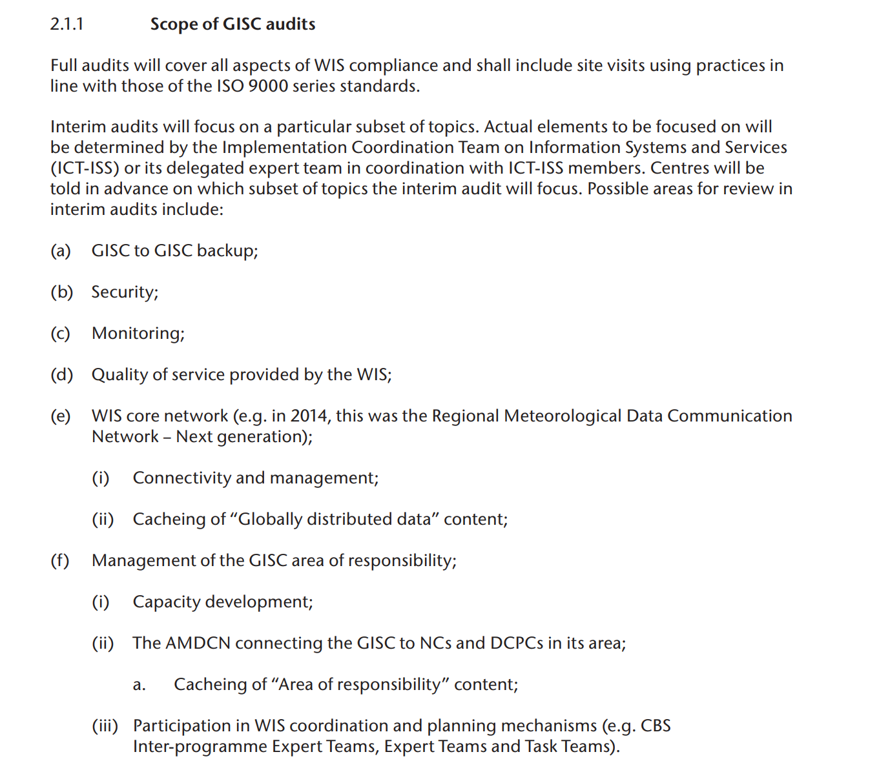

Slide 5
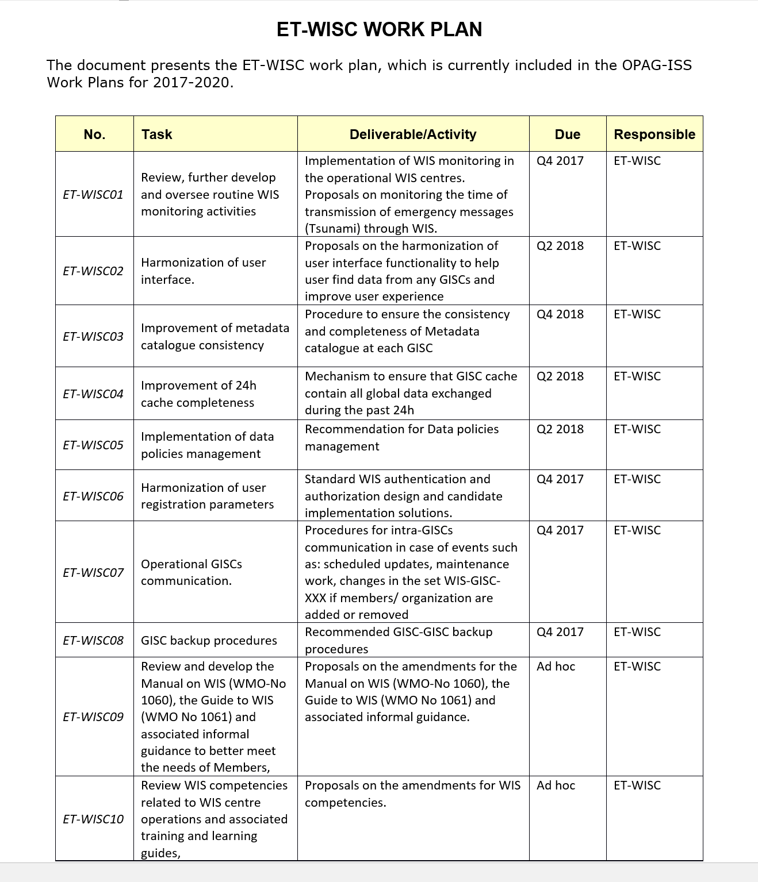

Slide 6
ISO9001:2015
ISO 9001:2015 focuses on six organisational management functions:
Clause 5 – Leadership
Clause 6 – Planning
Clause 7 – Support
Clause 8 – Operation
Clause 9 – Performance evaluation
Clause 10 – Improvement
And then wraps these in risk-based thinking

Slide 7

Thank you
Merci
Kia Ora

