Slide 1
Toward a new version of the “Guide on IT Security”
Ilona Glaser
4.2
Expert Team on Communication Techniques and Systems
ET-CTS2017
13-17 November 2017, Geneva

Slide 2
Agenda
What is our task?
Where are we now?
What to we need to do?
What is the plan for that work?

Slide 3
1. What is our task?
Resolution 7 (EC-69) Implementation of the WMO Information System decides:
(3) To amend as specified in Annex 4 to Recommendation 18 (CBS-16) the Guide to Information Technology Security to reflect modern practices;

Slide 4
2. Where are we now?
WMO document 1115 is official
  Open points from last ET-CTS meeting:
    Not all comments have been included, postponed to next revision
    Document to be read in the third person
    Review should keep in line with the evolving WIS
  “major” review started

Slide 5
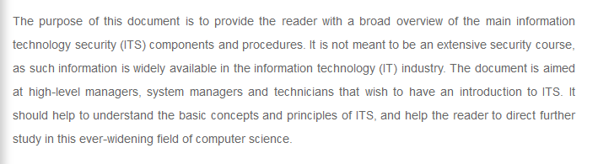
Aim of Document
  Original document can be found here:
  http://library.wmo.int/pmb_ged/wmo_1115_en.pdf

Slide 6
3. What do we need to do?
ET-CTS decided that a new document is required.
This new document should:
  Relevant and covering all current IT Security matters
  provide valuable guidance to all WIS centers (good business practice)
  provide a definition of IT security
  outline minimum requirements (must be implemented)
  be modular (maybe not all sections will be required)

Slide 7
3. What do we need to do?
Where possible, refer to existing information from other sources. Avoid having to re-package such material. However, ET-CTS recognised that the value of the current Guide is that it is self-contained; a reader should understand at least the basic information from reading the single document, and be referred to other sources for additional information

Slide 8
3. What do we need to do?
In particular, ET-CAC noted the need to reference the proposed “cyber security maturity model” discussed during item [§4.1] (e.g. revised audit criterial for WIS Centres and amendments to WIS technical regulation for ICT [and cyber security] aspects).
ET-CAC noted that the revised Guide should be strongly aligned with the new technical regulations for the forthcoming WIS Part C Information Management. WIS Part C will provide the context within which cyber security should be applied; e.g. cyber security is a necessary foundation for effective information management.

Slide 9
Suggestion: new structure
Executive Summary
Definitions of IT Security
Motivation
  Threats
  Impact analysis
Organizational Aspects / Procedures
  Training
  Cyber security maturity model
Technical Aspects
  Infrastructure
  Networks
  IT Systems
  Applications
  Cloud Services

Slide 10
4. What is the plan for the work?
ACTION: First draft of the revised Guide to be prepared for review at ET-CTS2018.
Note: Aim to produce final version of the Guide in late 2019, ready for formal approval and publication.
ACTION: Secretariat to determine opportunities for formal approval of the amended Guide, noting that (i) approval of previous changes has been given by Executive Council following recommendation from CBS, and (ii) Cg-18 is considering constituent body reform, and CBS may not exist in its current form.

Slide 11

Thank you
Merci

