Slide 1
Expert Team - Cache in and through the cloud

Slide 2
Background
As a follow-up to the successful cache in and through the cloud pilot, follow-up activities were undertaken in the following areas:
Analysis of potential benefits and application of a cloud based cache
Definition of key functional and technical requirements for operating the WIS cache (data + metadata) in and through the cloud
Analysis of financial implications and service level implications (costs, areas of uncertainty, service level management)
Development of a proposed implementation strategy/high level plan
Analysis of requirements for executing management functions necessary to operate the cache in and through the cloud
Highlight remaining concerns to be investigated going forward

Slide 3
Benefits and and strategic goals

Slide 4
Why the cloud (general benefits)?
Minimizing IT maintenance costs
High availability / reliability
On-demand scalability (Elastic)
Simplified capacity planning and management
Public cloud: accessibility via the internet for all
Notes:
Minimizing IT maintenance costs
Business centric
VM based cloud:
still requiring IT technicians to maintain OS and software packages
High Availability / Reliability
Commercial Cloud providers guarantee high reliability
simplifying HA solution between different cloud providers
On-Demand Scalability (Elastic)
Capacity planning and management are simplified
Scale up the cloud when necessary
Public cloud: Accessible via Internet for all

Slide 5
How the cloud applies to the WIS data cache
A cloud-centric approach provides opportunities to:
Flexible options for configuring underlying infrastructure - do not need to be designed/implemented manually by user and simplifies some levels of setup (can also employ scripted setup for reproducibility/reuse in some cases)
Reducing to number of connections between GISCs – removing any to any replication, leveraging cloud service facilities to add failover/mirroring and performance optimization
Serve data closer to source (limit physical data exchange between GISCs - linked to failover strategy and performance tuning)
Simplified catalogue strategy - centralized catalogue may be feasible, simplified sync where multi-instance is required

Slide 6
Functional and technical requirements

Slide 7
Data requirements in the cloud
Performance
  Centralized Global data is to be transmitted end-to-end within two minutes (when priority data is included).
  Global data is to be required at all GISCs within 15 minutes
Scalability
  Individual instance of data cache will be at least 200GB (assuming 24 hour cache, higher should data throughput increase or should the period covered by the cache be increased from 24 hours)
  Decision to extend service will be at least partially driven by cost
Data output/exchange
  Once the cloud implementation progresses towards full implementation, subscription/access services would be required for DCPC/NC to be able to download data as GFNC. (unpacked Global-Exchange)
  Introduction of cloud-based subscription/access services will introduce new costs
Notes:
Reference documents:
WIS-TECHSPEC-3: Centralization of Global Distributed Data
According to WIS-TECHSPEC-3 of “Centralization of Global Distributed Data”.
As the performance metrics global information is some of the operation-critical data intended for global distribution is to be transmitted end-to-end within two minutes.
Data flow, Inputs is Global information, and outputs is Cached Global information.
In the notes, Global data is required to be all GISCs within 15 minutes.
200GB data cache is based on the assumption that the data volume for 1 day is ~10 GB per GISC
2 GB products x 4 times + other data = about 10 GB x 15 GISCs x 1 day = 150 GB minimum
This does not include ancillary storage for VM appliances and other virtual infrastructure
Current estimate assumes that original file uploaded to the GISC will be stored as is, but during exchange between GISCS it will be circulated as Global-Exchange (packed).

Slide 8
Metadata requirements in the cloud
Aggregate view
  Aggregate view of metadata for data coming into all GISCs is required
  Opportunities for centralized catalogue over synchronization (full synchronization has never been done before…)
Clear provenance
  The authoritative metadata (versus sync’d copies) must be clear (problem would be addressed more efficiently in a centralized catalogue)
Multi-tenant
  Requires ability for all GISCs to insert/update/delete metadata records (policy, security, and user management considerations…)
Notes:
Reference documents:

Slide 9
Service management requirements in the cloud
Virtual Machine (IT maintenance)
  Operating System level + maintenance including system resources (CPU, storage, …) monitoring
  Software packages that are dependent on by WIS service
    e.g. Tomcat, JDK, FTP
Configuration
  Business logics, options, …
Users, Roles, and Rights
  Authorization
  user activity tracking?
Data availability and timeliness
  monitoring & statistics
Capacity (of resources)
  Procurement/provisioning
Notes:
Reference documents:
WIS-TECHSPEC-4: maintenance of user identification and role information
WIS-TECHSPEC-5: consolidated view of distributed identification and role information
WIS-TECHSPEC-6: authentication of a user
WIS-TECHSPEC-7: authorization of a user role
WIS-TECHSPEC-15: reporting of quality of service
Typical competencies for “Managers”
Virtual Machine (IT maintenance)
Experienced IT admin skills
Dedicated routine works?
Configuration Management
(at least) Familiar with WIS business
(at least) Familiar with business application (e.g. AFD)
Users, Roles, and Rights
Authority or authorized points that can “officially verify” the users identity
(at least) Familiar with WIS rules for user roles and rights
Data availability and timeliness
(at least) Familiar with WIS business
Capacity (of resources)
(at least) Familiar with VM resources and WIS business

Slide 10
Executing management functions in the cloud
Varies by function:
Low level infrastructure management
Configuration management
User management
Data (on-shift) monitoring
Data issues
Capacity (on-shift) monitoring and IT administration
Capacity management
Notes:
Varies by function:
Low level infrastructure management may be contracted (commercial IT maintenance - up to 24/7) and/or undertaken by centre staff, dedicated volunteers as part of normal work hours
Configuration management would likely be undertaken by WMO admin support from relevant centres/expert teams
User management may be undertaken by WMO secretariat?, expert team?, WMO centre administration support (GISC,...)?
Data (on-shift) monitoring may be taken on by volunteers from GISCs and DCPCs
Data issues may be taken on by GISCs as assignee to contact AoR(?) centres
Capacity (on-shift) monitoring and IT admin could be taken on by volunteers from GISCs and DCPCs
Capacity management could be taken by WIS administration support from relevant WMO expert teams

Slide 11
Cybersecurity requirements in the cloud
Service needs - IDS/IPS?
IP filtering
Limited protocol to upload/download data
Configuration versus procured (e.g. cloud services) options
Incident monitoring and information exchange
Notes:
Reference documents:

Slide 12
Proposed implementation approach

Slide 13
Proposed approach
Operation of the cloud service should be step-by-step transition
Initial stage:
All GISCs participate.
Add Global Exchange data (unrestricted) and Non-Priority 1.
Add Metadata to the cloud.
Evolution stages:
Some of NC/DCPCs participate.
Add restricted data and manage user access right control.
Growth of data amount in the Cloud.
Introduce Contingency plan (robustness enhancement)
Final stages:
Subscription to data/products by users.
Meet WIS 2.0 requirements.
Stop Full mesh topology between GISCs.
Initial stage
Evolution
stage
Final stage
2022-?
Post 2022?
2019 - 2022

Slide 14

Participating centres by implementation phase
Initial stage: GISCs
Evolution stage: DCPC/NCs
Future stage: Others?
GISC
GISC
DCPC
NC
NC
NC
DCPC
NC
GISC
GISC
DCPC
NC
NC
NC
DCPC
NC
GISC
GISC
User
DCPC
NC
NC
NC
DCPC
NC
User

Slide 15
Managing scope/access to data in the cloud
Scope of data included in each phase of the project and access are controlled by metadata keywords set by originating centre/data provider:
  WMO_DataLicenseCode – whether or not the data is considered essential and if the data has associated licensing/access constraints
  WMO_DistributionScopeCode – level of data exchange (global, regional, centre)
  WMO_ProductCategoryCode – GTS priority level (also determines if QoS mechanisms are required)

Slide 16
Metadata in the cloud
Metadata in the cloud supports discovery of data, establishing data access rights, and ensuring priority 1 data is exchanged through high availability channels.
Metadata catalogue and synchronization issues must be addressed early in the cloud onboarding process.
Implementation options include a centralized catalogue with failover, or a federated catalogue (using a metadata broker) where GISCs provide a catalogue or products available from the centre.
However, it must be noted that metadata strategy will be impacted by WIS 2.0 implementation.
Notes:
The WIS metadata set should be centralized in the cloud.
Current issues (full mesh sync):
Complicated. Inefficient due to duplicated efforts.
Complete synchronization among all GISCs has never been done so far.
Not easy to identify which set is authoritative. Confusing.
Possible pros (metadata in the cloud):
Remove duplication of effort.
Much easier to sync.
It’ll be obviously the authoritative set.
Possible issues (metadata in the cloud):
Policy and way to modify/insert/delete metadata.
Good thing is transition impact is smaller compared to “data”.
Metadata is not as -time and operational- critical.

Slide 17
Key milestone dates – Initial Phase
ICT-ISS - January 2018
TECO – March 2018
Version 2 of Specification for tender - May 2018
Paper describing expected WMO support/role - May 2018
EC - June 2018
  Ask PRs for volunteers to run a tender (assume full cost recover for this)
  Estimate 15 - 20K (what currency?) to run the tender - September 2018
Responses from tender - December 2018
Deliver tender report - April 2019
Translation - Before May 2019
Congress - May 2019
  Approve tendering report
Implementation - Initial phase - 2019 – 2022
By 2022, should know what WIS 2.0 will look like and will be prepared for any required changes through the evolution phase

Slide 18
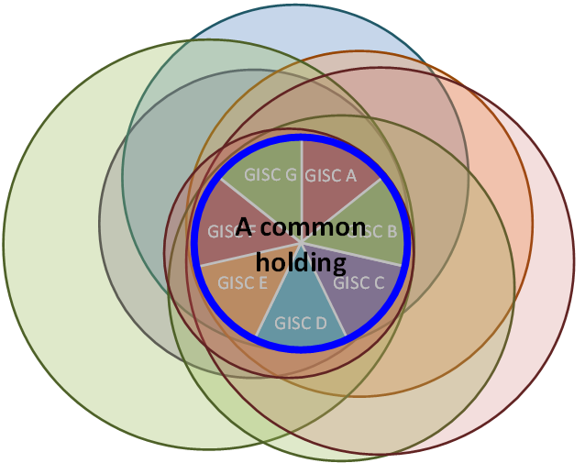
Concerns
  Implementing access controls, QoS, etc. based on WMO metadata content (WMO_ProductCategoryCode, etc.)
Maintain a clear understanding of what ‘cached data’ means (GlobalExchange data, Core Cache)
Managing data transport length (‘hops’)
Ensuring service consistently meets certification requirements
=
Cached data
Notes:
WMO_ProductCategoryCode：GTSPriority1 (critical)
How to control data priority
end-to-end within two minutes in the Cloud
or don’t need to be in the Cache
Cached data is:
Same as GlobalExchange data?
Same as Core Cache?
The number of hops will be increased
Without cloud : Data provider --> GISC --> GISC --> consumer
With cloud : Data provider --> GISC --> Cloud --> GISC --> consumer
With cloud (Final stage): Data provider --> Cloud --> consumer?
Need to estimate processing time (additional delay?) in the Cloud in the pilot stage
Throughput
There is “TCP/IP Round Trip Time (RTT) issue”
The distances to the cloud of all GISCs are not same.
Reduce the RTT by using Contents Delivery Network (CDN)?
It depends on the cost.
How can we find lacking data?
How can we know it?
How can we request it?
Email, FAX, Telephone, chat tool, and so on
How can we search data on the Cloud?
Requirements beyond metadata catalogue?

Slide 19
Procurement requirements and options

Slide 20
Financial requirements
Investigated options for procuring cloud-based services from multiple vendors (global, regional)
Focused on commercial cloud providers, not self-hosted
Compare service offerings capable of addressing the data cache and metadata hosting, exchange, access, and supporting requirements for WMO centres
Identify projected baseline costs for multiple scenarios
Highlight challenges, concerns, limitations planning efforts, considering multi-regional subscription base
Notes:
Considerations:
Cloud is a business term, both on-premise and public cloud solution should be considered.
The end goal is about subscribers of the cached data. The focus should not be on the technical aspects alone.
More work is required to understand this topic once the technical solution has been better understood.
Costs are accurate as of the time the assessment was completed.

Slide 21
Summary of cloud investigations
Both AWS and Azure are comparable with AWS being more open with their pricing.
AWS is the market leader and it is clear they can move data across regions.
Interoute seem to be a typical small scale cloud provider in comparison to AWS and Azure. Products and services are limited.
Cloud providers generally bill monthly, fundamental to any cloud initiative is determine who picks up the cost. There are two cost tiers. The first is the day-to-day running cost, storing the data. The second and generally less well budgeted is the usage cost. This can increase significantly based on the number of subscribers.

Slide 22
Proposed funding strategy for cloud solution
It was agreed that adopting cloud-based solutions should not result in costs at the DCPC level – current recommendation is to split the costs equally between the GISCs.
GISCs require a level of certainty in terms of cloud hosting costs for financial planning – current plan is to execute a tender, determine successful vendors, produce baseline costs, monitor actual costs for a period (e.g. 3 years?), then revise costs to GISCs in a managed way with advance discussion/notice.
Role of WMO:
Signing the contract, control of the provider (like what ECWMF does with the RMDCN) - (may be WMO) non-partisan, global in scope
Flow of funding (likely WMO) - setting the trust fund for GISCs to pay into, recover funds from GISCs

Slide 23
Other considerations
Technical:
Richness of cloud service offerings continues to grow
New/evolving approaches in storing/exchanging data
Technical and cost efficiencies associated with proprietary versus non-proprietary options
Uncertainty in planning core service capacity
Notes:
Richness of cloud service offerings continues to grow:
New service offerings (security, access services, monitoring and reporting)
Greater granularity for core infrastructure (for a given service such as storage, greater options in terms of resource type, performance, reliability, and scalability)
New/evolving approaches in storing/exchanging data (table vs BLOB vs File stores)
Technical and cost efficiencies associated with proprietary versus non-proprietary options:
Geographic failover and replication options exist which present technical and cost efficiencies over using traditional replication options
Uncertainty in planning core service capacity:
Network I/O is not as straight-forward to plan
Adding failover and performance optimization options adds complexity/cost
Adding access and security layers/services increases complexity/cost

Slide 24
Financial considerations
Investigation shows that the real cost to consider is outbound data requests.
When considering cloud, understanding data movement is essential. All the main cloud provides charge for outbound data requests.
  AWS and Azure charge ($0.9, $0.8 per GB)
A subscription based model the cost is uncontrollable and will grow exponentially based on volume of data consumed

Slide 25
Other considerations
Factors not included in financial breakdowns and which should be investigated:
Virtual Machine (VM) and other layers.
Supporting services including monitoring and security.
Optimization services (FinOps) - Each cloud provider has tooling which can improve the service level. The cost of this hasn’t been included as it’s specific to each provider.
GISCs may have existing infrastructure which may be re-provisioned in support of a cloud implementation (e.g. self-hosted or hybrid)
Local policies may hinder having a single cache on cloud based infrastructure.
Only store the 7GB~ if non essential data is stored this introduces unknown costs.
Notes:
FinOps is one of the terms used to describe optimising your usage of cloud resources to reduce your spend

Slide 26
Proposed cloud on-boarding approach
Initially, store only metadata in the cloud or restrict the data to a clearly defined global essential cache.
Each GISC is responsible for core support of the cloud environment.
The use of multiple cloud suppliers is recommended to accommodate regional constraints.
Each GISC is responsible for any subscription based costs.
Look to use a cloud provider that does not charge for outbound data traffic. Interoute is one such provider.
Notes:
There is a need to understand local regional constraints.
Storing non-essential data into cloud storage will increase costs.
A chargeback model would need to be put in place. Which includes day-to-day running costs and usage costs. Usage costs can be capped but this restrains the service.
A better understanding of the subscriber base. Without this will mean uncontrollable usage costs.
Clearly articulating the types and level of costs of delivering the service (e.g. users tend to forget people and other administrative costs).

Slide 27
Concerns
Working in a cloud environment it is easy to focus on the technical aspect. Successful cloud deployments focus on process and governance. Ensuring financial and security are at the forefront of any cloud based design.
Account ownership across GISCs.
Finding the right balance between efficiencies which can be achieved at the GISC level (possibly between GISCs) and ensuring the integrity of the ecosystem (applying least privileges in security models, etc.).

Slide 28
Conclusions and next steps

Slide 29
Conclusions - functional and technical requirements
The WIS Technical Specifications provide clear functional requirements for many aspects of cloud-based cache implementation, but the technical specifications do not dictate end-to-end IT infrastructure implementation and management. It is not recommended that one simply replicate an on-site architecture in the cloud.
Cloud service implementation can vary to an extent by service provider and it is likely that multiple cloud service providers will be employed.
Keeping the preceding points in mind, the implementation of a cloud based cache should be designed and implemented to meet the WIS centre certification requirements, with standards and best practices developed collaboratively between teams supporting the cloud footprint for WIS centres.

Slide 30
Conclusions - implementation strategy
Taking an evolutionary (phased) approach to onboarding in the cloud is seen as a more manageable strategy over a massive switch-over.

Slide 31
Questions?

Slide 32
Annex A – technical configuration for phases of implementation

Slide 33

Target architecture
<< Initial Stage >>
Condition:
SLA: | Best Effort
Data Volume, User License, Optional Service, etc. …
Storage: | 200 GB
Number of users: | 15 users (GISCs)
CDN Service: | May be needed to meet 20 Mb/s or more
Management: | Volunteer? or use Provider’s management service? e.g. ECMWF providing huge human resource to manage RMDCN
Throughput: | 20 Mb/s (not contractual) between a GISC and the cloud e.g. to get 4 GB (e.g. NWP) within 30 minutes, minimum actual speed must be 20Mb/s or more (see below)
If actual speed of each connection is 20Mb/s, the deliver time (end-to-end) will be 120 minutes
20Mb/s
4GB/30 min
20Mb/s
4GB/30 min
20Mb/s
4GB/30 min
20Mb/s
4GB/30 min
DCPC-A
NWP
GISC-A
Cache
GISC-B
DCPC-B
NC-B
End-to-end : 120 minutes

Slide 34
What kind of data?
 | Initial Stage | Evolution, Future stages
WMO_DataLicenseCode | WMOEssential, WMONoLimitation | WMOAdditional, WMOOther
WMO_DistributionScopeCode | GlobalExchange | RegionalExchange, OriginatingCentre
WMO_ProductCategoryCode | GTSPriority2,3,4 (except 1) | GTSPriority1 (Priority level control like “QoS” is required .)
 | Mechanism for many to many (as opposed to any to any)
GTS Priority … See Attachment II-5 of Manual on the GTS

Slide 35
Protocol
To Cloud | Initial Stage | Evolution & Future Stage
Internet | SFTP (GET/PUT) HTTPS (GET/PUT) | AMQP, Others
Closed network (e.g. RMDCN) | FTP (GET/PUT)

Slide 36
File format
Initial stage:
  WMO batched FTP file format
    CCCCNNNNNNN.ext and GFNC (Att.II-15, Manual on the GTS)
    Not unpacked in the Cloud (for transmission performance)
Evolution/Future stage:
  GISC uploads “pflag=X” files (Mixed files)
    See Attachment-II-15 of Manual on the GTS
  Data format for end users to download
    It will be required to unpack “pflag=X” files uploaded by GISCs so that DCPC/NCs or other users can download just data they need. (“pflag=X” file could contain even data they do NOT need.)
Initial stage
Evolution/Future stage
RJTD00000001.b
Original file
RJTD00000001.b
Cloud
GISC A
GISCB
Original file
Mix file: X__RJTD_yyyymmddHHMMSS.tar.gz
X__RJTD_yyyymmddHHMMSS.tar.gz
Unpack mix file for users
RJTD00000001.b
RJTD00000002.f
Z__C_RJTD_yyyymmddMMDDSS.grib
RJTD00000001.b
RJTD00000002.f
Z__C_RJTD_yyyymmddMMDDSS.grib
GISC A
Cloud
GISCB

Slide 37
Transmission of data
Initial stage
  Data volume per 1 file is up to 200 Mbytes.
    Each GISC should upload 1 data within 7.5 minutes, because, according to WIS Manual, Global data is required to be across all GISCs to within 15 minutes.
    In case of 4 Mbps access line, a potential capacity of its circuit has max 225 Mega Bytes per 7.5 minutes.
    For example
      WMO Batched FTP: Bulletin: up to 50 MB per 1 file (500KB x 100 messages as binary)
      WMO GFNC: up to 200 MB per 1 file
Evolution/Future stage
  To be able to change specification according to the Manual on the WIS/GTS
GISC-A
7.5 min
7.5 min
GISC-B
Cloud
Within 15 min

Slide 38
Storage
XX TB
(Future)
Initial stage: 200 GB
  Based on assumptions that:
  Cache time is 24 hours at least
    24h would be reasonable as done in pilot so far according to Tech-Spec-3.
  Data volume for 1 day “GlobalExchange” is 10 GB at each GISC.
    2 GB data/products x 4 times + other data = 10 GB x 15 GISCs x 1 day = Approx. 150 GB
    → 200 GB is required as operation.
  For transmission performance, cloud should handle uploaded files as it is. (Cloud does not unpack WMO batched FTP file.)
Evolution stage: ???? GB
  Cache time can be changed to 48h/1w/more… whenever in the future as per emerging requirements. (This is related to cloud’s storage capacity, which has cost implications.)
  Cloud needs directories (space) for DCPC/NC to upload/download data.
200 GB
(Initial)

Slide 39



Security
 | Initial stage | Evolution/Future stage
IDS/IPS | None | Using any security service, but it depends on budget.
IP & port filtering as firewall | Cloud needs to register each GISC’s IP address and just open port of protocol (FTP, SFTP, HTTPS) for exchanging data in order to prevent unauthorized access.
IP & port filtering
FTP, SFTP, HTTPS
GISC
Cloud
To block the unauthorized access

Slide 40

Robustness, Contingency plan
Evolution/Final stage
  Backup (backup cloud(s), GISC backup etc.)
GISC
1
Cloud
Main Cloud
GISC
2
GISC
3
Cloud
Cloud
Backup1
Backup2
GISC Backup

Slide 41
Annex b – financial analysis details

Slide 42
Definition of Service Level Agreement (SLA)
Cloud: depends on cloud provider
Virtual Machine (IT maintenance besides cloud)
Services:
  OS maintenance
  software packages maintenance
  system security defense
Reliability: outage < 0.5 day per year
Responsiveness: 24/7, response time < 1 hour
Monitoring/Reporting: monitoring the VM performance in real-time; report everyday to members

Slide 43
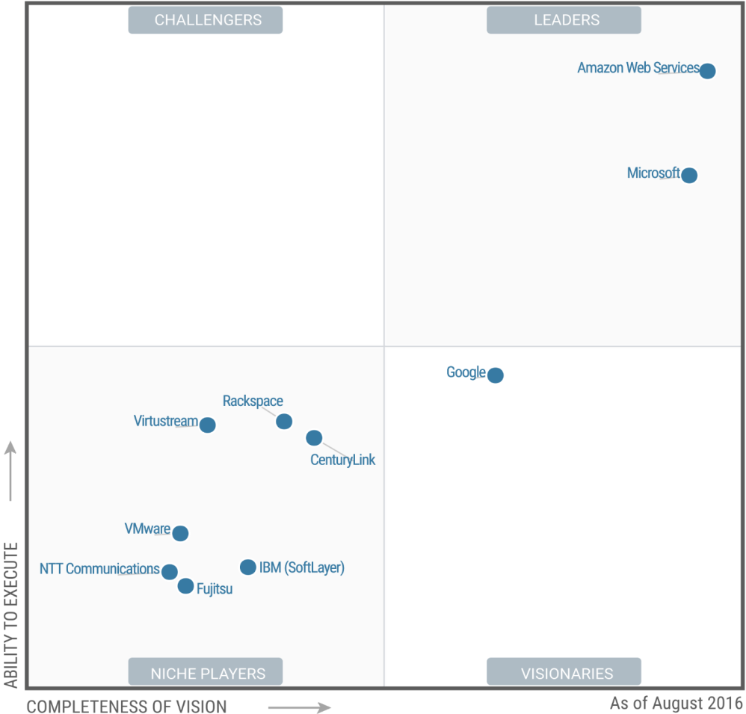
Current players
Source: Gartner (August 2016)
Notes:
Gartner Quadrant shows AWS are the leader in the cloud market, with Microsoft not far behind. This is backed up by a recent exercise the Met Office did, looking at cloud technologies to satisfy a future requirement.
The market leader is AWS with Azure a close second. Google have the investment power and will move into the Leader quadrant in the next few years.
Interoute (not visible, but in the Niche Players quadrant) is very niche (source EMCWF), but are the only supplier able to host cloud services on the RMDCN.
Consideration, moving data across regions has cost implications.
Consideration, the use of more than a single cloud provider for different regions - likely a reality given that service and data centre availability vary, even for a given provider.

Slide 44
Procurement (Public – AWS, Azure, Interoute)
Amazon, Azure:
Understand the technical requirement and purchase the corresponding service(s).
Procuring public cloud services are like building blocks.
All suppliers require a single account setup.
Leading cloud providers don’t provide bespoke solutions for PAAS.
Interoute:
Currently hosting the trial infrastructure
Only provider hosting on the RMDCN
Limited product and services
Notes:
Amazon, Azure:
Procurement in the cloud is straightforward, determine what services you require and purchase those services.
Without understanding the true technical solution the focus is around what we understand. For instance. The essential cache data is ~7GB, using main cloud hubs like USA, Europe, Asia etc.. Makes the cost cheaper.
GISC’s will push data into the cache (although in the future NC’s could also do this).
Based on each region’s requirement, some cloud providers might be excluded.
Consider the use of more than one cloud provider.
Interoute:
Interoute were a good fit for the trial but realistically there are more mature providers of cloud services.
Outbound traffic within Interoute is not the same as AWS/Azure costing, there is an assumption that the VM cost is higher but it covers traffic cost.
European hosting only.
Note: An on premises solution was not looked at as this would be the same as we have now.

Slide 45
Cost management considerations
      Account Ownership
          Single master account, WHO owns the account!
          Rotate account ownership between GISC’s.
          Each GISC takes responsibility for a set period of time.
          Understand the regional limitations
      Cost Ownership
          Single organisational model wouldn't work
          Putting ~7GB essential data into a cloud environment is free
          A chargeback model would need to be in place.
Core cost model
            GISC chargeback
            Subscription based chargeback
Notes:
Single account ownership. Cost ownership, Having a single account may be an issue? Sub accounts can be created for each GISC to administer. This in itself could be problematic
In a single organisation sharing the costs is fairly straight-forward. A budget is allocated and owner of the budget draws down against on the actual monthly cloud cost. See https://aws.amazon.com/s3/pricing/ for a full cost breakdown in AWS. For Azure see https://azure.microsoft.com/en-gb/pricing/calculator/
Core cost model is monthly storage cost. All other chargeback models would need agreements in place.

Slide 46
Financial breakdown - AWS
Cost of transferring ~7GB into S3 storage, free
Moving data across regions $0.020/GB
Acceleration transfer tool, additional $0.04/GB
Storing data in the cloud $0.024/GB per month, 7*0.024=0.068/day. 0.068*30 days =$5.04.
Put, Copy, Post or List Requests, $0.0053/1,000 requests
Get and all other requests, $0.0042/10,000 requests
Additional costs would be incurred based on any solution accessing data
Notes:
Pricing based on location is set to London. Because the data changes on a daily basis then a daily rate is applied. Acceleration transfer tool can speed up transferring data between regions, although some local testing did not show a real improvement.
Final point – the layer above the data would incur cost but until this is better defined it’s hard to understand what the cost would be

Slide 47
AWS Costs (20GB and 300GB daily)
$0.09 per GB
Transfer out cost
Notes:
The costs represent 20GB in and 20GB and 300GB out. Transfer out with no regional difference is $0.09 per GB Initial scenario is $91.62, with a jump to $823.41. 300GB translates to 15 GISC’s taking the data out.

Slide 48
Financial breakdown – Azure
Cost of transferring ~7GB into Azure storage, free
Moving data across regions, “unclear”
Storing data in the cloud $0.056/GB per month, 7*0.056=0.392/day. 0.392*30 days =$11.76.
Put, Copy, Post or List Requests, $0.0150/10,000 requests
Get and all other requests, $0.0015/10,000 requests
Additional costs would be incurred based on any solution accessing data
Notes:
Pricing based on location is set to London. Because the data changes on a daily basis then a daily rate is applied. Acceleration transfer tool can speed up transferring data between regions, although some local testing didn't show a real improvement.

Slide 49
Azure Costs (300GB daily)
Service type | Region | Description | Estimated Cost
Virtual Machines | UK South | 1 virtual machine(s) x 1 hours: A2 v2: 2 cores, 4 GB RAM, 20 GB disk | $78.86
Storage | UK South | File storage 9TB | $691.23
Virtual Machines | UK South | 1 virtual machine(s) x 1 hours: A2 v2: 2 cores, 4 GB RAM, 20 GB disk | $78.86
Support |  | Support | $0.00
 |  | Monthly Total | $848.96
 |  | Annual Total | $10,187.51
$0.08 per GB
Transfer out cost
Notes:
The costs represent 20GB in and 300GB out. Transfer out with no regional difference is $0.08 per GB 300GB translates to 15 GISC’s taking the data out.

Slide 50
Financial breakdown – Interoute
A discussion was held with Interoute but they were vague in terms of pricing.
An indicative cost for a virtual server is 4k€ per year). This is a fairly typical cost for hosting virtual servers and comparable to an on-premises VM.
Interoute is only based in Europe.

