Slide 1
Status of RA II WIS Implementation Plan
EG-WIS

Slide 2
EG-WIS-1
25-27 November 2015 in Tokyo, Japan
Review of progress
  R2-WIS-IP, RMTN, TDCF migration, the implementation status of DAR metadata, WIS centres, WIS projects, …
Discussion of future structure and actions of EG-WIS
Main recommendations
  Amendment of the Manual on WIS
    update the information of DPRK in table B.3 (National Centres)
  Future structure of EG-WIS in RA II
    the meeting requested EG-WIS consider establishing ICG-WIS in RA II-16
  Designation procedure for expert group EG-WIS in RA II
    the meeting requested RA II MG to consider designation procedure to be approved within 6 months after RA II session

Slide 3
R2-WIS-IP
WIS Implementation Plan
  Initial draft was reviewed by 15th RA II
  15th RA II requested EG-WIS to finalize
  Established specialized TT with expert from six GISCs, one DCPC and two NCs
  Completed the first version and submitted to the President of RA II
  The first version of R2-WIS-IP was approved in Dec. 2013. (available at: http://wis.wmo.int/file=653)
  Review of R2-WIS-IP is ongoing
    Updates (WIS centres implementation status) will be submitted to RA II and WMO secretariat by the end of 2016
  A new structure of R2-WIS-IP will be proposed to RA II-16

Slide 4
RMTN status
Updates
Bhutan: Link New Delhi-Thimphu
  The link added in RMTN (Res-5 XIII-RA II)
  Connected to RTH New Delhi in June 2015
  Started receiving data with support from RTH New Delhi, UEMETSAT and JICA.
  Started distributing their obs. data in BUFR in July 2016
New links (after 15th RA II)
  One supplementary regional circuit
  Seven additional circuits

Slide 5
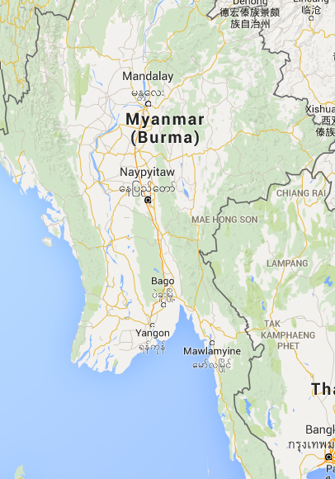

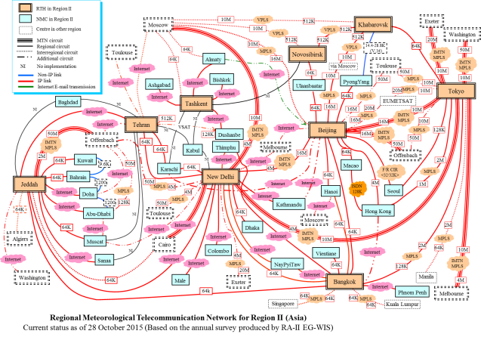
RMTN status
Updates
Myanmar changed the location of NMC from Yangon to Nay Pyi Taw
Nay Pyi Taw started its GTS operation in 2013
Reflected to RMTN
RTH New Delhi
Nay Pyi Taw
Yangon
RTH Bangkok

Slide 6
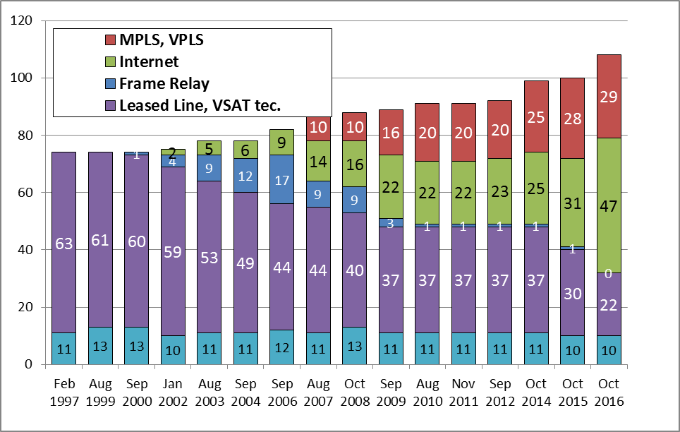
RMTN Status
Service type of Network
(October 2016)
MPLS(29)
Internet(47)
FR (0)
Leased+etc.(22)
not-operation(10)

Slide 7
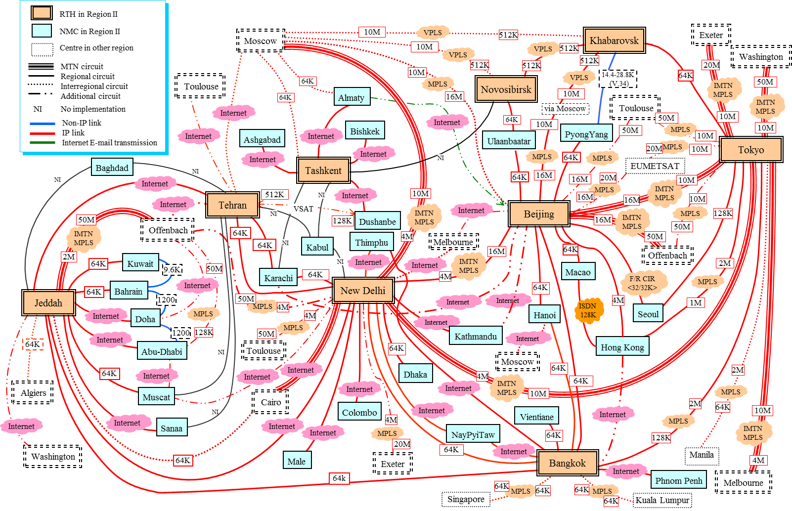
RMTN Status as of October 2016
The NI circuit between Karachi and Tashkent has not been implemented yet. Because there are difficulties to deploy telecommunication infrastructure for the area, both RTHs requested to remove the link from RA II regional circuit plan.

Slide 8
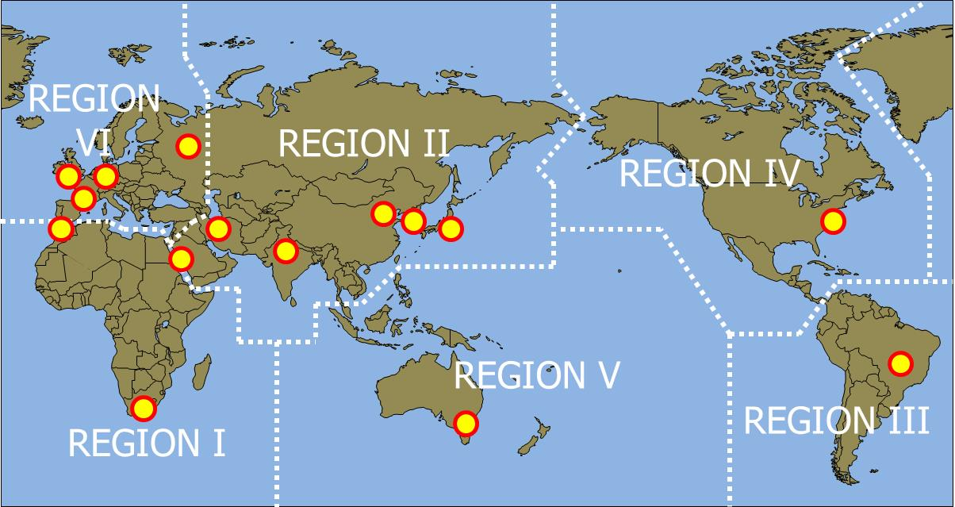
WIS Implementation (GISC)
Note: GISC Moscow is geographically located in RA VI, but middle and east Russia is in RA II, and GISC Moscow provides services to DCPCs/NCs in RA II members.

Slide 9
WIS Implementation (GISC) as of December 2016
GISC | Operation | AMDCN (AoR) | AoR's Metadata | GISC Backup | Workshop/Training for AoR | WIS Monitoring
Reference |  | WIS-IP: Para. 6.1.4 | WIS-IP: Para. 6.1.2, 6.1.6, 6.1.7 | WIS-IP: Para. 6.1.2, CBS2014 Rec. 21: WIS Guide 6.3 | WIS-IP: Para. 3-b), Para. 7.3, 8.5 CBS2014 Rec. 21: WIS Guide 6.2 | WIS-IP: Para. 8.7
Beijing | 15 Aug 2011 | # Connected to all DCPCs/NCs through Dedicated line or Internet in AoR | # Collecting/managing metadata from all DCPCs/NCs in AoR | # In operation with Tokyo # Made agreements with Offenbach and Melbourne # Disaster recovery site started operation in May, 2016 | # Held WIS workshop 2011 # Holds face-to-face meeting/training for each NC in AoR every year # providing on-site training for neighing centers (CMACast users) every year | # Providing JSON file # Providing WMO Common Dashboard
Jeddah | 02 Oct 2014 | # Connected to all DCPCs/NCs through Dedicated line or Internet in AoR | # Collecting metadata from all DCPCs/NCs in AoR | # Under discussion with Seoul (?) | # Holds staff training in Nov. 2015 # Plan to hold workshop in Feb. 2016 | # Plans to provide JSON file
Moscow |  |  |  | # In operation with Offenbach |  | # Providing JSON file
New Delhi | 2016 | operation | pre-operation | # Plan to start coordination (DRC in Pune was started operation in 2014) | Plan to have on-site training | Plans to provide JSON file
Seoul | 13 Jun 2013 | # Connected to DCPCs/NCs in AoR # Plan to connect remaining DCPC over VPN/Internet | # Collecting metadata from DCPCs/NCs in AoR # Plan to collect metadata from remaining DCPC | # Plan to start discussion with Jeddah # Arrangement with Moscow, and cooperation with Melbourne on GISC backup | # Held GISC Seoul workshops in '12, '13, '14 # Provided training to DCPC Tashkent in 2013 and DCPCs/NCs in AoR in 2015 | # Providing JSON file
Tehran | 04 Aug 2014 | # Connected to DCPCs/NCs # Plan to connect remaining DCPCs/NCs | # Collecting metadata # Plan to provide metadata service to remaining NCs | # Plan to start arrangement | # Held training workshop in 2011 and 2014 | # Plans to provide JSON file
Tokyo | 01 Aug 2011 | # Connected to all DCPCs/NCs in its AoR over the MPLS. Some CNs are connected via DCPC/RTH Bangkok | # Collecting metadata from all DCPCs/NCs in AoR | # In operation with Beijing and Offenbach # Made an agreement with Melbourne (DRS started operation in March 2015) | # Holds WIS workshop every two year ('10, '12, '14) # Holds on-site-workshop at each DCPC/NC in AoR, at least once a two years | # Providing JSON file including information of all NCs in AoR # Providing WMO Common Dashboard

Slide 10
WIS Centres in RA-II Nov. 2016
NC: 37
  37: approved by EC-64
DCPC: 29
  26: endorsed/approved by CBS/Cg/EC
  3: not submitted
GISC: 7 (including GISC Moscow)
  7: approved by Cg-16
  7: are in operation
Notes:
3 DCPCs approved by Cg-17, DCPC GMC, Gulf Marine Centre (Qatar), DCPC Space weather (Japan), DCPC RTH (Thailand)

Slide 11
WIS Centres in RA-II Nov. 2016
NC: 37
  37: approved by EC-64
DCPC: 29
  26: endorsed/approved by CBS/Cg/EC
  3: not submitted
GISC: 7 (including GISC Moscow)
  7: approved by Cg-16
  7: are in operation
Notes:
3 DCPCs approved by Cg-17, DCPC GMC, Gulf Marine Centre (Qatar), DCPC Space weather (Japan), DCPC RTH (Thailand)

Slide 12
2017 update to RA-II WISIP
AMDCN
National Focal Points
  Updated in August, 2017
Training programme
  RAII-16 invite RAII GISCs and RTCs provide a training plan to indicate their commitments to WIS training activities for 2017-2020.
  GISC Beijing, Moscow, Seoul, and Tokyo: WIS training activities for 2017 to 2020
  The update will be completed in December, 2017

Slide 13
Thank you.

