Slide 1
ET-CAC Report
Kevin ALDER
Agenda item 6-3 (1)
Expert Team on WIS Centres
ET-WISC2017
13-17 November 2017, Geneva

Slide 2
General
ET-CAC held its first meeting in Darmstadt, Germany from the 18-20 October 2017.
11 core and associate members in attendance.
Three of the team have previous WIS auditing experience (Kevin, Lothar, Weiqing).
Other members have general (mostly QMS) auditing experience.

Slide 3
Current ToRs
Operate the procedures for technical endorsement of WIS Centres and advise CBS on centres’ level of technical compliance with standards and procedures:
  Validate and monitor the conformance of WIS Centres’ interfaces to the agreed specifications and practices;
  Coordinate and organize demonstrations of capabilities of candidate WIS centres as required, including onsite audits of GISCs;

Slide 4
ToRs Cont’d
Make recommendations to ICT-ISS regarding continuous improvement of the procedures for certification and periodic assessment of WIS centres;
Advise ICT-ISS on systematic issues identified during certification and assessment activities.

Slide 5
Proposed ToRs
Develop and maintain an audit framework for the assessment of WMO Centres based on the WMO provisions for Quality Management (WMO-No. 49, Part VII) and ISO 9001:2015 - the WMO Framework for Audit and Evaluation of International Operational Facilities
Provide guidance to system and process owners regarding the specification of assessment criteria based on a risk-based approach for inclusion within the audit framework
Coordinate and schedule audits of operational centres in response to instructions from CBS, other relevant WMO bodies and other cooperating international organizations

Slide 6
Proposed ToRs
In collaboration with nominated subject matter experts, conduct audits of operational centres, in accordance with the audit framework.
Review audit activities to identify opportunities for improvement in audit procedures and their implementation, reporting to OPAG-ISS.

Slide 7
ET-CAC Methodology
The scope of ET-CAC activities has extended to cover all types of WMO Centres.
The authority for ET-CAC to conduct audits derives from Part VII Quality Management of WMO-No. 49 Volume I.
The audit team works to criteria set by the ‘system owner’ (ET-WISC ToRs, Manual and Guide on WIS).
A risk-based approach is proposed in the new audit framework.

Slide 8
Relevant Information for ET-WISC
ET-WISC defines the assessment criteria for WIS Centres.
Each GISC Revalidation Audit will be based on these criteria using a risk-based approach.
The on site audit initiated by formal invitation from the GISC.

Slide 9
Relevant Information for ET-WISC
It is expected that pre-audit information will be requested by the audit team.
Audits conducted over 2 days by a two member audit team.
GISC audits performed May 18 - April 19 (provisional).

Slide 10
Relevant Information for ET-WISC
ET-CAC requests ET-WISC to review the current GISC Audit Criteria and update the ‘GISC Audit Check Sheet’.
Certification Audits for DCPCs will continue using the current criteria and the existing process.

Slide 11
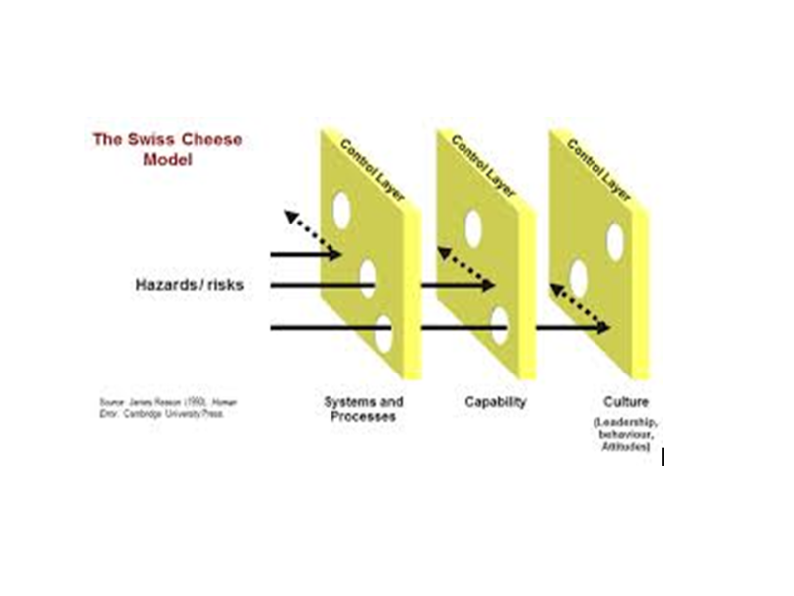
What is a Risk-Based Approach?

Slide 12
ISO 9001 Basics
ISO 9001:2015 focuses on six organisational management functions:
Clause 5 – Leadership
Clause 6 – Planning
Clause 7 – Support
Clause 8 – Operation
Clause 9 – Performance evaluation
Clause 10 – Improvement
And then wraps these in risk-based thinking

Slide 13
What is a ‘Risk-based’ Approach?
The concept of risk-based thinking has been implicit in previous editions ISO 9001:
taking preventive action to eliminate potential nonconformities
analysing any nonconformities that do occur
taking appropriate corrective action to prevent recurrence
In its 2015 revision, ISO has incorporated risk-thinking explicitly across the six functions.

Slide 14
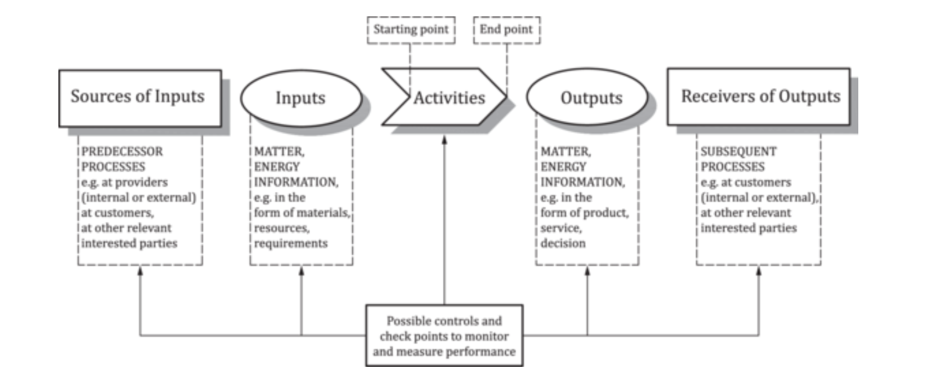
ISO – Elements of a Process

Slide 15
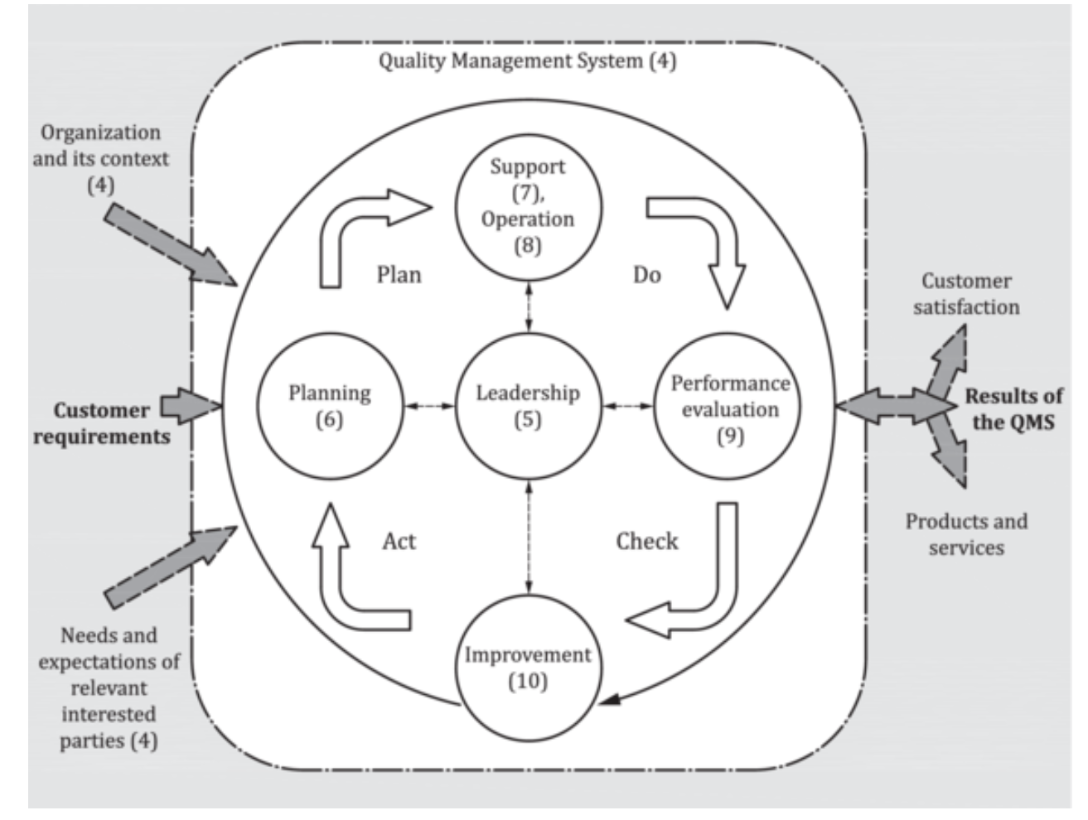
Plan – Do – Check - Act

Slide 16
The ‘Risk-based’ Approach
“A Risk-Based Approach requires an organization to plan and implement actions to address risks and opportunities”.
Knowing what the risks to its operations are
Putting effective controls in place to mitigate those risks
Regularly review the effectiveness of those controls, and introduce new controls as required.
“Addressing both risks and opportunities is the basis for achieving improved operations and reducing/preventing negative effects.”

Slide 17
From the Audit Perspective
An auditor can learn a lot about an organisation from how it treats risk. Risk Managment provides insight into:
Areas where the organisation sees what its greatest risks are
What the controls are and how are effective they are.
What activities are currently under way or are planned to manage risks.

Slide 18
From the Auditor Perspective
The auditor will be able to review a centre’s
operations
quality management activities and
risk information
and selectively test to see that the controls are in place and are effective.

Slide 19
The Benefit to the Centre
The audit is more focussed and becomes a conversation about the 6 functional management activities.
The auditor doesn’t need to ask 1001 ‘pointless’ questions
The audit result will be less likely to be disputed.

Slide 20
The Benefit to the Centre
The auditor should be able to make an assessment of the maturity of aspects of the operation under audit.
An audit report can then provide support for ongoing improvement activities.
The audit adds value to the organisation.

Slide 21

Thank you
Merci

