Slide 1
GISC Washington status
Kari Sheets
Agenda item 4.1.13
Task Team – GISC
Geneva (via teleconference)
November 13, 2017
1
1
1

Slide 2
Contents
Area of Responsibility
Training – Capacity building activity
Operational issues in last period
GISC Back up and activities
Monitoring Activity & volume
Changes in GISC, including new features since last meeting
Outlook (planned changes/improvements)
Any other issues of interest

Slide 3


Area of Responsibility
WMO Region IV
Antigua & Barbuda
Bahamas
Barbados
Belize
Canada
Cayman Islands
Costa Rica
Cuba
Dominica
Dominican Republic
Ecuador
El Salvador
Grenada
Guadeloupe
Guatemala
Haiti
Honduras
Jamaica
Mexico
Montserrat
Nicaragua
Panama
Saint Lucia
Trinidad and Tobago
Turks & Caicos Islands
Internet
NODC
DCPC
NCDC
DCPC
NCAR
DCPC
Internet
NC
NC
NC
GTS/
RMDCN
NC
NC
NC
NC
NC
NC/
DCPC
NC
GISC Washington
NC
NC
NC
GISC
TOULOUSE
WIS
core
network
NC
NC
GISC
BRASILIA
Region IV NCs
NC
DCPC
NC
GISC
EXETER
GISC
Satellite Dissemination
IGDDS,
EUMETSAT,
etc.
Internet
Satellite
Two-Way System
Internet
NC
NC
NC
NC

Slide 4
Training – Capacity building activity
Connectino to WIS-MetED – COMET
  Designed to make the COMET materials available to support the development of the KMA prototype for the WMO Global Campus Searchable Training Calendar of events and Catalogue of Resources"

Slide 5
Operational issues in last period
Mid-February 2017- March 20, 2017
  Registered Users were unable to login into GISC Washington due to an incompatiable software update on the infrastructure
  Search capabilities remained operational

Slide 6
GISC Back up and activities
Brasilia is Back-up – connectivity tested and confirmed in self-audit processes December 2016

Slide 7
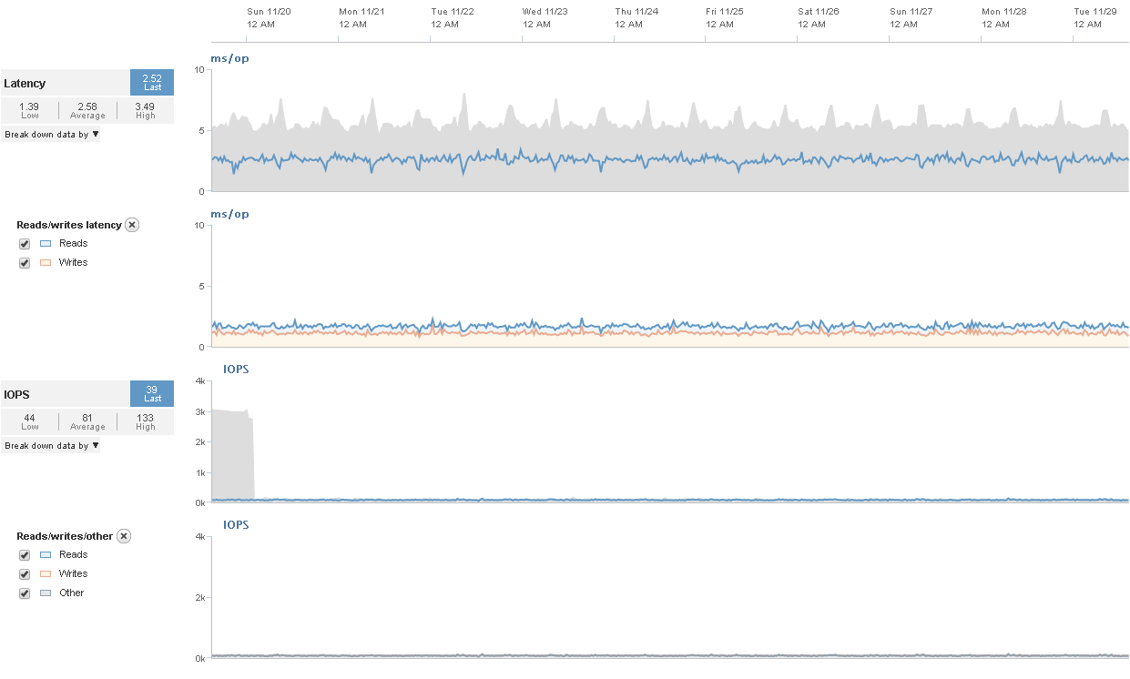
Monitoring Activity & volume
2017 official annual report is in process
December 2016 Latency reports on primary and back-up NWS infrastructure

Slide 8
Changes in GISC, including new features since last meeting
Upgraded software (OpenWIS) and infrastructure hosting GISC Washington
NWS telecommunications gate was was sunset in early 2017
  All systems running on the NWSTG were migrated in 2015 and 2016
  Replaced by Integrated Dissemination Program Infrastructure
  Redundant Systems located in College Park, MD & Boulder, CO
GISC-Washington became operational on the new hardware December 19, 2016
6 Audit Tests (self-audit) were performed prior to official migration to the new hardware
All registered user actions were also verified

Slide 9
Outlook
(planned changes/improvements)
Complete testing of direct connection with Toulouse and Offenbach
Re-establish direct connection to Melbourne
Encourage more US metadata registrations in GISC-Washington
Continue to participate in technical and steering committee for the OpenWIS association with a focus on keeping in step with developing WIS 2.0 requirements and keeping GISC-Washington up to date

Slide 10
Any other issues of interest

