Slide 1
GISC Offenbach
Kai Wirt
Task Team GISC
TT-GISC2017
13-17 November 2017, Geneva

Slide 2
Connectivity
AoR of 28 countries (Estonia last member)
GISC Offenbach is directly connected to 12 of the other GISCs
Internet Access 7.5 GB/s via two ISPs
Backup Internet Access in Berlin
RMDCN Connection

Slide 3
Training
Internal Training for new staff
Provide expertise / help to users
Seeking sugestions for improvements
Moving from managed to self-management

Slide 4
Operational Issues
Upgrade of mss system postponed to 12/2017

Slide 5
Backup
GISC Tokyo and GISC Moscow
Complete full backup (3 countries have only 1 backup)
Quarterly Backup Tests
  Very valuable

Slide 6
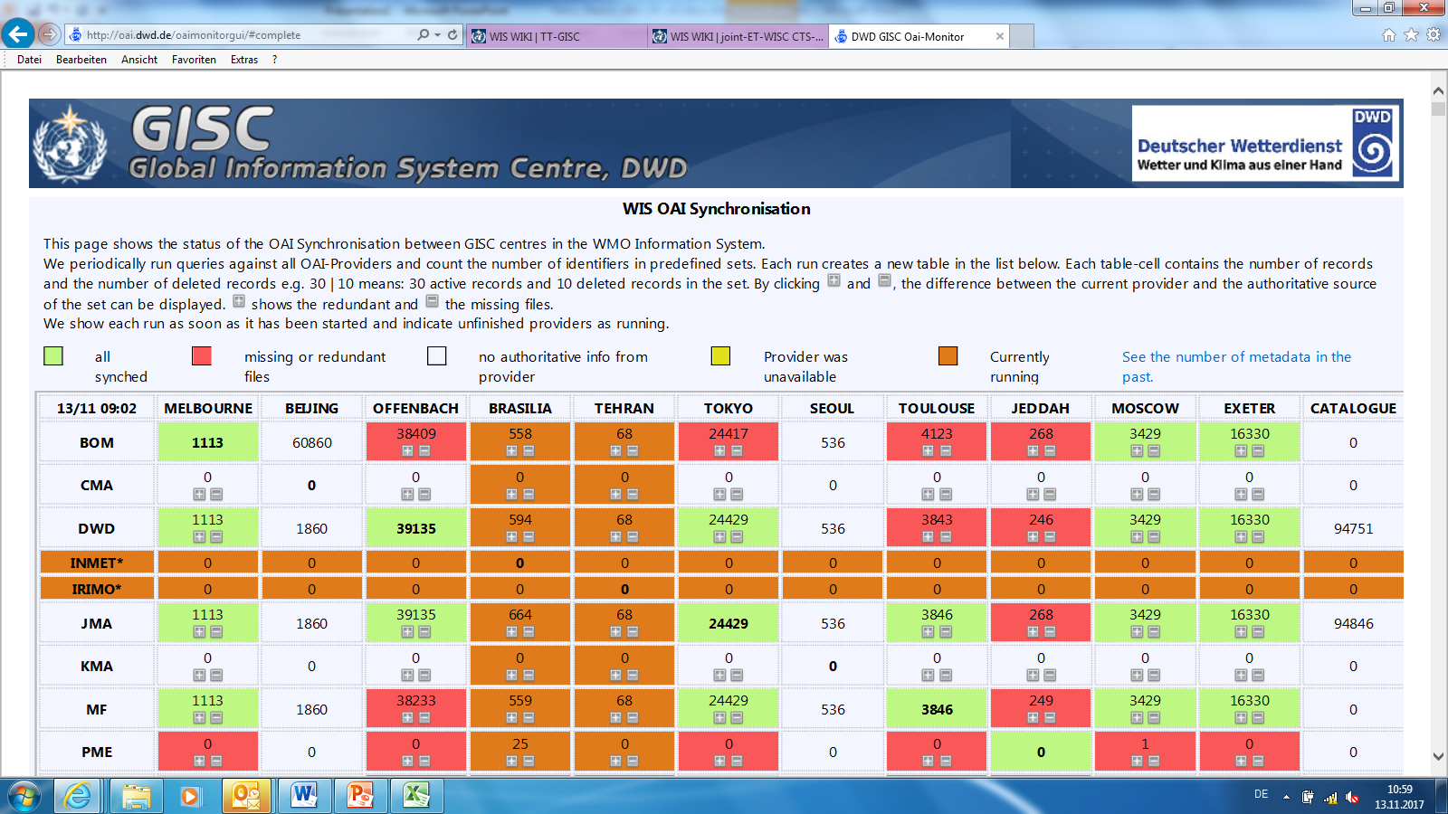
Monitoring

Slide 7
Traffic size
358 users registered
Uptime 100% in 2017 for data transfer
NWP Model Changes in 2016 / 2017

Slide 8
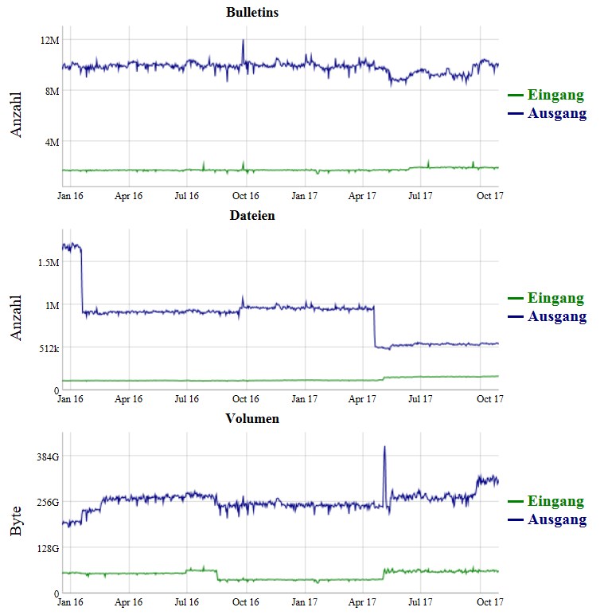

Slide 9
Changes / Updates
Upgrade of portal in 08 /2017
Plan to improve usability further
  Data preview etc
DWD became accepted as GPC-LRF
New WIS / RTH Focal Points
  Thorsten BÜßELBERG
  Kai-Thorsten WIRT

Slide 10

Thank you
Merci

