Slide 1
WMO Priorities
Secretariat
Plenary 2.0
Opening Plenary
Joint Meeting
ET-WISC/CTS& TT-GISC 2017
13-17 November 2017, Geneva

Slide 2
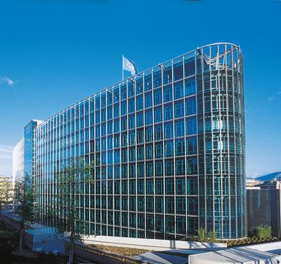
Current WMO “climate”
Growing amount of disasters & economic losses. Contribution to humanitarian, refugee & even military crisis growing. Political weight of weather, climate and water growing.
Gap between developed and less developed Members growing. Need and readiness for collaboration exists, financial resources by development partners & recipient country governments expected.
Delivery of observations for global use not optimal
Urbanization is a new challenge for WMO
Members are expecting more modern, dynamic and streamlined WMO activities, e.g. meetings, concrete action & constituent body structures
Growing private sector engagement
UN needs WMO services and expertise

Slide 3
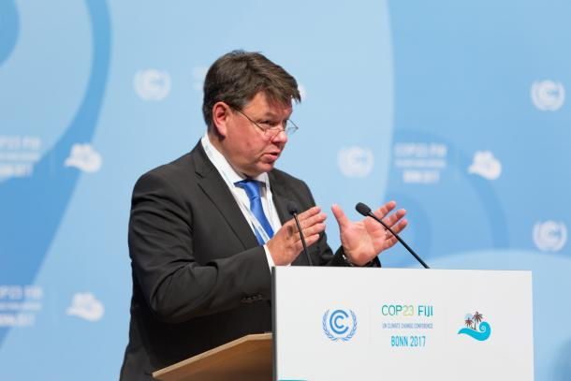
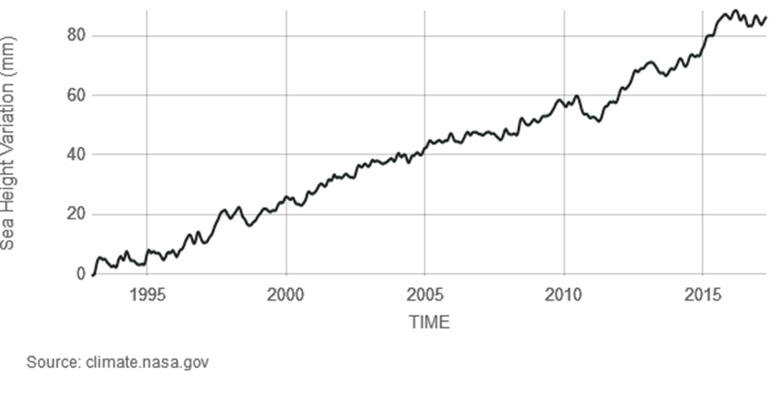
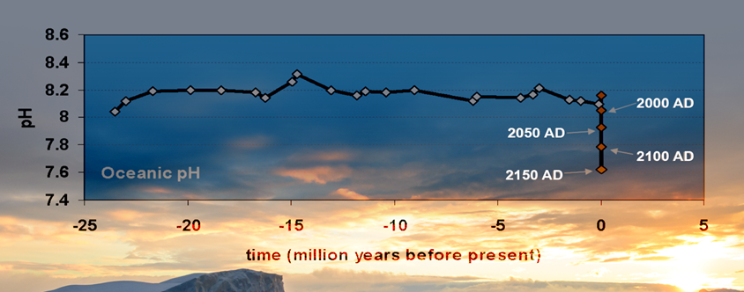
State of the climate (COP-23)
GHG report showed emissions are levelling out, but concentrations – because CO2 remains in the atmosphere – increased at a record pace from 2015 to 2016.
The year 2016 was the warmest on record – 1.1 °C above the preindustrial period, partly due to a strong El Niño event. 2017 is expected to be one of the three warmest years on record, and the warmest not influenced by El Niño.
Sea surface and ocean temperatures are among warmest on record, sea levels continue to rise, so far by 26 cm. Arctic and more recently Antarctic sea-ice extent continues shrinking. Ocean acidification threatens marine ecosystems and fisheries and coral reefs are bleaching.
The North Atlantic hurricane season broke records and led to massive loss and damage in the Caribbean and U.S.A. There were major monsoon floods in South Asia and continuing severe drought in east Africa. The drought has been boosting crisis in fragile countries, like Somalia.
Notes:
The latest state of the climate report shows we are on track …
More extreme events affecting many parts of our lives and well being …

Slide 4
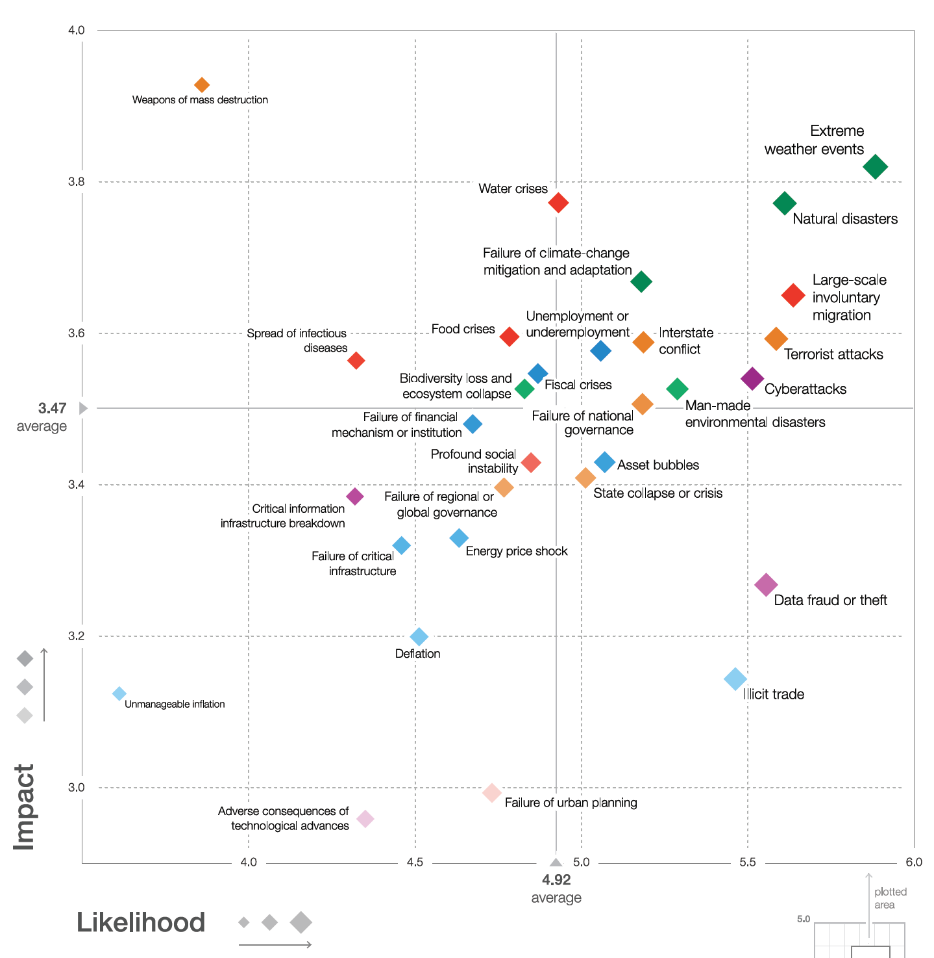
Global risks landscape 2017
World Economic Forum
Notes:
WEF identified that extreme wx events, nature dissasters water & food crisiss and failure to mitigate or adapt to climate changes are among the greatest risks. This is evident in the UN Sustainable development goals

Slide 5


















/WMO
Weather resilience
Climate change services
Water resource management
Solar, wind & hydro use
Climate resilience
Big data, innovations
Air quality, heat waves, flooding
DRR, Adaptation, carbon & climate monitoring
Sea level rise, climate<->oceans
Climate change <->ecosystems
Climate driven conflicts
Resources for climate adaptation & DRR
Notes:
WMO has a a role I many of the sustainable development goads as indicated here.

Slide 6
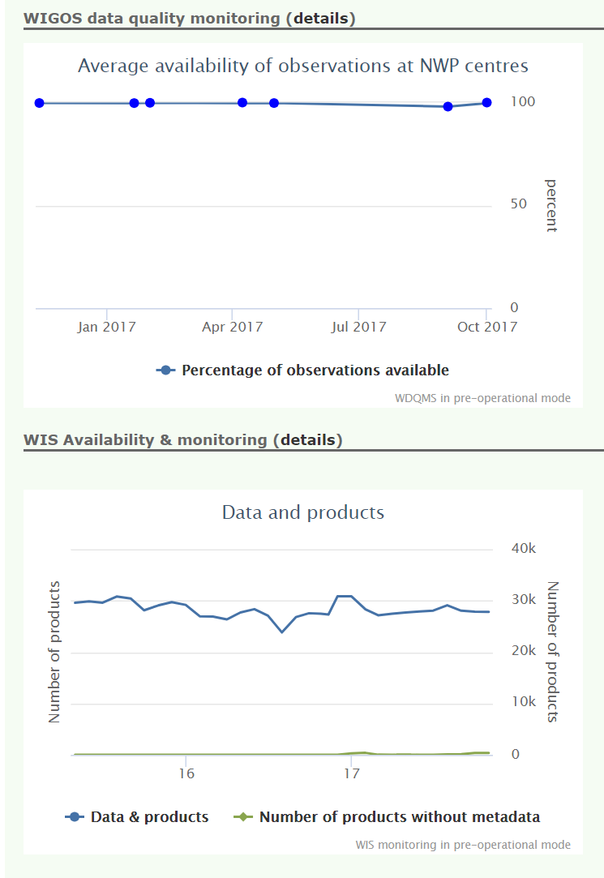
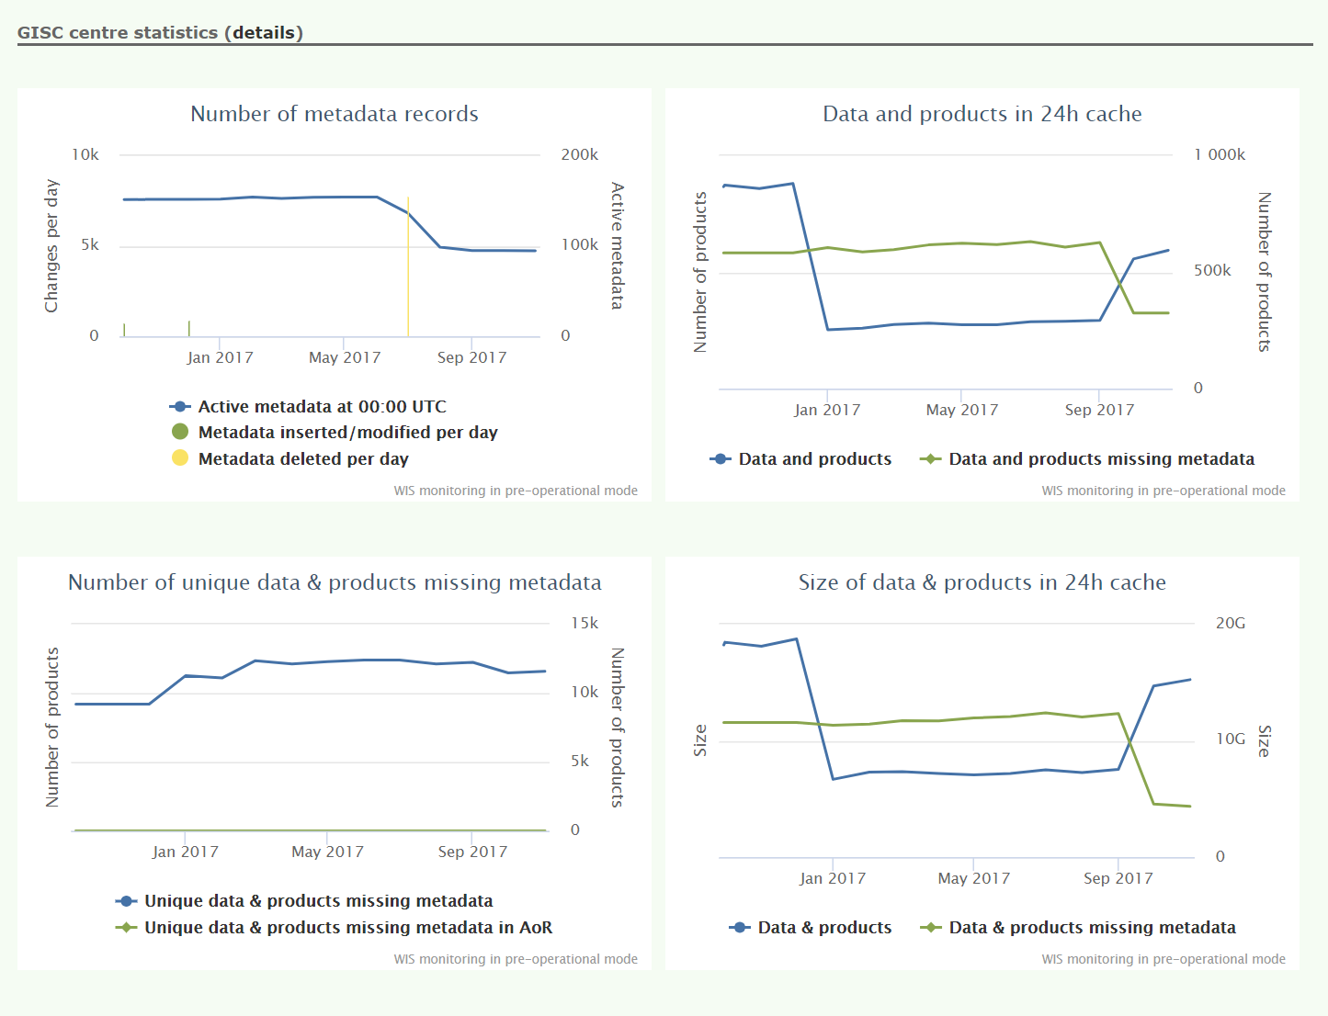
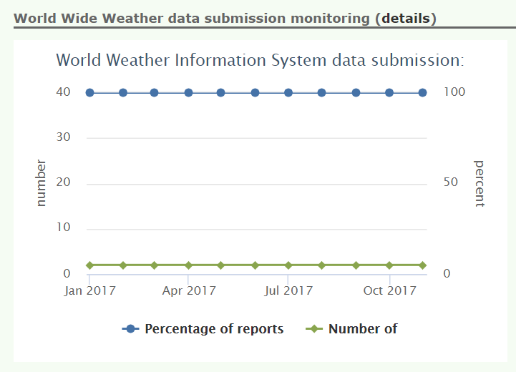
CPDB – Monitoring
Members can see their status
Notes:
WIS and WIGOS monitoring is feeding in to the CPDB

Slide 7
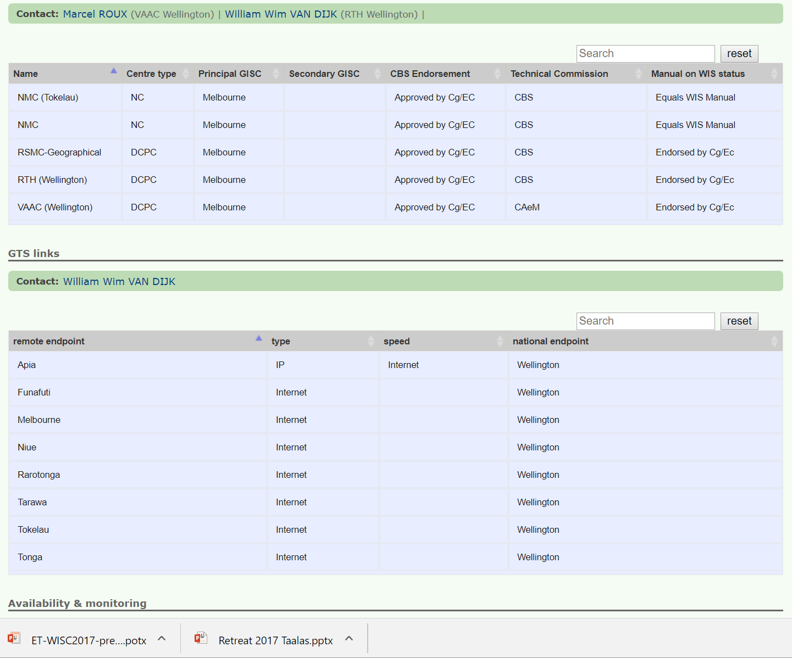
Members will see and update their WIS data
Notes:
At the moment, Members can see the GTS details as we have them and in next versions will see all WIS details and be able to update them directly

Slide 8
Partnership with Industry
Industry has close contact with NMHS
Train industry so Members get better solutions
Partnerships through participation in expert teams
New directions with systems as a service
NMHS may need to refocus their energies to where they add most value
Consider a model like ITU which has sector and academic membership

Slide 9
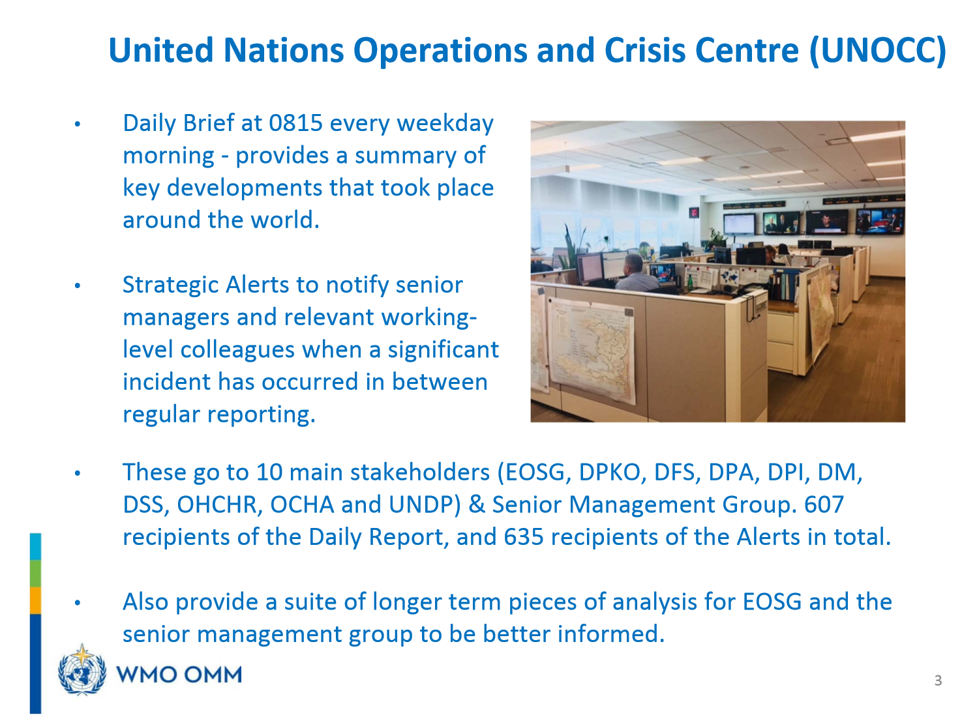

Slide 10
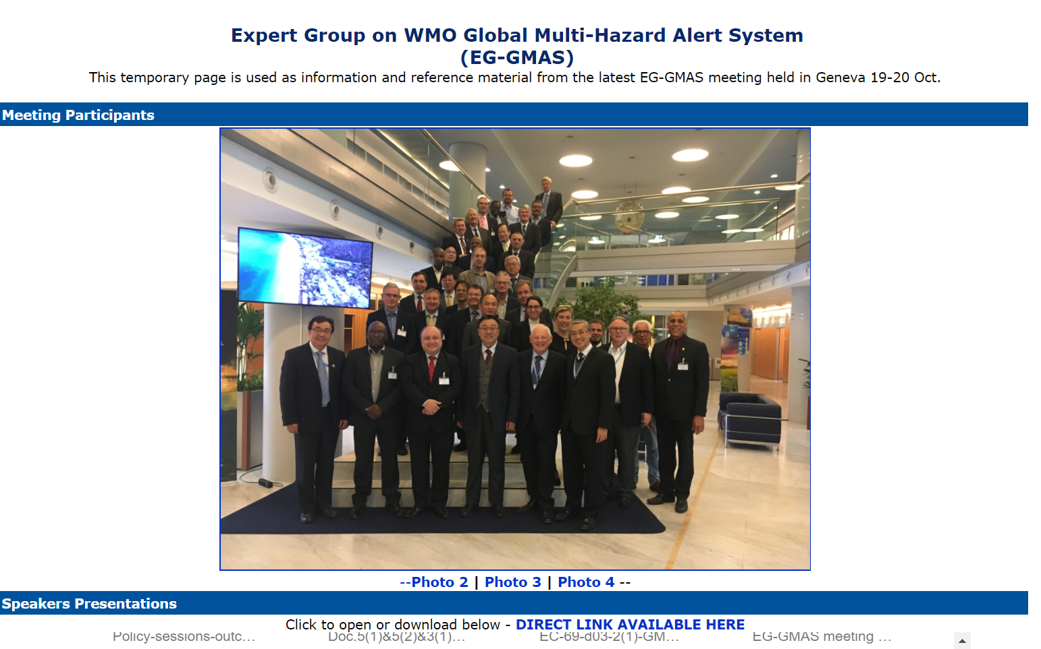
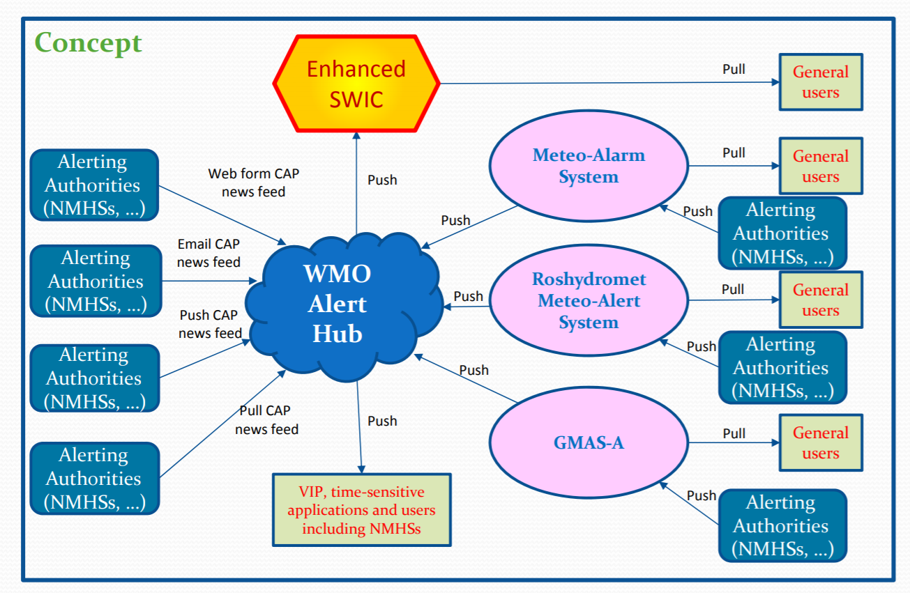
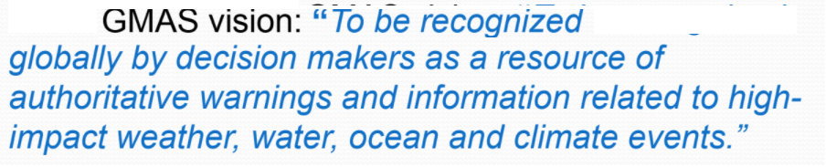
GMAS
Notes:
Based on CAP, and now developing

Slide 11
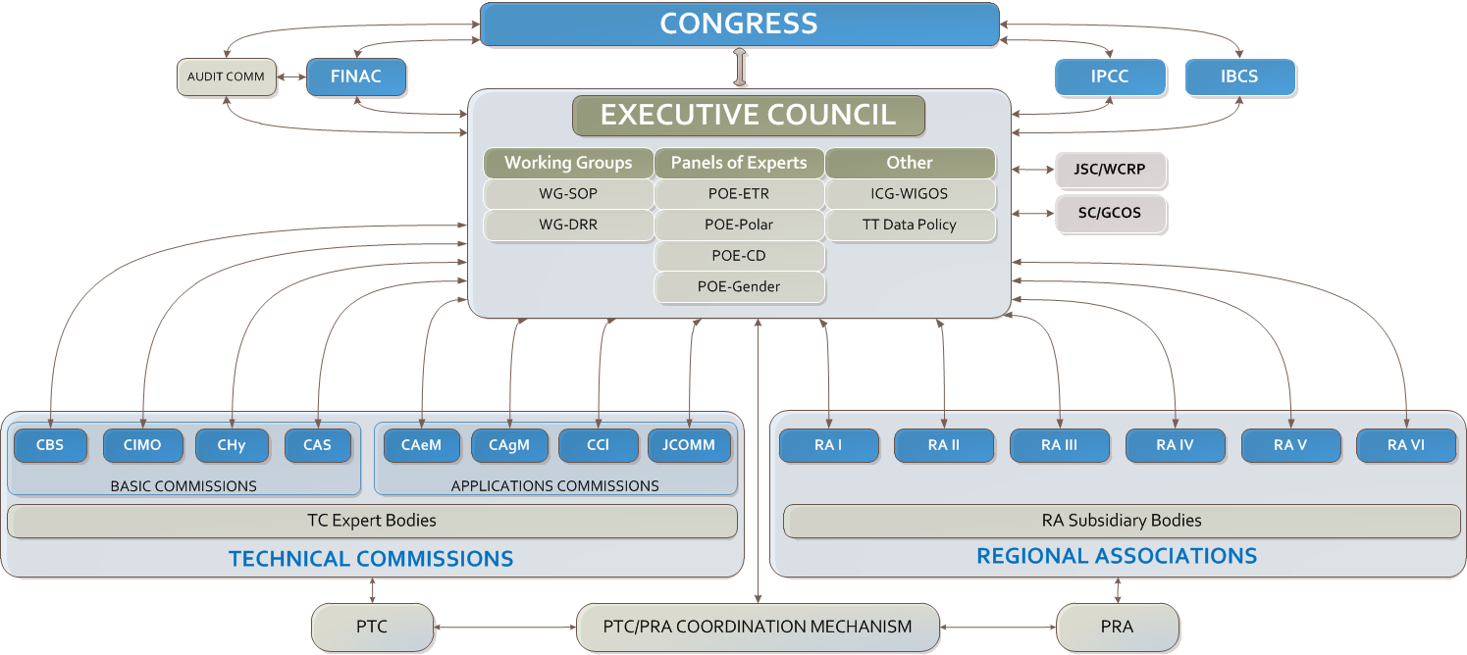
Current structure

Slide 12
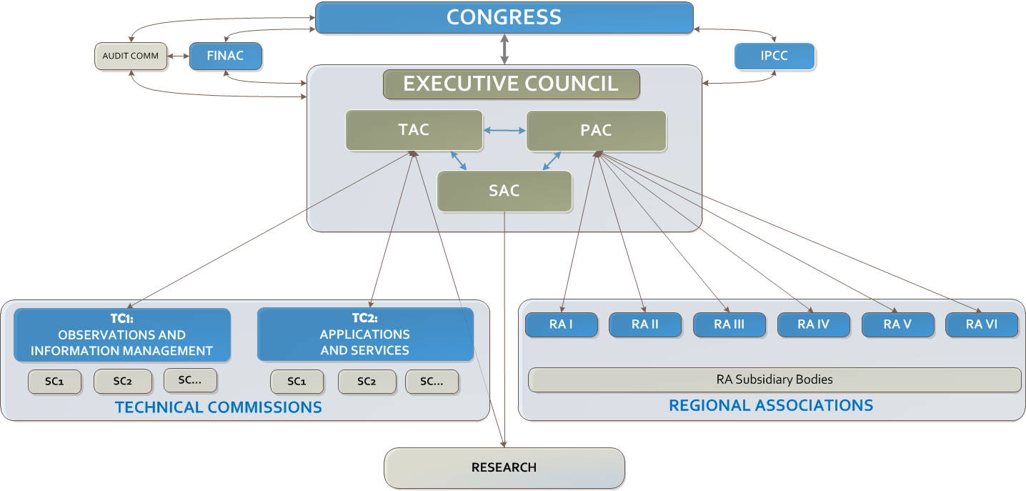
Proposed structure

Slide 13
Impact on ICT-ISS
WIS 2.0 an enabler for future WMO
Information management
Competencies and practices for all ICT aspects
Security & Quality assurance
Monitoring and Member system status
New structure of Technical Commissions
Support WMP Programmes’ new directions
Partnership with industry

Slide 14

Thank you
Merci

